Slide 1

Digital Counter/Watch
Jeong-Gun Lee
Dept. of Computer Engineering, Hallym University
Email: Jeonggun.Lee@gmail.com

Slide 2
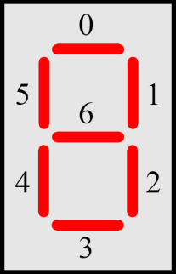
Digital Watch
Digital watch design with DE0 nano board
Display Hour/Minute/Second with 7-Segments
7-Segment →

Slide 3
7-Segment
HEX3
HEX2
HEX1
HEX0
Min
Sec

Slide 4
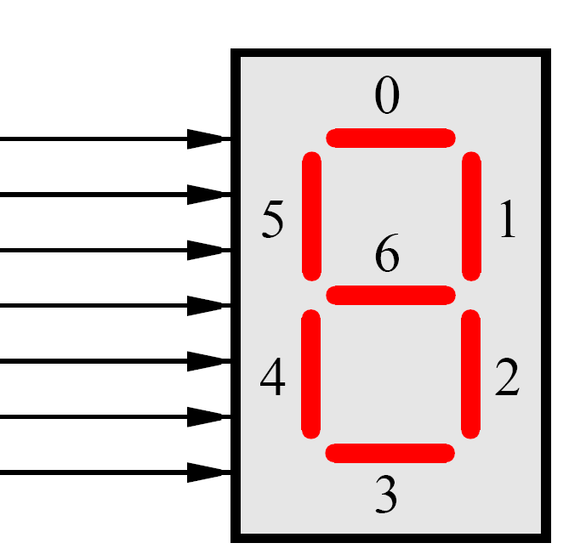
Control 7-Segment
HEX0[0]
HEX0[1]
HEX0[2]
HEX0[3]
HEX0[4]
HEX0[5]
HEX0[6]
Do pin assignment properly
[Assignment]→[Import Assignment]

Slide 5
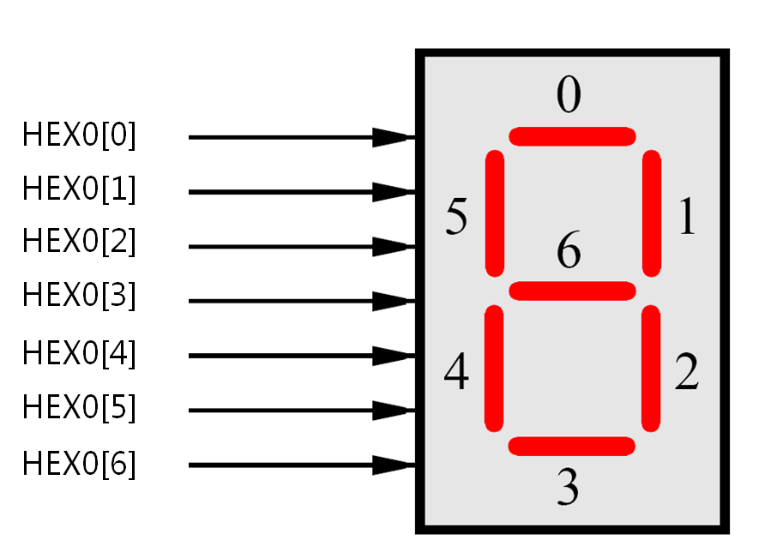
7-Segment의 제어
If (HEX0[0] == 1)
Turn off “0”position
Else
Turn on “0”position
module segdisplay(oHEX0_D, oHEX1_D, oHEX2_D, oHEX3_D);
// input iCLK_50;
output [6:0] oHEX0_D, oHEX1_D, oHEX2_D, oHEX3_D;
// HELO
assign oHEX0_D = 7'b111_1110;
assign oHEX1_D = 7'b111_1101;
assign oHEX2_D = 7'b111_1011;
assign oHEX3_D = 7'b111_0111;
endmodule
oHEX3_D
oHEX2_D
oHEX1_D
oHEX0_D

Slide 6
Move a bar on 7-Segments
Move a led bar move around the 7-segment
oHEX0_D
oHEX0_D
oHEX0_D
oHEX0_D
oHEX0_D
oHEX0_D
oHEX0_D
oHEX0_D
Time →

Slide 7
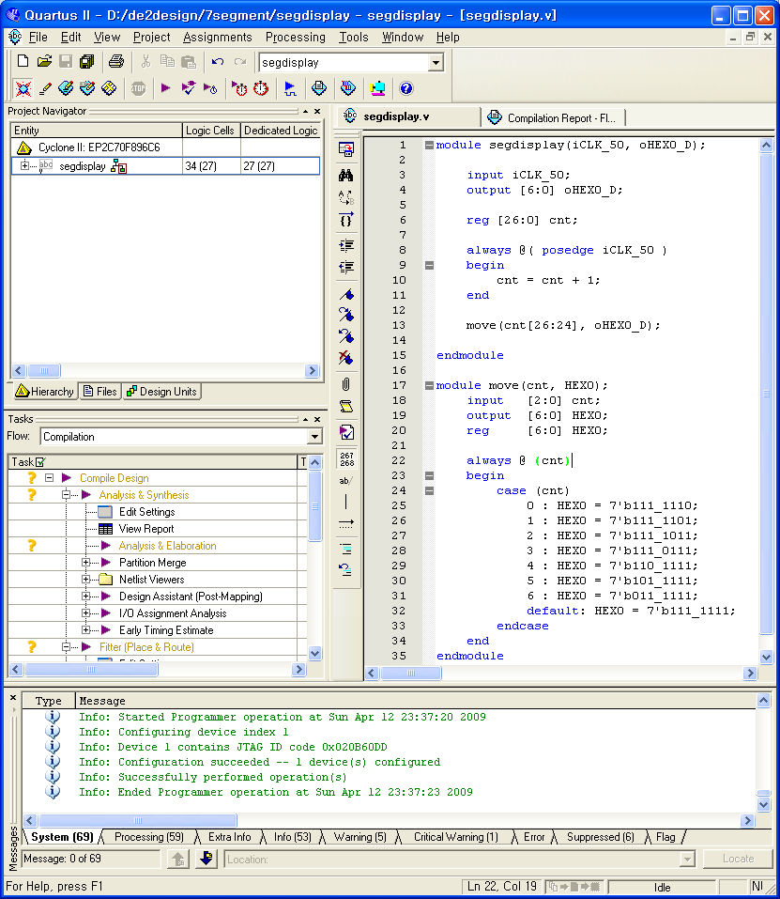
Move a led bar on 7-Segment
module segdisplay(iCLK_50, oHEX0_D);
input iCLK_50;
output [6:0] oHEX0_D;
reg [26:0] cnt;
always @( posedge iCLK_50 )
begin
cnt = cnt + 1;
end
move(cnt[26:24], oHEX0_D);
endmodule
module move(cnt, HEX0);
input [2:0] cnt;
output [6:0] HEX0;
reg [6:0] HEX0;
always @ (cnt)
begin
case (cnt)
0 : HEX0 = 7'b111_1110;
1 : HEX0 = 7'b111_1101;
2 : HEX0 = 7'b111_1011;
3 : HEX0 = 7'b111_0111;
4 : HEX0 = 7'b110_1111;
5 : HEX0 = 7'b101_1111;
6 : HEX0 = 7'b011_1111;
default: HEX0 = 7'b111_1111;
endcase
end
endmodule

Slide 8
Counter Design with 7-Segment
Design a circuit displaying from 0 to 9, a, b, C, d, E, F
oHEX0_D
oHEX0_D
oHEX0_D
oHEX0_D
oHEX0_D
oHEX0_D
oHEX0_D
oHEX0_D
oHEX0_D
oHEX0_D
oHEX0_D
oHEX0_D
oHEX0_D
oHEX0_D
oHEX0_D
oHEX0_D
oHEX0_D

Slide 9
Timing Control with Counter
DE0-nano has an on-board 50MHz clock oscillator
It means that the clock ticks 50*10⁶ per second
Q)Show “50*10⁶” in a binary number
Q)How many registers we have to keep to store the large number such as “50*10⁶” ?

Slide 10
Watch Counting 16 Second
Design a HEXA counter incrementing its value every second
oHEX0_D
oHEX0_D
oHEX0_D
oHEX0_D
oHEX0_D
oHEX0_D
oHEX0_D
oHEX0_D
oHEX0_D
oHEX0_D
oHEX0_D
oHEX0_D
oHEX0_D
oHEX0_D
oHEX0_D
oHEX0_D
Repeat!

