Slide 1
Chapter 5 :: Digital Building Blocks
Digital Design and Computer Architecture
David Money Harris and Sarah L. Harris
Lectured by Jeong-Gun Lee @ Hallym
Copyright © 2007 Elsevier
5-<<number>>

Slide 2
Chapter 5 :: Topics
Introduction
Arithmetic Circuits (산술 연산 회로)
Number Systems (수 체계)
Sequential Building Blocks (순차 회로 블록)
Memory Arrays (메모리 배열)
Logic Arrays (회로 배열)
Copyright © 2007 Elsevier
5-<<number>>

Slide 3
Introduction
Digital building blocks include:
  Gates (게이트), multiplexers(멀티플렉서), decoders(디코더), registers(레지스터), arithmetic circuits (연산회로), counters (카운터), memory arrays (메모리), logic arrays
Building blocks are important in their own right and they demonstrate hierarchy(계층성), modularity(모듈성), and regularity(규칙성):
  They are built from a hierarchy of simpler components - 계층성
  They have well-defined interfaces and functions - 모듈성
  Their regular structure is easily extended to different sizes - 규칙성
We’ll use many of these building blocks to build a microprocessor in Chapter 7
Copyright © 2007 Elsevier
5-<<number>>

Slide 4
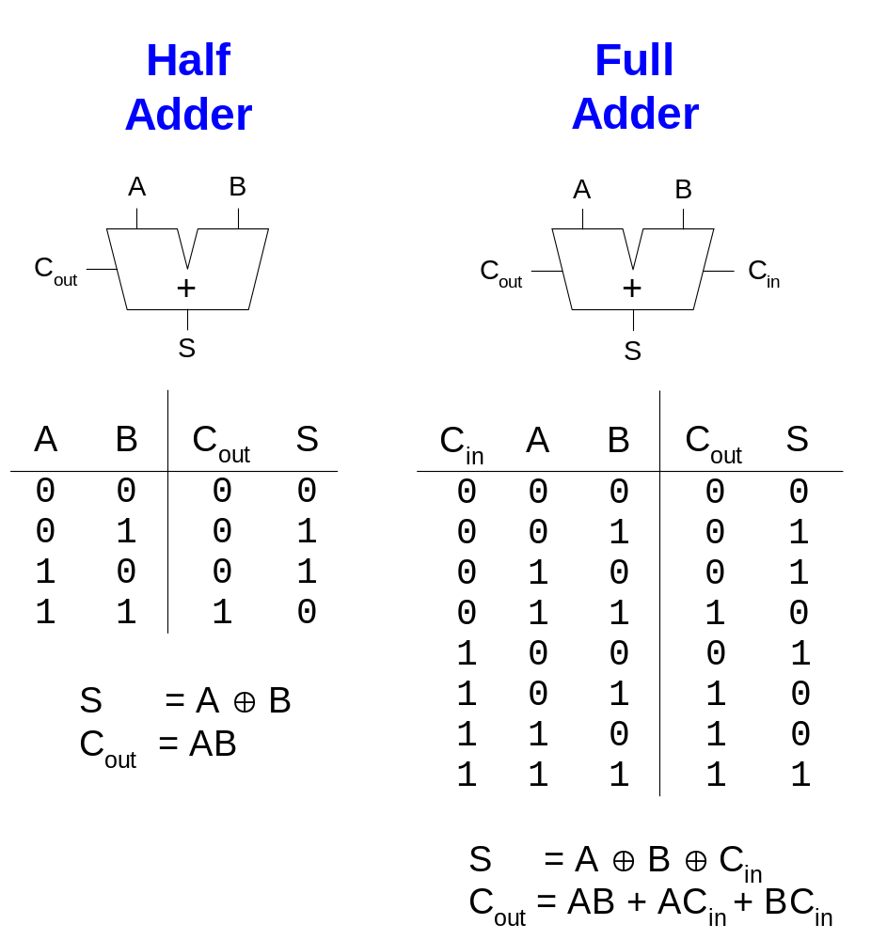
1-Bit Adders
Copyright © 2007 Elsevier
5-<<number>>

Slide 5
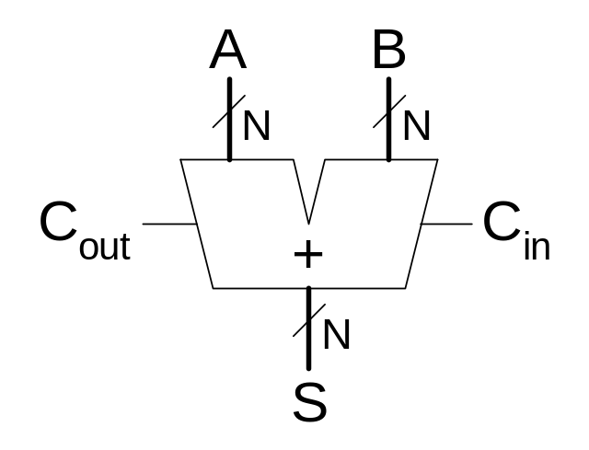
Multibit Adder, also called CPA
Several types of carry propagate adders (캐리전파덧셈기, CPAs) are:
  Ripple-carry adders (slow)
  Carry-lookahead adders (fast)
  Prefix adders (faster)
Carry-lookahead and prefix adders are faster for large adders but require more hardware.
  Symbol
Copyright © 2007 Elsevier
5-<<number>>

Slide 6
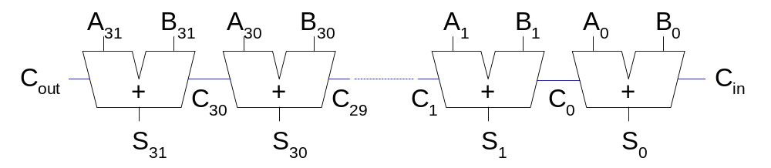
Ripple-Carry Adder
Chain 1-bit adders together(1비트 가산기를 연쇄적으로 연결)
Carry ripples through entire chain
Disadvantage(단점): slow
Copyright © 2007 Elsevier
5-<<number>>

Slide 7
Ripple-Carry Adder Delay
The delay of an N-bit ripple-carry adder is:
t_{ripple} = Nt_{FA}
where t_{FA} is the delay of a full adder
Copyright © 2007 Elsevier
5-<<number>>

Slide 8
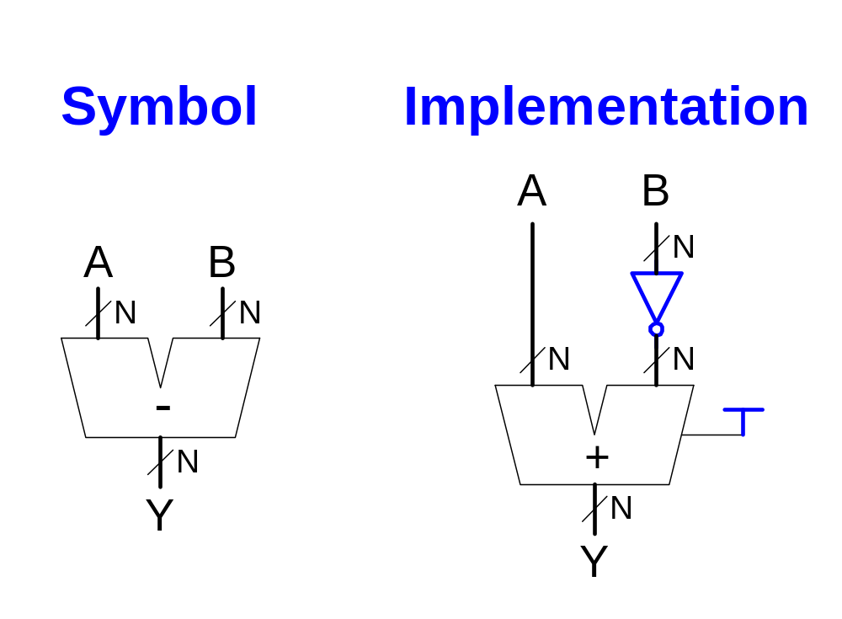
Subtracter
Copyright © 2007 Elsevier
5-<<number>>

Slide 9
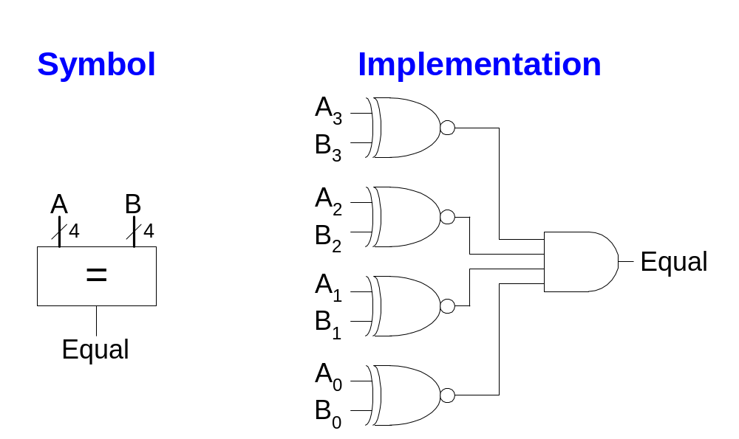
Comparator: Equality
Copyright © 2007 Elsevier
5-<<number>>

Slide 10
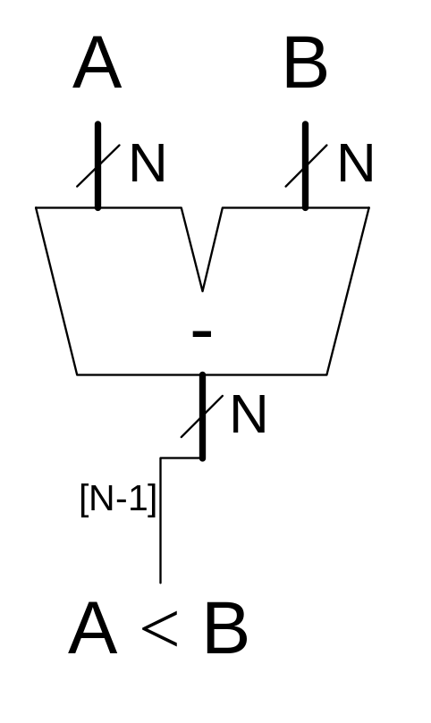
Comparator: Less Than
부호비트
Copyright © 2007 Elsevier
5-<<number>>

Slide 11
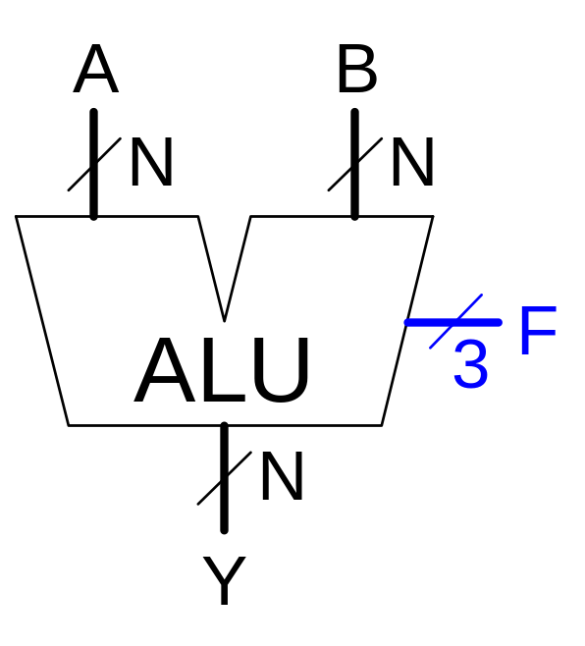
Arithmetic Logic Unit (ALU)
F_{2:0} | Function
000 | A & B
001 | A | B
010 | A + B
011 | not used
100 | A & ~B
101 | A | ~B
110 | A - B
111 | SLT
Copyright © 2007 Elsevier
5-<<number>>

Slide 12
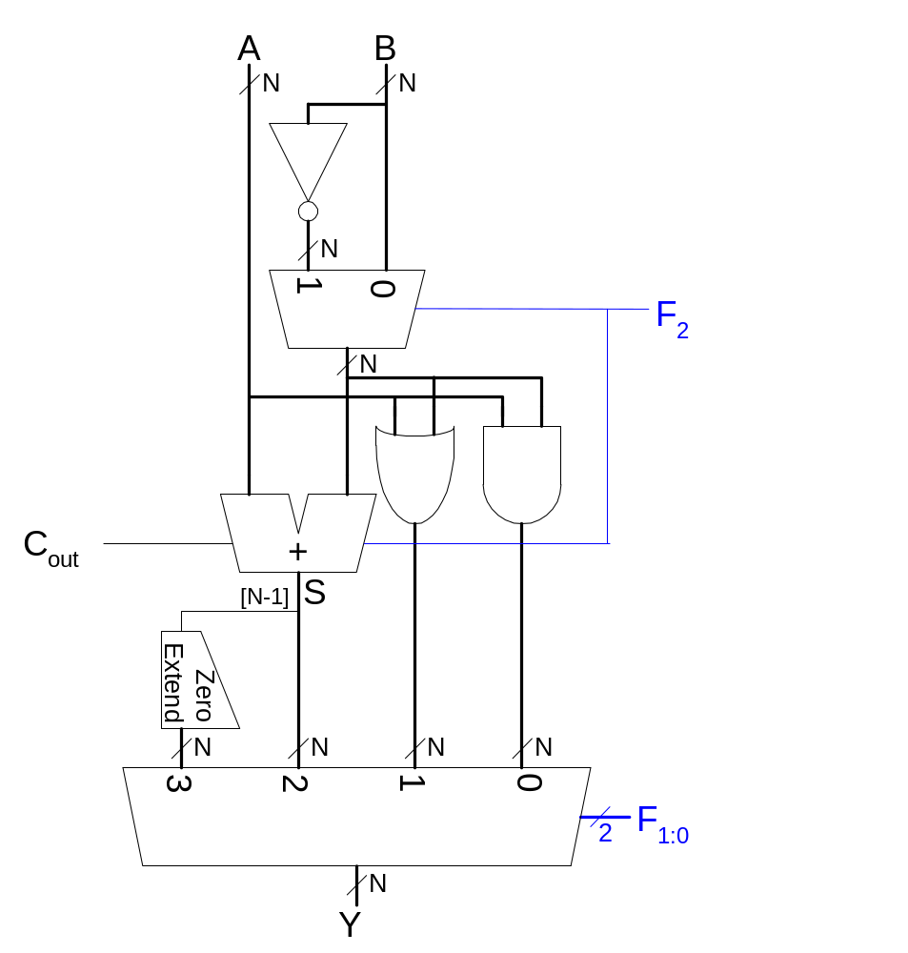
ALU Design
Copyright © 2007 Elsevier
5-<<number>>

Slide 13
ALU Function
F_{2:0} | Function
000 | A & B
001 | A | B
010 | A + B
011 | not used
100 | A & B
101 | A | ~B
110 | A - B
111 | SLT
Copyright © 2007 Elsevier
5-<<number>>

Slide 14

Set Less Than (SLT) Example
Configure a 32-bit ALU for the set if less than (SLT) operation. Suppose A = 25 and B = 32.
Copyright © 2007 Elsevier
5-<<number>>

Slide 15
Set Less Than (SLT) Example
Configure a 32-bit ALU for the set if less than (SLT) operation. Suppose A = 25 and B = 32.
  Because A is indeed less than B, we expect Y to be the 32-bit representation of 1 (0x00000001).
  For SLT, F_{2:0} = 111.
  F₂ = 1 configures the adder unit as a subtracter. So 25 - 32 = -7.
  The two’s complement representation of -7 has a 1 in the most significant bit, so S₃₁ = 1.
  With F_{1:0} = 11, the final multiplexer selects Y = S₃₁ = 1.
Copyright © 2007 Elsevier
5-<<number>>

Slide 16
Shifters
Logical shifter: shifts value to left or right and fills empty spaces with 0’s
  Ex: 11001 >> 2 = 00110
  Ex: 11001 << 2 = 00100
Arithmetic shifter: same as logical shifter, but on right shift, fills empty spaces with the old most significant bit (msb).
  Ex: 11001 >>> 2 = 11110
  Ex: 11001 <<< 2 = 00100
Rotator: rotates bits in a circle, such that bits shifted off one end are shifted into the other end
  Ex: 11001 ROR 2 = 01110
  Ex: 11001 ROL 2 = 00111
Copyright © 2007 Elsevier
5-<<number>>

Slide 17
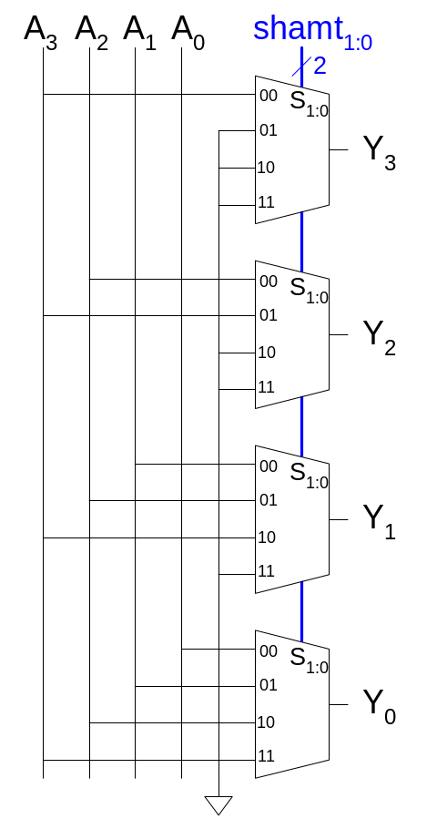
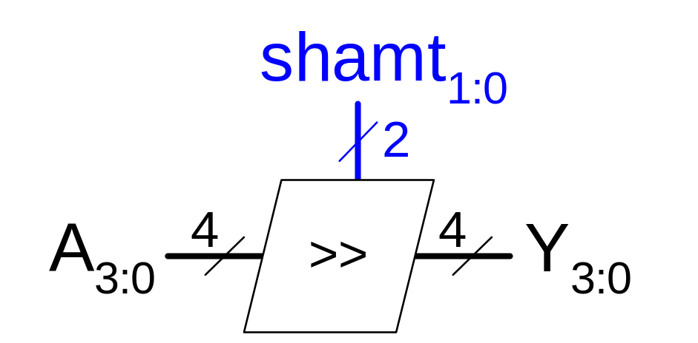
Shifter Design
‘0’
Copyright © 2007 Elsevier
5-<<number>>

Slide 18
Shifters as Multipliers and Dividers
A left shift by N bits multiplies a number by 2^{N}
  Ex: 00001 << 2 = 00100 (1 × 2² = 4)
  Ex: 11101 << 2 = 10100 (-3 × 2² = -12)
The arithmetic right shift by N divides a number by 2^{N}
  Ex: 01000 >>> 2 = 00010 (8 ÷ 2² = 2)
  Ex: 10000 >>> 2 = 11100 (-16 ÷ 2² = -4)
Copyright © 2007 Elsevier
5-<<number>>

Slide 19
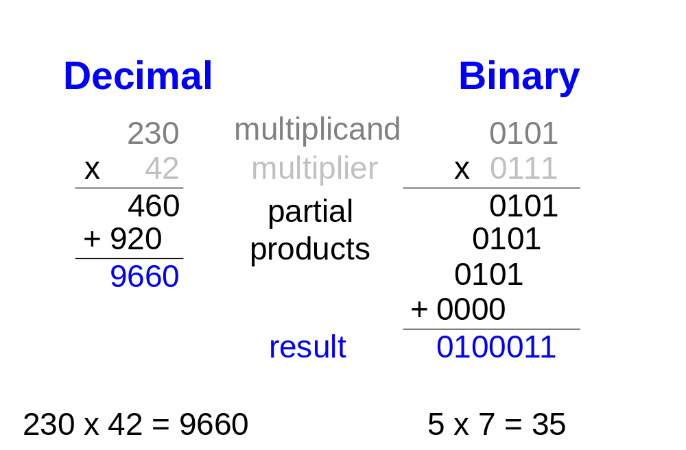
Multipliers
Steps of multiplication for both decimal and binary numbers:
  Partial products are formed by multiplying a single digit of the multiplier with the entire multiplicand
  Shifted partial products are summed to form the result
Copyright © 2007 Elsevier
5-<<number>>

Slide 20
Number Systems
What kind of numbers do you know how to represent using binary representations?
  Positive numbers
    Unsigned binary
  Negative numbers
    Two’s complement
    Sign/magnitude numbers
What about fractions?
Copyright © 2007 Elsevier
5-<<number>>

Slide 21
Numbers with Fractions
Two common notations:
  Fixed-point:
  the binary point is fixed
  Floating-point:
  the binary point floats to the right of the most significant 1
Copyright © 2007 Elsevier
5-<<number>>

Slide 22
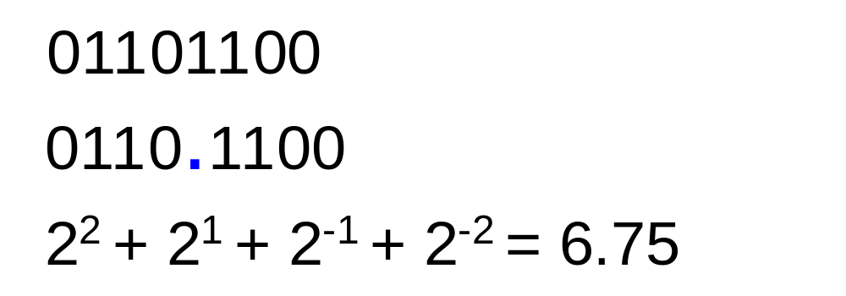
Fixed-Point Numbers
Fixed-point representation of 6.75 using 4 integer bits and 4 fraction bits:
The binary point is not a part of the representation but is implied.
The number of integer and fraction bits must be agreed upon by those generating and those reading the number.
Copyright © 2007 Elsevier
5-<<number>>

Slide 23
Fixed-Point Numbers
Represent 6.5₁₀ using an 8-bit binary representation with 4 integer bits and 4 fraction bits.
  01101000
Copyright © 2007 Elsevier
5-<<number>>

Slide 24
Signed Fixed-Point Numbers
As with whole numbers, negative fractional numbers can be represented two ways:
  Sign/magnitude notation
  Two’s complement notation
Represent -6.5₁₀ using an 8-bit binary representation with 4 integer bits and 4 fraction bits.
  Sign/magnitude:
  11101000
  Two’s complement:
  1. Invert bits: 10010111
  2. Add 1 to lsb: + 1
  10011000
Copyright © 2007 Elsevier
5-<<number>>

Slide 25
Floating-Point Numbers
The binary point floats to the right of the most significant 1.
Similar to decimal scientific notation.
For example, write 273₁₀ in scientific notation:
  Move the decimal point to the left of the most significant digit and increase the exponent:
  273 = 2.73 × 10²
In general, a number is written in scientific notation as:
± M × B^{E}
Where,
  M = mantissa (가수)
  B = base (밑수)
  E = exponent (지수)
  In the example, M = 2.73, B = 10, and E = 2
Copyright © 2007 Elsevier
5-<<number>>

Slide 26
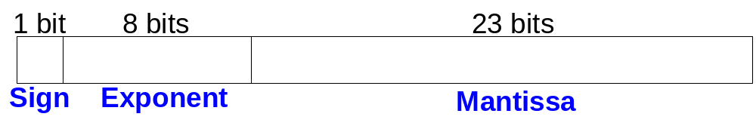
Floating-Point Numbers
We represent floating-point numbers using 32 bits: 1 sign bit, 8 exponent bits, and the remaining 23 bits for the mantissa.
Example: represent the value 228₁₀ using a 32-bit floating point representation.
The following slides show three versions of floating-point representation for 228₁₀.
The final version is called the IEEE 754 floating-point standard.
Copyright © 2007 Elsevier
5-<<number>>

Slide 27
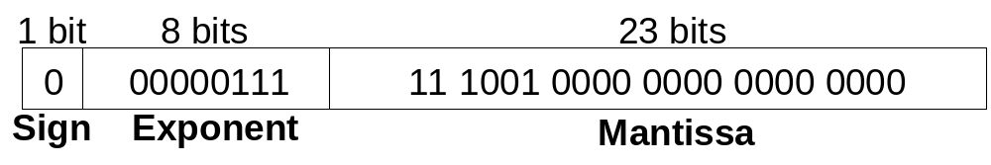
Floating-Point Representation
First, convert the decimal number to binary:
  228₁₀ = 11100100₂ = 1.11001 × 2⁷
Next, fill in each field in the 32-bit number:
  The sign bit is positive (0)
  The 8 exponent bits give the value 7
  The remaining 23 bits are the mantissa
Copyright © 2007 Elsevier
5-<<number>>

Slide 28
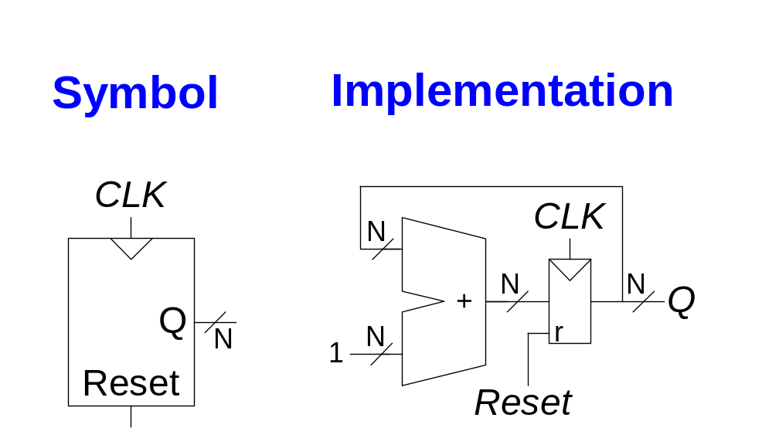
Counters
Increments on each clock edge.
Used to cycle through numbers. For example,
  000, 001, 010, 011, 100, 101, 110, 111, 000, 001…
Counters are used in many digital systems, for example:
  Digital clock displays
  Program counter: used in computers to keep track of the current instruction that is executing
Copyright © 2007 Elsevier
5-<<number>>

Slide 29
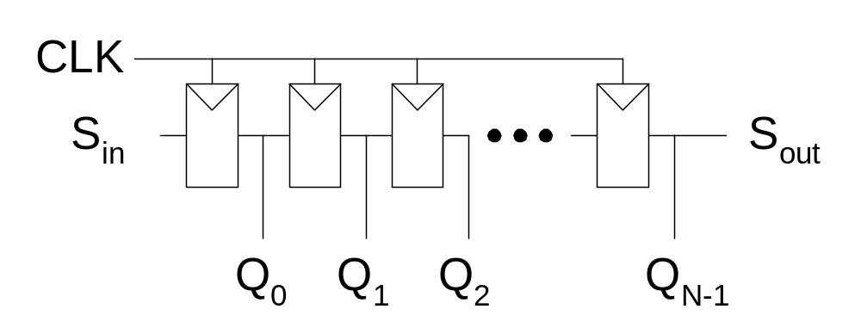
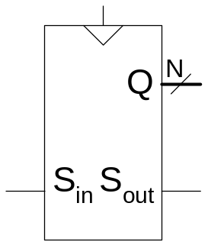
Shift Register
Shift a new value in on each clock edge
Shift a value out on each clock edge
Serial-to-parallel converter: converts serial input (S_{in}) to parallel output (Q_{0:N-1})
Symbol:
Implementation:
Copyright © 2007 Elsevier
5-<<number>>

Slide 30
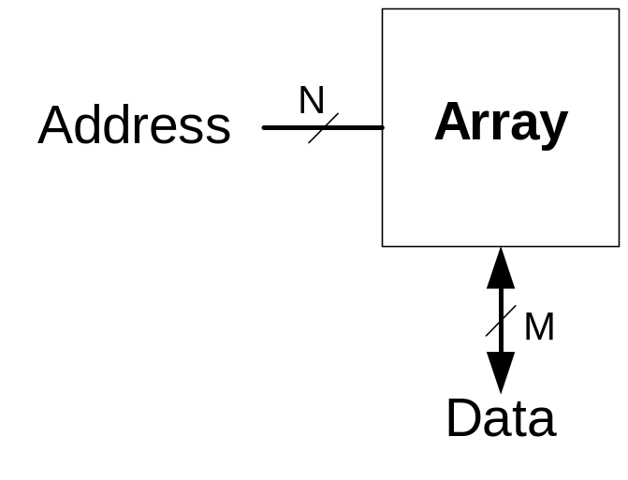
Memory Arrays
Memory arrays efficiently store large amounts of data.
Three common types of memory arrays:
  Dynamic random access memory (DRAM)
  Static random access memory (SRAM)
  Read only memory (ROM)
An M-bit data value can be read or written at each unique N-bit address.
Copyright © 2007 Elsevier
5-<<number>>

Slide 31
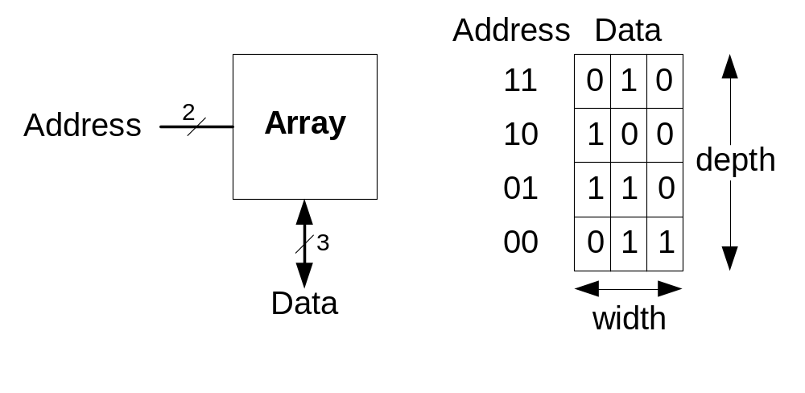
Memory Arrays
Memory arrays are organized as a two-dimensional array of bit cells. Each bit cell stores one bit.
An array with N address bits and M data bits has 2^{N} rows and M columns. Each row of data is called a word.
  Depth: number of rows in a memory array
  Width: number of columns in a memory array (the word size)
  Array size is given as depth × width
Copyright © 2007 Elsevier
5-<<number>>

Slide 32
Memory Array: Example
The memory array below is a 2² × 3-bit array.
The word size is 3-bits.
For example, the 3-bit word stored at address 10 is 100.
Example:
Copyright © 2007 Elsevier
5-<<number>>

Slide 33
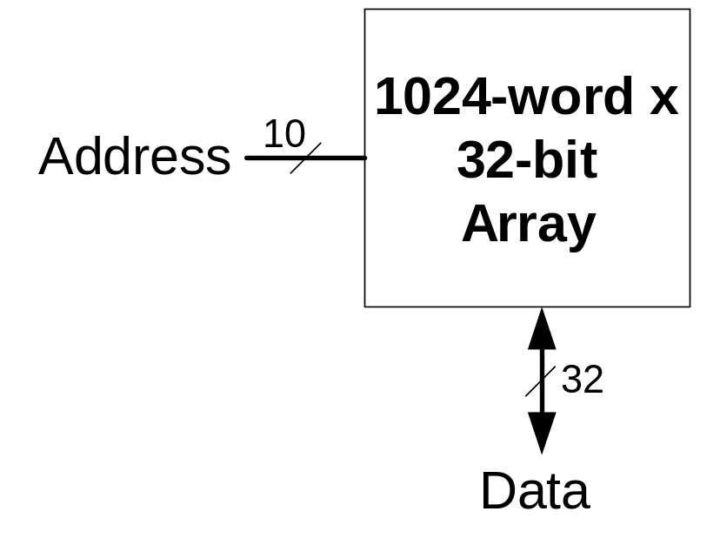
Memory Arrays
Copyright © 2007 Elsevier
5-<<number>>

Slide 34
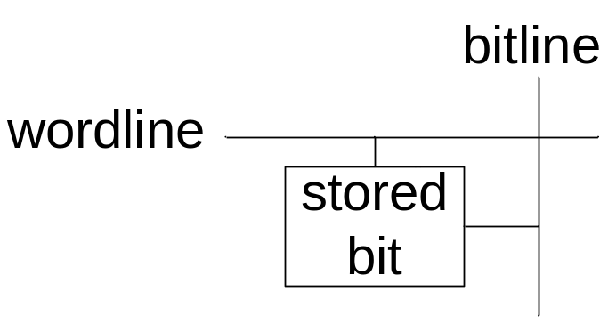
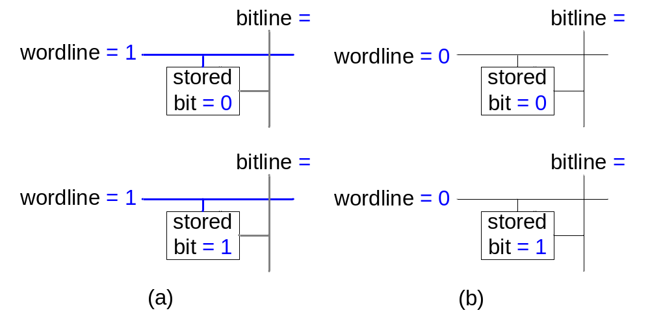
Memory Array Bit Cells
Example:
Copyright © 2007 Elsevier
5-<<number>>

Slide 35
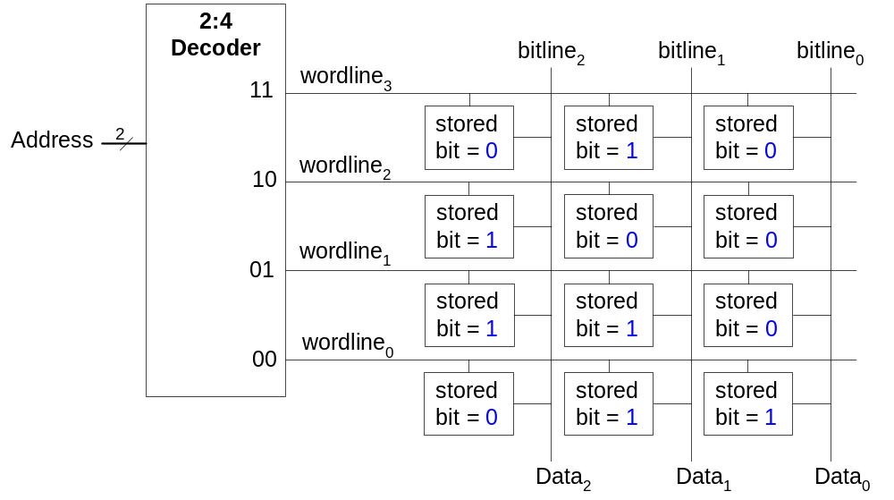
Memory Array
The wordline, similar to an enable, allows a single row in the memory array to be read or written at once.
Each wordline corresponds to a unique address – only one wordline is HIGH at any given time
Copyright © 2007 Elsevier
5-<<number>>

Slide 36
Types of Memory
Random access memory (RAM): volatile
Read only memory (ROM): nonvolatile
Copyright © 2007 Elsevier
5-<<number>>

Slide 37
RAM
Random access memory
  Volatile (휘발성): loses its data when the power is turned off
  Can be read and written quickly
  Main memory in your computer is RAM (specifically, DRAM)
  Historically called random access memory because any data word can be accessed as easily as any other (in contrast to sequential access memories such as a tape recorder).
Copyright © 2007 Elsevier
5-<<number>>

Slide 38
Types of Memory
Read only memory (ROM)
  Nonvolatile: retains its data when power is turned off
  Can be read quickly, but writing is slow
  Memory in cameras, thumb drives, and digital cameras are all ROMs
  Historically called read only memory because ROMs were written by burning fuses. Once the fuses were written by the manufacturer, they could not be written again. This is no longer the case.
Copyright © 2007 Elsevier
5-<<number>>

Slide 39
Types of RAM
The two main types of RAM are:
  Dynamic random access memory (DRAM)
  Static random access memory (SRAM)
They differ in how they store data:
  DRAM uses a capacitor
  SRAM uses cross-coupled inverters
Copyright © 2007 Elsevier
5-<<number>>

Slide 40
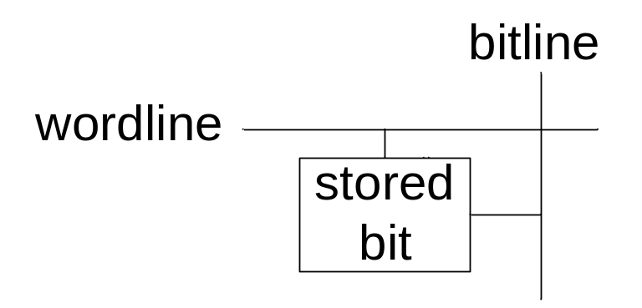
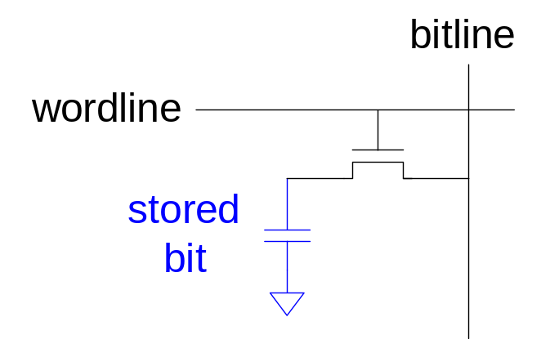
DRAM
Data bits are stored on a capacitor.
DRAM is called dynamic because the value needs to be refreshed (rewritten) periodically and after being read because:
  Charge leakage from the capacitor degrades the value
  Reading destroys the stored value
Copyright © 2007 Elsevier
5-<<number>>

Slide 41
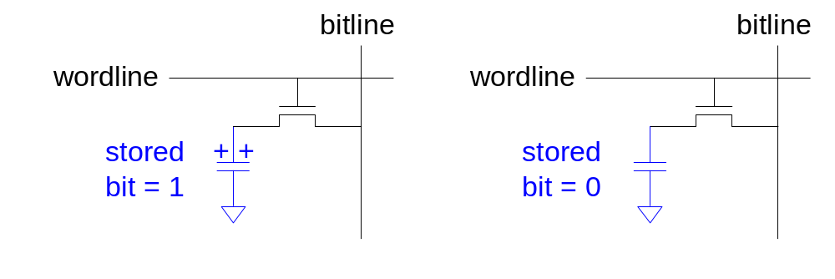
DRAM
Copyright © 2007 Elsevier
5-<<number>>

Slide 42
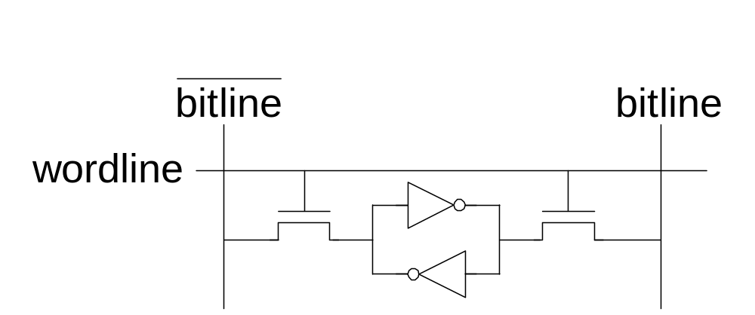
SRAM
Copyright © 2007 Elsevier
5-<<number>>

Slide 43

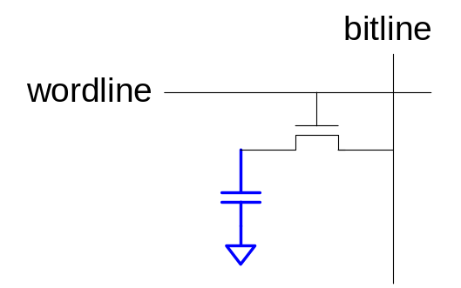
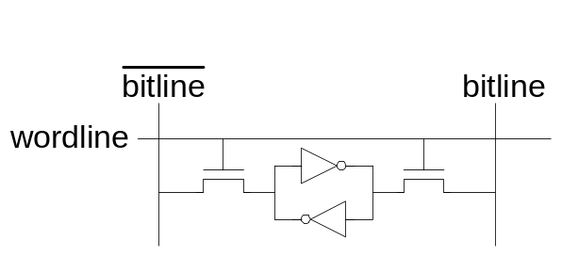
Memory Arrays
DRAM bit cell:
SRAM bit cell:
Copyright © 2007 Elsevier
5-<<number>>

Slide 44
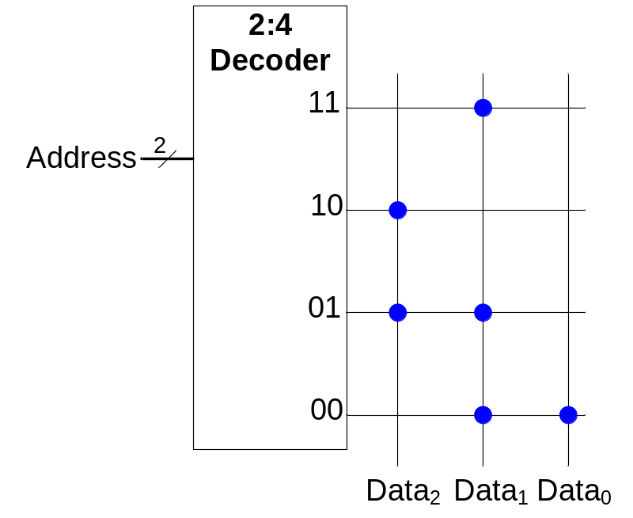
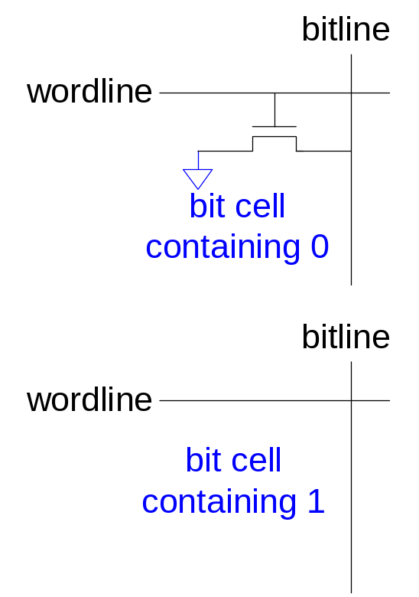
ROMs
Copyright © 2007 Elsevier
5-<<number>>

Slide 45
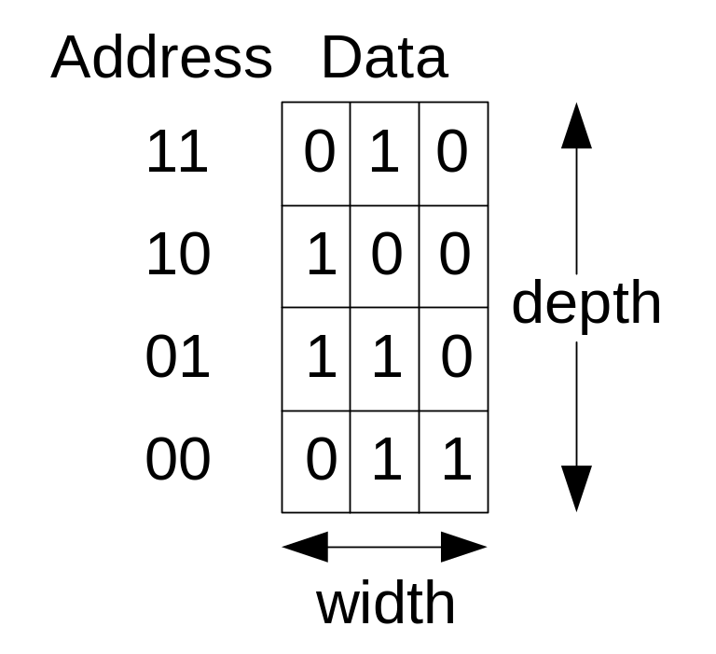
ROM Storage
Copyright © 2007 Elsevier
5-<<number>>

Slide 46
ROM Logic
Data₂ = A₁ ⊕ A₀
Data₁ = A₁ + A₀
Data₀ = A₁A₀
Copyright © 2007 Elsevier
5-<<number>>

Slide 47
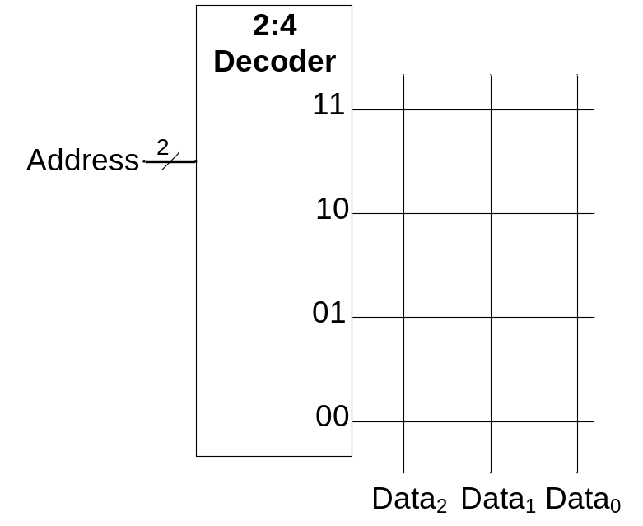
Example: Logic with ROMs
Implement the following logic functions using a 2² × 3-bit ROM:
  X = AB
  Y = A + B
  Z = AB
Copyright © 2007 Elsevier
5-<<number>>

Slide 48
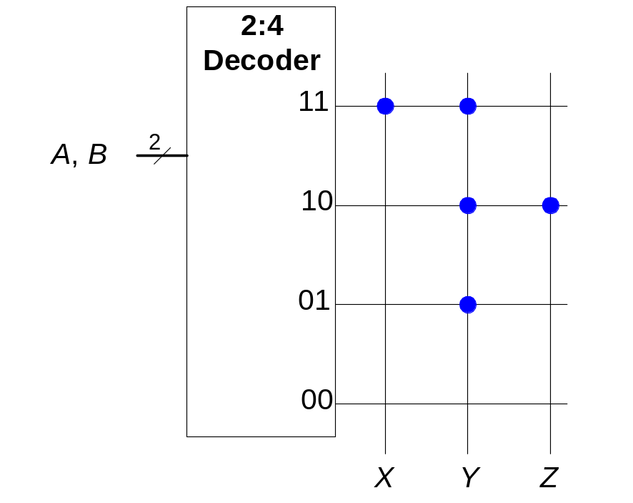
Example: Logic with ROMs
Implement the following logic functions using a 2² × 3-bit ROM:
  X = AB
  Y = A + B
  Z = AB
Copyright © 2007 Elsevier
5-<<number>>

Slide 49
Logic with Memory Arrays
Data₂ = A₁ ⊕ A₀
Data₁ = A₁ + A₀
Data₀ = A₁A₀
Copyright © 2007 Elsevier
5-<<number>>

Slide 50
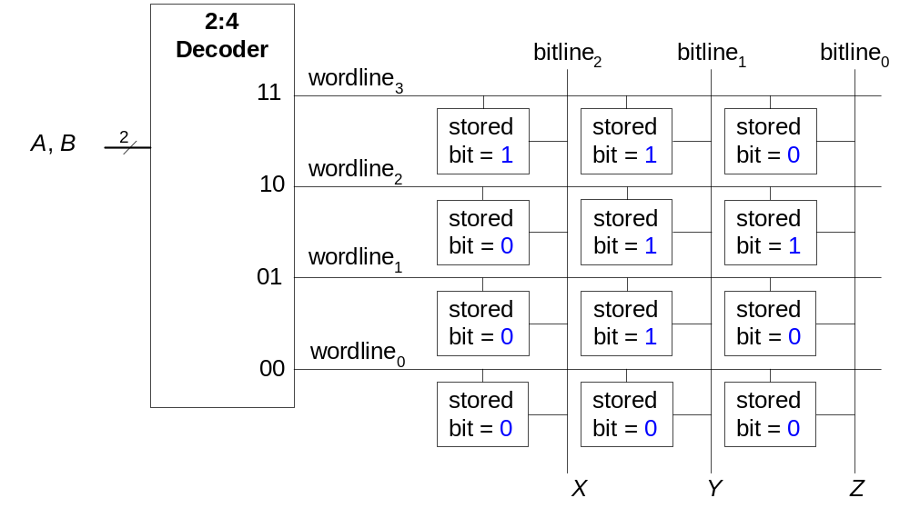
Logic with Memory Arrays
Implement the following logic functions using a 2² × 3-bit memory array:
  X = AB
  Y = A + B
  Z = AB
Copyright © 2007 Elsevier
5-<<number>>

Slide 51
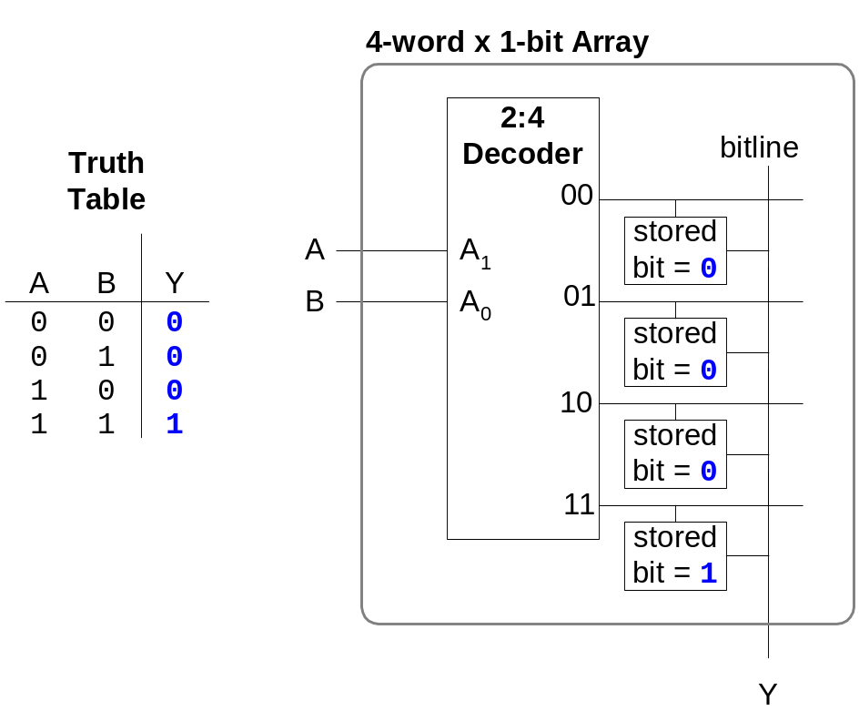
Logic with Memory Arrays
Memory arrays used to perform logic are called lookup tables (LUTs).
The user looks up the value of the output at each input combination (address).
Copyright © 2007 Elsevier
5-<<number>>

Slide 52
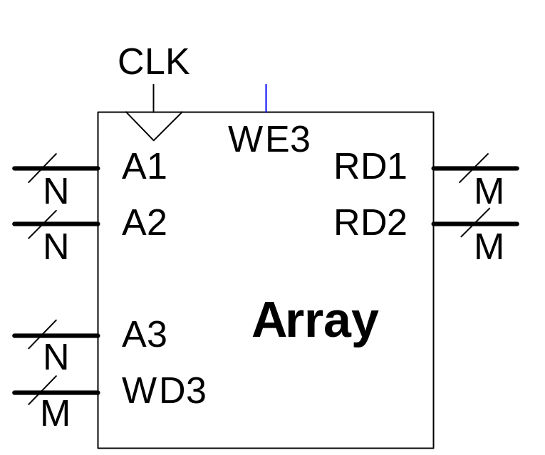
Multi-ported Memories
Port: address/data pair
3-ported memory
  2 read ports (A1/RD1, A2/RD2)
  1 write port (A3/WD3, WE3 enables writing)
Copyright © 2007 Elsevier
5-<<number>>

Slide 53
Verilog Memory Arrays
// memory module with one read/write port
module dmem( input clk, we,
input [7:0] a
input [2:0] wd,
output [2:0] rd);
reg [2:0] RAM[255:0];
assign rd = RAM[a];
always @ (posedge clk)
if (we)
RAM[a] <= wd;
endmodule
Copyright © 2007 Elsevier
5-<<number>>

Slide 54
Logic Arrays
Programmable logic arrays (PLAs)
  AND array followed by OR array
  Perform combinational logic only
  Fixed internal connections
Field programmable gate arrays (FPGAs)
  Array of configurable logic blocks (CLBs)
  Perform combinational and sequential logic
  Programmable internal connections
Copyright © 2007 Elsevier
5-<<number>>

Slide 55
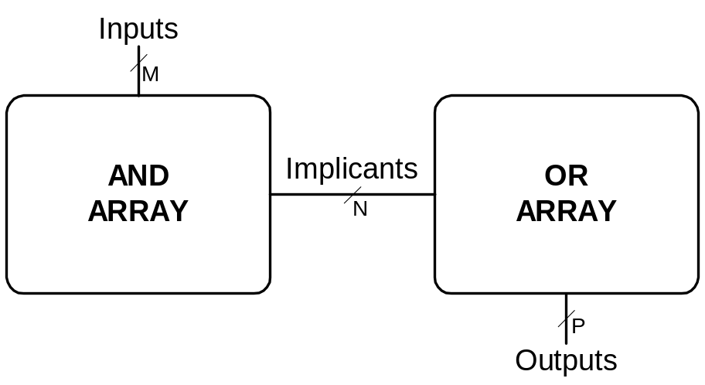
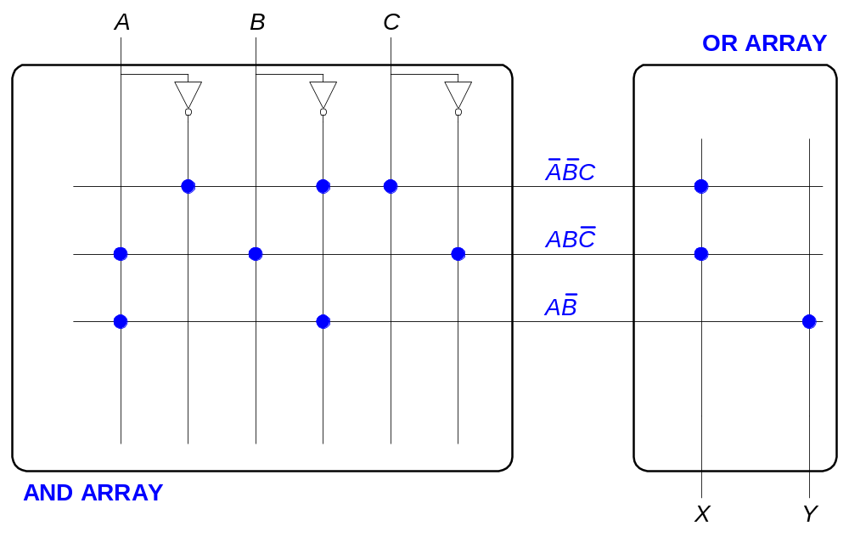
PLAs
Copyright © 2007 Elsevier
5-<<number>>

Slide 56
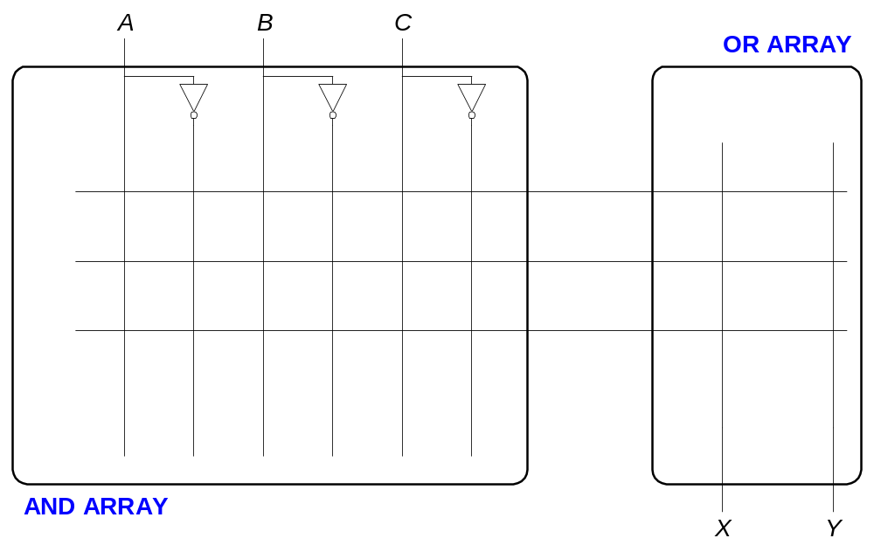
PLAs
Copyright © 2007 Elsevier
5-<<number>>

Slide 57
참조 자료
Copyright © 2007 Elsevier
6-<<number>>

Slide 58
FPGAs
Composed of:
  CLBs (Configurable logic blocks): to perform logic
  IOBs (Input/output buffers): to interface with outside world
  Programmable interconnection: to connect CLBs and IOBs
  Some FPGAs include other building blocks such as multipliers and RAMs
Copyright © 2007 Elsevier
5-<<number>>

Slide 59
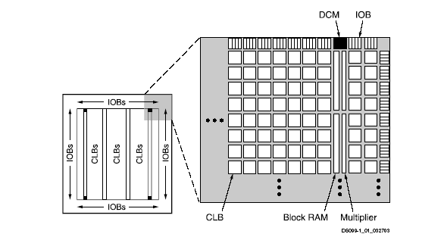
Xilinx Spartan 3 FPGA Schematic
Copyright © 2007 Elsevier
5-<<number>>

Slide 60
CLBs
Composed of:
  LUTs (lookup tables): to perform combinational logic
  Flip-flops: to perform sequential functions
  Multiplexers: to connect LUTs and flip-flops
Copyright © 2007 Elsevier
5-<<number>>

Slide 61
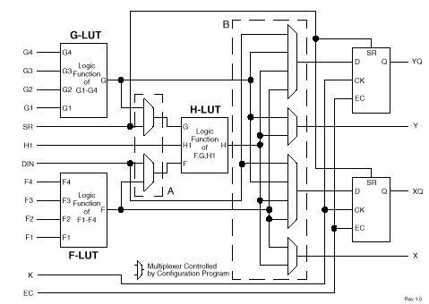
Xilinx Spartan CLB
Copyright © 2007 Elsevier
5-<<number>>

Slide 62
Xilinx Spartan CLB
The Spartan CLB has:
  3 LUTs:
    F-LUT (2⁴ x 1-bit LUT)
    G-LUT (2⁴ x 1-bit LUT)
    H-LUT (2³ x 1-bit LUT)
  2 registered outputs:
    XQ
    YQ
  2 combinational outputs:
    X
    Y
Copyright © 2007 Elsevier
5-<<number>>

Slide 63
CLB Configuration Example
Show how to configure the Spartan CLB to perform the following functions:
  X = ABC + ABC
  Y = AB
Copyright © 2007 Elsevier
5-<<number>>

Slide 64
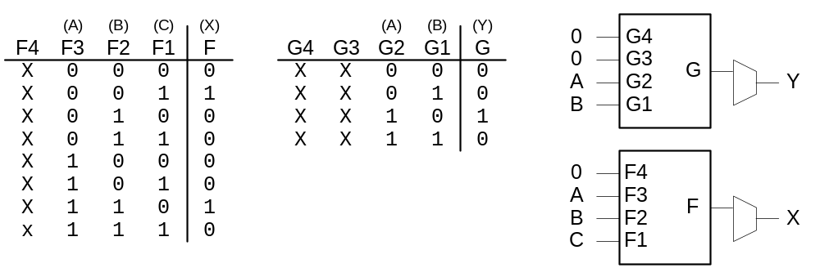
CLB Configuration Example
Show how to configure the Spartan CLB to perform the following functions:
  X = ABC + ABC
  Y = AB
Copyright © 2007 Elsevier
5-<<number>>

Slide 65
FPGA Design Flow
A CAD tool (such as Xilinx Project Navigator) is used to design and implement a digital system.
The user enters the design using schematic entry or an HDL.
The user simulates the design.
A synthesis tool converts the code into hardware and maps it onto the FPGA.
The user uses the CAD tool to download the configuration onto the FPGA
This configures the CLBs and the connections between them and the IOBs.
Copyright © 2007 Elsevier
5-<<number>>

