Slide 1
Chapter 6 :: Architecture
Digital Design and Computer Architecture
David Money Harris and Sarah L. Harris
Lectured by Jeong-Gun Lee @ Hallym
Class Homepage: https://sites.google.com/site/embeddedsochallymuniv/coarse/comparch
Copyright © 2007 Elsevier
6-<<number>>

Slide 2
Chapter 6 :: Topics
Introduction
Assembly Language (어셈블리 언어)
Machine Language (기계어)
Programming (프로그래밍)
Addressing Modes (주소 지정 방식)
Lights, Camera, Action: Compiling, Assembling, and Loading (컴파일링, 어셈블링, 로딩)
Odds and Ends (기타…)
Copyright © 2007 Elsevier
6-<<number>>

Slide 3
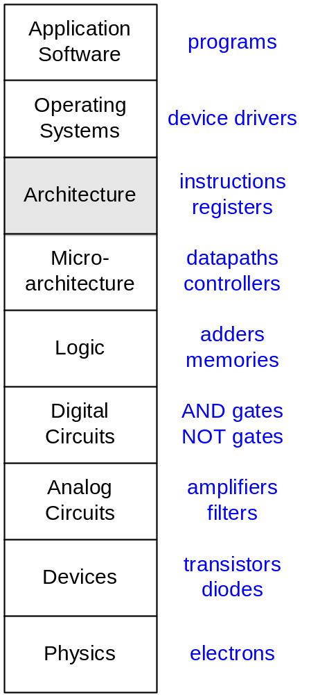
Introduction
Jumping up a few levels of abstraction (추상화).
Architecture: the programmer’s view of the computer (프로그래머 관점)
  Defined by instructions (operations) and operand locations
Microarchitecture: how to implement an architecture in hardware (covered in Chapter 7) : 어떻게 하드웨어로 구현할 것인가!
Copyright © 2007 Elsevier
6-<<number>>

Slide 4
Assembly Language
To command a computer, you must understand its language.
  Instructions(명령어): words in a computer’s language
  Instruction set(명령어집합): the vocabulary of a computer’s language
Instructions indicate the operation to perform and the operands to use.(명령어는 수행할 명령어와 사용할 데이터를 나타낸다)
  Assembly language: human-readable format of instructions
  어셈블리 언어: 사람이 읽을 수 있는 명령어 포맷/형식
  Machine language: computer-readable format (1’s and 0’s)
  기계어: 기계가 읽을 수 있는 명령어 포맷/형식
We introduce the MIPS architecture.
  Developed by John Hennessy and his colleagues at Stanford and in the 1980’s.
  Used in many commercial systems, including Silicon Graphics, Nintendo, and Cisco
Once you’ve learned one architecture, it’s easy to learn others.
Copyright © 2007 Elsevier
6-<<number>>

Slide 5

What ? Assembly ?
# a program that prints "hello world"
.text
.globl __start
__start:
la $a0, str
li $v0, 4
syscall
li $v0, 10
syscall
.data
str: .asciiz "hello world\n"
Copyright © 2007 Elsevier
6-<<number>>

Slide 6
System Call Service
Service | Code in $v0 | Arguments | Result
print integer | 1 | $a0 = integer to print
print float | 2 | $f12 = float to print
print double | 3 | $f12 = double to print
print string | 4 | $a0 = address of null-terminated string to print
read integer | 5 |  | $v0 contains integer read
read float | 6 |  | $f0 contains float read
read double | 7 |  | $f0 contains double read
read string | 8 | $a0 = address of input buffer $a1 = maximum number of characters to read | See note below table
sbrk (allocate heap memory) | 9 | $a0 = number of bytes to allocate | $v0 contains address of allocated memory
exit (terminate execution) | 10
Copyright © 2007 Elsevier
6-<<number>>

Slide 7

John Hennessy
President of Stanford University
Professor of Electrical Engineering and Computer Science at Stanford since 1977
Coinvented the Reduced Instruction Set Computer (RISC)
Developed the MIPS architecture at Stanford in 1984 and cofounded MIPS Computer Systems
As of 2004, over 300 million MIPS microprocessors have been sold
Copyright © 2007 Elsevier
6-<<number>>

Slide 8
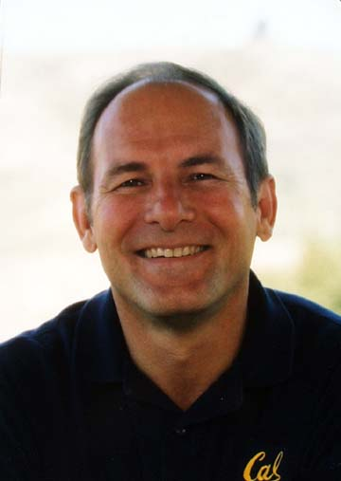
David Patterson
Writes textbooks with John Hennessy
First in his family to graduate from college (UCLA, 1969)
Professor of Computer Science at UC Berkeley since 1977, where he coinvented RISC, the Reduced Instruction Set Computer
In 1984, he developed the SPARC architecture used by Sun Microsystems
Invented RAID (Redundant Array of Inexpensive Disks) and NOW (Network of Workstations)
Copyright © 2007 Elsevier
6-<<number>>

Slide 9
Architecture Design Principles
The underlying design principles that we will follow, as articulated by Hennessy and Patterson:
    Simplicity favors regularity(단순함은 규칙성에서 나온다)
    Make the common case fast (일반적인 경우를 빠르게 만들라!)
    Smaller is faster (작을 수록 빠르다)
    Good design demands good compromises (좋은 설계는 좋은 타협으로부터 나온다…)
Copyright © 2007 Elsevier
6-<<number>>

Slide 10
Instructions: Addition (덧셈)
The most common operation computers perform is addition.
(컴퓨터가 수행하는 가장 일반적인 연산! – 덧셈!)
add: the mnemonic indicates what operation to perform
b, c: source operands on which the operation is performed
a: destination operand to which the result is written
High-level code
a = b + c;
MIPS assembly code
add a, b, c
연산명령
Copyright © 2007 Elsevier
6-<<number>>

Slide 11
Instructions: Subtraction
Subtraction is similar to addition. Only the mnemonic changes.
sub: the mnemonic indicates what operation to perform
b, c: source operands on which the operation is performed
a: destination operand to which the result is written
High-level code
a = b - c;
MIPS assembly code
sub a, b, c
Copyright © 2007 Elsevier
6-<<number>>

Slide 12
Design Principle 1
Simplicity favors regularity
Consistent instruction format. (일관적인 명령어 포맷!)
Same number of operands – easier to encode and handle in hardware.
(같은 수의 오퍼랜드! – 해독하기 쉽고 하드웨어로 구성하기 쉽다!)
Copyright © 2007 Elsevier
6-<<number>>

Slide 13
Instructions: More Complex Code
More complex code is handled by multiple MIPS instructions.
High-level code
a = b + c - d;
// single line comment
/* multiple line
comment */
MIPS assembly code
add t, b, c # t = b + c
sub a, t, d # a = t - d
Copyright © 2007 Elsevier
6-<<number>>

Slide 14
Design Principle 2
Make the common case fast
MIPS includes only simple, commonly used instructions.
So, the hardware to decode and execute the instruction can be simple, small, and fast.
More complex instructions (that are less common) can be performed using multiple simple instructions.
MIPS is a reduced instruction set computer (RISC), with a small number of simple instructions.
Other architectures, such as Intel’s IA-32 found in many PC’s, are complex instruction set computers (CISC).
Include complex instructions that are rarely used, such as the “string move” instruction that copies a string (a series of characters) from one part of memory to another.
Copyright © 2007 Elsevier
6-<<number>>

Slide 15
Operands
A computer needs a physical location from which to retrieve binary operands.
A computer retrieves operands from:
  Registers
  Memory
  Constants (also called immediates (즉치))
Copyright © 2007 Elsevier
6-<<number>>

Slide 16
Operands: Registers
Memory is slow.
Most architectures have a small set of (fast) registers.
MIPS has thirty-two 32-bit registers.
MIPS is called a 32-bit architecture because it operates on 32-bit data.
(A 64-bit version of MIPS also exists, but we will consider only the 32-bit version.)
Copyright © 2007 Elsevier
6-<<number>>

Slide 17
Design Principle 3
Smaller is Faster
MIPS includes only a small number of registers.
Just as retrieving data from a few books on your table is faster than retrieving data from 1000 books, retrieving data from 32 registers is faster than retrieving it from 1000 registers or a large memory.
Copyright © 2007 Elsevier
6-<<number>>

Slide 18
The MIPS Register Set
Name | Register Number | Usage
$0 | 0 | the constant value 0
$at | 1 | assembler temporary
$v0-$v1 | 2-3 | procedure return values
$a0-$a3 | 4-7 | procedure arguments
$t0-$t7 | 8-15 | temporaries
$s0-$s7 | 16-23 | saved variables
$t8-$t9 | 24-25 | more temporaries
$k0-$k1 | 26-27 | OS temporaries
$gp | 28 | global pointer
$sp | 29 | stack pointer
$fp | 30 | frame pointer
$ra | 31 | procedure return address
Copyright © 2007 Elsevier
6-<<number>>

Slide 19
Operands: Registers
Registers:
  Written with a dollar sign ($) before their name
  For example, register 0 is written “$0”. It can be pronounced “register zero” or “dollar zero”.
Certain registers are used for specific purposes.
  For example,
    $0 always holds the constant value 0.
    the temporary registers, $t0 - $t9 are used to hold temporary values.
For now, we only use the temporary registers ($t0 - $t9) and the saved registers ($s0 - $s7).
We will use the other registers in later slides.
Copyright © 2007 Elsevier
6-<<number>>

Slide 20
Instructions with registers
We revisit previous code using registers to hold the variables.
High-level code
a = b + c
MIPS assembly code
# $s0 = a, $s1 = b, $s2 = c
add $s0, $s1, $s2
Copyright © 2007 Elsevier
6-<<number>>

Slide 21
Operands: Memory
All the data doesn’t fit in 32 registers
Also store operands in memory
Memory is large, so it can hold a lot of data.
But it’s also slow.
Commonly used variables are kept in registers.
Using a combination of registers and memory, a program can access a large amount of data fairly quickly.
Copyright © 2007 Elsevier
6-<<number>>

Slide 22
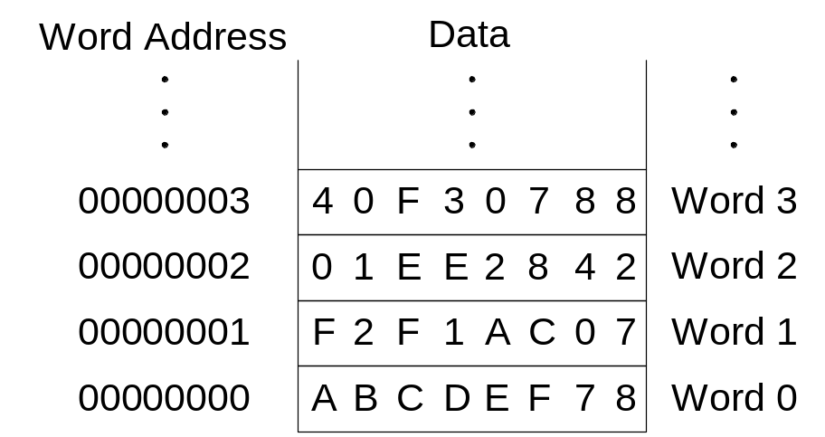
Word-Addressable Memory
For explanation purposes, we begin by describing a word-addressable memory, where each 32-bit data word has a unique address.
Copyright © 2007 Elsevier
6-<<number>>

Slide 23
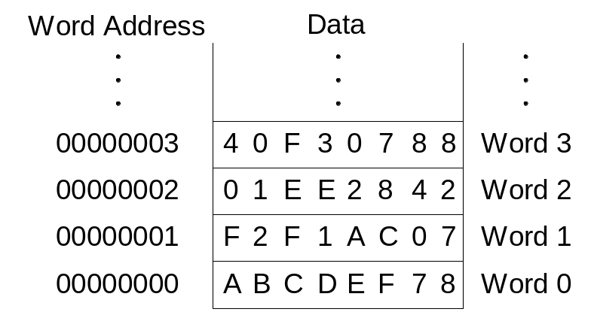
Reading Word-Addressable Memory
Memory reads are called loads.
The mnemonic is load word (lw).
Read a word of data at memory address 1 into $s3.
Memory address calculation:
  add the base address ($0) to the offset (1)
  In this case, the memory address is ($0 + 1) = 1.
Any register may be used to store the base address.
$s3 holds the value 0xF2F1AC07 after the instruction completes.
Assembly code
lw $s3, 1($0) # read memory word 1 into $s3
Copyright © 2007 Elsevier
6-<<number>>

Slide 24
Writing Word-Addressable Memory
Memory writes are called stores.
The mnemonic is store word (sw).
Write (store) the value held in $t4 into memory address 7.
The offset can be written in decimal (default) or hexadecimal.
Memory address calculation:
  Add the base address ($0) to the offset (0x7).
  In this case, the memory address is ($0 + 0x7) = 7.
Any register may be used to store the base address.
Assembly code
sw $t4, 0x7($0) # write $t4 to memory word 7
Copyright © 2007 Elsevier
6-<<number>>

Slide 25
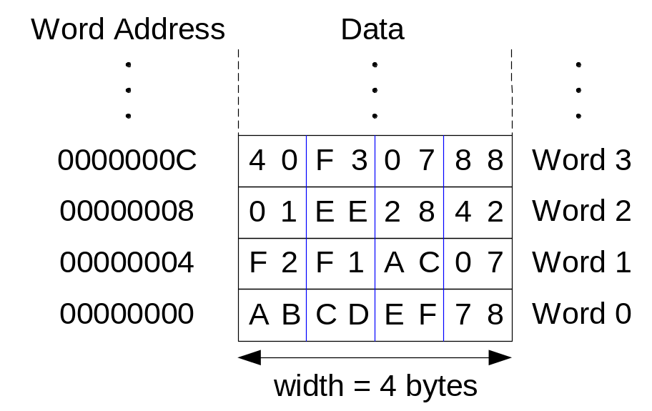
Byte-Addressable Memory
Each data byte has a unique address
Load and store single bytes: load byte (lb) and store byte (sb)
Each 32-bit words has 4 bytes, so the word address increments by 4
Copyright © 2007 Elsevier
6-<<number>>

Slide 26
Reading Byte-Addressable Memory
The address of a memory word must now be multiplied by 4. For example,
  the address of memory word 2 is 2 × 4 = 8
  the address of memory word 10 is 10 × 4 = 40 (0x28)
Load a word of data at memory address 4 into $s3.
$s3 holds the value 0xF2F1AC07 after the instruction completes.
MIPS assembly code
lw $s3, 4($0) # read memory word 1 into $s3
Copyright © 2007 Elsevier
6-<<number>>

Slide 27
Writing Byte-Addressable Memory
The assembly code below stores the value held in $t7 into memory address 0x2C (44).
MIPS assembly code
sw $t7, 44($0) # write $t7 into memory word 11
Copyright © 2007 Elsevier
6-<<number>>

Slide 28
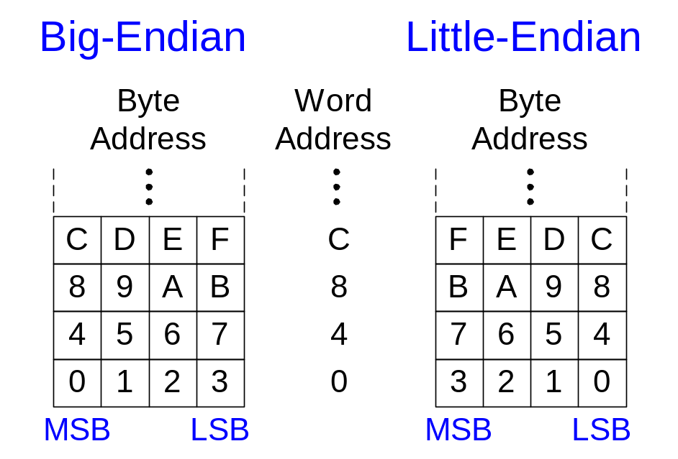
Big-Endian and Little-Endian Memory
How to number bytes within a word
Word address is the same for big- or little-endian
Little-endian: numbers bytes starting at the little (least significant) end
Big-endian: numbers bytes starting at the big (most significant) end
Copyright © 2007 Elsevier
6-<<number>>

Slide 29
Big-Endian and Little-Endian Memory
From Jonathan Swift’s Gulliver’s Travels where the Little-Endians broke their eggs on the little end of the egg and the Big-Endians broke their eggs on the big end.
As indicated by the farcical name, it doesn’t really matter which addressing type is used – except when the two systems need to share data!
Copyright © 2007 Elsevier
6-<<number>>

Slide 30
Big- and Little-Endian Example
Suppose $t0 initially contains 0x23456789. After the following program is run on a big-endian system, what value does $s0 contain? In a little-endian system?
sw $s0, 0($0)
lb $s0, 1($0)
Copyright © 2007 Elsevier
6-<<number>>

Slide 31
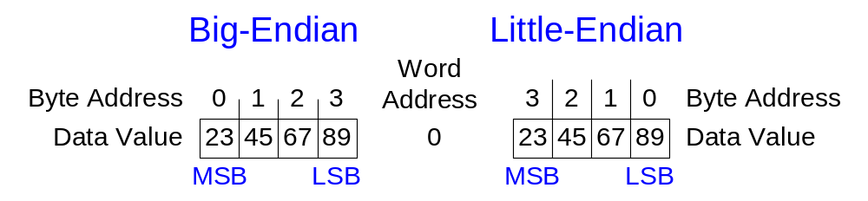
Big- and Little-Endian Example
Suppose $t0 initially contains 0x23456789. After the following program is run on a big-endian system, what value does $s0 contain? In a little-endian system?
sw $s0, 0($0)
lb $s0, 1($0)
Big-endian: 0x00000045
Little-endian: 0x00000067
Copyright © 2007 Elsevier
6-<<number>>

Slide 32
Design Principle 4
Good design demands good compromises
Multiple instruction formats allow flexibility (유연성).
  add, sub: use 3 register operands
  lw, sw: use 2 register operands and a constant
Number of instruction formats kept small
(명령어 포맷의 수는 가능한 작게 !!!)
  to adhere to design principles 1 and 3 (simplicity favors regularity and smaller is faster).
Copyright © 2007 Elsevier
6-<<number>>

Slide 33
Operands: Constants/Immediates
lw and sw illustrate the use of constants or immediates.
Called immediates because they are immediately available from the instruction.
Immediates don’t require a register or memory access.
The add immediate (addi) instruction adds an immediate to a variable (held in a register).
An immediate is a 16-bit two’s complement number.
Is subtract immediate (subi) necessary?
High-level code
a = a + 4;
b = a – 12;
MIPS assembly code
# $s0 = a, $s1 = b
addi $s0, $s0, 4
addi $s1, $s0, -12
Copyright © 2007 Elsevier
6-<<number>>

Slide 34
Machine Language
Computers only understand 1’s and 0’s
Machine language: binary representation of instructions
32-bit instructions
  Again, simplicity favors regularity: 32-bit data and instructions
Three instruction formats:
  R-Type: register operands
  I-Type: immediate operand
  J-Type: for jumping (we’ll discuss later)
Copyright © 2007 Elsevier
6-<<number>>

Slide 35
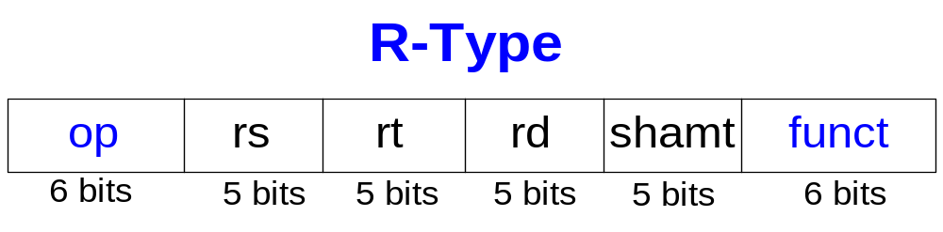
R-Type
Register-type
3 register operands:
  rs, rt: source registers
  rd: destination register
Other fields:
  op: the operation code or opcode
  funct: the function
  together, the opcode and function tell the computer
  what operation to perform
  shamt: the shift amount for shift instructions, otherwise it’s 0
Copyright © 2007 Elsevier
6-<<number>>

Slide 36
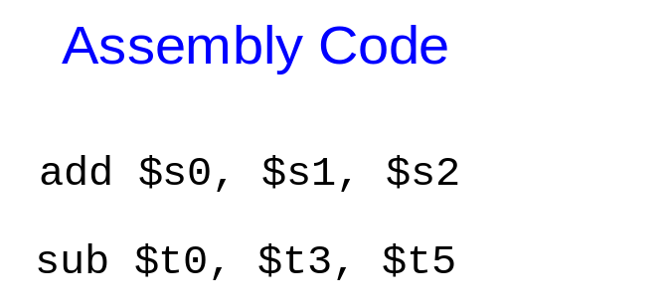
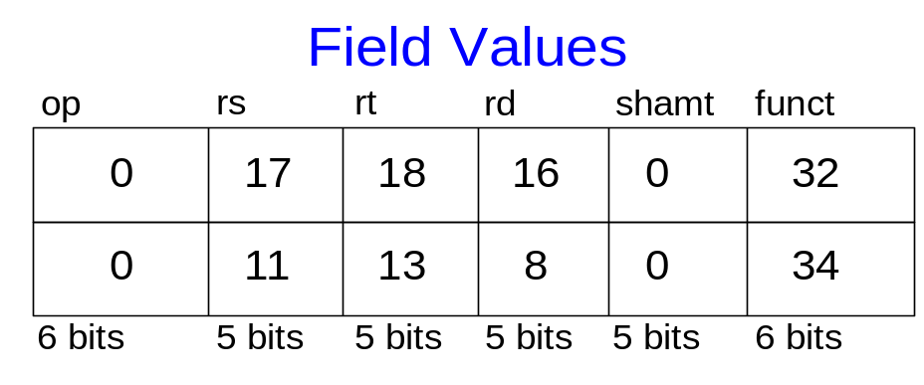
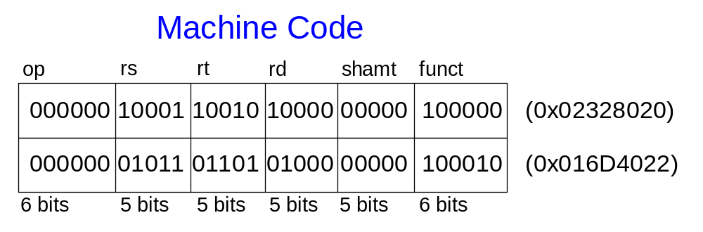
R-Type Examples
Note the order of registers in the assembly code: i.e., add rd, rs, rt
Copyright © 2007 Elsevier
6-<<number>>

Slide 37
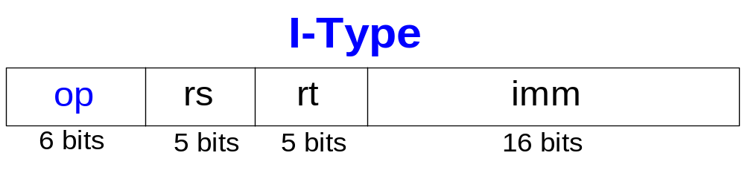
I-Type
Immediate-type
3 operands:
  rs, rt: register operands
  imm: 16-bit two’s complement immediate
Other fields:
  op: the opcode
  Simplicity favors regularity: all instructions have opcode
  Operation is completely determined by the opcode
Copyright © 2007 Elsevier
6-<<number>>

Slide 38
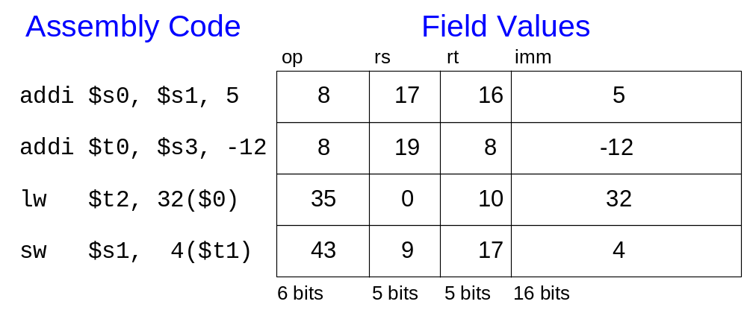
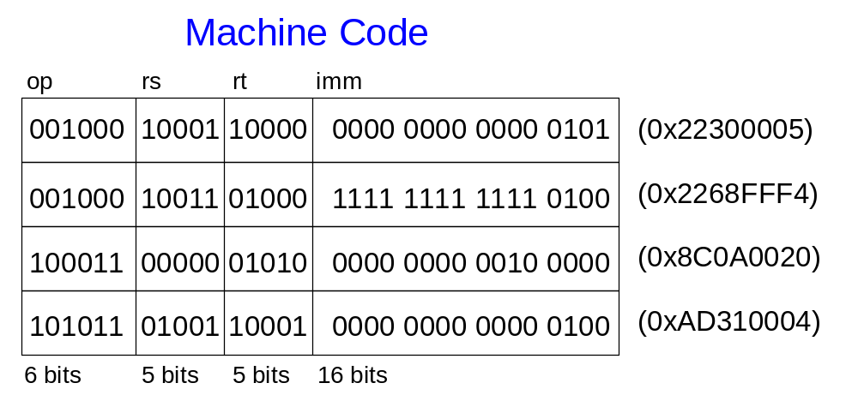
I-Type Examples
Note again the differing order of registers in the assembly and machine codes:
addi rt, rs, imm
lw rt, imm(rs)
sw rt, imm(rs)
Copyright © 2007 Elsevier
6-<<number>>

Slide 39
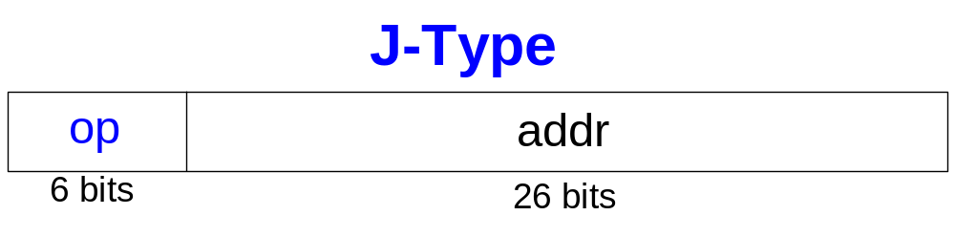
Machine Language: J-Type
Jump-type
26-bit address operand (addr)
Used for jump instructions (j)
Copyright © 2007 Elsevier
6-<<number>>

Slide 40
Review: Instruction Formats
Copyright © 2007 Elsevier
6-<<number>>

Slide 41
The Power of the Stored Program
32-bit instructions and data stored in memory
Sequence of instructions: only difference between two applications (for example, a text editor and a video game)
To run a new program:
  No tedious rewiring required
  Simply store new program in memory
The processor hardware executes the program:
  fetches (reads) the instructions from memory in sequence
  performs the specified operation
A program counter (PC) keeps track of the current instruction.
In MIPS, programs typically start at memory address 0x00400000.
Copyright © 2007 Elsevier
6-<<number>>

Slide 42
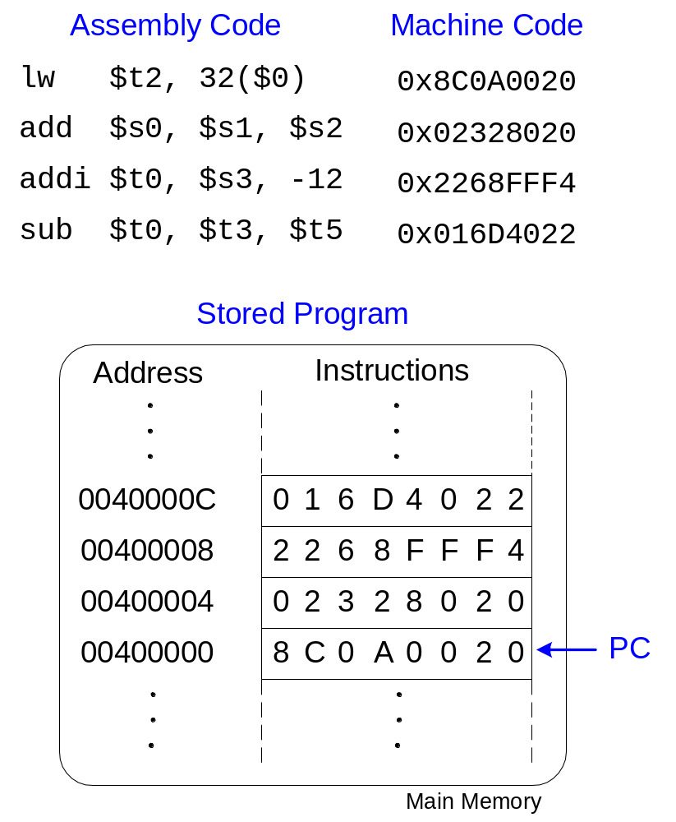
The Stored Program
Copyright © 2007 Elsevier
6-<<number>>

Slide 43
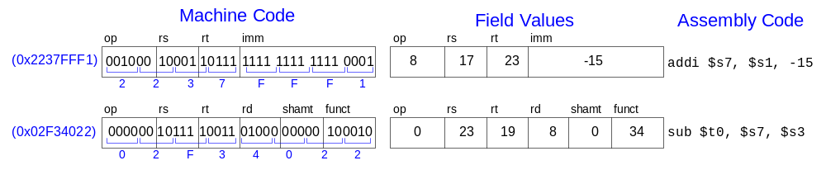
Interpreting Machine Language Code
Start with opcode
Opcode tells how to parse the remaining bits
If opcode is all 0’s
  R-type instruction
  Function bits tell what instruction it is
Otherwise
  opcode tells what instruction it is
Copyright © 2007 Elsevier
6-<<number>>

Slide 44
Programming
High-level languages:
  e.g., C, Java
  Written at more abstract level
Common high-level software constructs:
  if/else statements
  for loops
  while loops
  array accesses
  procedure calls
Other useful instructions:
  Arithmetic/logical instructions
  Branching
Copyright © 2007 Elsevier
6-<<number>>

Slide 45
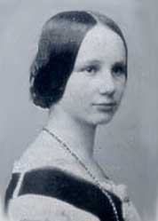
Ada Lovelace, 1815 - 1852
Wrote the first computer program
Her program calculated the Bernoulli numbers on Charles Babbage’s Analytical Engine
She was the only legitimate child of the poet Lord Byron
Copyright © 2007 Elsevier
6-<<number>>

Slide 46
Logical Instructions
and, or, xor, nor
  and: useful for masking bits
    Masking all but the least significant byte of a value:
    0xF234012F AND 0xFF = 0x0000002F
  or: useful for combining bits
    Combine 0xF2340000 with 0x000012BC:
    0xF2340000 OR 0x000012BC = 0xF23412BC
  nor: useful for inverting bits:
    A NOR $0 = NOT A
andi, ori, xori
  16-bit immediate is zero-extended (not sign-extended)
  nori not needed
Copyright © 2007 Elsevier
6-<<number>>

Slide 47
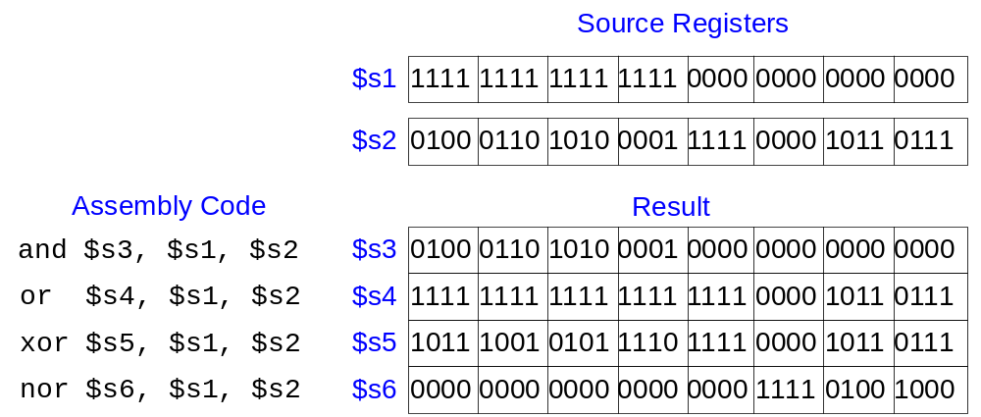
Logical Instruction Examples
Copyright © 2007 Elsevier
6-<<number>>

Slide 48
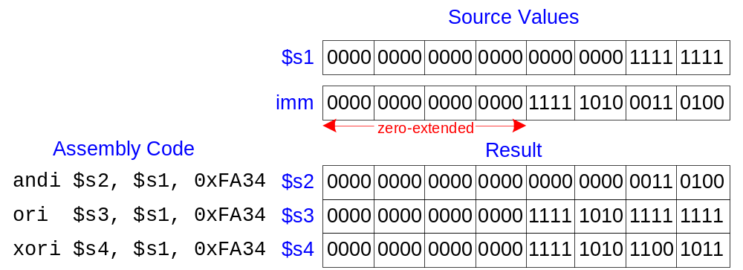
Logical Instruction Examples
Copyright © 2007 Elsevier
6-<<number>>

Slide 49
Shift Instructions
sll: shift left logical
  Example: sll $t0, $t1, 5 # $t0 <= $t1 << 5
srl: shift right logical
  Example: srl $t0, $t1, 5 # $t0 <= $t1 >> 5
sra: shift right arithmetic
  Example: sra $t0, $t1, 5 # $t0 <= $t1 >>> 5
Variable shift instructions:
sllv: shift left logical variable
  Example: sll $t0, $t1, $t2 # $t0 <= $t1 << $t2
srlv: shift right logical variable
  Example: srl $t0, $t1, $t2 # $t0 <= $t1 >> $t2
srav: shift right arithmetic variable
  Example: sra $t0, $t1, $t2 # $t0 <= $t1 >>> $t2
Copyright © 2007 Elsevier
6-<<number>>

Slide 50
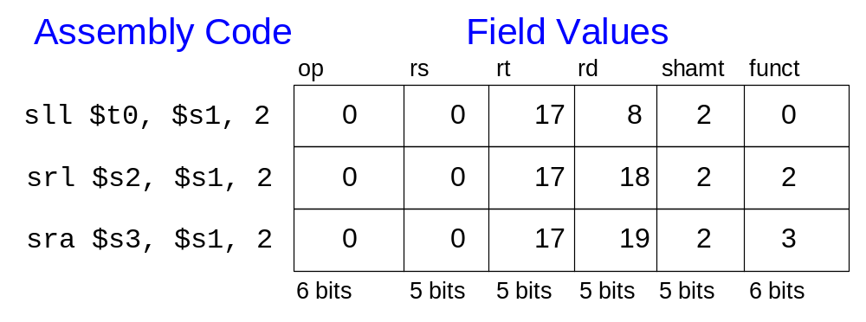
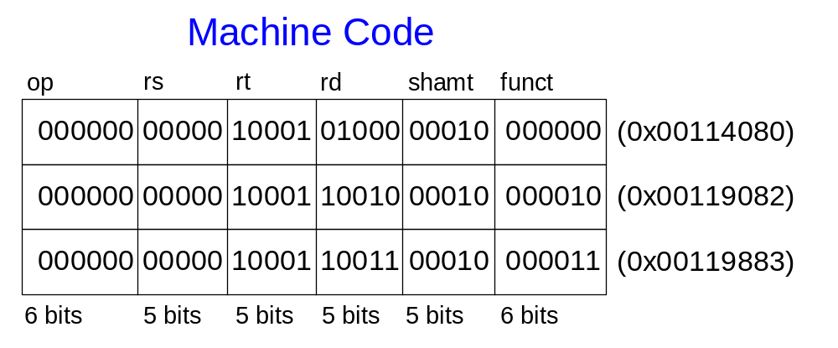
Shift Instructions
Copyright © 2007 Elsevier
6-<<number>>

Slide 51
Generating Constants
16-bit constants using addi:
32-bit constants using load upper immediate (lui) and ori:
(lui loads the 16-bit immediate into the upper half of the register and sets the lower half to 0.)
High-level code
// int is a 32-bit signed word
int a = 0x4f3c;
MIPS assembly code
# $s0 = a
addi $s0, $0, 0x4f3c
High-level code
int a = 0xFEDC8765;
MIPS assembly code
# $s0 = a
lui $s0, 0xFEDC
ori $s0, $s0, 0x8765
Copyright © 2007 Elsevier
6-<<number>>

Slide 52
Multiplication, Subtraction
Special registers: lo, hi
32 × 32 multiplication, 64 bit result
  mult $s0, $s1
  Result in hi, lo
32-bit division, 32-bit quotient, 32-bit remainder
  div $s0, $s1
  Quotient in lo
  Remainder in hi
Copyright © 2007 Elsevier
6-<<number>>

Slide 53
Branching
Allows a program to execute instructions out of sequence.
Types of branches:
  Conditional branches:
    branch if equal (beq)
    branch if not equal (bne)
  Unconditional branches:
    jump (j)
    jump register (jr)
    jump and link (jal)
Copyright © 2007 Elsevier
6-<<number>>

Slide 54
Review: The Stored Program
Copyright © 2007 Elsevier
6-<<number>>

Slide 55
Conditional Branching (beq)
# MIPS assembly
addi $s0, $0, 4 # $s0 = 0 + 4 = 4
addi $s1, $0, 1 # $s1 = 0 + 1 = 1
sll $s1, $s1, 2 # $s1 = 1 << 2 = 4
beq $s0, $s1, -4 # branch is taken
addi $s1, $s1, 1 # not executed
sub $s1, $s1, $s0 # not executed
target: # label
add $s1, $s1, $s0 # $s1 = 4 + 4 = 8
PC
PC+4
PC+8
PC+12
If($s0==$s1) goto PC+4-16
Labels indicate instruction locations in a program. They cannot use reserve words and must be followed by a colon (:).
Copyright © 2007 Elsevier
6-<<number>>

Slide 56
The Branch Not Taken (bne)
# MIPS assembly
addi $s0, $0, 4 # $s0 = 0 + 4 = 4
addi $s1, $0, 1 # $s1 = 0 + 1 = 1
sll $s1, $s1, 2 # $s1 = 1 << 2 = 4
bne $s0, $s1, target # branch not taken
addi $s1, $s1, 1 # $s1 = 4 + 1 = 5
sub $s1, $s1, $s0 # $s1 = 5 – 4 = 1
target:
add $s1, $s1, $s0 # $s1 = 1 + 4 = 5
Copyright © 2007 Elsevier
6-<<number>>

Slide 57
Unconditional Branching (j)
# MIPS assembly
addi $s0, $0, 4 # $s0 = 4
addi $s1, $0, 1 # $s1 = 1
j target # jump to target
sra $s1, $s1, 2 # not executed
addi $s1, $s1, 1 # not executed
sub $s1, $s1, $s0 # not executed
target:
add $s1, $s1, $s0 # $s1 = 1 + 4 = 5
Copyright © 2007 Elsevier
6-<<number>>

Slide 58
Unconditional Branching (jr)
# MIPS assembly
0x00002000 addi $s0, $0, 0x2010
0x00002004 jr $s0
0x00002008 addi $s1, $0, 1
0x0000200C sra $s1, $s1, 2
0x00002010 lw $s3, 44($s1)
Copyright © 2007 Elsevier
6-<<number>>

Slide 59
High-Level Code Constructs
if statements
if/else statements
while loops
for loops
Copyright © 2007 Elsevier
6-<<number>>

Slide 60
If Statement
High-level code
if (i == j)
f = g + h;
f = f – i;
MIPS assembly code
# $s0 = f, $s1 = g, $s2 = h
# $s3 = i, $s4 = j
bne $s3, $s4, L1
add $s0, $s1, $s2
L1: sub $s0, $s0, $s3
Notice that the assembly tests for the opposite case (i != j) than the test in the high-level code (i == j).
Copyright © 2007 Elsevier
6-<<number>>

Slide 61
If / Else Statement
High-level code
if (i == j)
f = g + h;
else
f = f – i;
MIPS assembly code
# $s0 = f, $s1 = g, $s2 = h
# $s3 = i, $s4 = j
bne $s3, $s4, L1
add $s0, $s1, $s2
j done
L1: sub $s0, $s0, $s3
done:
Copyright © 2007 Elsevier
6-<<number>>

Slide 62
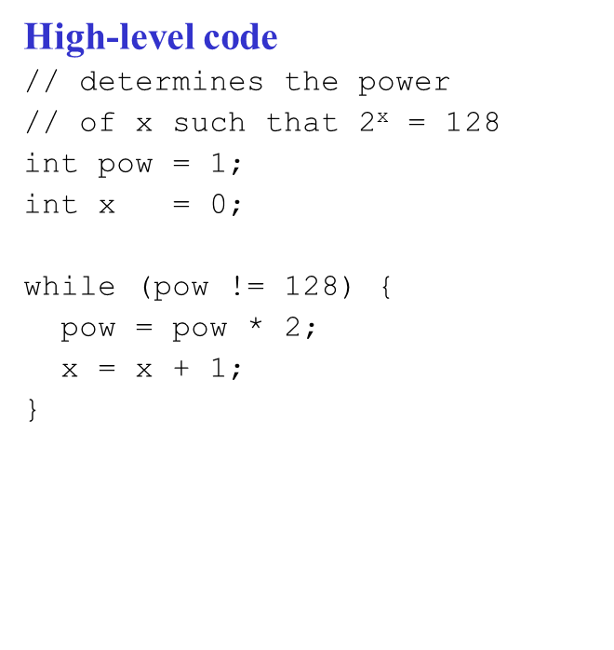
While Loops
MIPS assembly code
# $s0 = pow, $s1 = x
addi $s0, $0, 1 ; pow ← 1
add $s1, $0, $0 ; x ← 0
addi $t0, $0, 128 ; $t0 ← 128
JSLEE: beq $s0, $t0, done ; if(pow==128) goto done
sll $s0, $s0, 1 ; pow ← pow << 1 ( x2 )
addi $s1, $s1, 1 ; x ← x + 1
j JSLEE ; goto while
done:
Notice that the assembly tests for the opposite case (pow == 128) than the test in the high-level code (pow != 128).
Copyright © 2007 Elsevier
6-<<number>>

Slide 63
For Loops
The general form of a for loop is:
for (initialization; condition; loop operation)
loop body
initialization: executes before the loop begins
condition: is tested at the beginning of each iteration
loop operation: executes at the end of each iteration
loop body: executes each time the condition is met
Copyright © 2007 Elsevier
6-<<number>>

Slide 64
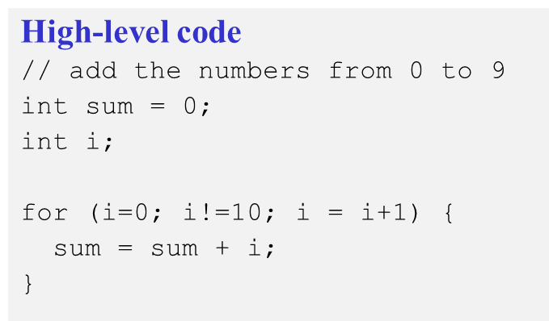
For Loops
MIPS assembly code
# $s0 = i, $s1 = sum
addi $s1, $0, 0 ; $s1 ← 0
add $s0, $0, $0 ; $s0 ← 0
addi $t0, $0, 10 ; $t0 ← 10
for: beq $s0, $t0, done ; if($s0==$t0) goto done
add $s1, $s1, $s0 ; $s1 ← $s1 + $s0
addi $s0, $s0, 1 ; $s0 ← $s0 + 1
j for ; goto for
done:
Notice that the assembly tests for the opposite case (i == 128) than the test in the high-level code (i != 10).
Copyright © 2007 Elsevier
6-<<number>>

Slide 65
For Loops: Using slt (set less than)
High-level code
// add the powers of 2 from 1
// to 100
int sum = 0;
int i;
for (i=1; i < 101; i = i*2) {
sum = sum + i;
}
MIPS assembly code
# $s0 = i, $s1 = sum
addi $s1, $0, 0 ; sum ← 0
addi $s0, $0, 1 ; i ← 1
addi $t0, $0, 101 ; $t0 ← 101
loop: slt $t1, $s0, $t0
beq $t1, $0, done
add $s1, $s1, $s0 ; sum = sum + i
sll $s0, $s0, 1 ; i = i * 2
j loop
done:
$t1 = 1 if i < 101.
slt $t1, $s0, $t0
===
If($s0 < $t0) $t1 ← 1;
Else $t1 ← 0;
slt $t1, i < 101
beq $t1, $0, end_of_for_loop
Copyright © 2007 Elsevier
6-<<number>>

Slide 66
Arrays
Useful for accessing large amounts of similar data
Array element: accessed by index
Array size: number of elements in the array
Copyright © 2007 Elsevier
6-<<number>>

Slide 67
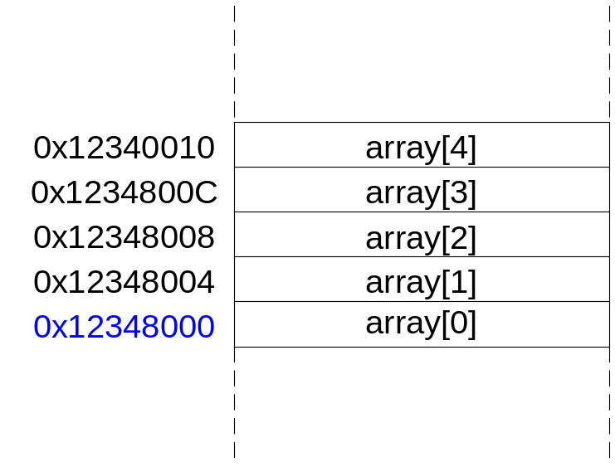
Arrays
5-element array
Base address = 0x12348000 (address of the first array element, array[0])
First step in accessing an array: load base address into a register
Copyright © 2007 Elsevier
6-<<number>>

Slide 68
Arrays
// high-level code
int array[5];
array[0] = array[0] * 2;
array[1] = array[1] * 2;
# MIPS assembly code
# array base address = $s0
lui $s0, 0x1234 # put 0x1234 in upper half of $S0
ori $s0, $s0, 0x8000 # put 0x8000 in lower half of $s0
lw $t1, 0($s0) # $t1 = array[0]
sll $t1, $t1, 1 # $t1 = $t1 * 2
sw $t1, 0($s0) # array[0] = $t1
lw $t1, 4($s0) # $t1 = array[1]
sll $t1, $t1, 1 # $t1 = $t1 * 2
sw $t1, 4($s0) # array[1] = $t1
Copyright © 2007 Elsevier
6-<<number>>

Slide 69
Arrays Using For Loops
// high-level code
int array[1000];
int i;
for (i=0; i < 1000; i = i + 1)
array[i] = array[i] * 8;
Copyright © 2007 Elsevier
6-<<number>>

Slide 70
Arrays Using For Loops
# MIPS assembly code
# $s0 = array base address, $s1 = i
# initialization code
lui $s0, 0x23B8 # $s0 = 0x23B80000
ori $s0, $s0, 0xF000 # $s0 = 0x23B8F000
addi $s1, $0, 0 # i = 0
addi $t2, $0, 1000 # $t2 = 1000
loop:
slt $t0, $s1, $t2 # i < 1000?
beq $t0, $0, done # if not then done
sll $t0, $s1, 2 # $t0 = i * 4 (byte offset)
add $t0, $t0, $s0 # address of array[i]
lw $t1, 0($t0) # $t1 = array[i]
sll $t1, $t1, 3 # $t1 = array[i] * 8
sw $t1, 0($t0) # array[i] = array[i] * 8
addi $s1, $s1, 1 # i = i + 1
j loop # repeat
done:
Copyright © 2007 Elsevier
6-<<number>>

Slide 71
ASCII Codes
American Standard Code for Information Interchange (ASCII): assigns each text character a unique byte value
For example, S = 0x53, a = 0x61, A = 0x41
Lower-case and upper-case letters differ by 0x20 (32).
See Table 6.2 in Digital Design and Computer Architecture, Harris and Harris, for a complete list of ASCII codes
Copyright © 2007 Elsevier
6-<<number>>

Slide 72
0번지에다 0x 00 00 00 01 한워드를 쓰고!
0번지에서 한바이트를 읽어요!
Copyright © 2007 Elsevier
6-<<number>>

Slide 73
Procedure Calls
Definitions
Caller: calling procedure (in this case, main)
Callee: called procedure (in this case, sum)
High-level code
void main()
{
int y;
y = sum(42, 7);
...
}
int sum(int a, int b)
{
return (a + b);
}
Copyright © 2007 Elsevier
6-<<number>>

Slide 74
Procedure Calls
Procedure calling conventions:
Caller:
  passes arguments to callee.
Callee:
  must not overwrite registers or memory needed by the caller
  returns to the point of call
  returns the result to caller
MIPS conventions:
Call procedure: jump and link (jal)
Return from procedure: jump register (jr)
Argument values: $a0 - $a3
Return value: $v0
Copyright © 2007 Elsevier
6-<<number>>

Slide 75
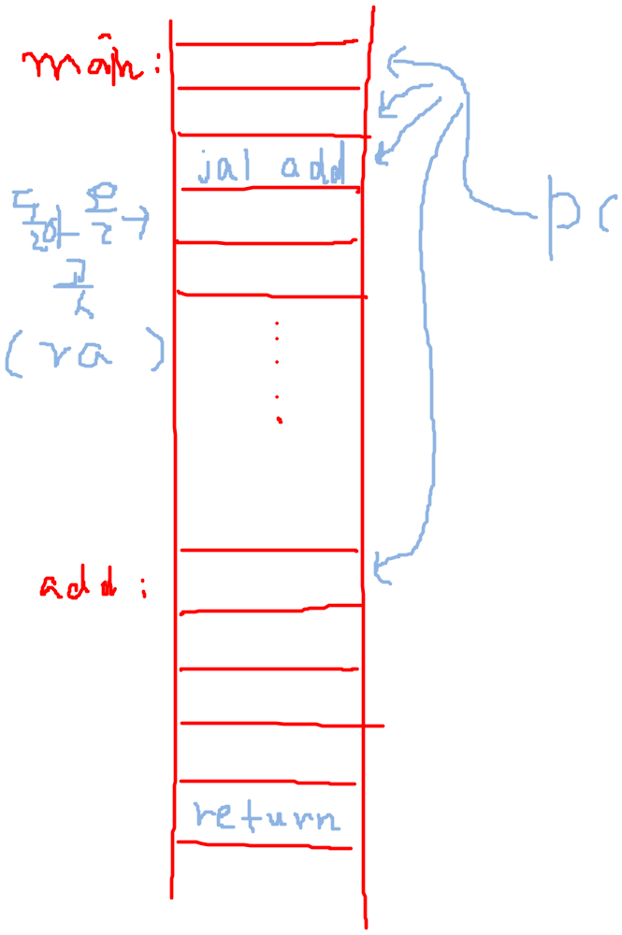
jal: // jump & link
1) $ra ← PC+4 // link
2) PC ← 함수의 시작 주소 // jump
jr (jump register)
jr $ra // retrun !
Return:
PC ← $ra
Copyright © 2007 Elsevier
6-<<number>>

Slide 76
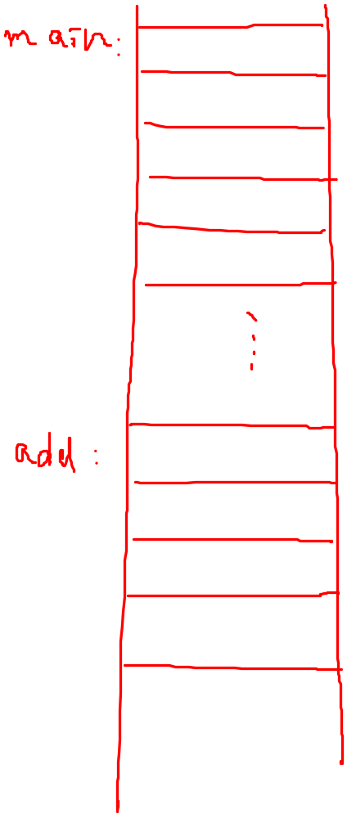


jal add
return
Copyright © 2007 Elsevier
6-<<number>>

Slide 77
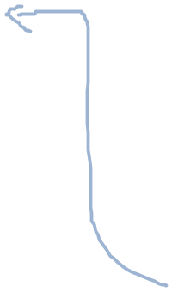
jal add
return
Copyright © 2007 Elsevier
6-<<number>>

Slide 78

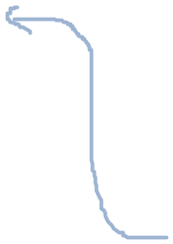
Jal:
$ra ← PC + 4
PC ← add함수의 주소
jal add
return
Copyright © 2007 Elsevier
6-<<number>>

Slide 79
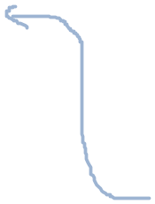
jal add
return
Copyright © 2007 Elsevier
6-<<number>>

Slide 80
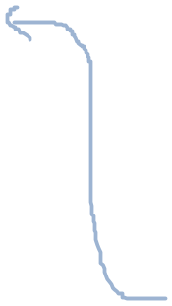
jal add
return
Copyright © 2007 Elsevier
6-<<number>>

Slide 81
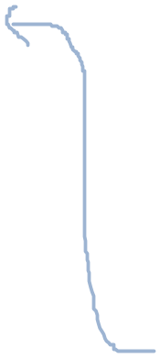
jal add
return
Copyright © 2007 Elsevier
6-<<number>>

Slide 82

jal add
return
Copyright © 2007 Elsevier
6-<<number>>

Slide 83
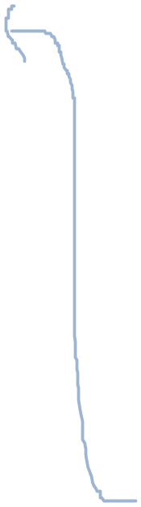
jal add
return
Copyright © 2007 Elsevier
6-<<number>>

Slide 84
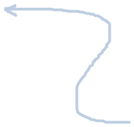
jal add
return
Copyright © 2007 Elsevier
6-<<number>>

Slide 85
Main()
{
…
…
C = Sum(a, b);
…
}
sum(int a, int b)
{
…
…
return a + b
}
Copyright © 2007 Elsevier
6-<<number>>

Slide 86
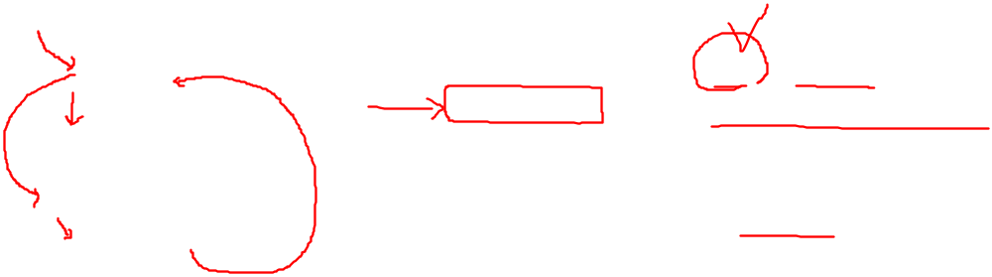
Procedure Calls
High-level code
int main() {
simple();
a = b + c;
}
void simple() {
return;
}
MIPS assembly code
0x00400200 main: jal simple
0x00400204 add $s0, $s1, $s2
...
0x00401020 simple: jr $ra
void means that simple doesn’t return a value.
Copyright © 2007 Elsevier
6-<<number>>

Slide 87
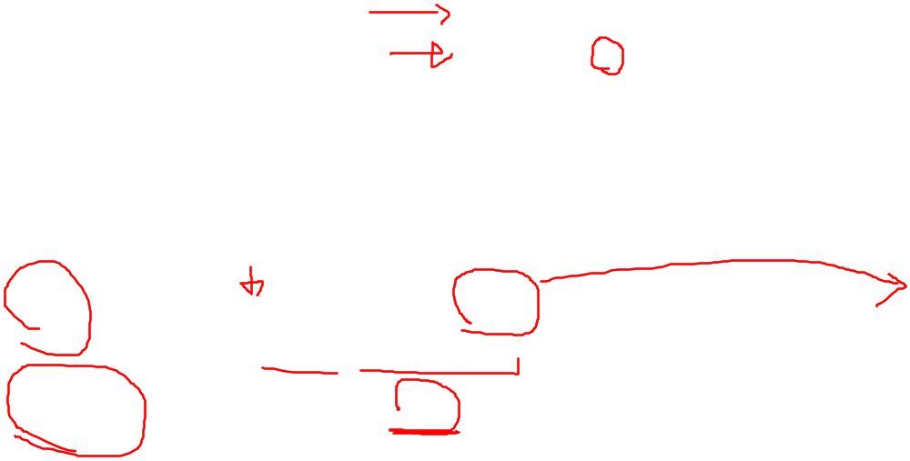
Procedure Calls
High-level code
int main() {
simple();
a = b + c;
}
void simple() {
return;
}
MIPS assembly code
0x00400200 main: jal simple
0x00400204 add $s0, $s1, $s2
...
0x00401020 simple: jr $ra
jal: jumps to simple and saves PC+4 in the return address register ($ra).
In this case, $ra = 0x00400204 after jal executes.
jr $ra: jumps to address in $ra, in this case 0x00400204.
Copyright © 2007 Elsevier
6-<<number>>

Slide 88
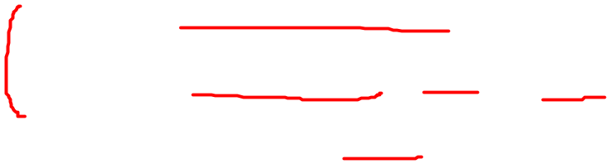
Input Arguments and Return Values
MIPS conventions:
Argument values: $a0 - $a3
Return value: $v0
Copyright © 2007 Elsevier
6-<<number>>

Slide 89
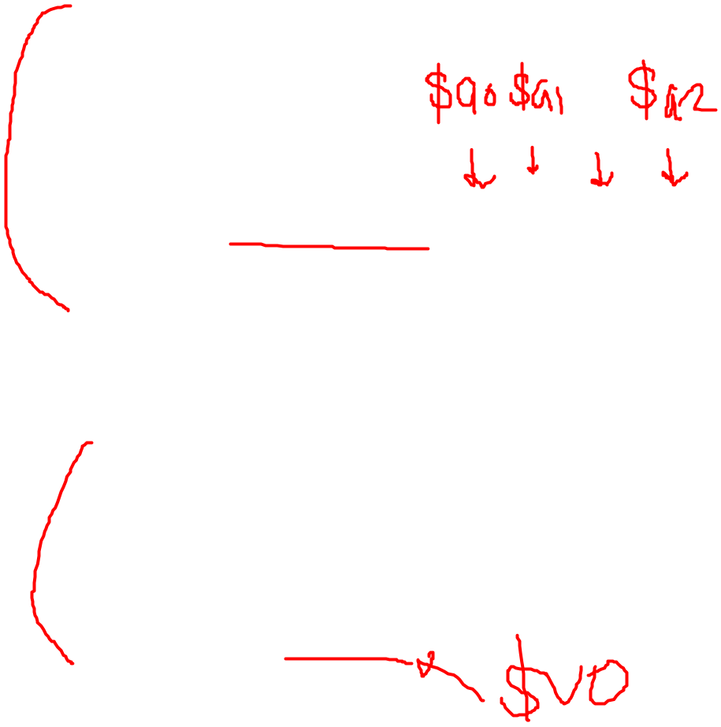
Input Arguments and Return Values
High-level code
int main()
{
int y;
...
y = diffofsums(2, 3, 4, 5); // 4 arguments
...
}
int diffofsums(int f, int g, int h, int i)
{
int result;
result = (f + g) - (h + i);
return result; // return value
}
Copyright © 2007 Elsevier
6-<<number>>

Slide 90
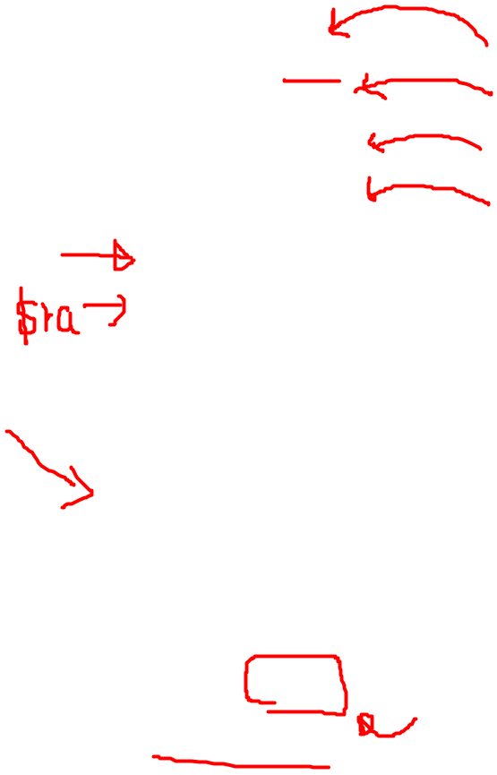
Input Arguments and Return Values
MIPS assembly code
# $s0 = y
main:
...
addi $a0, $0, 2 # argument 0 = 2
addi $a1, $0, 3 # argument 1 = 3
addi $a2, $0, 4 # argument 2 = 4
addi $a3, $0, 5 # argument 3 = 5
jal diffofsums # call procedure
add $s0, $v0, $0 # y = returned value
...
# $s0 = result
diffofsums:
add $t0, $a0, $a1 # $t0 = f + g
add $t1, $a2, $a3 # $t1 = h + i
sub $s0, $t0, $t1 # result = (f + g) - (h + i)
add $v0, $s0, $0 # put return value in $v0
jr $ra # return to caller
Copyright © 2007 Elsevier
6-<<number>>

Slide 91
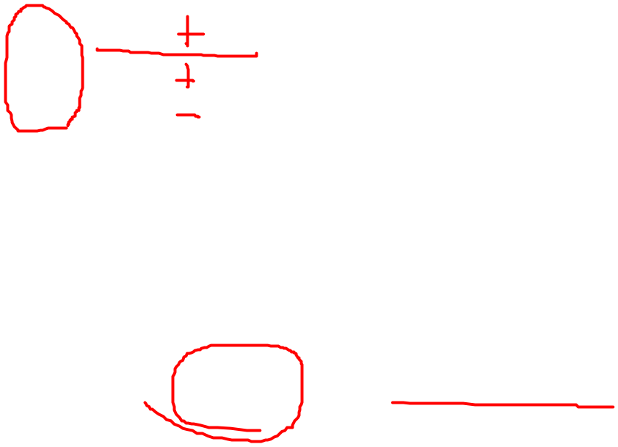
Input Arguments and Return Values
MIPS assembly code
# $s0 = result
diffofsums:
add $t0, $a0, $a1 # $t0 = f + g
add $t1, $a2, $a3 # $t1 = h + i
sub $s0, $t0, $t1 # result = (f + g) - (h + i)
add $v0, $s0, $0 # put return value in $v0
jr $ra # return to caller
diffofsums overwrote 3 registers: $t0, $t1, and $s0
diffofsums can use the stack to temporarily store registers
Copyright © 2007 Elsevier
6-<<number>>

Slide 92
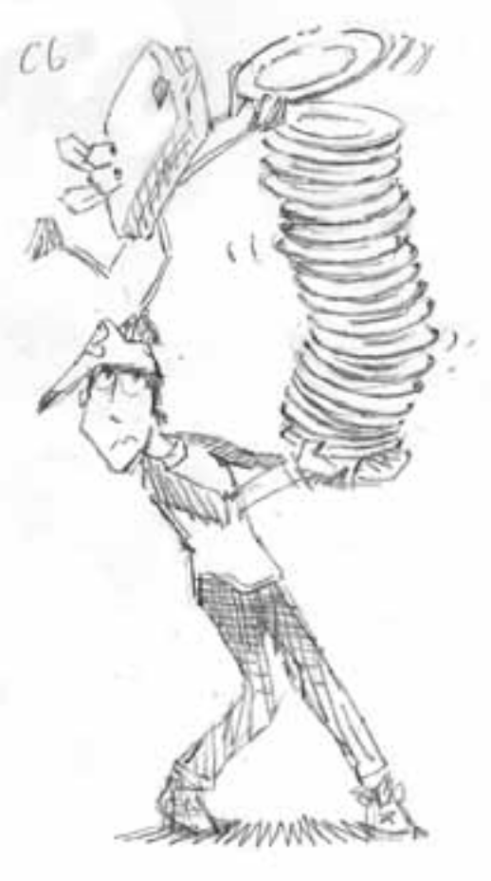
The Stack
Memory used to temporarily save variables
Like a stack of dishes, last-in-first-out (LIFO) queue
Expands: uses more memory when more space is needed
Contracts: uses less memory when the space is no longer needed
FILO LIFO
Copyright © 2007 Elsevier
6-<<number>>

Slide 93
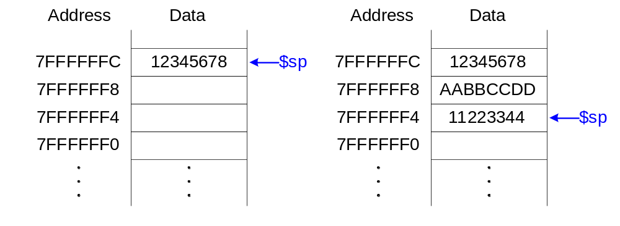
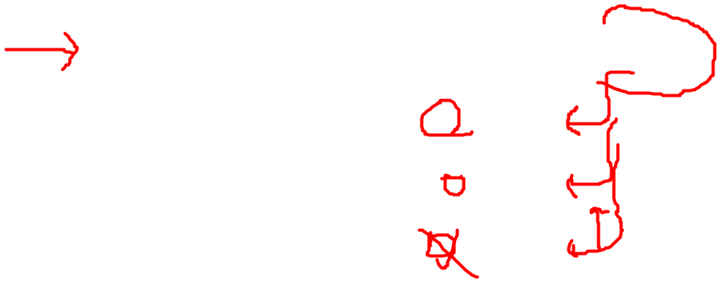
The Stack
Grows down (from higher to lower memory addresses)
Stack pointer: $sp, points to top of the stack
Copyright © 2007 Elsevier
6-<<number>>

Slide 94
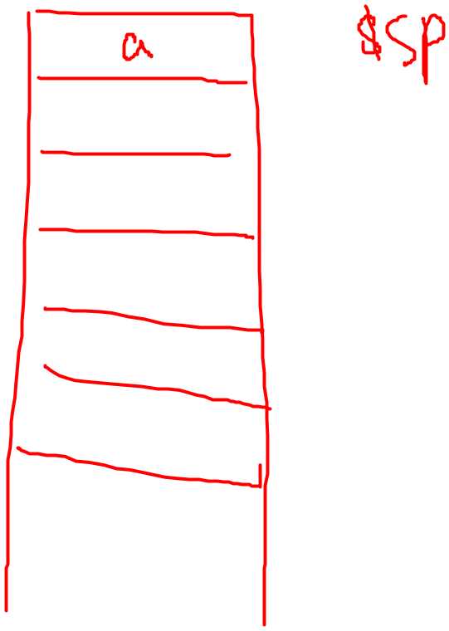
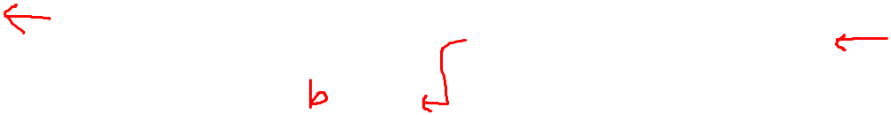
Pop(t):
t ← Stack[$sp];
$sp ← $sp – 4
a = Pop()
PUSH(b):
$sp ← $sp + 4;
Stack[$sp] = b;
a == Stack[$sp]
Copyright © 2007 Elsevier
6-<<number>>

Slide 95
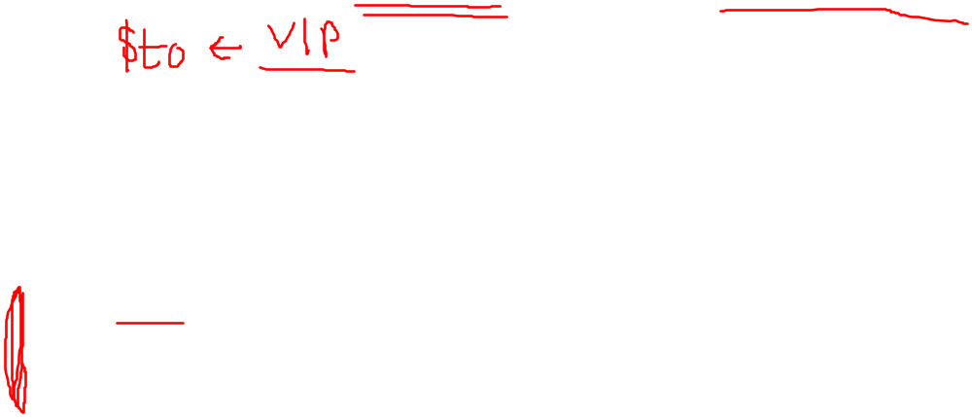
How Procedures use the Stack
Called procedures must have no other unintended side effects.
But diffofsums overwrites 3 registers: $t0, $t1, $s0
# MIPS assembly
# $s0 = result
diffofsums:
add $t0, $a0, $a1 # $t0 = f + g
add $t1, $a2, $a3 # $t1 = h + i
sub $s0, $t0, $t1 # result = (f + g) - (h + i)
add $v0, $s0, $0 # put return value in $v0
jr $ra # return to caller
Copyright © 2007 Elsevier
6-<<number>>

Slide 96
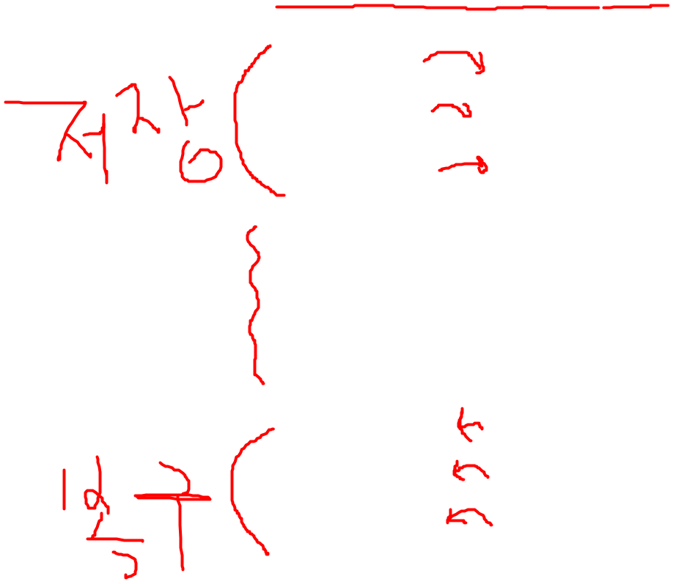
Storing Register Values on the Stack
# $s0 = result
diffofsums:
addi $sp, $sp, -12 # make space on stack
# to store 3 registers
sw $s0, 8($sp) # save $s0 on stack
sw $t0, 4($sp) # save $t0 on stack
sw $t1, 0($sp) # save $t1 on stack
add $t0, $a0, $a1 # $t0 = f + g
add $t1, $a2, $a3 # $t1 = h + i
sub $s0, $t0, $t1 # result = (f + g) - (h + i)
add $v0, $s0, $0 # put return value in $v0
lw $t1, 0($sp) # restore $t1 from stack
lw $t0, 4($sp) # restore $t0 from stack
lw $s0, 8($sp) # restore $s0 from stack
addi $sp, $sp, 12 # deallocate stack space
jr $ra # return to caller
Copyright © 2007 Elsevier
6-<<number>>

Slide 97
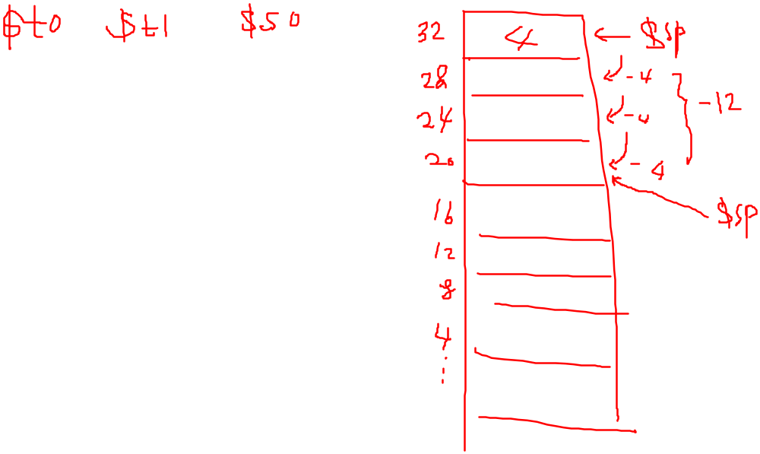
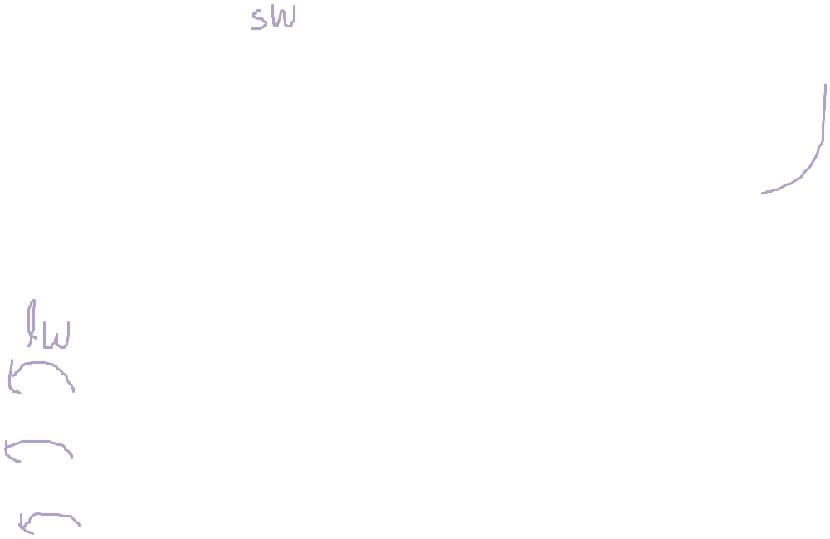
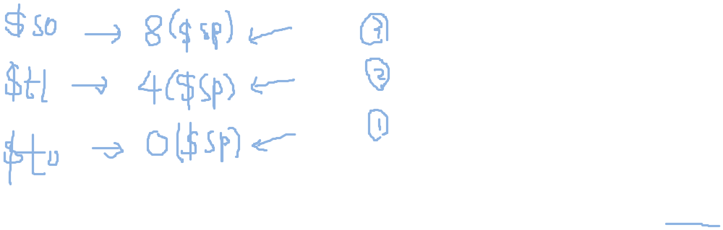
Copyright © 2007 Elsevier
6-<<number>>

Slide 98
Storing Register Values on the Stack
PUSH($t0):
addi $sp,$sp,-4
sw $t0, 0($sp)
POP($t0):
lw $t0, 0($sp)
addi $sp,$sp,4
# $s0 = result
diffofsums:
PUSH($t0)
PUSH($t1)
PUSH($s0)
add $t0, $a0, $a1 # $t0 = f + g
add $t1, $a2, $a3 # $t1 = h + i
sub $s0, $t0, $t1 # result = (f + g) - (h + i)
add $v0, $s0, $0 # put return value in $v0
POP($s0)
POP($t1)
POP($t0)
jr $ra # return to caller
Copyright © 2007 Elsevier
6-<<number>>

Slide 99
Storing Register Values on the Stack
# $s0 = result
diffofsums:
PUSH($t0)
PUSH($t1)
PUSH($s0)
add $t0, $a0, $a1 # $t0 = f + g
add $t1, $a2, $a3 # $t1 = h + i
sub $s0, $t0, $t1 # result = (f + g) - (h + i)
add $v0, $s0, $0 # put return value in $v0
POP($s0)
POP($t1)
POP($t0)
jr $ra # return to caller
Copyright © 2007 Elsevier
6-<<number>>

Slide 100

The Stack during diffofsums Call
Copyright © 2007 Elsevier
6-<<number>>

Slide 101

Registers
Preserved Callee-Saved | Nonpreserved Caller-Saved
$s0 - $s7 | $t0 - $t9
$ra | $a0 - $a3
$sp | $v0 - $v1
stack above $sp | stack below $sp
Copyright © 2007 Elsevier
6-<<number>>

Slide 102


Multiple Procedure Calls
proc1:
addi $sp, $sp, -4 # make space on stack
sw $ra, 0($sp) # save $ra on stack
jal proc2
...
lw $ra, 0($sp) # restore $s0 from stack
addi $sp, $sp, 4 # deallocate stack space
jr $ra # return to caller
Copyright © 2007 Elsevier
6-<<number>>

Slide 103



?
1
Push($ra)
Pop($ra)
Copyright © 2007 Elsevier
6-<<number>>

Slide 104
?
2
Push($ra)
Push($ra)
Pop($ra)
Pop($ra)
Copyright © 2007 Elsevier
6-<<number>>

Slide 105

Storing Saved Registers on the Stack
# $s0 = result
diffofsums:
addi $sp, $sp, -4 # make space on stack to
# store one register
sw $s0, 0($sp) # save $s0 on stack
add $t0, $a0, $a1 # $t0 = f + g
add $t1, $a2, $a3 # $t1 = h + i
sub $s0, $t0, $t1 # result = (f + g) - (h + i)
add $v0, $s0, $0 # put return value in $v0
lw $s0, 0($sp) # restore $s0 from stack
addi $sp, $sp, 4 # deallocate stack space
jr $ra # return to caller
Copyright © 2007 Elsevier
6-<<number>>

Slide 106

Recursive Procedure Call
High-level code
int factorial(int n) {
if (n <= 1)
return 1;
else
return (n * factorial(n-1));
}
Copyright © 2007 Elsevier
6-<<number>>

Slide 107
Recursive Procedure Call
MIPS assembly code
0x90 factorial: addi $sp, $sp, -8 # make room
0x94 sw $a0, 4($sp) # store $a0
0x98 sw $ra, 0($sp) # store $ra
0x9C addi $t0, $0, 2
0xA0 slt $t0, $a0, $t0 # a <= 1 ?
0xA4 beq $t0, $0, else # no: go to else
0xA8 addi $v0, $0, 1 # yes: return 1
0xAC addi $sp, $sp, 8 # restore $sp
0xB0 jr $ra # return
0xB4 else: addi $a0, $a0, -1 # n = n - 1
0xB8 jal factorial # recursive call
0xBC lw $ra, 0($sp) # restore $ra
0xC0 lw $a0, 4($sp) # restore $a0
0xC4 addi $sp, $sp, 8 # restore $sp
0xC8 mul $v0, $a0, $v0 # n * factorial(n-1)
0xCC jr $ra # return
Copyright © 2007 Elsevier
6-<<number>>

Slide 108


Stack during Recursive Call
Copyright © 2007 Elsevier
6-<<number>>

Slide 109
Addressing Modes
How do we address the operands?
Register Only
Immediate
Base Addressing
PC-Relative
Pseudo Direct
Copyright © 2007 Elsevier
6-<<number>>

Slide 110
Addressing Modes
Register Only Addressing
Operands found in registers
  Example: add $s0, $t2, $t3
  Example: sub $t8, $s1, $0
Immediate Addressing
16-bit immediate used as an operand
  Example: addi $s4, $t5, -73
  Example: ori $t3, $t7, 0xFF
Copyright © 2007 Elsevier
6-<<number>>

Slide 111
Addressing Modes
Base Addressing
Address of operand is:
  base address + sign-extended immediate
  Example: lw $s4, 72($0)
    Address = $0 + 72
  Example: sw $t2, -25($t1)
    Address = $t1 - 25
Copyright © 2007 Elsevier
6-<<number>>

Slide 112

Addressing Modes
PC-Relative Addressing
0x10 beq $t0, $0, else
0x14 addi $v0, $0, 1
0x18 addi $sp, $sp, i
0x1C jr $ra
0x20 else: addi $a0, $a0, -1
0x24 jal factorial
Copyright © 2007 Elsevier
6-<<number>>

Slide 113


Addressing Modes
Pseudo-direct Addressing
0x0040005C jal sum
...
0x004000A0 sum: add $v0, $a0, $a1
Copyright © 2007 Elsevier
6-<<number>>

Slide 114

How do we run an application?
Copyright © 2007 Elsevier
6-<<number>>

Slide 115

Grace Hopper, 1906 - 1992
Graduated from Yale University with PhD in mathematics
Developed first compiler
Helped develop the COBOL programming language
Highly awarded naval officer
Received World War II Victory Metal and National Defense Service Medal, among others
Copyright © 2007 Elsevier
6-<<number>>

Slide 116
What needs to be stored in memory?
Instructions (also called text)
Data
  Global/static: allocated before program begins
  Dynamic: allocated within program
How big is memory?
  At most 2³² = 4 gigabytes (4 GB)
  From address 0x00000000 to 0xFFFFFFFF
Copyright © 2007 Elsevier
6-<<number>>

Slide 117

The MIPS Memory Map
Copyright © 2007 Elsevier
6-<<number>>

Slide 118
Running a Program
Copyright © 2007 Elsevier
6-<<number>>

Slide 119
Example Program: C Code
int f, g, y; // global variables
int main(void)
{
f = 2;
g = 3;
y = sum(f, g);
return y;
}
int sum(int a, int b) {
return (a + b);
}
Copyright © 2007 Elsevier
6-<<number>>

Slide 120
Example Program: Assembly Code
.data
f:
g:
y:
.text
main:
addi $sp, $sp, -4 # stack frame
sw $ra, 0($sp) # store $ra
addi $a0, $0, 2 # $a0 = 2
sw $a0, f # f = 2
addi $a1, $0, 3 # $a1 = 3
sw $a1, g # g = 3
jal sum # call sum
sw $v0, y # y = sum()
lw $ra, 0($sp) # restore $ra
addi $sp, $sp, 4 # restore $sp
jr $ra # return to OS
sum:
add $v0, $a0, $a1 # $v0 = a + b
jr $ra # return
int f, g, y; // global
int main(void)
{
f = 2;
g = 3;
y = sum(f, g);
return y;
}
int sum(int a, int b) {
return (a + b);
}
Copyright © 2007 Elsevier
6-<<number>>

Slide 121
The MIPS Memory Map
Copyright © 2007 Elsevier
6-<<number>>

Slide 122
Example Program: Symbol Table
Symbol | Address
f | 0x10000000
g | 0x10000004
y | 0x10000008
main | 0x00400000
sum | 0x0040002C
Copyright © 2007 Elsevier
6-<<number>>

Slide 123

Example Program: Executable
Copyright © 2007 Elsevier
6-<<number>>

Slide 124

Example Program: In Memory
Copyright © 2007 Elsevier
6-<<number>>

Slide 125
Odds and Ends
Pseudoinstructions
Exceptions
Signed and unsigned instructions
Floating-point instructions
Copyright © 2007 Elsevier
6-<<number>>

Slide 126
Pseudoinstructions
Pseudoinstruction | MIPS Instructions
li $s0, 0x1234AA77 | lui $s0, 0x1234 ori $s0, 0xAA77
mul $s0, $s1, $s2 | mult $s1, $s2 mflo $s0
clear $t0 | add $t0, $0, $0
move $s1, $s2 | add $s2, $s1, $0
nop | sll $0, $0, 0
Copyright © 2007 Elsevier
6-<<number>>

Slide 127
Exceptions
Unscheduled procedure call to the exception handler
Casued by:
  Hardware, also called an interrupt, e.g. keyboard
  Software, also called traps, e.g. undefined instruction
When exception occurs, the processor:
  Records the cause of the exception
  Jumps to the exception handler at instruction address 0x80000180
  Returns to program
Copyright © 2007 Elsevier
6-<<number>>

Slide 128
Exception Registers
Not part of the register file.
  Cause
    Records the cause of the exception
  EPC (Exception PC)
    Records the PC where the exception occurred
EPC and Cause: part of Coprocessor 0
Move from Coprocessor 0
  mfc0 $t0, EPC
  Moves the contents of EPC into $t0
Copyright © 2007 Elsevier
6-<<number>>

Slide 129
Exception Causes
Exception | Cause
Hardware Interrupt | 0x00000000
System Call | 0x00000020
Breakpoint / Divide by 0 | 0x00000024
Undefined Instruction | 0x00000028
Arithmetic Overflow | 0x00000030
Copyright © 2007 Elsevier
6-<<number>>

Slide 130
Exceptions
Processor saves cause and exception PC in Cause and EPC
Processor jumps to exception handler (0x80000180)
Exception handler:
  Saves registers on stack
  Reads the Cause register
  mfc0 Cause, $t0
  Handles the exception
  Restores registers
  Returns to program
    mfc0 EPC, $k0
    jr $k0
Copyright © 2007 Elsevier
6-<<number>>

Slide 131
Signed and Unsigned Instructions
Addition and subtraction
Multiplication and division
Set less than
Copyright © 2007 Elsevier
6-<<number>>

Slide 132
Addition and Subtraction
Signed: add, addi, sub
  Performs same operation as unsigned versions
  But processor takes exception on overflow
Unsigned: addu, addiu, subu
  Doesn’t take exception on overflow
  Note: addiu sign-extends the immediate
Copyright © 2007 Elsevier
6-<<number>>

Slide 133
Multiplication and Division
Signed: mult, div
Unsigned: multu, divu
Copyright © 2007 Elsevier
6-<<number>>

Slide 134
Set Less Than
Signed: slt, slti
Unsigned: sltu, sltiu
  Note: sltiu sign-extends the immediate before comparing it to the register
Copyright © 2007 Elsevier
6-<<number>>

Slide 135
Loads
Signed:
  Sign-extends to create 32-bit value
  Load halfword: lh
  Load byte: lb
Unsigned: addu, addiu, subu
  Zero-extends to create 32-bit value
  Load halfword unsigned: lhu
  Load byte: lbu
Copyright © 2007 Elsevier
6-<<number>>

Slide 136
Floating-Point Instructions
Floating-point coprocessor (Coprocessor 1)
32 32-bit floating-point registers ($f0 - $f31)
Double-precision values held in two floating point registers
  e.g., $f0 and $f1, $f2 and $f3, etc.
  So, double-precision floating point registers: $f0, $f2, $f4, etc.
Copyright © 2007 Elsevier
6-<<number>>

Slide 137
Floating-Point Instructions
Name | Register Number | Usage
$fv0 - $fv1 | 0, 2 | return values
$ft0 - $ft3 | 4, 6, 8, 10 | temporary variables
$fa0 - $fa1 | 12, 14 | procedure arguments
$ft4 - $ft8 | 16, 18 | temporary variables
$fs0 - $fs5 | 20, 22, 24, 26, 28, 30 | saved variables
Copyright © 2007 Elsevier
6-<<number>>

Slide 138

F-Type Instruction Format
Opcode = 17 (010001₂)
Single-precision:
  cop = 16 (010000₂)
  add.s, sub.s, div.s, neg.s, abs.s, etc.
Double-precision:
  cop = 17 (010001₂)
  add.d, sub.d, div.d, neg.d, abs.d, etc.
3 register operands:
  rs, rt: source operands
  fd: destination operands
Copyright © 2007 Elsevier
6-<<number>>

Slide 139
Floating-Point Branches
Set/clear condition flag: fpcond
  Equality: c.seq.s, c.seq.d
  Less than: c.lt.s, c.lt.d
  Less than or equal: c.le.s, c.le.d
Conditional branch
  bclf: branches if fpcond is FALSE
  bclt: branches if fpcond is TRUE
Loads and stores
  lwc1: lwc1 $ft1, 42($s1)
  swc1: swc1 $fs2, 17($sp)
Copyright © 2007 Elsevier
6-<<number>>

