Slide 1
Chapter 7 :: Microarchitecture
Digital Design and Computer Architecture
David Money Harris and Sarah L. Harris
Lectured by Jeong-Gun Lee @ Hallym
Copyright © 2007 Elsevier
7-<<number>>

Slide 2
Chapter 7 :: Topics
Introduction
Performance Analysis (성능 분석)
Single-Cycle Processor (단 사이클 프로세서)
Multicycle Processor
Pipelined Processor
Exceptions
Advanced Microarchitecture
Copyright © 2007 Elsevier
7-<<number>>

Slide 3
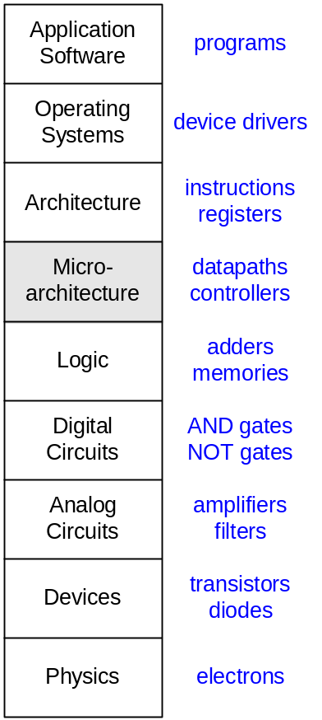

Introduction
Microarchitecture: how to implement an architecture in hardware
Processor:
  Datapath: functional blocks
  Control: control signals
Copyright © 2007 Elsevier
7-<<number>>

Slide 4
Microarchitecture
Multiple implementations for a single architecture:
  Single-cycle (단일 싸이클)
    Each instruction executes in a single cycle
  Multicycle (다수 싸이클)
    Each instruction is broken up into a series of shorter steps
  Pipelined (파이프라인)
    Each instruction is broken up into a series of steps
    Multiple instructions execute at once.
Copyright © 2007 Elsevier
7-<<number>>

Slide 5
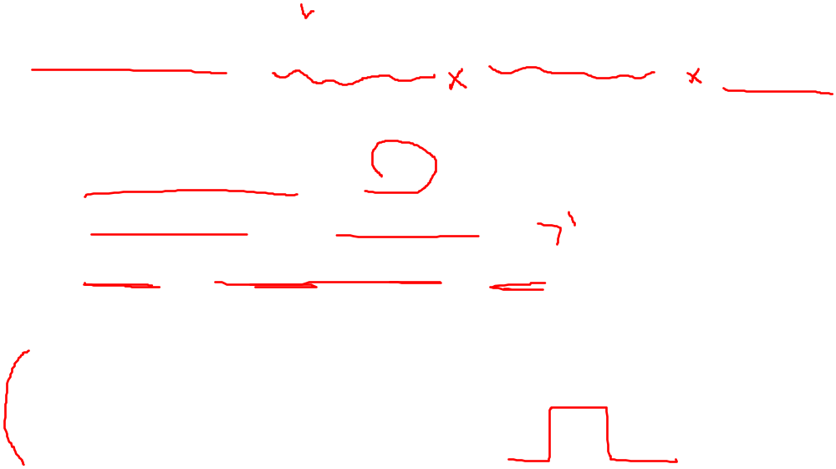
Processor Performance
Program execution time (프로그램 수행시간)
Execution Time = (# instructions)(cycles/instruction)(seconds/cycle)
Definitions:
  Cycles/instruction = CPI // 명령어당 요구되는 클럭 싸이클
  Seconds/cycle = clock period
  1/CPI = Instructions/cycle = IPC // 한클럭당 수행되는 명령어수
Challenge is to satisfy constraints of:
  Cost (비용)
  Power (파워소모)
  Performance (성능)
Copyright © 2007 Elsevier
7-<<number>>

Slide 6
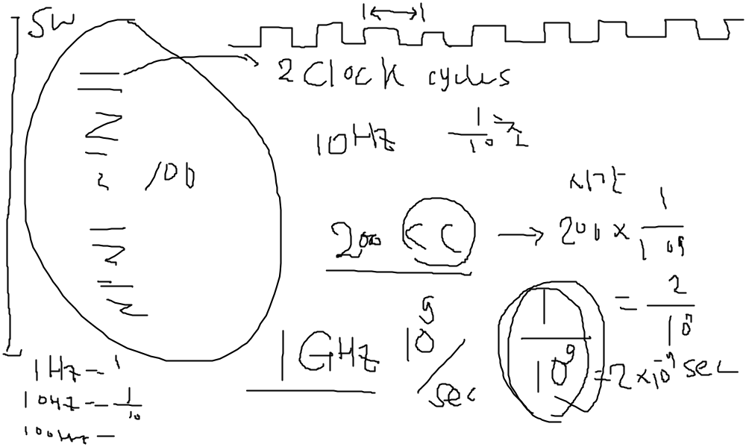
Copyright © 2007 Elsevier
6-<<number>>

Slide 7
MIPS Processor
We consider a subset of MIPS instructions:
  R-type instructions: and, or, add, sub, slt
  Memory instructions: lw, sw
  Branch instructionsbeq
Copyright © 2007 Elsevier
7-<<number>>

Slide 8
Architectural State (아키텍쳐 상태)
Determines everything about a processor:
프로세서에 대한 모든 것을 결정하자!
  PC
  32 registers
  Memory
Copyright © 2007 Elsevier
7-<<number>>

Slide 9
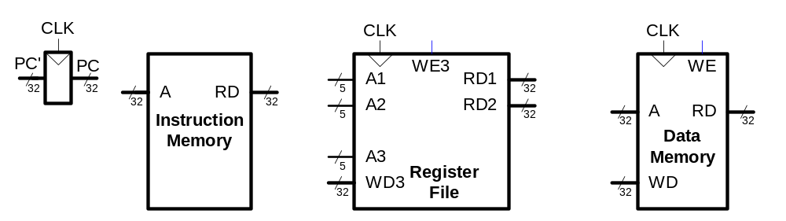
MIPS State Elements (상태 요소들)
상태 요소들 == 메모리 요소들
Copyright © 2007 Elsevier
7-<<number>>

Slide 10
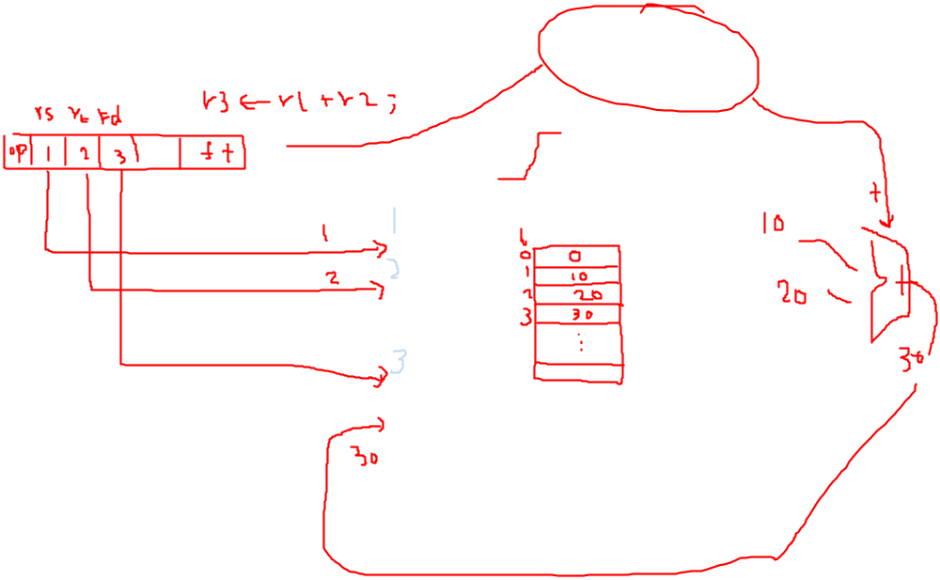
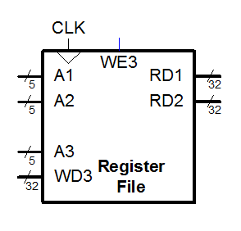
Copyright © 2007 Elsevier
6-<<number>>

Slide 11
Single-Cycle MIPS Processor
Datapath (데이터가 계산되는 흐름)
Control (제어신호를 생성하는 흐름)
Copyright © 2007 Elsevier
7-<<number>>

Slide 12

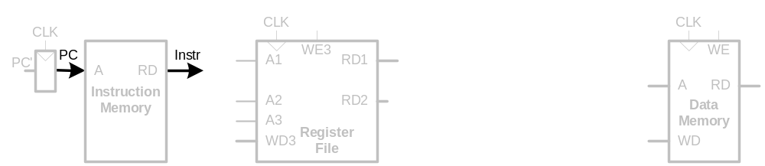
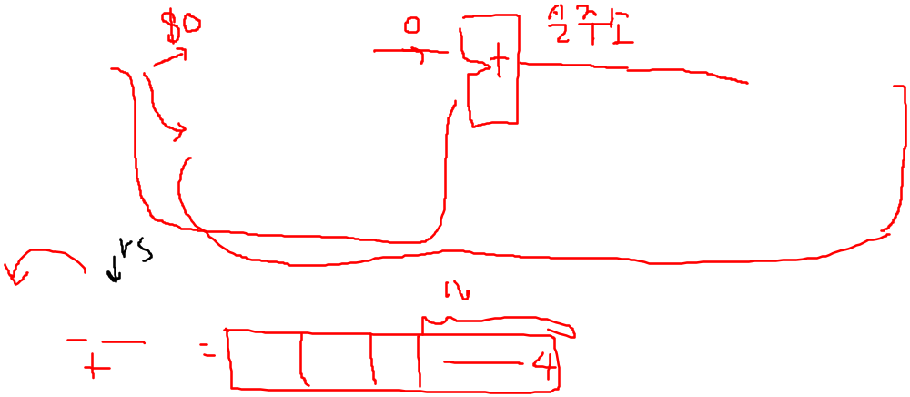
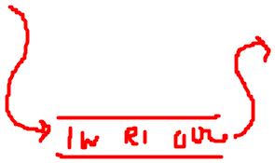
Single-Cycle Datapath
First consider executing lw
우선, lw 명령어의 실행을 고려해 봅시다!
STEP 1: Fetch instruction (명령어 가져오기)
lw $s0, 4($0)
Copyright © 2007 Elsevier
7-<<number>>

Slide 13
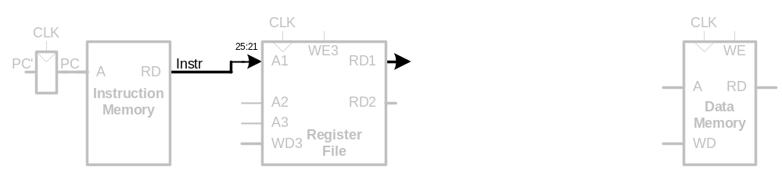
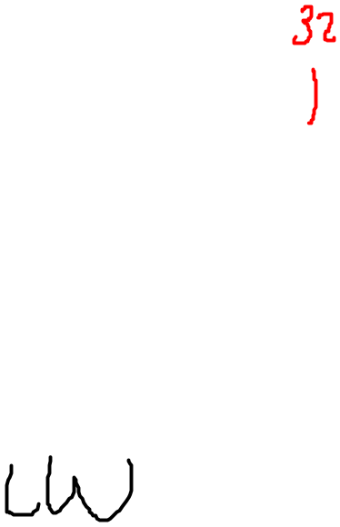
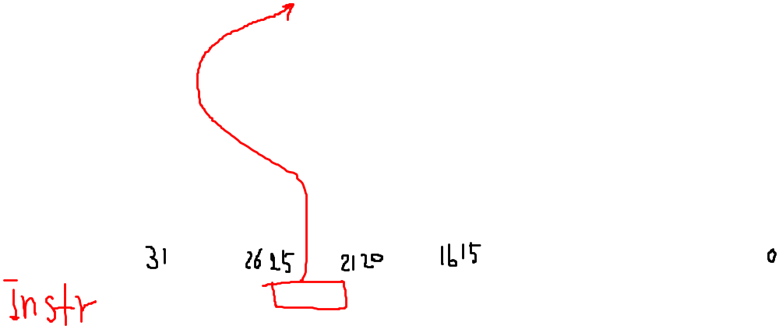
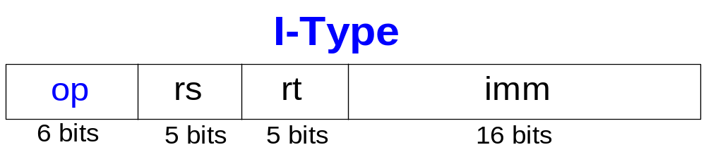
Single-Cycle Datapath
STEP 2: Read source operands from register file
레지스터 파일로 부터 소스 오퍼런드 읽어오기!
Copyright © 2007 Elsevier
7-<<number>>

Slide 14
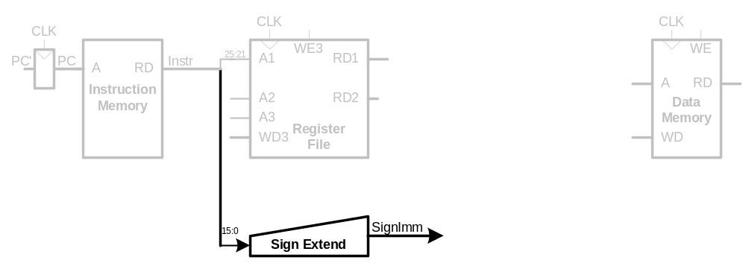
Single-Cycle Datapath
STEP 3: Sign-extend the immediate
Copyright © 2007 Elsevier
7-<<number>>

Slide 15
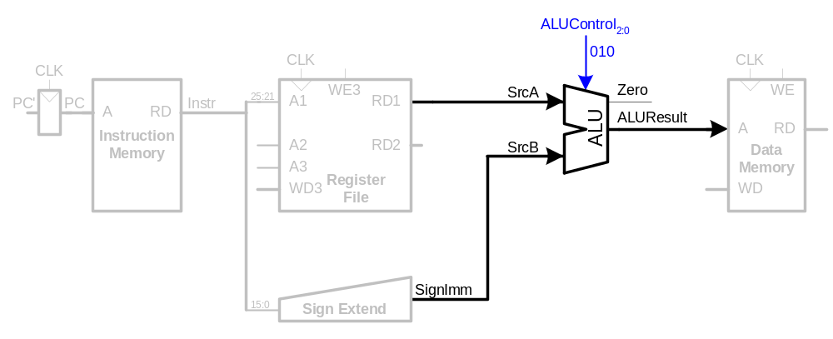
Single-Cycle Datapath
STEP 4: Compute the memory address
메모리 주소 계산하기
Copyright © 2007 Elsevier
7-<<number>>

Slide 16
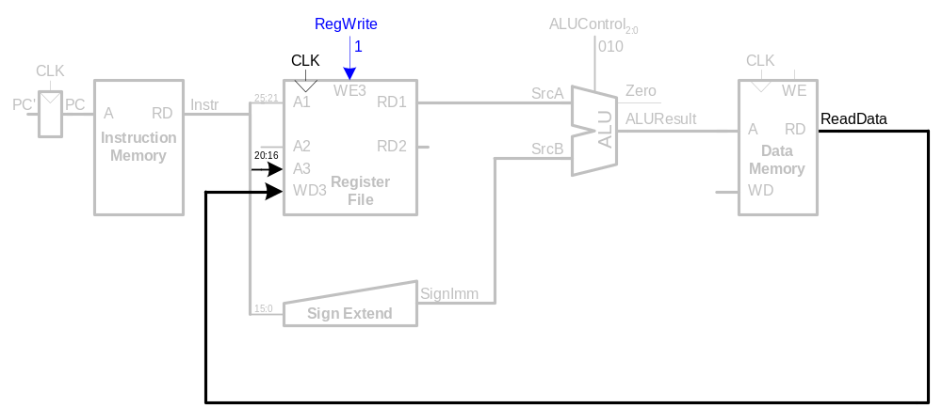
Single-Cycle Datapath
STEP 5: Read data from memory and write it back to register file
메모리로부터 데이터 읽고 그 데이터를 레지스터 파일에 쓰기!
Copyright © 2007 Elsevier
7-<<number>>

Slide 17
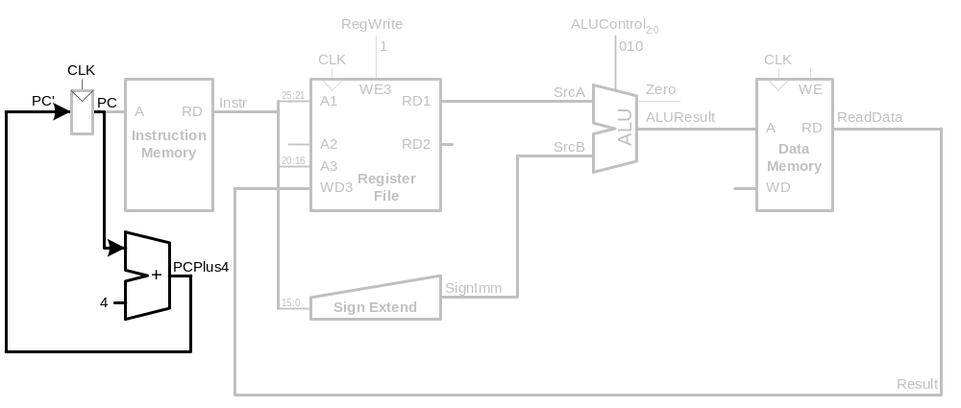
Single-Cycle Datapath
STEP 6: Determine the address of the next instruction
다음 명령어의 주소를 결정하기
Copyright © 2007 Elsevier
7-<<number>>

Slide 18
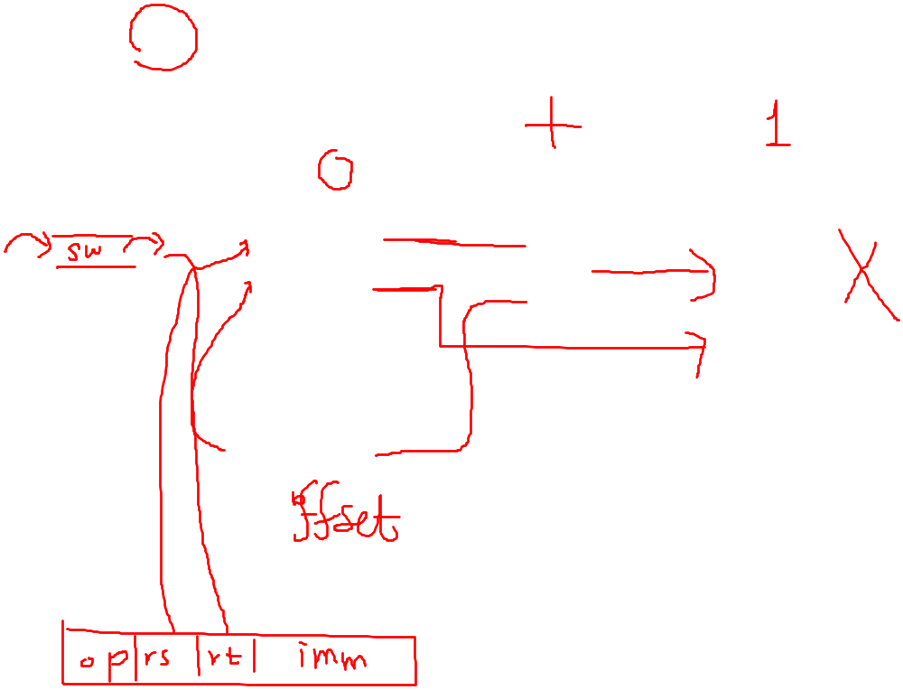
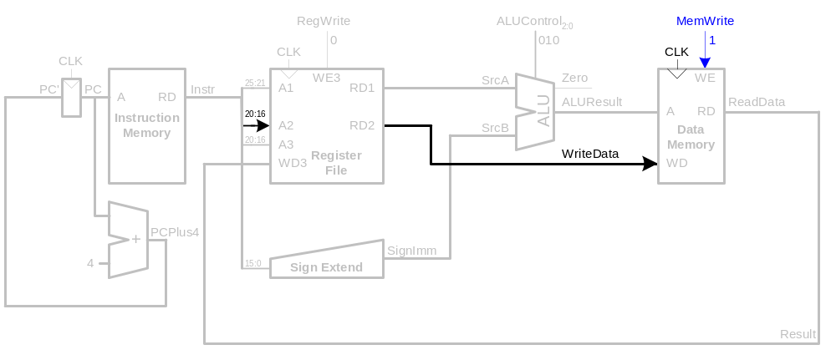
Single-Cycle Datapath
Consider sw
Need to write data to memory
Copyright © 2007 Elsevier
7-<<number>>

Slide 19
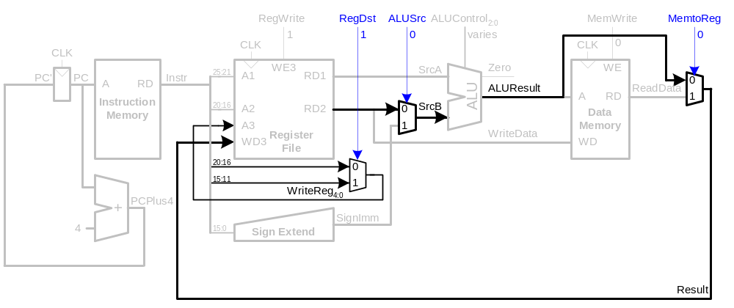











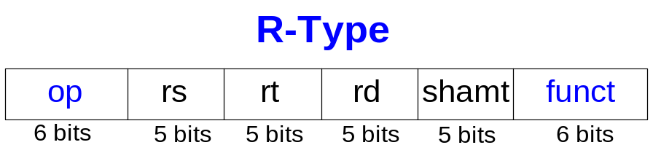
Single-Cycle Datapath
Consider R-type instructions: add, sub, and, or
Write ALUResult to register file
Writing to rd field of instruction (instead of rt)
Copyright © 2007 Elsevier
7-<<number>>

Slide 20
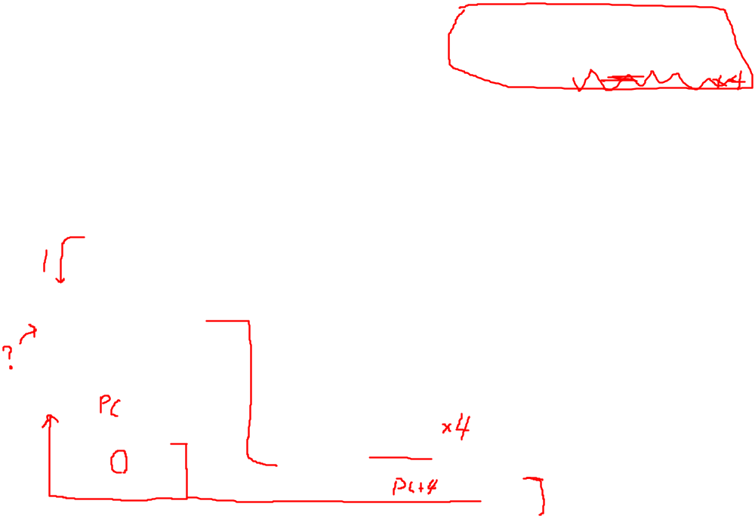
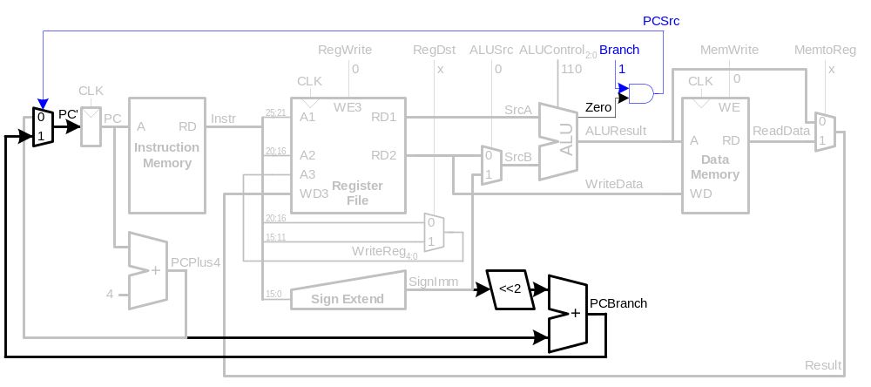
Single-Cycle Datapath
beq 명령어의 정의
beq $r1, $r2, Offset
===
if($r1 == $r2) goto (PC+4) + Offset<<2
Consider branch instruction: beq
Determine whether register values are equal
Calculate branch target address (BTA) from sign-extended immediate and PC+4
Copyright © 2007 Elsevier
7-<<number>>

Slide 21
Copyright © 2007 Elsevier
6-<<number>>

Slide 22
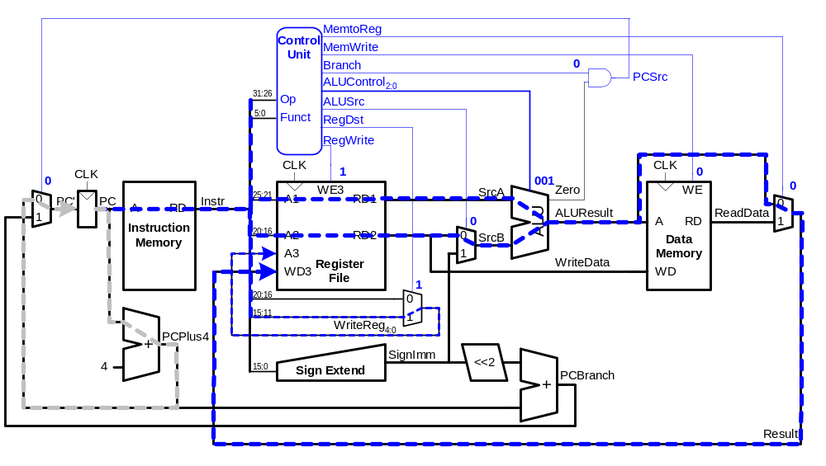
Single-Cycle Datapath Example: or
Copyright © 2007 Elsevier
7-<<number>>

Slide 23
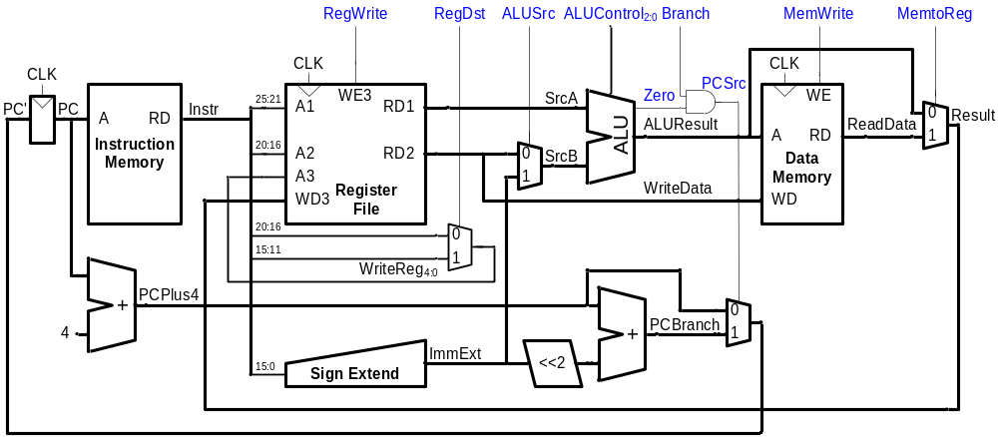
Single-Cycle Datapath: sw
Copyright © 2007 Elsevier
7-<<number>>

Slide 24
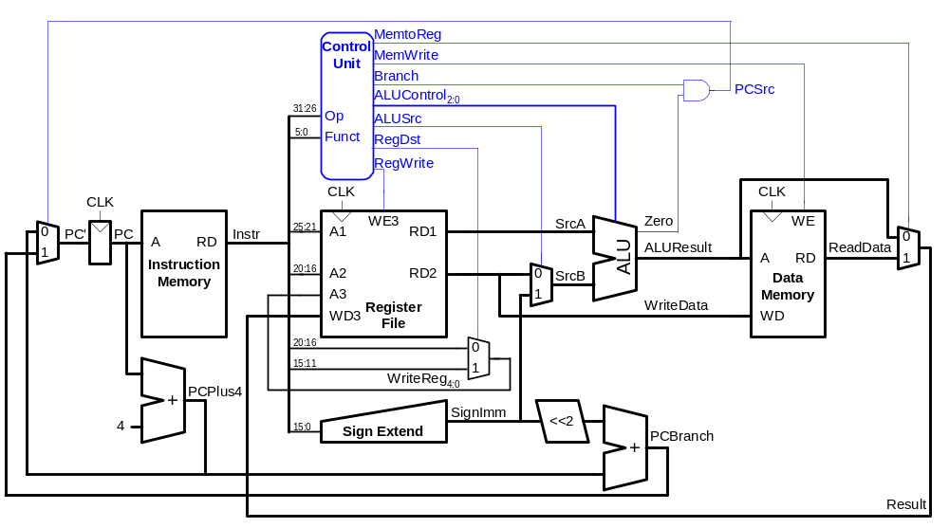
Single-Cycle Control
Copyright © 2007 Elsevier
7-<<number>>

Slide 25
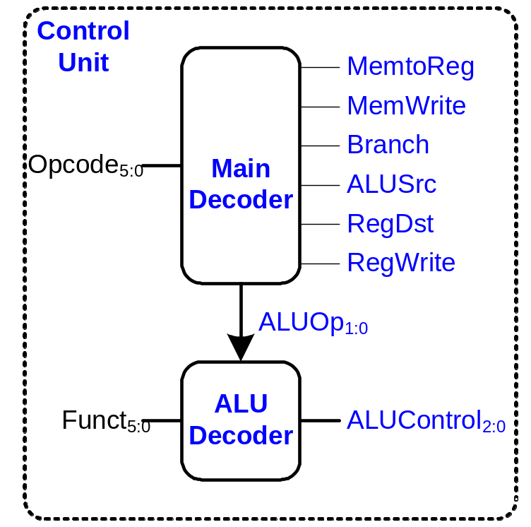
Control Unit
Copyright © 2007 Elsevier
7-<<number>>

Slide 26
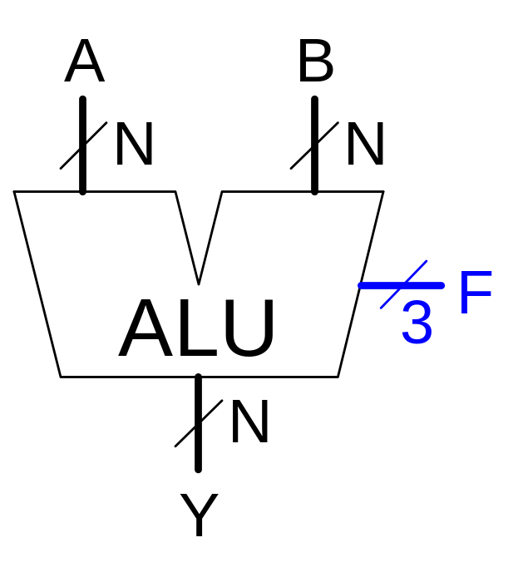
Review: ALU
F_{2:0} | Function
000 | A & B
001 | A | B
010 | A + B
011 | not used
100 | A & B
101 | A | ~B
110 | A - B
111 | SLT
Copyright © 2007 Elsevier
7-<<number>>

Slide 27
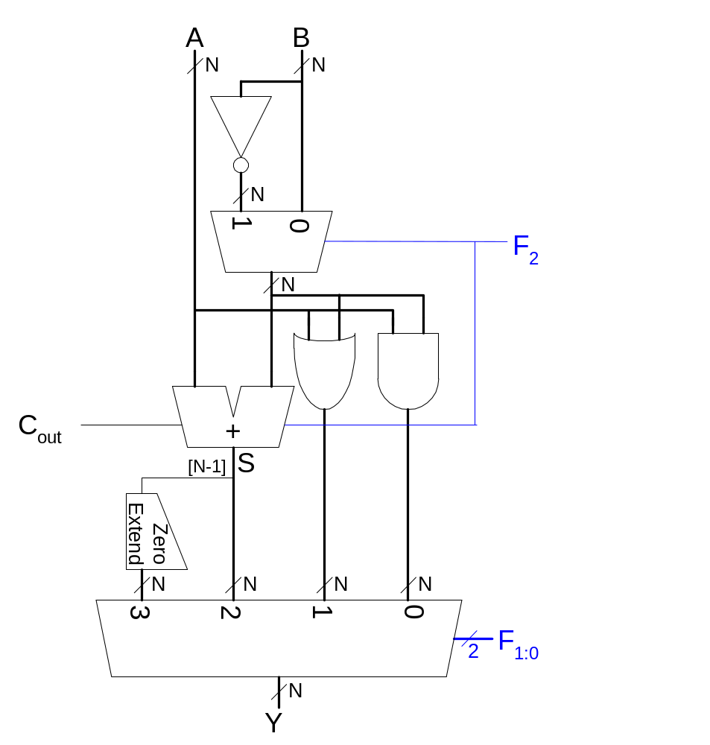
Review: ALU
Inverting or not ?
Copyright © 2007 Elsevier
7-<<number>>

Slide 28
Control Unit: ALU Decoder
ALUOp_{1:0} | Meaning
00 | Add
01 | Subtract
10 | Look at Funct
11 | Not Used
ALUOp_{1:0} | Funct | ALUControl_{2:0}
00 | X | 010 (Add)
X1 | X | 110 (Subtract)
1X | 100000 (add) | 010 (Add)
1X | 100010 (sub) | 110 (Subtract)
1X | 100100 (and) | 000 (And)
1X | 100101 (or) | 001 (Or)
1X | 101010 (slt) | 111 (SLT)
Copyright © 2007 Elsevier
7-<<number>>

Slide 29
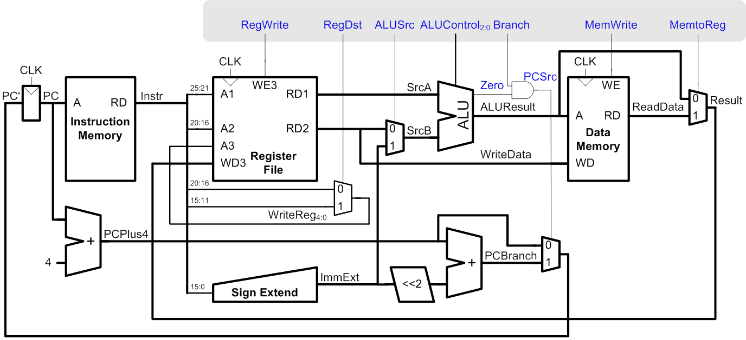
Control Unit: Main Decoder
Instruction | Op_{5:0} | RegWrite | RegDst | AluSrc | Branch | MemWrite | MemtoReg | ALUOp_{1:0}
R-type | 000000 | 1 | 1 | 0 | 0 | 0 | 0 | 10
lw | 100011 | 1 | 0 | 1 | 0 | 0 | 0 | 00
sw | 101011 | 0 | X | 1 | 0 | 1 | X | 00
beq | 000100 | 0 | X | 0 | 1 | 0 | X | 01
Copyright © 2007 Elsevier
7-<<number>>

Slide 30
Extended Functionality: addi
Instruction | Op_{5:0} | RegWrite | RegDst | AluSrc | Branch | MemWrite | MemtoReg | ALUOp_{1:0}
R-type | 000000 | 1 | 1 | 0 | 0 | 0 | 0 | 10
lw | 100011 | 1 | 0 | 1 | 0 | 0 | 0 | 00
sw | 101011 | 0 | X | 1 | 0 | 1 | X | 00
beq | 000100 | 0 | X | 0 | 1 | 0 | X | 01
Copyright © 2007 Elsevier
7-<<number>>

Slide 31
Control Unit: Main Decoder
Instruction | Op_{5:0} | RegWrite | RegDst | AluSrc | Branch | MemWrite | MemtoReg | ALUOp_{1:0}
R-type | 000000 | 1 | 1 | 0 | 0 | 0 | 0 | 10
lw | 100011 | 1 | 0 | 1 | 0 | 0 | 1 | 00
sw | 101011 | 0 | X | 1 | 0 | 1 | X | 00
beq | 000100 | 0 | X | 0 | 1 | 0 | X | 01
addi | 001000 | 1 | 0 | 1 | 0 | 0 | 0 | 00
Copyright © 2007 Elsevier
7-<<number>>

Slide 32
Extended Functionality: j
Copyright © 2007 Elsevier
7-<<number>>

Slide 33
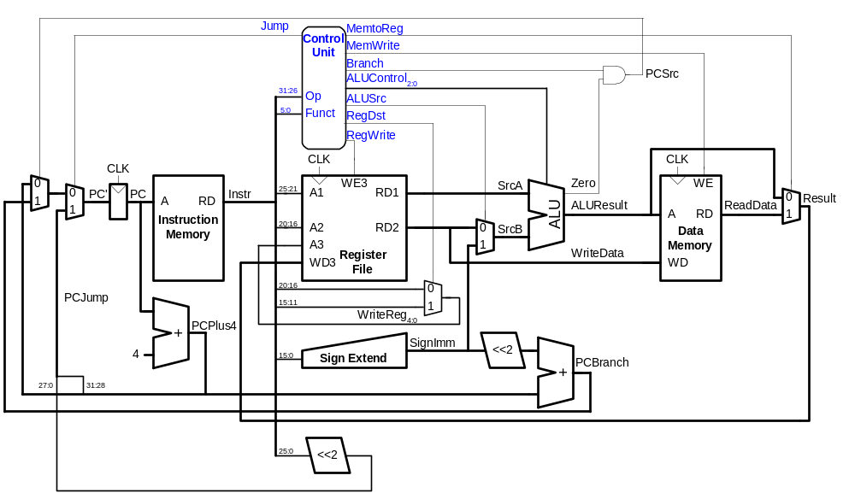
Extended Functionality: j
Copyright © 2007 Elsevier
7-<<number>>

Slide 34
Control Unit: Main Decoder
Instruction | Op_{5:0} | RegWrite | RegDst | AluSrc | Branch | MemWrite | MemtoReg | ALUOp_{1:0} | Jump
R-type | 000000 | 1 | 1 | 0 | 0 | 0 | 0 | 10 | 0
lw | 100011 | 1 | 0 | 1 | 0 | 0 | 1 | 00 | 0
sw | 101011 | 0 | X | 1 | 0 | 1 | X | 00 | 0
beq | 000100 | 0 | X | 0 | 1 | 0 | X | 01 | 0
addi | 001000 | 1 | 0 | 1 | 0 | 0 | 0 | 00 | 0
j | 000100 | 0 | X | X | X | 0 | X | XX | 1
Copyright © 2007 Elsevier
7-<<number>>

Slide 35
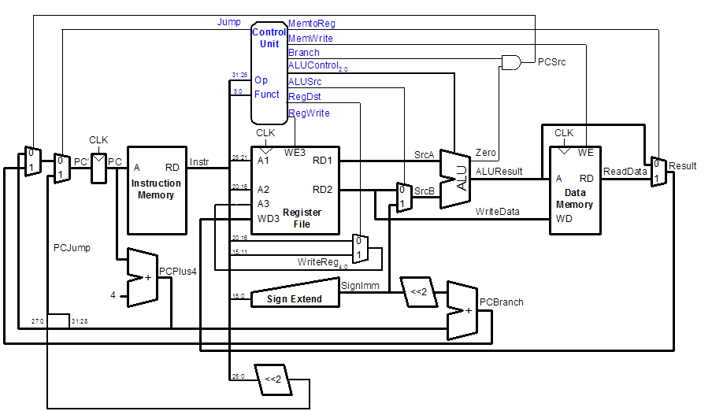
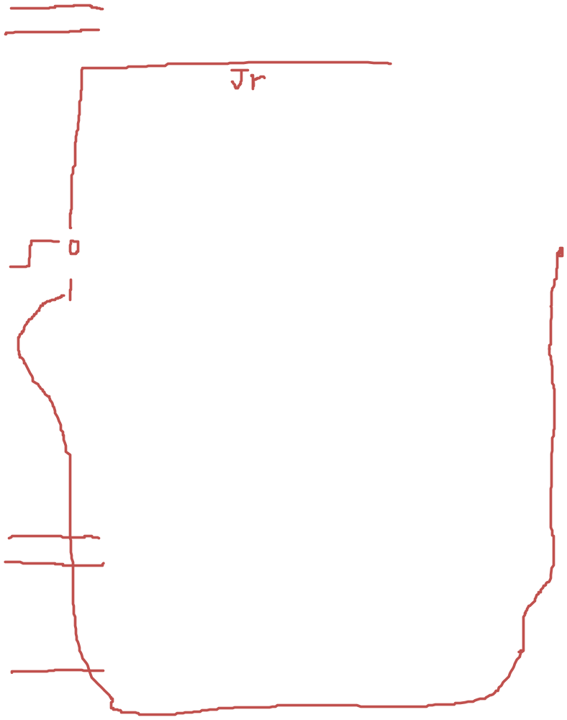
Extended Functionality: jr
jr $r ;; PC <- $r
Copyright © 2007 Elsevier
7-<<number>>

Slide 36
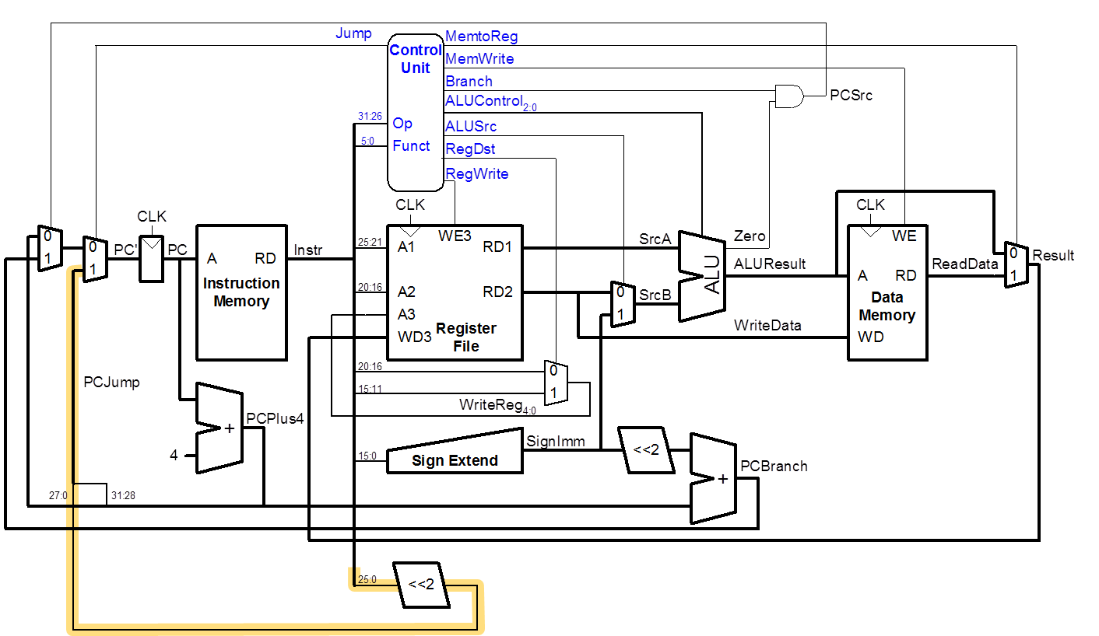
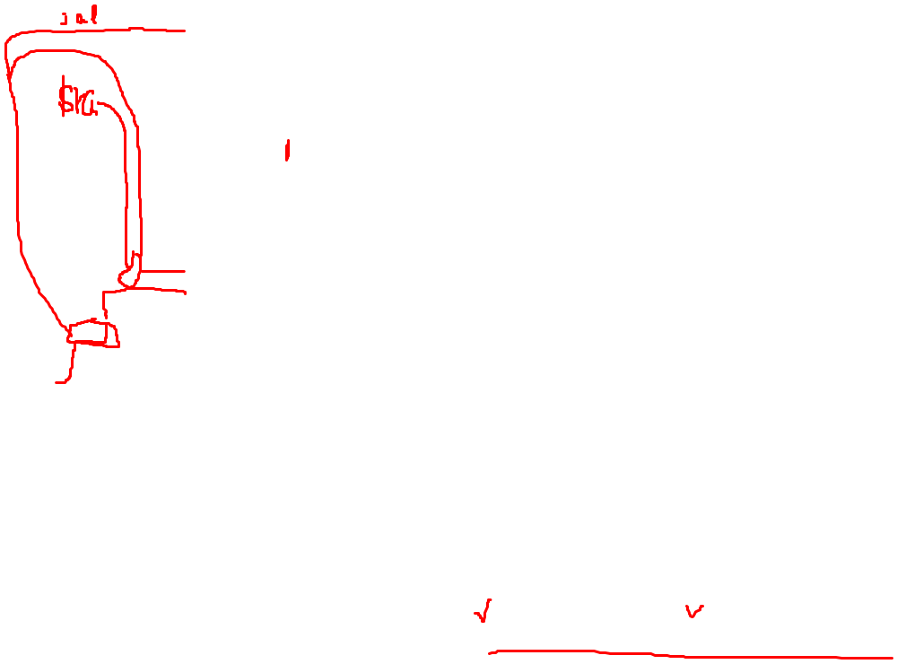
Extended Functionality: jal
Jal simple
= $ra <- PC + 4;
jump simple
Copyright © 2007 Elsevier
7-<<number>>

Slide 37
Single-Cycle Performance
How fast is the single-cycle processor?
Copyright © 2007 Elsevier
7-<<number>>

Slide 38
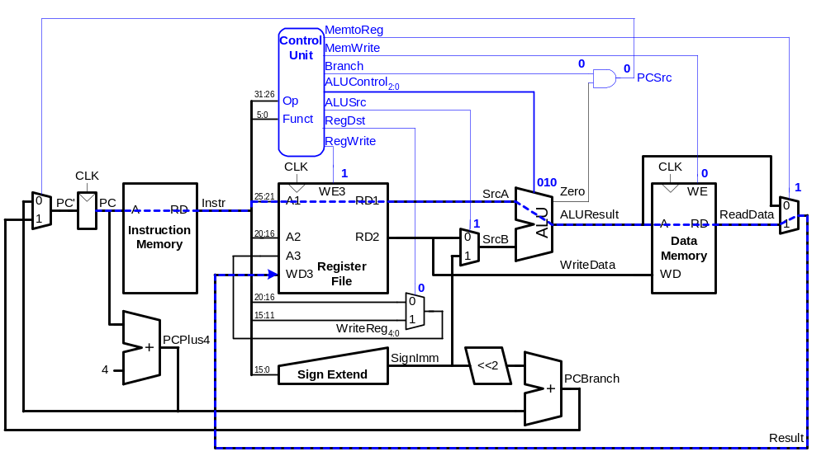
Single-Cycle Performance
Clock cycle time is limited by the critical path (lw)
Copyright © 2007 Elsevier
7-<<number>>

Slide 39
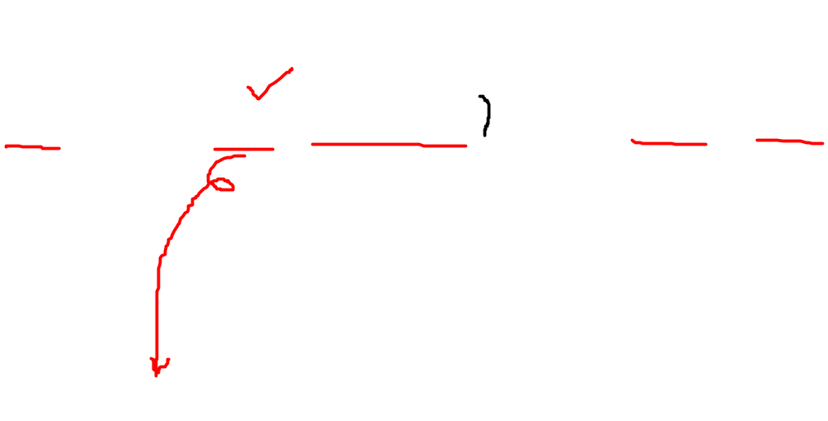
Single-Cycle Performance
Single-cycle critical path:
T_{c} = t_{pcq_PC} + t_{mem} + max(t_{RFread}, t_{sext}) + t_{mux} + t_{ALU} + t_{mem} + t_{mux} + t_{RFsetup}
In most implementations, limiting paths are: memory, ALU, register file. Thus,
T_{c} = t_{pcq_PC} + 2t_{mem} + t_{RFread} + 2t_{mux} + t_{ALU} + t_{RFsetup}
Copyright © 2007 Elsevier
7-<<number>>

Slide 40
Single-Cycle Performance Example
Element | Parameter | Delay (ps)
Register clock-to-Q | t_{pcq_PC} | 30
Register setup | t_{setup} | 20
Multiplexer | t_{mux} | 25
ALU | t_{ALU} | 200
Memory read | t_{mem} | 250
Register file read | t_{RFread} | 150
Register file setup | t_{RFsetup} | 20
T_{c} = t_{pcq_PC} + 2t_{mem} + t_{RFread} + 2t_{mux} + t_{ALU} + t_{RFsetup}
= [30 + 2(250) + 150 + 2(25) + 200 + 20] ps
= 950 ps
Copyright © 2007 Elsevier
7-<<number>>

Slide 41
Single-Cycle Performance Example
For a program with 100 billion instructions executing on a single-cycle MIPS processor,
Execution Time = (# instructions)(cycles/instruction)(seconds/cycle)
= (100 × 10⁹)(1)(950 × 10⁻¹² s)
= 95 seconds
Copyright © 2007 Elsevier
7-<<number>>

