Slide 1
CenterNet
20145170 정재민

Slide 2
Abstract
Most successful object detectors find all potential object locations and classify each. This is wasteful, inefficient, and requires additional post-processing. So this paper takes a different approach.
This paper models a single point, which is the center point of the bounding box. The detector of this paper finds the center point using keypoint estimation and regression to the attributes of all other object such as size, 3D position, orientation and attitude

Slide 3
MS COCO dataset
Resnet : 142 FPS / 28.1 AP
DLA34 : 52 FPS / 37.4 AP
Hourglass-104 : 1.4 FPS / 45.1 AP
estimate the 3D bounding box in the KITTI benchmark and calculate the human posture in coco
KITTI : http://www.cvlibs.net/datasets/kitti/eval_object.php?obj_benchmark=3d
COCO : http://cocodataset.org/#download

Slide 4
Introduce
Post processing is difficult to distinguish and difficult to train. Therefore, most detectors are not capable of end-to-end training. Neverthless, it was a good success.
Sliding window based object detectors are wasted because they need to locate all possible objects. So this paper explains the alternatives

Slide 5
object detection is a standard keypoint estimation problem.
Just input the image to the convolution network that generates the heat map. The peaks of this heatmap correspond to the center of the object, and the image features of each peaks predict the height and thickness of the bounding box.
This paper provides experiments for 3D object detection and multi-person posture estimation by predicting additional outputs at each center point.

Slide 6
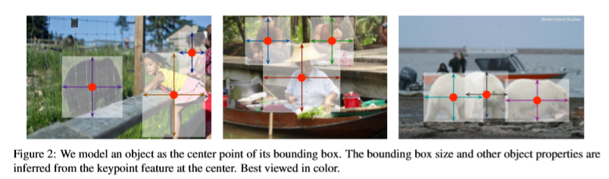

Slide 7
Related work
This paper is closely related to anchor However, there are some important differences.
CenterNet assigns an anchor based on the position of the box, not the overlap. There are no thresholds for foreground and background.
NMS is not required because there is only one anchor per object. Simply extract the peak from the keypoint hit map.
CenterNet uses a large output resolution compared to existing object detector. This eliminates the need for multiple anchors

Slide 8
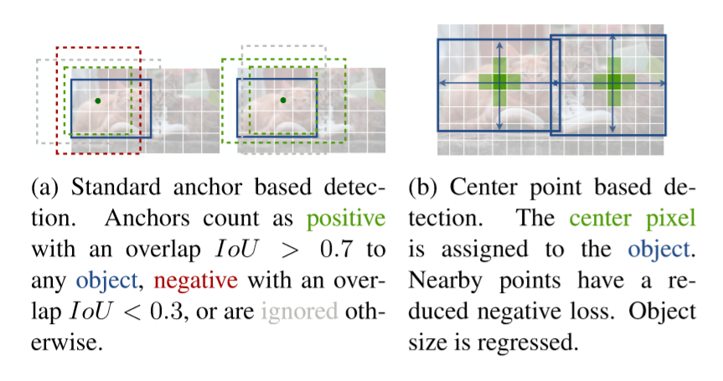

Slide 9





Preliminary
Image
W : width
H : height
R: output stride
C : number of keypoint type
The keypoint types include C=17(human joints) in estimating human postures, and C=80 in object detection
Use several fully convolution encoder-decoder networks to predict Y from image I
Keypoint heatmap
Keypoint
Background

Slide 10




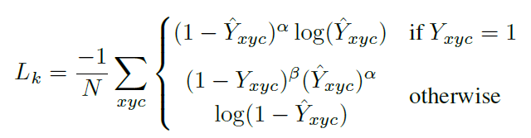
Each ground truth keypoint
Compute the low-resolution
gaussian kernel
Use gaussian to place all ground truth keypoint in the heat map. Where σ(p) is the object size-adaptive standard deviation. If two gaussian overlap in the same class, take the maximum value per element. The training objective is a penalty-reduced pixelwise logistic regression with focal loss.
α,β : focal loss hyper parameter
N : the number of keypoints in image I
According to low and deng
α : 2 β : 4
Focal loss
In one-stage object detection, it is designed to solve extreme severe imbalances between foreground and background classes (eg 1: 1000).

Slide 11

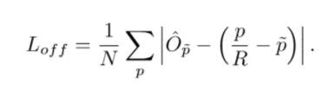
offset prediction : L1 loss
To further recover the mathematical error caused by the output stride,
We further estimate the local offset for each center point
The offset is trained with L1 loss
L1 loss = sum of | actual value – predicted value |

Slide 12

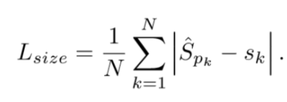

Objects as Points
For each object, regression to
S(k) = ((x2-x1),(y2-y1)) (w,h)
Use the original pixel coordinates directly, without standardizing the scale. Instead, adjust the loss to a constant λsize.
λsize : 0.1
λsoff : 1
keypoint Y ', offset O', size S '.
The network predicts a total of C + 4 outputs at each location
L1 loss

Slide 13
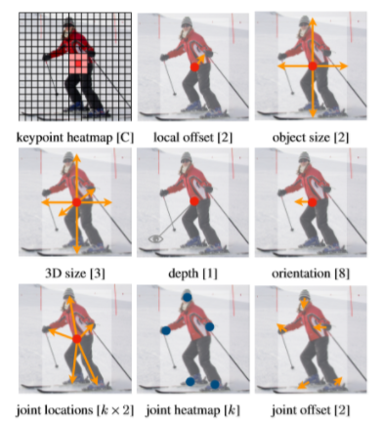

Slide 14



3D detection
Three additional attributes per center point (depth, 3D size and orientation) are required.
orientation
The direction is basically a single scalar, but it is difficult to regress.
Two bin represent directions. Specifically, the direction is encoded using 8 scalar and 4 scalar. For one bin, two scalars are used for the softmax class and the remaining two scalars are returned in angles within each bin.
σ is sigmoid function
Depth
3D size
, L1 loss

Slide 15

Human pose estimation
Estimating the human posture aims to estimate k 2D human joint positions for all people (COCO k = 17).
Parameterize each keypoint in a way that is spaced from the center point.
Joint offset regression
, L1 loss

Slide 16
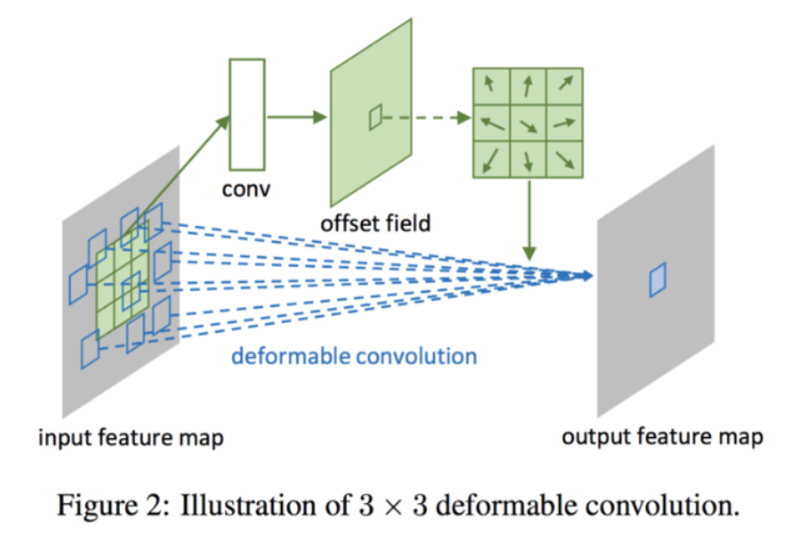

Slide 17
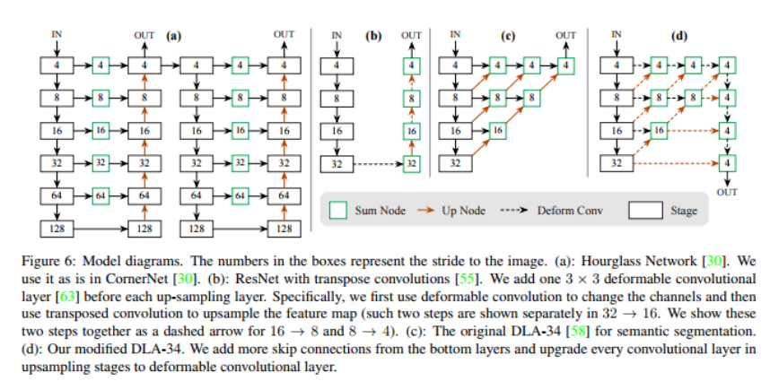
Model

Slide 18
Hourglass
The stacked Hourglass Network [30, 40] downsamples the input by 4X, followed by two sequential hourglass modules. Each hourglass module is a symmetric 5-layer down- and up-convolutional network with skip connections.

Slide 19
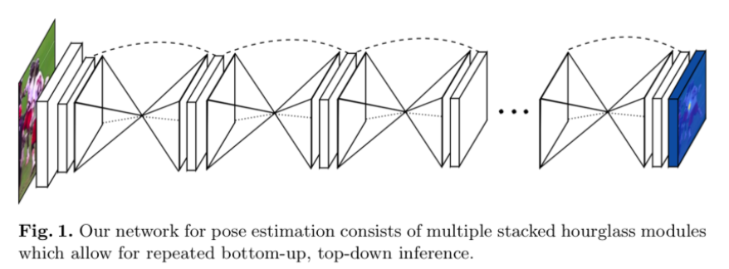

Slide 20
ResNet
We used three up-convolution networks to enhance the residual network for high-resolution output
To save the calculation, first change the channels of the three upsampling layers to 256, 128, and 64, respectively.
Then add a 3x3 deformable convolution layer before each up-convolution. The up-convolution kernel is initialized with linear interpolation

Slide 21
DLA
Deep Layer Aggregation (DLA) is an image classification network that uses hierarchical skip connections.
We use a fully convolution upsampling version of DLA for density prediction and use deep aggregation repeatedly to increase the resolution of the feature map
Use a deformable convolution layer from low layer to output to enhance skip connection. Specifically, we change the original convolution from all upsampling layers to 3x3 deformable convolution layers.

Slide 22
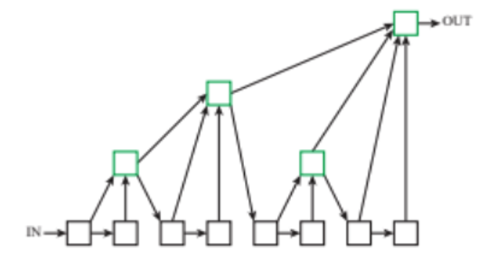

Slide 23
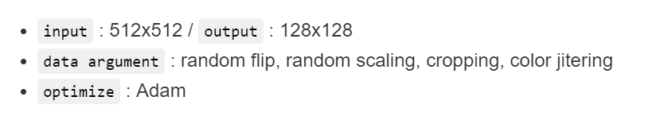
Training

Slide 24
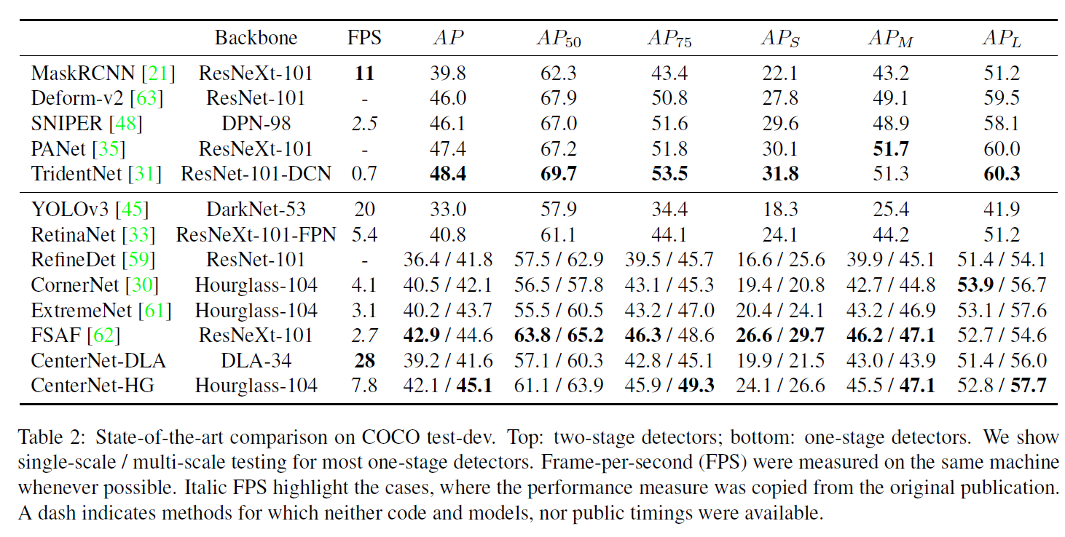

Slide 25
Conclusion
Present a new representation of the object as a point. Find the center of the object and return its size. This algorithm is simple, fast, accurate and end-to-end differentiation without NMS post-processing.

