Slide 1
CenterNet
20145170 정재민

Slide 2
Abstract
Most successful object detectors find all potential object locations and classify each. This is wasteful, inefficient, and requires additional post-processing. So this paper takes a different approach.
This paper models a single point, which is the center point of the bounding box. The detector of this paper finds the center point using keypoint estimation and regression to the attributes of all other object such as size, 3D position, orientation and attitude

Slide 3
MS COCO dataset
Resnet : 142 FPS / 28.1 AP
DLA34 : 52 FPS / 37.4 AP
Hourglass-104 : 1.4 FPS / 45.1 AP
estimate the 3D bounding box in the KITTI benchmark and calculate the human posture in coco
KITTI : http://www.cvlibs.net/datasets/kitti/eval_object.php?obj_benchmark=3d
COCO : http://cocodataset.org/#download

Slide 4
Introduce
Post processing is difficult to distinguish and difficult to train. Therefore, most detectors are not capable of end-to-end training. Neverthless, it was a good success.
Sliding window based object detectors are wasted because they need to locate all possible objects. So this paper explains the alternatives

Slide 5
object detection is a standard keypoint estimation problem.
Just input the image to the convolution network that generates the heat map. The peaks of this heatmap correspond to the center of the object, and the image features of each peaks predict the height and thickness of the bounding box.
This paper provides experiments for 3D object detection and multi-person posture estimation by predicting additional outputs at each center point.

Slide 6
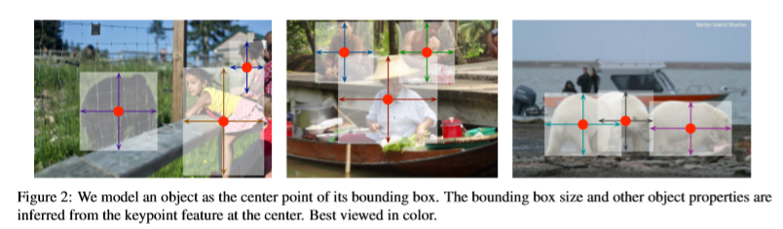

Slide 7
Related work
This paper is closely related to anchor However, there are some important differences.
CenterNet assigns an anchor based on the position of the box, not the overlap. There are no thresholds for foreground and background.
NMS is not required because there is only one anchor per object. Simply extract the peak from the keypoint hit map.
CenterNet uses a larget output resolution compared to existing object detector. This eliminates the need for multiple anchors

Slide 8
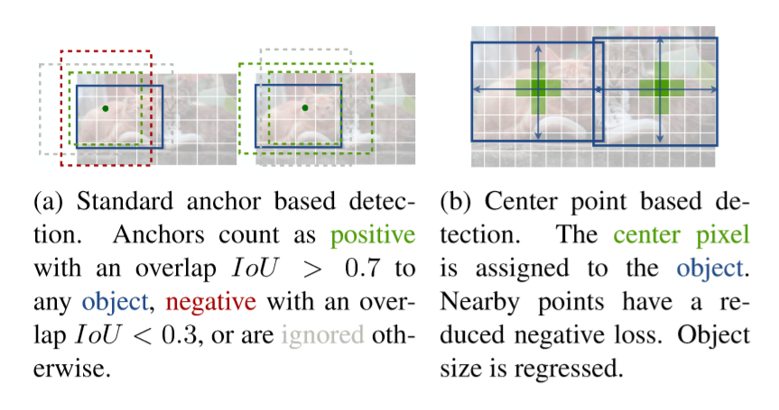

Slide 9





Preliminary
Image
W : width
H : height
R: output stride
C : number of keypoint type
The keypoint types include C=17(human joints) in estimating human postures, and C=80 in object detection
Use several fully convolution encoder-decoder networks to predict Y from image I
Keypoint heatmap
Keypoint
Background

Slide 10



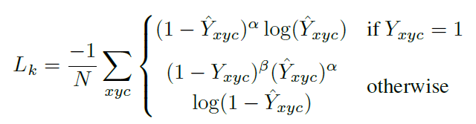
Each ground truth keypoint
Compute the low-resolution
gaussian kernel
Use gaussian to place all ground truth keypoint in the heat map. Where σ(p) is the object size-adaptive standard deviation. If two gaussian overlap in the same class, take the maximum value per element. The training objective is a penalty-reduced pixelwise logistic regression with focal loss.
α,β : focal loss hyper parameter
N : the number of keypoints in image I
According to low and deng
α : 2 β : 4

