Slide 1
ENGINEERING REVIEW
Catch release blockers while the change is still small
A proposal to run release checks on every pull request
Presenter Name · Platform team · 2026-10
Notes:
Today I am asking for one decision: a four-week pilot that moves our release checks from the release branch to every pull request.

Slide 2
AGENDA
Three questions decide whether the pilot is worth it
01
Where release blockers are found today
02
What changes when checks run per pull request
03
What the pilot costs and how we judge it
2
Notes:
We will answer three questions in order.

Slide 3
01
Where blockers are found today
Notes:
First, where we find release blockers now.

Slide 4
CURRENT STATE
Most blockers surface only after the branch is cut
71%
2.4 days
3 of 4
found on the release branch
median delay per blocker
blockers trace to one change
Illustrative figure for the sample deck
From detection to merged fix
The rest combine two or more changes
Source: Illustrative data, sample deck
4
Notes:
Most blockers appear late, and each one costs more than two days.

Slide 5
CURRENT STATE
The later a blocker is found, the longer the fix takes
Median hours to fix
Fixing on the release branch takes 10x longer than fixing in the pull request.
Source: Illustrative data, sample deck
5
Notes:
The release branch is where the cost jumps.

Slide 6
02
What changes per pull request
Notes:
Next, what the change looks like.

Slide 7
PROPOSAL
The same checks run earlier, on a smaller change
Today
→
Proposed
Checks run once, on the release branch
Checks run on every pull request
A failure blocks every change in the release
A failure blocks only that change
The author has moved on to other work
The author fixes it while the context is fresh
7
Notes:
Nothing about the checks changes; only when they run.

Slide 8
PROPOSAL
A pull request passes four gates before merge
01
02
03
04
Build
Contract tests
Migration dry run
Review
Compile and package exactly as the release does
Verify public interfaces against consumers
Apply schema changes to a production snapshot
Merge only when all three checks pass
8
Notes:
The migration dry run is the new gate; the others exist today.

Slide 9
PROPOSAL
Checks run in an isolated runner, never against production
CI environment
Pull request
on push
Check runner
isolated
dry run
Snapshot DB
masked copy
Check report
pass / fail
Merge gate
The runner reads a masked snapshot; it holds no production credentials.
9
Notes:
This is the only new infrastructure, and it never touches production.

Slide 10
COST
The pilot needs one runner pool and two weeks of setup
Item | Option A — shared pool | Option B — per team
Runner capacity | Shared 8 parallel jobs | Dedicated 4 jobs per team
Setup effort | 2 weeks one platform engineer | 3 weeks platform and each team
Monthly cost | Illustrative low reuses idle capacity | Illustrative high new capacity
Isolation | Per job sandboxed runners | Per team separate pools
10
Notes:
We recommend the shared pool for the pilot.

Slide 11
PLAN
Four weeks from setup to a go / no-go decision
Week 1
Week 2
Week 3
Week 4
Set up runners
Two teams join
Checks block merge
Decide
Shared pool and snapshot job
Checks are advisory only
For the two pilot teams
Compare blockers found and time to fix
11
Notes:
The decision point is at the end of week four.

Slide 12
DECISION
We judge the pilot on three measures agreed in advance
The pilot continues only if the measures improve without slowing merges.
Share of blockers found before merge — target: a clear majority
Median time to fix — target: lower than on the release branch
Median time to merge — must not grow by more than a small margin
Measured on the same two teams
before and during the pilot
12
Notes:
These measures are agreed now so the result is not argued afterwards.

Slide 13
APPENDIX
Teams opt in with one line in their pipeline file
checks:
release-gates: enabled # build, contract tests, migration dry run
13
Notes:
Opting in is one line.

Slide 14
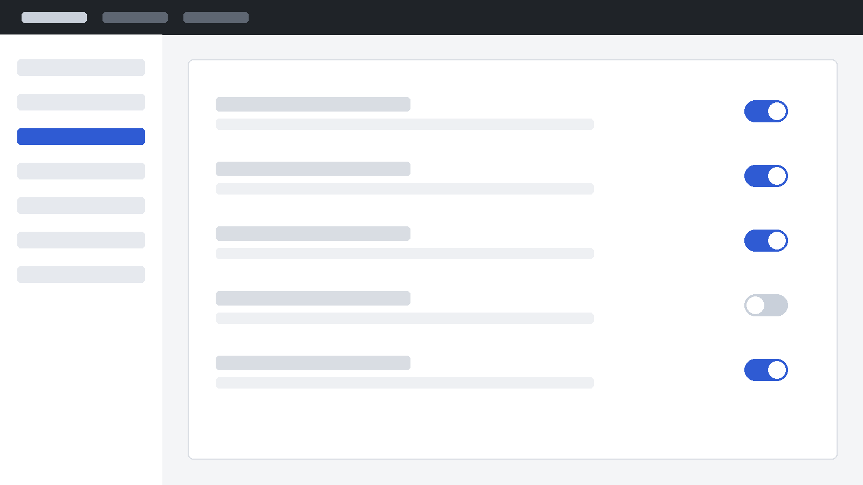
APPENDIX
Each gate can be switched off per repository while teams adopt it
Wireframe of the pipeline settings screen; one gate is switched off.
14
Notes:
Teams keep control during the pilot; any gate can be turned off.

Slide 15
APPENDIX
Each role gets something concrete from the pilot
Authors
Reviewers
Release managers
A failing check points at their own change, while it is still fresh
Reviews start from a change that already builds and migrates
Release week stops being the first time the checks run together
15
Notes:
The biggest relief is for release managers.

Slide 16
“We stopped dreading release week once failures arrived one change at a time.”
Team lead · illustrative quote for the sample deck
Notes:
Replace with a real, approved quote or delete the slide.

Slide 17
THE ASK
Approve a four-week pilot with two teams.
We return with the three measures and a go / no-go recommendation.
Notes:
That is the decision I am asking for today.

Slide 18
Thank you
Questions and discussion
platform-team@example.com
Notes:
Thank you.

