Slide 1

bayesmeta
priming
Notes:
https://cran.r-project.org/web/packages/bayesmeta/vignettes/bayesmeta.html

Slide 2
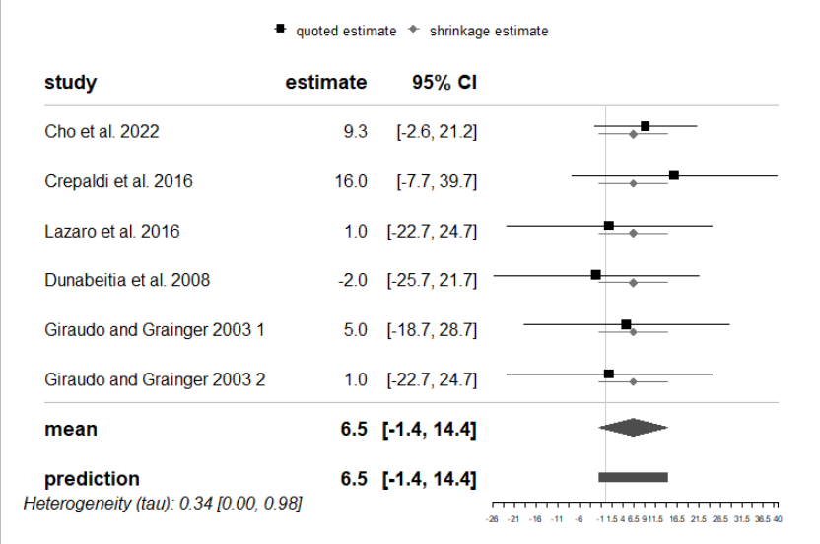
orthographic priming
Notes:
The performed analysis allows to update our information on the θiθi; these shrinkage estimates are shown along with the original data as grey horizontal lines.

Slide 3
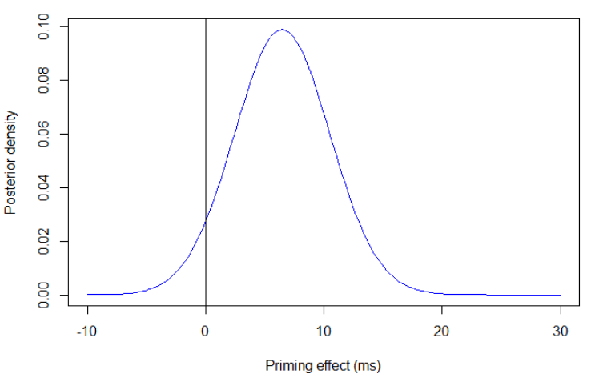
orthographic priming
bma$summary
tau mu theta
mode 0.0000000 6.466207 6.466347
median 0.3360284 6.466173 6.466224
mean 0.3975045 6.466157 6.466157
sd 0.3003206 4.034005 4.036638
95% lower 0.0000000 -1.440375 -1.445775
95% upper 0.9764538 14.372667 14.378040

Slide 4
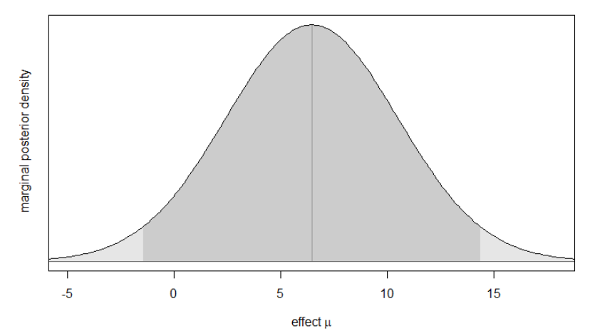
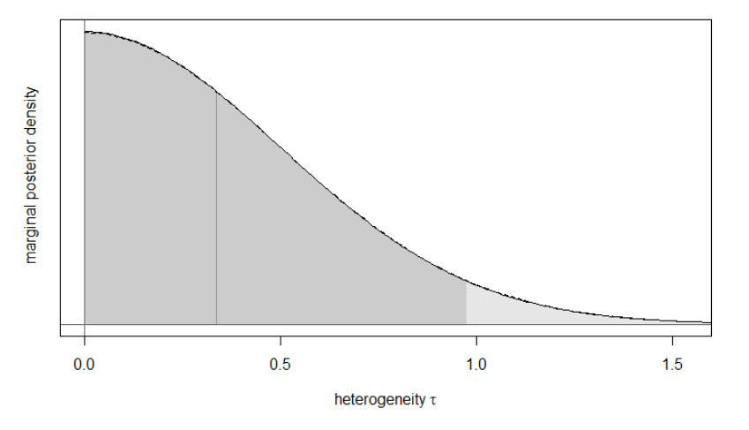
orthographic priming

Slide 5
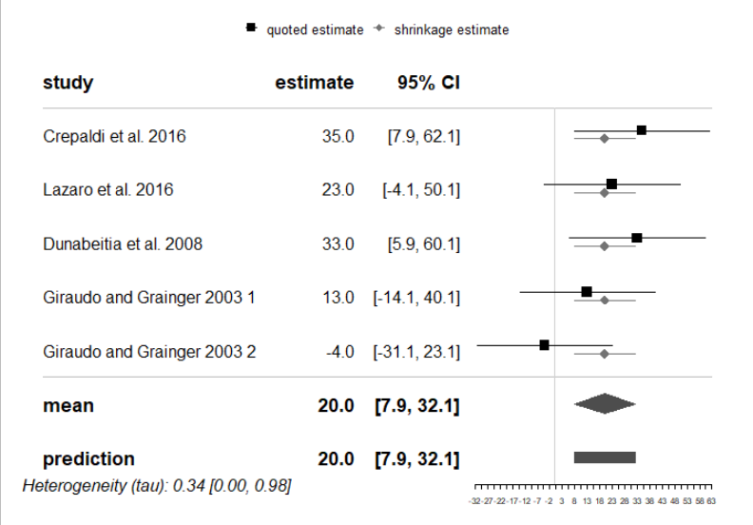
Derivational morpheme

Slide 6
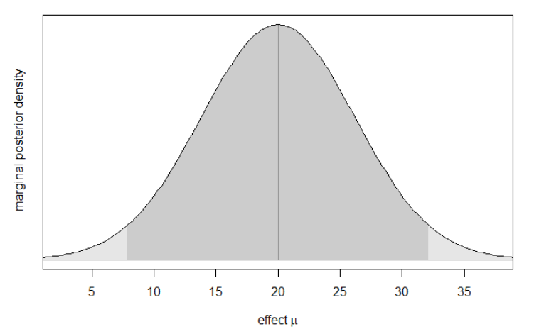
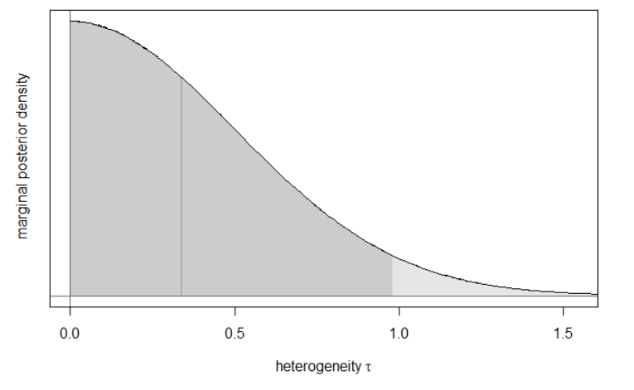
Derivational morpheme

