Slide 1
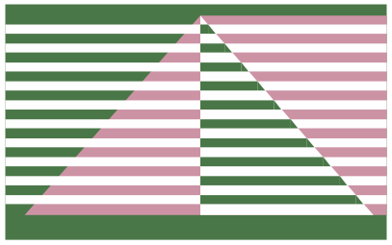






When Mitigations Backfire: Timing Channel Attacks and Defense for PRAC-Based RowHammer Mitigations
Jeonghyun Woo
Joyce Qu, Gururaj Saileshwar, Prashant J. Nair
ISCA 2025
Tokyo, Japan

Slide 2


The RowHammer Vulnerability
RowHammer
RowHammer Threshold: Min. Required Activations for Bit-Flips
DRAM Row
DRAM Row
Victim Row
14X Drop in Threshold
DRAM Row
Victim Row
DRAM Row
ACT
Aggressor Row
DRAM Row
Victim Row
DRAM Row
Victim Row
DRAM Row

Slide 3




The RowHammer Vulnerability: RowHammer Attacks
RowHammer Threshold: Min. Required Activations for Bit-Flips
Security Breaches
14X Drop in Threshold
Performance Degradation (Denial-of-Service)
ML Model Corruption

Slide 4
Per Row Activation Counting (PRAC)
Memory Controller
1
Per-Row Activation Counters
RFM_{ab}
Alert
CNT
2
Alert Back-Off (ABO) Protocol
CNT
CNT
Activation Count ≥ Back-Off Threshold (N_{BO})
CNT
CNT
DRAM Bank
PRAC Offers Robust RowHammer Protection Even at Sub-100 Thresholds

Slide 5

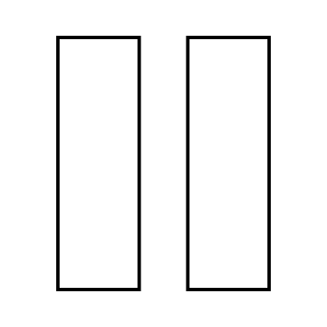
PRAC: Counter Updates & Alert Back-Off Protocol
Activation Counter Updates
Alert Back-Off Protocol
Memory Controller
Memory Controller
350ns
ACT
RFM_{ab}
Alert
Row
0
REF
Row
0
Row
0
REF
Row
0
Row
0
1
Row
1
10
10
ACT
REF
0
Row
0
REF
Row
0
Row
0
REF
Row
0
DRAM Bank
DRAM Bank
Back-Off Threshold: 10

Slide 6





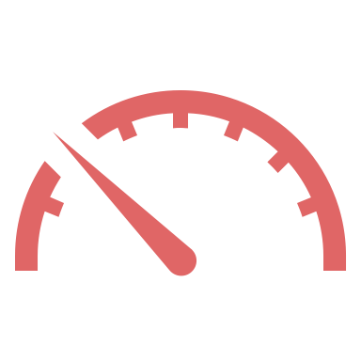
Timing Difference Due to ABO-Triggered RFM
Memory Latency Without RFM
Memory Latency During RFM
Core 0
Core 1
Core 0
Core 1
Memory Controller
Memory Controller
RFM_{ab}
Alert
350ns
Fast
Slow
RFM Due to ABO → Introduces a Noticeable System-Wide Latency Spike

Slide 7
Timing Difference Due to ABO-Triggered RFM
Memory Latency With Victim Activity
Memory Latency Without Victim Activity
Alert Back-Off (ABO)
ABO-Triggered RFM: Activity-Dependent → Activity-Based Timing Channel

Slide 8
PRAC Timing Channels: Uniquely Precise
Core 0
Core 1
Activation-Count-Based Channel: Leak Exact # of Victim ACTs
Memory Controller
Row
1
Share Same DRAM Row
RFM_{ab}
ACT
ACT
Alert
Row
Bank
Bank
Bank
Bank
2
Victim: X ACTs
Row
70
Attacker
Victim
X
X = 30
3
Attacker: ACTs until ABO
Row
Back-Off Threshold (N_{BO}): 100
Row
4
Leak Victim ACTs: N_{BO} - 70
Activation-Count-Based Channel → Leak Exact # of Victim Activations

Slide 9

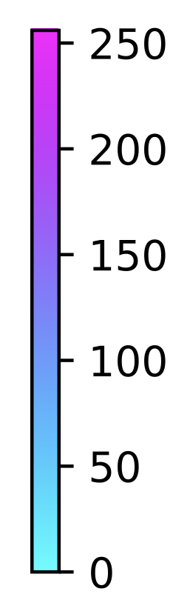


PRACLeak Side-Channel Attacks
AES T-Tables Attacks: Chosen Plaintext Attack on First AES Round
Attacker Activations to Row Triggering the First RFM
Victim Activations
Row 0
Other Rows
Observing Row Incurs First RFM → Leaks Secret Key and Victim Activities
8

Slide 10
PRACLeak Covert-Channel Attacks
123.6 Kbps
41.4 Kbps
Activation-Count-Based Channel Transmits Multiple Bits → Higher Bitrates

Slide 11

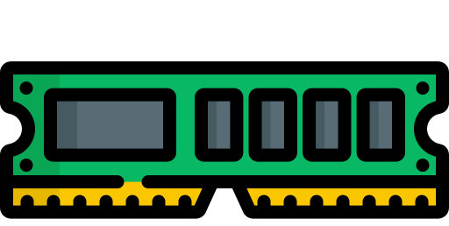


Vulnerability of PRAC Timing Channels
Why Care About PRAC Timing Channels?
Cache
Row Buffer
Performance-Driven
Performance-Driven Channels: Safely Closed with Performance Overhead

Slide 12

Not All Timing Channels Are Equal!
Memory Controller
RFM_{ab}
Alert
Row
CNT
Row
CNT
Row
CNT
Cache
Row Buffer
PRAC
Performance-Driven
Security-Driven
Disabling PRAC to Close Timing Channels → Vulnerable to RowHammer
PRAC Must Remain Active → Important to Prevent

Slide 13

Timing-Safe PRAC: Activity-Independent Mitigation
Key Idea: Proactively issue activity-independent RFMs to eliminate RFMs triggered by ABO
Back-Off Threshold
: Row Activation
TB-RFM: Timing-Based RFM
TB-RFM
TB-RFM
TB-RFM
ABO-RFM
ABO-RFM: RFM Triggered by ABO
TB-Window
TB-Window
TB-Window
Timing-Based RFM: Proactively Issue RFMs Independent of Activation
Eliminates ABO-Triggered RFM (ABO-RFM) → Close Timing Channels

Slide 14
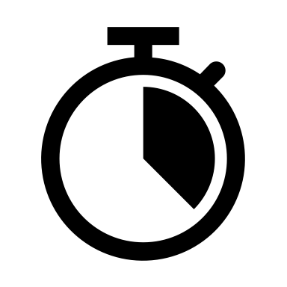

Design of Timing-Safe PRAC (TPRAC)
DRAM Bank with PRAC
Memory Controller
DRAM Array
RFM Interval Register
Mitigation Queue
Activate
TB-RFM
Row ID
CNT
TB-Window
Mitigation
Tracking
: Row Activation
Single-Entry Mitigation Queue
TB-RFM
TB-RFM
TB-RFM
TB-Window ∝ RowHammer Threshold
Time
TB-Window
TB-Window
TB-Window
RH Threshold = 1024 → TB-Window = 6.2 us (1.6 tREFI)
Please See Paper for How to Tune TB-window for each RH Threshold

Slide 15

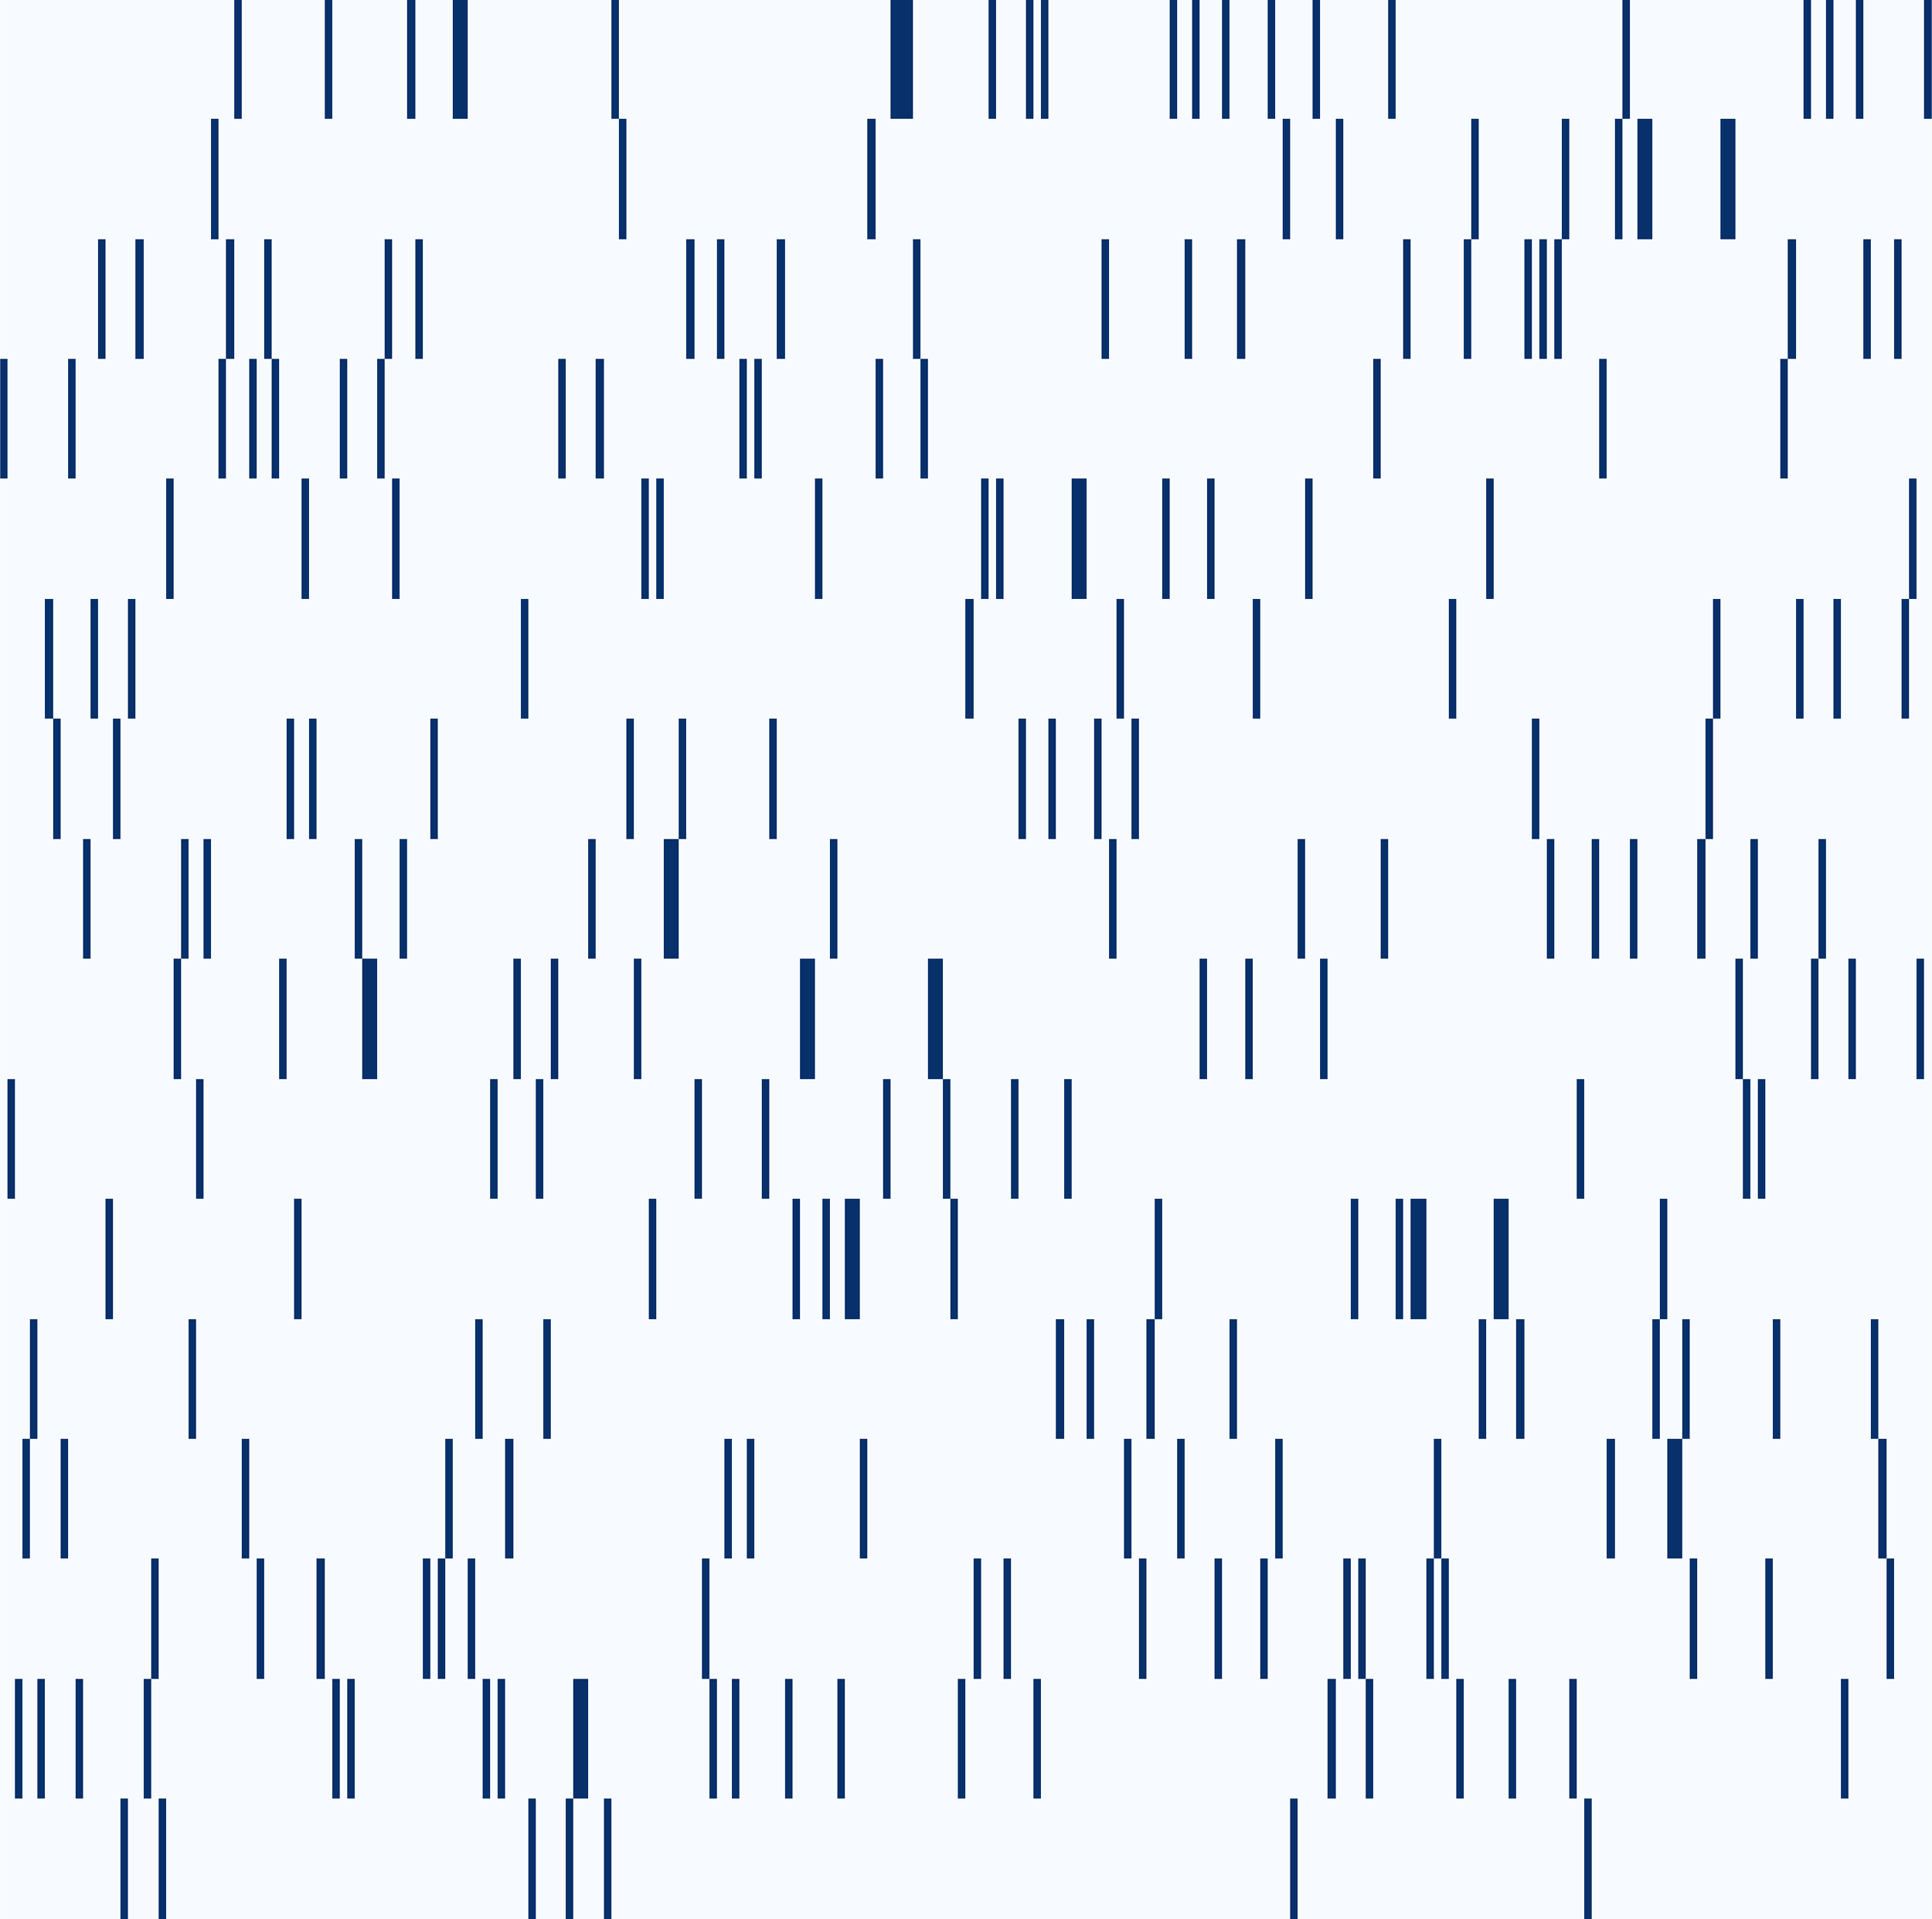
TPRAC: Empirical Security Validation
Row Triggering First RFM for Attacker
Baseline PRAC
With TPRAC
TB-RFMs: Eliminate RFMs Caused by ABO → Prevent Timing Channels
Please See the Paper for Detailed Security Analysis

Slide 16
TPRAC: Performance Results
Targeted Refresh: Perform RowHammer Mitigation During Periodic Refresh (tRFC)
RowHammer Threshold (N_{RH}) = 1024
TPRAC: Timing-Based RFMs → Minimal Average Slowdown of 3.4%
TPRAC w/ Targeted Refresh: Skip Several Timing-Based RFMs → Improve Performance

Slide 17

More In The Paper
Paper
Detailed Security Analysis
Required TB-Window for each RowHammer Threshold
Example of how TPRAC can prevent worst-case attacks
Additional Performance Evaluations
Sensitivity to PRAC Level
Sensitivity to Targeted Refresh
Sensitivity to RowHammer Threshold
Sensitivity to Activation Counter Reset
Discussions on Alternative Mitigations
Obfuscation (Randomization)-Based Mitigations
Bank partitioning with per-bank RFM

Slide 18
Summary
PRAC Can Backfire → Activity-Dependent RFMs Create Timing Channels
PRAC Timing Channels → Security-Driven and Uniquely Precise
PRACLeak Attacks → Demonstrate Side-Channel and Covert-Channel Attacks
TPRAC: Activity-Independent Timing-Based RFM → Eliminates Timing Channels
Our Work is Open Source and Artifact Evaluated:
https://github.com/STAR-Laboratory/PRAC_TC_ISCA25

Slide 19


Thank You! Any Questions?
Paper
Homepage
Code

