Slide 1



DAPPER: A Performance-Attack-Resilient Tracker for RowHammer Defense
Jeonghyun Woo and Prashant J. Nair
HPCA 2025

Slide 2
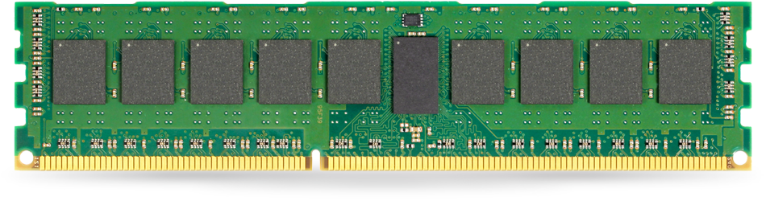
RowHammer
Victim Row
ACTIVATE (ACT)
Victim Row
Aggressor Row
Victim Row
Victim Row

Slide 3
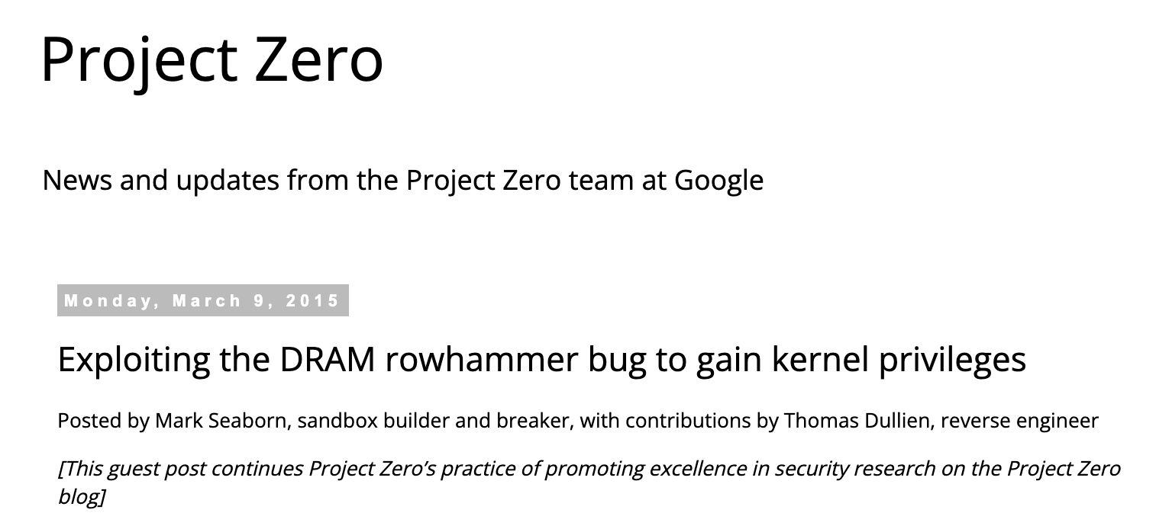


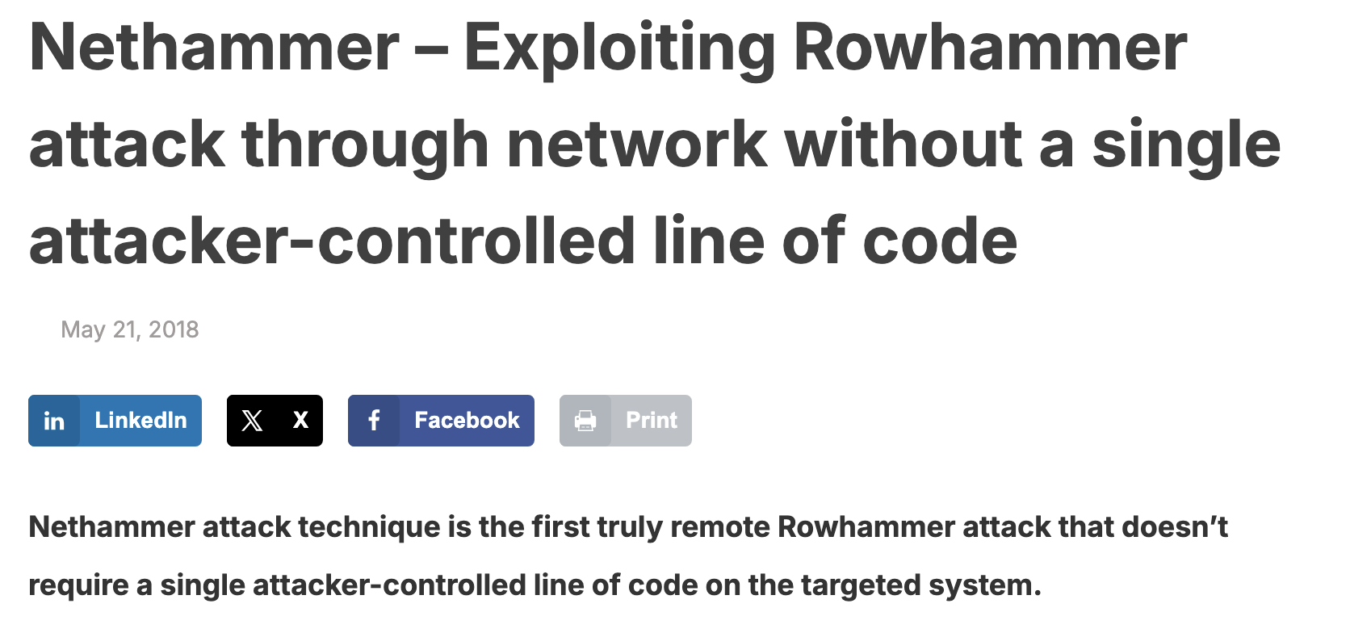
Why is RowHammer Serious?

Slide 4

RowHammer is Getting Worse
RowHammer Threshold: Min. Required Activations for Bit-Flips
14X in Threshold
Require Mitigations to Scale To Low RowHammer Thresholds
Revisiting RowHammer: an experimental analysis of modern DRAM devices and mitigation techniques [Kim+, 2020]

Slide 5
Scalable RowHammer (RH) Mitigations
1
Storing Per-Row RowHammer Counters in DRAM
START [Saxena+, 2024]
Last-Level Cache
Reserved for RH Counters
Hydra [Qureshi+, 2022]
Memory Controller
Reserved for per-row RH counters
Shared Counter Cache
DRAM

Slide 6
Scalable RH Mitigations: Using Group Counters
2
Share a RH counter Between Multiple Rows
CoMeT [Bostanci+, 2024]
Row Group
ABACUS [Olgun+, 2024]
Memory Controller
Row Group Counters
Row Group ID
Count
Row Group ID
Count
Row Group ID
Count
Row Group ID
Count
DRAM

Slide 7
Performance Attacks on Hydra and START
Problem: Each Counter Cache Miss Incurs Two Additional DRAM Accesses
START [Saxena+, 2024]
Last-Level Cache
Reserved for RH Counters
MISS
2
Fetch
Hydra [Qureshi+, 2022]
1
Update
Memory Controller
2
Fetch
Reserved for per-row RH counters
Shared Counter Cache
MISS
1
Update
DRAM
Excessive DRAM Accesses → Reduced BW for Co-Running Applications

Slide 8
Performance Attacks on CoMeT & ABACUS
Problem: Counter Resets Require Refreshing All DRAM Rows
Row Group
CoMeT [Bostanci+, 2024]
ABACUS [Olgun+, 2024]
Memory Controller
Row Group Counters
Row Group ID
Count
Refresh All DRAM Rows
Row Group ID
Count
Row Group ID
Count
Row Group ID
Count
DRAM
Frequent Counter Reset → Reduce DRAM BW for Co-running Applications

Slide 9
Perf-Attack Vulnerability of Scalable Mitigations
RowHammer Threshold = 500
Significant Slowdowns Under Performance Attacks → 60% to 90%

Slide 10
Goals
1. Designing RowHammer Mitigation Resilient to Performance Attacks
2. Ensuring Low Tracking Overhead for Scalable RowHammer Mitigations

Slide 11
DAPPER-S: Dynamic Secure Hash-Based Mapping
Key Idea: Randomize Counter Mapping Using a Dynamic Secure Hash
Row Group (RG) Counter Table
ENC/DEC (LLBC)
RG ID
Count
RG ID
Count
Change periodically (e.g., 32ms)
RG ID
Count
Key
RG ID
Count
Memory Controller
Bank 0
DRAM
Bank 31

Slide 12
DAPPER-S Operation: RGC Updates per Activation
Row Group Counter (RGC) Table
Y
RG A
1
Encryption (LLBC)
RG B
249
Y*
RG C
10
RG D
0
1
Key
Memory Controller
Bank 0
DRAM
Bank 31
Only Randomizes Counter Mapping → Does Not Affect DRAM Operations

Slide 13
DAPPER-S Operation: RowHammer Mitigation
RowHammer Threshold: 500
Row Group Counter (RGC) Table
Mitigation Threshold: 250
Y
Z
RG A
1
Encryption (LLBC)
RG B
250
Z*
249
RG C
10
RG D
0
1
Key
Memory Controller
Bank 0
DRAM
Bank 31

Slide 14
DAPPER-S Operation: RowHammer Mitigation
RowHammer Threshold: 500
Row Group Counter (RGC) Table
Mitigation Threshold: 250
RG A
1
Decryption (LLBC)
Encryption (LLBC)
RG B
0
249
B*
250
RG C
10
B*+1
RG D
0
1
Key
B*+2
B*+255
Memory Controller
Bank 0
DRAM
Bank 31

Slide 15



DAPPER-S: Vulnerability to Mapping-Capturing Attacks
Mitigations
ACT
Row Group Counter (RGC) Table
Overwhelm Counters 2X Faster
0
Bank 0
0
249
250
ACT
0
ACT
Extracts Mapping Every 7.6ms
ACT
0
ACT
Mitigation Threshold: 250
Bank 1

Slide 16
DAPPER-S: Vulnerability to Mapping-Agnostic Attacks
1
Refresh Attacks
Mitigations
Row Group Counter (RGC) Table
ACT
0
0
Bank 0
250
0
0
Mitigation Threshold: 250
Bank 1
Need to Mitigate All Member Rows (256) → Significant Slowdowns

Slide 17
DAPPER-S: Vulnerability to Mapping-Agnostic Attacks
2
Streaming Attacks
Row Group Counter (RGC) Table
250
0
250
Mitigations to All Rows
Bank 0
0
250
0
250
0
Mitigation Threshold: 250
Bank 1
Full DRAM Refresh Every 6ms → Severe Performance Slowdowns

Slide 18
DAPPER-S: Vulnerability to Mapping-Agnostic Attacks
RowHammer Threshold = 500
Significant Slowdowns Under Mapping-Agnostic Attacks

Slide 19
DAPPER-H: Dynamic Double-Hash-Based Design
Key Idea: Track Activation Counts using a Double-Hash instead of a Single-Hash
Mitigation Threshold: 250
Row Group Counter (RGC) Table 1
Row Group Counter (RGC) Table 2
1
250
0
249
0
0
0
10
249
249
X*
X**
5
15
0
Hash 1 (LLBC)
Hash 2 (LLBC)
X

Slide 20
DAPPER-H: Dynamic Double-Hash-Based Design
Mitigation Threshold: 250
Row Group Counter (RGC) Table 1
Row Group Counter (RGC) Table 2
1
250
0
249
0
0
0
250
10
249
249
5
250
Y**
15
Y*
0
Hash 1 (LLBC)
Hash 2 (LLBC)
Y
Mitigate

Slide 21
DAPPER-H: Mitigation Process
Key Idea: Mitigate Only Rows Shared Between RGC Tables
Mitigation Threshold: 250
B
Row Group Counter (RGC) Table 1
Decryption 1 (LLBC)
Decryption 2 (LLBC)
Row Group Counter (RGC) Table 2
1
250
0
249
0
B*
B**
0
0
250
10
249
249
5
250
A*
A**
15
0
Decryption 1 (LLBC)
Decryption 2 (LLBC)
A
Shared Row Occurrence is Rare → 99.9% of Mitigations Target Single Row
Mitigate

Slide 22
DAPPER-H: Mitigate Mapping-Capturing & Refresh Attack
1. Double-Hashing makes mapping extraction improbable → 99.99% prevention within 32ms
2. Selective mitigation prevents refresh attacks → Most mitigations affect only a single row

Slide 23
DAPPER-H: Row Group Counter Reset During Mitigation
Challenge: Cannot Reset Counters to Zero
Mitigation Threshold: 250
B
Row Group Counter (RGC) Table 1
Decryption 1 (LLBC)
Decryption 2 (LLBC)
Row Group Counter (RGC) Table 2
1
D*
250
0
249
0
D**
0
0
10
250
10
5
249
5
250
C*
C**
15
0
0 → 5
Reset Counter
Decryption 1 (LLBC)
Decryption 2 (LLBC)
Reset Counter
10
C

Slide 24
DAPPER-H: Prevent Streaming Attacks With Bit-Vector
Key Idea: Avoid Counter Overestimation by Filtering Activations from Different Banks
Row Group Counter Table 1
Row Group Counter Table 2
Bit-Vector
2
0 1
1
10
0 1
1 1
1 0
2
4
3
1 1
5
9
1 0
7
5
4
ACT
ACT
Force Attackers to Attack Single Bank→ Only ~48 Activations per RGC
Bank 0
Bank 1

Slide 25
DAPPER-H: Performance Under Perf-Attacks
RowHammer Threshold = 500
Maximum 4.7% Slowdown and 0.6% Average Slowdown

Slide 26
DAPPER-H: Performance Under Benign Applications
RowHammer Threshold = 500
Maximum 4.4% Slowdown and 0.1% Average Slowdown

Slide 27
Summary
RowHammer (RH) is Getting Worse → Requires Scalable Mitigations
Scalable RH Mitigations → Susceptible to Perf-Attacks
DAPPER-H → Dynamic Double-Hashing and Bit-Vector Methods
DAPPER-H → Resilient to Perf-Attacks & Scalable to Ultra-low T_{RH}

Slide 28




Thank You! Any Questions?
jhwoo36@ece.ubc.ca
JeonghyunW
jeonghyunwoo0306.github.io

