Slide 1
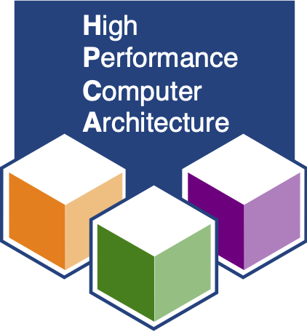




QPRAC: Towards Secure and Practical PRAC-based Rowhammer Mitigation using Priority Queues
Jeonghyun Woo
Shaopeng (Chris) Lin, Prashant J. Nair, Aamer Jaleel, Gururaj Saileshwar
HPCA 2025

Slide 2


The RowHammer Vulnerability
RowHammer Threshold: Min. Required Activations for Bit-Flips
RowHammer
DRAM Row
14X Drop in Threshold
Victim Row
Victim Row
Rapid ACTs
Aggressor Row
Victim Row
Victim Row
DRAM Row
Require Mitigations to Scale To Low RowHammer Thresholds

Slide 3
Per Row Activation Counting (PRAC)
Memory Controller
1
Per-Row Activation Counters
RFM_{ab}
Alert
CNT
CNT
2
Alert Back-Off (ABO) Protocol
CNT
CNT
CNT
DRAM Bank

Slide 4

PRAC: Operations
180ns (ABO_ACT)
Memory Controller
RFM_{ab}
Alert
Row A
1
ACT
0
REF
REF
Row B
0
Row C
0
0
20
ACT
1
Back-Off Threshold: 20
REF
Row D
0
REF
Row E
0
DRAM Bank

Slide 5
PRAC: Mitigation Timeline (ABO Protocol)
tABO_ACT (180ns)
PRAC-1
ACT
ABO
ACT
ABO
ACT
ABO
ACT
RFM_{ab}
Time
Alert
PRAC-2
ACT
ABO
ACT
ABO
ACT
ABO
ACT
RFM_{ab}
RFM_{ab}
Time
Alert
PRAC-4
ACT
ABO
ACT
ABO
ACT
ABO
ACT
RFM_{ab}
RFM_{ab}
RFM_{ab}
RFM_{ab}
Time
Alert

Slide 6
PRAC Challenge: No Details on Implementations
PRAC is A Specification → Does Not Define Implementations
Performance & Security → Dependent on Underlying Implementations
Full DRAM Refresh Every 6ms → Severe Performance Slowdowns

Slide 7

UPRAC: PRAC Design without Mitigation Queue
DRAM Bank
Row A
15
Row B
10
Row C
0
RFM_{ab}
Mitigate
22
Memory Controller
Read All Counters (128K rows)
Alert
Row D
18
10ms
Row E
5
DRAM Cell
Significant Slowdowns → Mitigation Queue is Required
Understanding the Security Benefits and Overheads of Emerging Industry Solutions to DRAM Read Disturbance [Canpolat+, DRAMSec 2024]

Slide 8
Panopticon: FIFO-Based Mitigation Queue
Mitigation Threshold: 20
DRAM Bank
Mitigate
Row A
1
Enqueue
Full
20
0
ACT
0
RFM_{ab}
Memory Controller
Enqueue
Row A
Row B
20
Row B
0
ACT
0
Enqueue
Row B
Row C
0
Row C
0
ACT
20
Alert
Row D
0
Row C
Row E
0
FIFO-Based Service Queue
180ns (MAX 3 ACTs)
DRAM Cell
Panopticon: A Complete In-DRAM Rowhammer Mitigation [Bennett+, DRAMSec 2021]

Slide 9
Breaking Panopticon Using ABO_ACT
tABO_ACT (180ns)
PRAC-1
ACT
ABO
ACT
ABO
ACT
ABO
ACT
RFM_{ab}
Time
Alert

Slide 10

Fill+Escape Attack: Exploiting ABO_ACT
Mitigation Threshold: 20
DRAM Bank
Enqueue
Full
Mitigate
Row A
19
20
0
20
20
0
0
ACT
0
RFM_{ab}
Memory Controller
Row C
Row B
Mitigate
0
Row A
19
Row B
20
ACT
0
Enqueue
Row A
Row B
0
Row C
Row C
19
0
ACT
20
Alert
Row C
22
Row A
25
1300
Row T
19
ACT
0
ACT
Row E
0
FIFO-Based Service Queue
180ns (MAX 3 ACTs)
DRAM Cell
Hammer Target Row Using ABO_ACT → Breaks Panopticon

Slide 11
Limitations of Prior PRAC Implementations & Goals
High
Security (Higher is Better)
UPRAC (No Queue)
Goal
Panopticon (FIFO Queue)
Low
No
Yes
Practical

Slide 12
QPRAC: Priority Service Queue-Based Design
Back-Off Threshold: 20
DRAM Bank
Row A
0
Addr
Cnt
Memory Controller
Row B
0
Addr
Cnt
Row C
0
Addr
Cnt
Row D
0
Priority Service Queue (PSQ)
Row E
0
DRAM Cell
PSQ: Tracks Both Row Addresses and Activation Counts

Slide 13
QPRAC: Operations
Back-Off Threshold: 20
DRAM Bank
Full
Enqueue
Row A
1
RFM_{ab}
0
ACT
5
ACT
Memory Controller
1
10
20
Row A
5
Row A
Enqueue
Row B
10
20
0
Row B
1
Mitigate
0
ACT
1
5
Row D
2
Row B
Enqueue
Row A
Row C
0
ACT
1
Alert
Row C
Row D
1
2
Row D
2
ACT
0
Replace
Priority Service Queue (PSQ)
Row E
0
180ns (MAX 3 ACTs)
DRAM Cell
Tracks most Highly Activated Rows & Mitigate them during ABO

Slide 14

QPRAC: Preventing Fill+Escape Attack
Back-Off Threshold: 20
DRAM Bank
Full
Row A
19
RFM_{ab}
0
ACT
20
Memory Controller
20
22
Row A
20
Row T
Row A
19
Row B
19
ACT
0
Row B
Row T
Row A
Row C
19
20
19
Row C
19
ACT
0
Alert
Replace
Row C
19
Row T
19
0
22
0
ACT
20
Priority Service Queue (PSQ)
Row E
0
180ns (MAX 3 ACTs)
DRAM Cell
QPRAC Accurately Track ABO_ACTs → Preventing Fill+Escape

Slide 15
QPRAC: Bounding Security
Worst-Case Attack Patterns: Wave/Feinting Attacks
Supports Sub-100 T_{RH} → 71 (PRAC-1), 58 (PRAC-2), 52 (PRAC-4)
Please See the Paper for A Detailed Security Analysis
ProTRR: Principled yet Optimal In-DRAM Target Row Refresh [Marazzi+, 2022]
Understanding the Security Benefits and Overheads of Emerging Industry Solutions to DRAM Read Disturbance [Canpolat+, 2024]

Slide 16
QPRAC Goals: Recap
1. Designing Secure PRAC-based Mitigations
2. Designing High-Performance PRAC-based Mitigations

Slide 17
QPRAC: Opportunistic Mitigations Under RFM_{ab}
Insight: Banks are idle during RFM_{ab} → Extra Opportunity for Mitigations
Memory Controller
ACT Bank 0 Row B
RFM_{ab}
Alert
Back-Off Threshold: 20
DRAM Bank 0
DRAM Bank 31
Row A
10
Row A
5
Row C
15
Row B
20
19
Row C
12
Row B
10
Row B
0
Row B
20
Row B
19
10
Row C
Row B
Row B
10
Row A
10
15
Row A
5
Row C
15
Row C
0
12
Row A
10
Row A
5
Row D
5
Row D
4
DRAM Cell
PSQ
DRAM Cell
PSQ
DRAM
Opportunistically Mitigates Highly Activated Rows Across All Banks

Slide 18
QPRAC: Proactive Mitigations Under Refresh
Insight: DRAM Can Perform RH Mitigations in A Few Refresh Operations
Memory Controller
Refresh
Back-Off Threshold: 20
DRAM Bank 0
DRAM Bank 31
Row A
10
Row A
5
Row C
15
Row A
10
Row A
5
Row B
10
Row B
0
Row B
20
Row B
0
19
10
Row A
10
Row A
5
Row C
0
Row C
0
15
12
Row A
5
Row D
5
Row D
4
DRAM Cell
PSQ
DRAM Cell
PSQ
DRAM
Proactively Mitigates Highest Activated Rows in All Banks during Refresh

Slide 19
QPRAC: Energy-Aware Proactive Mitigations
Insight: Only Mitigate Rows that is Likely to Cause ABO in the Future
Memory Controller
Proactive Mitigation Threshold: 10
Refresh
Back-Off Threshold: 20
DRAM Bank 0
DRAM Bank 31
Row A
10
Row A
5
0
Row A
10
Row A
5
Row B
0
Row B
20
Row B
0
19
10
Row B
20
Row B
19
Row C
12
Row C
0
Row C
0
15
12
Row C
15
Row A
5
Row D
5
Row D
4
DRAM Cell
PSQ
DRAM Cell
PSQ
DRAM
Minimize Energy Overhead while Maintaining Performance Benefit

Slide 20
QPRAC: Performance
Back-Off Threshold (N_{BO}) = 32 → Supported RowHammer Threshold (N_{RH}) = 71
QPRAC w/o Opportunistic
QPRAC
QPRAC w/ Proactive
QPRAC w/ Energy Aware Proactive
Opportunistic Mitigation Significantly Reduce Slowdowns: 12.8% → 0.8%
QPRAC with Proactive Mitigation → Negligible Slowdown
QPRAC with Energy Aware Proactive Mitigation → < 2% Energy Overhead

Slide 21
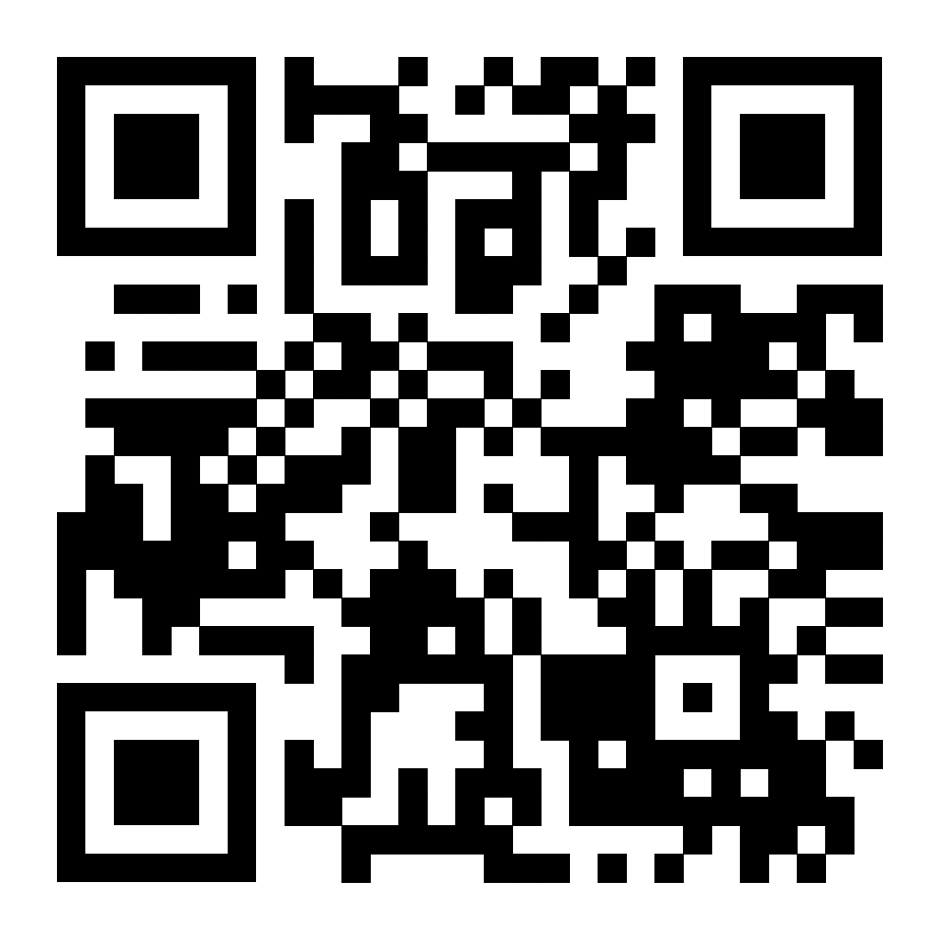
More In The Paper
Paper
Worse Attack on Panopticon
Toggle+Forget Attack: 20X More Activations
Detailed Security Analysis
Optimized Wave Attack: Accounts for Blast-Radius Effect
Security Bound with Proactive Mitigations
More Performance Analysis
Sensitivity to PRAC Level
Sensitivity to Back-Off Threshold
Sensitivity to Mitigation Queue Size
Comparison with In-DRAM Mitigations

Slide 22
Summary
PRAC: Framework → Perf. & Security Depend on Underlying Designs
Prior PRAC Designs (UPRAC & Panopticon) → Insecure or Impractical
QPRAC: Priority Queue-Based Design → Sub-100 RH Thresholds
QPRAC W/ Opportunistic and Proactive Mitigations → Practical Design

Slide 23

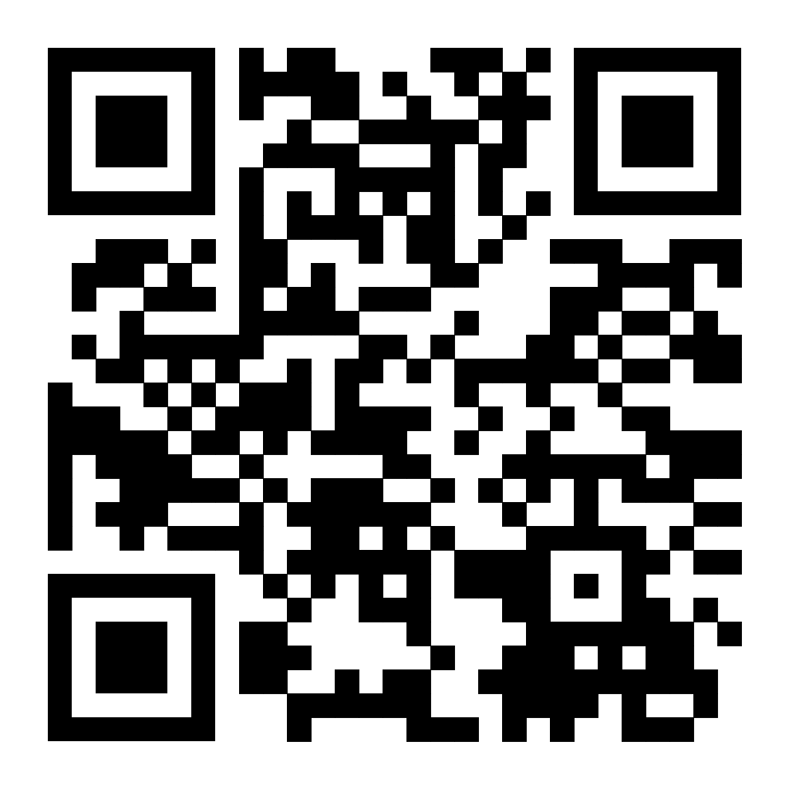

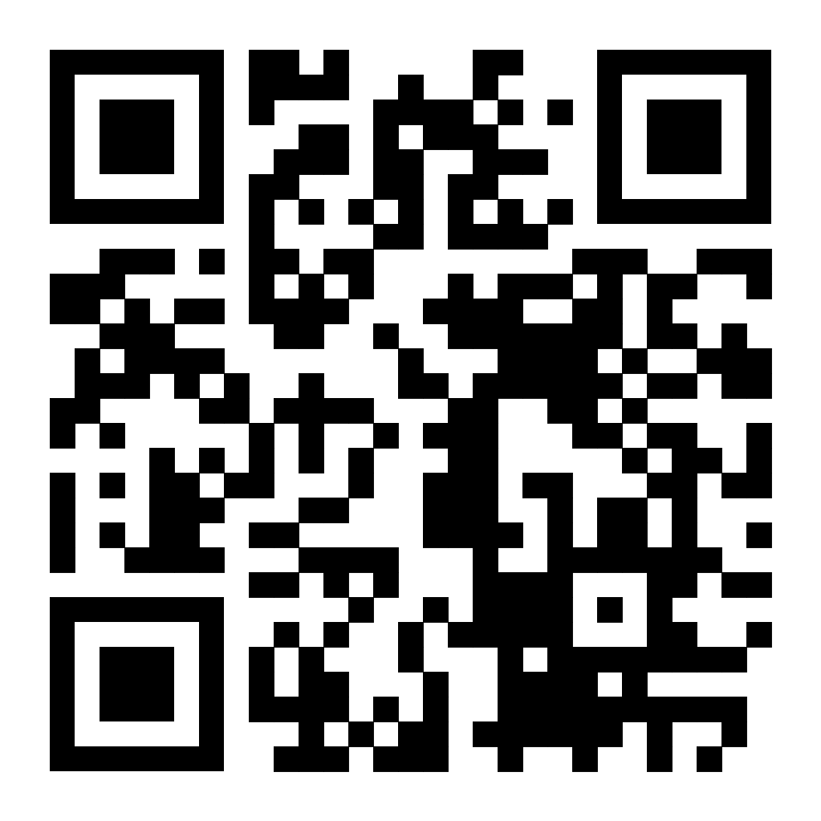

Thank You! Any Questions?
Paper
jhwoo36@ece.ubc.ca
Code
JeonghyunW
Homepage
jeonghyunwoo0306.github.io

