Slide 1
X-axis moving
Y-axis moving
DC
Motor
DC
Motor
Motor
Driver
Motor
Driver
Input Sensing
MUX 1개당 3D Magnetometer 8개 → 총 25개 연결 예정
Jetson nano
(Main Controller)
I2c bus
Extender
8-channel
I2c MUX
3D
Magnetometer
3D
Magnetometer
SCA
SDA
8-channel
I2c MUX
3D
Magnetometer
3D
Magnetometer
Output Feedback
Controller (IGBT or MOSFET)
SCA
SDA
8-channel
I2c MUX
3D
Magnetometer
3D
Magnetometer
SMPS
SMPS
SCA
SDA
8-channel
I2c MUX
3D
Magnetometer
적외선 센서
Induction
Heating
Module
Electromagnet
SCA
SDA
Thermal Feedback
Force Feedback
Vibration Feedback

Slide 2
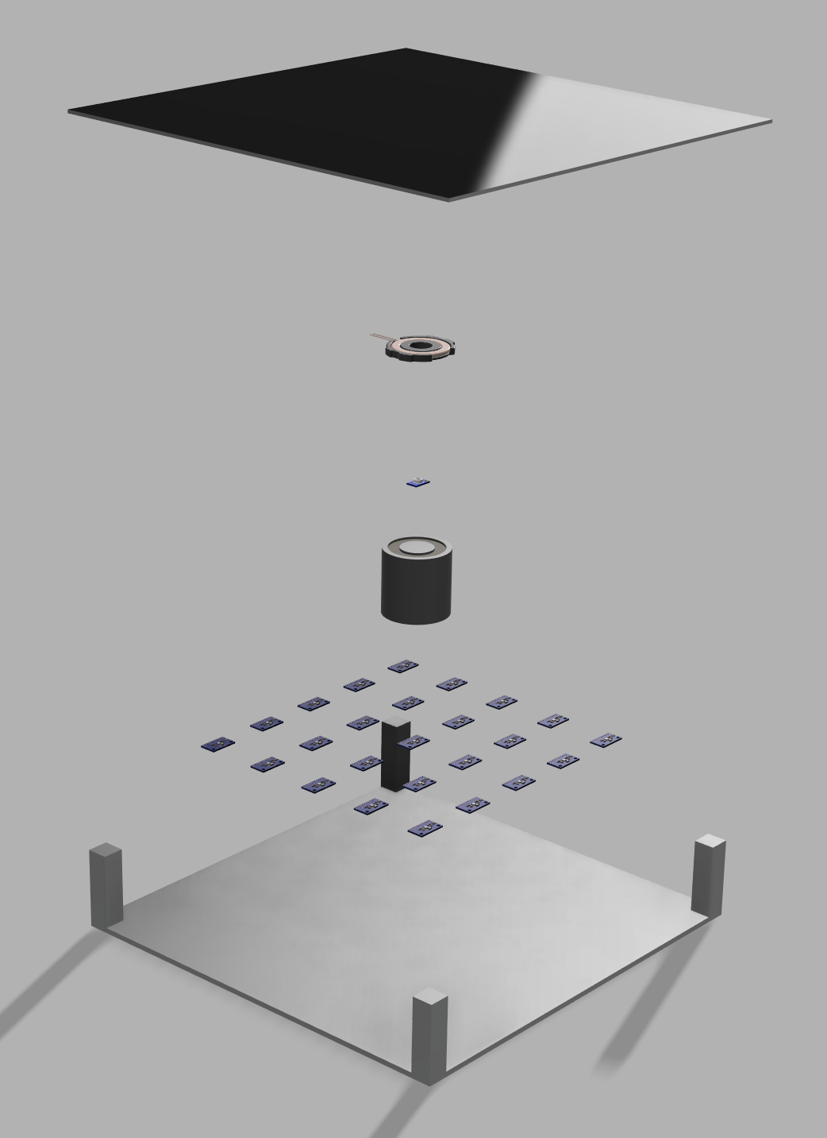
PE 패널
(가시광선 차단, IR 투과)
Induction Heater
IR Sensor
(Thermal Sensing)
Electromagnet
5x5 Hall Sensor Array

