Slide 1
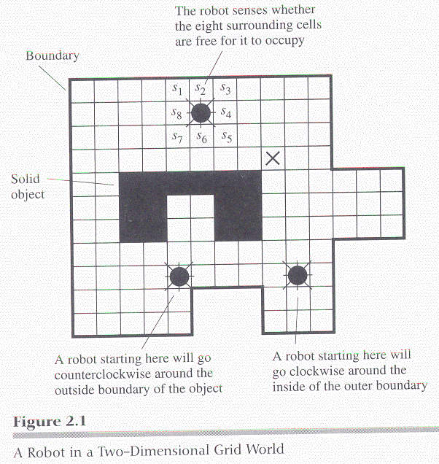
Sitimulus-response agent
a machine that has no internal state
  i.e. no memory inside
(ex) a robot in a grid world
  a boundary following (b-f)
  robot
Notes:
8개 방향

Slide 2
B-F Robot
Goal of the robot
  (1) go to a cell adjacent to a boundary (grid world 의 외곽 경계) or
  object (grid world 내부의 물체),
  (2) and then follow the boundary along its perimeter forever.
Sensory inputs of the robot
  s1, ...., s8
  si = 0 if the corresponding cell is empty. (otherwise 1 )
Actions of the robot
  north, east, south, west
  if the cell to move to is not empty, the action has no effect.
Designer’s job
  to specify a fuction of sensory input signals that selects an action
  appropriate for the task.
Notes:
s1~s8 : 8방향

Slide 3
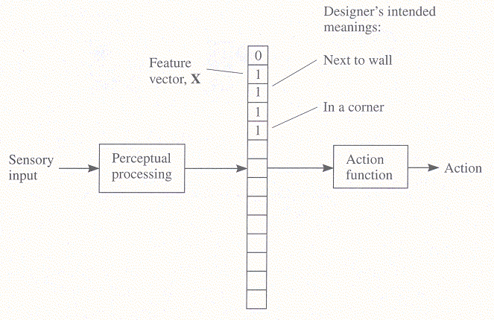
Perception and action components of the agent
the whole process is divided into two phases
  perceptual processing and
  action computation

Slide 4
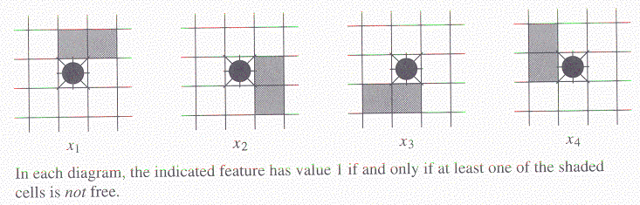
Features
a set of features x1, x2, ..., xn
  are prepared from the sensory signals
a feature vector X is formed
  X = <x1, x2, ....., xn>
  example: 4 features for b-f robot

Slide 5
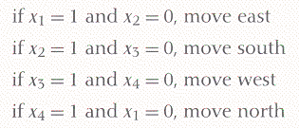
Action component of the b-f robot
(1) if all xi’s are 0 (i.e. all of its surrounding cells are free),
move north,
(2) Otherwise, use the rules below to achieve b-f behavior:
Feature : a boolean function of sensory inputs
Conditions of rules(or actions) : a boolean function of features
Notes:
Production system : 박스 , 조건만족시 수행 , 참이 아닐경우 다음으로, x1~x4

Slide 6
Boolean algebra
boolean function f(x1, x2, ...., xn )
  variables xi : a boolean, i.e., takes 0 or 1 as a value
  f takes a boolean value as the result.
  connectives :
  ⋅ (and)
  + (or)
  ‾ (not)
  constants : T (true), F (false)
  1 0
(ex) the condition for the action “move north”:
(ex) x4 = s1 + s8

Slide 7


Atom : a single (boolean) variable
Literal : an atom or a complement of an atom.
Demorgan’s law:
Distributive law
Notes:
Boolean function.

Slide 8

conjunctions or monomials or terms :
  a product of literals
disjunctions or clauses :
  a sum (or-ing) of literals
a disjunctive normal form (DNF) :
  a disjunction of monomials
a conjunctive normal form:
  a conjunction of clauses

Slide 9
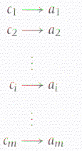
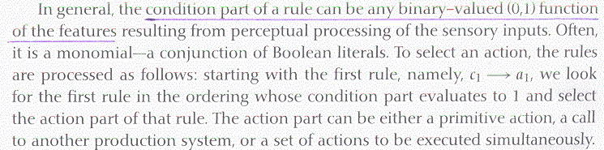
A production system
A sequence of productions (rules)
a production consists of condition and action parts.
Notes:
C1~cm중 하나가 참이되거나 cm값을 true로.?

Slide 10
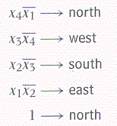


some examples of production systems
b-f robot:
A corner-staying robot (move to the corner and stay there):
  “c” is a boolean function of features that detect a corner
  “nil” : an action that does nothing
Notes:
Boundary follow

Slide 11
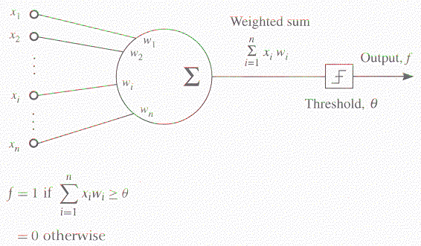
TLU
a threshold logic unit (TLU)
  a most primitive computing unit for computing boolean functions
Notes:
Learning, w1~ w n (weight) , xi wi 이므로 시그마 s = x1 * w1 … x n * w n , threshold 이상이면 1, 이하면 0
★ TLU = 각각 곱하고 + 모두더하고 + threshold 검사 를 network화

Slide 12
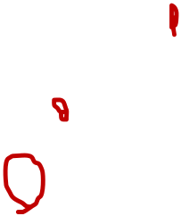
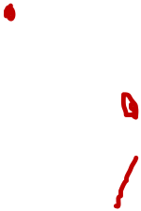
Networks of TLU
a TLU
  can implement linearly separable functions
A network of TLU’s
  can implement a non-linearly separable functions
a TLU for “AND”
a TLU for “OR”
a TLU for “NOT”
Is it possible to design a TLU for “XOR”?
N=1 흑인
N=0
백인
X1 x2 s f d
0 0 0 0 0
0 1 w1 0 0
1 0 w2 0 0
1 1 w1+w2 0 1
Notes:
선형(선을그어) 분리 Linearly separable function : x1~x n : n에따라 몇차원인지, f로 나옴 , n이 2차일때 위아래를 1, 0 흑인/백인
직선이 아닐경우 : not Linearly , Linearly 일 경우 1차일때 TLU로 만들수 있다.
W1, w2 threshold 값 무엇이냐(Parameters) 를 알면 TLU가 될수있다. Parameters of a system
AND :: X1 : 0 0 1 1 , x2 : 0 1 0 1 , s : 0 w1 w2 w1+w2, f : 0 0 0 0 , d : 0 0 0 1
0 < 세타 , w1 < 세타, w2 < 세타, w1+w2 >= 세타 의 4가지 부등식이 나옴
만약 w1=0.5 , w2 = 1.0일때 , w1+w2 = 1.5, 따라서 1.5 >= 세타 > 1.0 , 세타 = 1.3 (an answer)
숙제 : OR 을 TLU만들기
NOT :
XOR : 불가능, not linearly

Slide 13
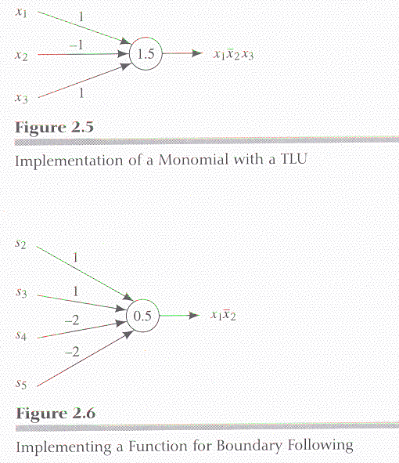


(ex)
Notes:
monomial

