Slide 1
(Intermediate) Java Programming
10. Various forms of classes
Chapter 5

Slide 2
Review: 추상 메소드와 추상 클래스
추상 메소드(abstract method)
선언되어 있으나 구현되어 있지 않은 메소드, abstract로 선언
추상 메소드는 서브 클래스에서 오버라이딩하여 구현해야 함
추상 클래스(abstract class)의 2종류
1. 추상 메소드를 하나라도 가진 클래스
클래스 앞에 반드시 abstract라고 선언해야 함
2. 추상 메소드가 하나도 없지만 abstract로 선언된 클래스
public abstract String getName();
public abstract void setName(String s);

Slide 3
Review: 추상 클래스의 용도
설계와 구현 분리
슈퍼 클래스에서는 개념 정의
서브 클래스마다 다른 구현이 필요한 메소드는 추상 메소드로 선언
각 서브 클래스에서 구체적 행위 구현
서브 클래스마다 목적에 맞게 추상 메소드 다르게 구현
계층적 상속 관계를 갖는 클래스 구조를 만들 때

Slide 4
Review: 인터페이스
자바의 인터페이스
클래스가 구현해야 할 메소드들이 선언되는 추상형
인터페이스 선언
interface 키워드로 선언
Ex) public interface SerialDriver {…}
자바 인터페이스에 대한 변화
Java 7까지
인터페이스는 상수와 추상 메소드로만 구성
Java 8부터
상수와 추상메소드 포함
default 메소드 포함 (Java 8)
private 메소드 포함 (Java 9)
static 메소드 포함 (Java 9)
여전히 인터페이스에는 필드(멤버 변수) 선언 불가

Slide 5
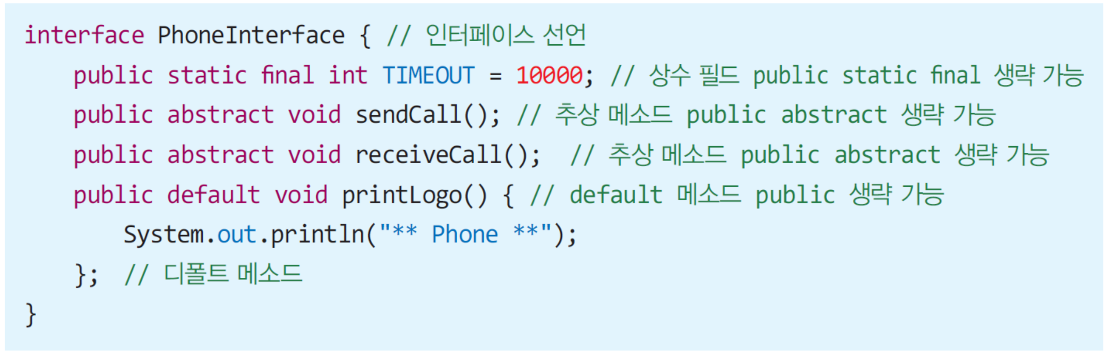
Review: 자바 인터페이스 예제

Slide 6
Review: 인터페이스의 전체적인 특징
인터페이스의 객체 생성 불가
인터페이스 타입의 레퍼런스 변수 선언 가능
인터페이스 구현
인터페이스를 상속받는 클래스는 인터페이스의 모든 추상 메소드 반드시 구현
다른 인터페이스 상속 가능
인터페이스의 다중 상속 가능

Slide 7
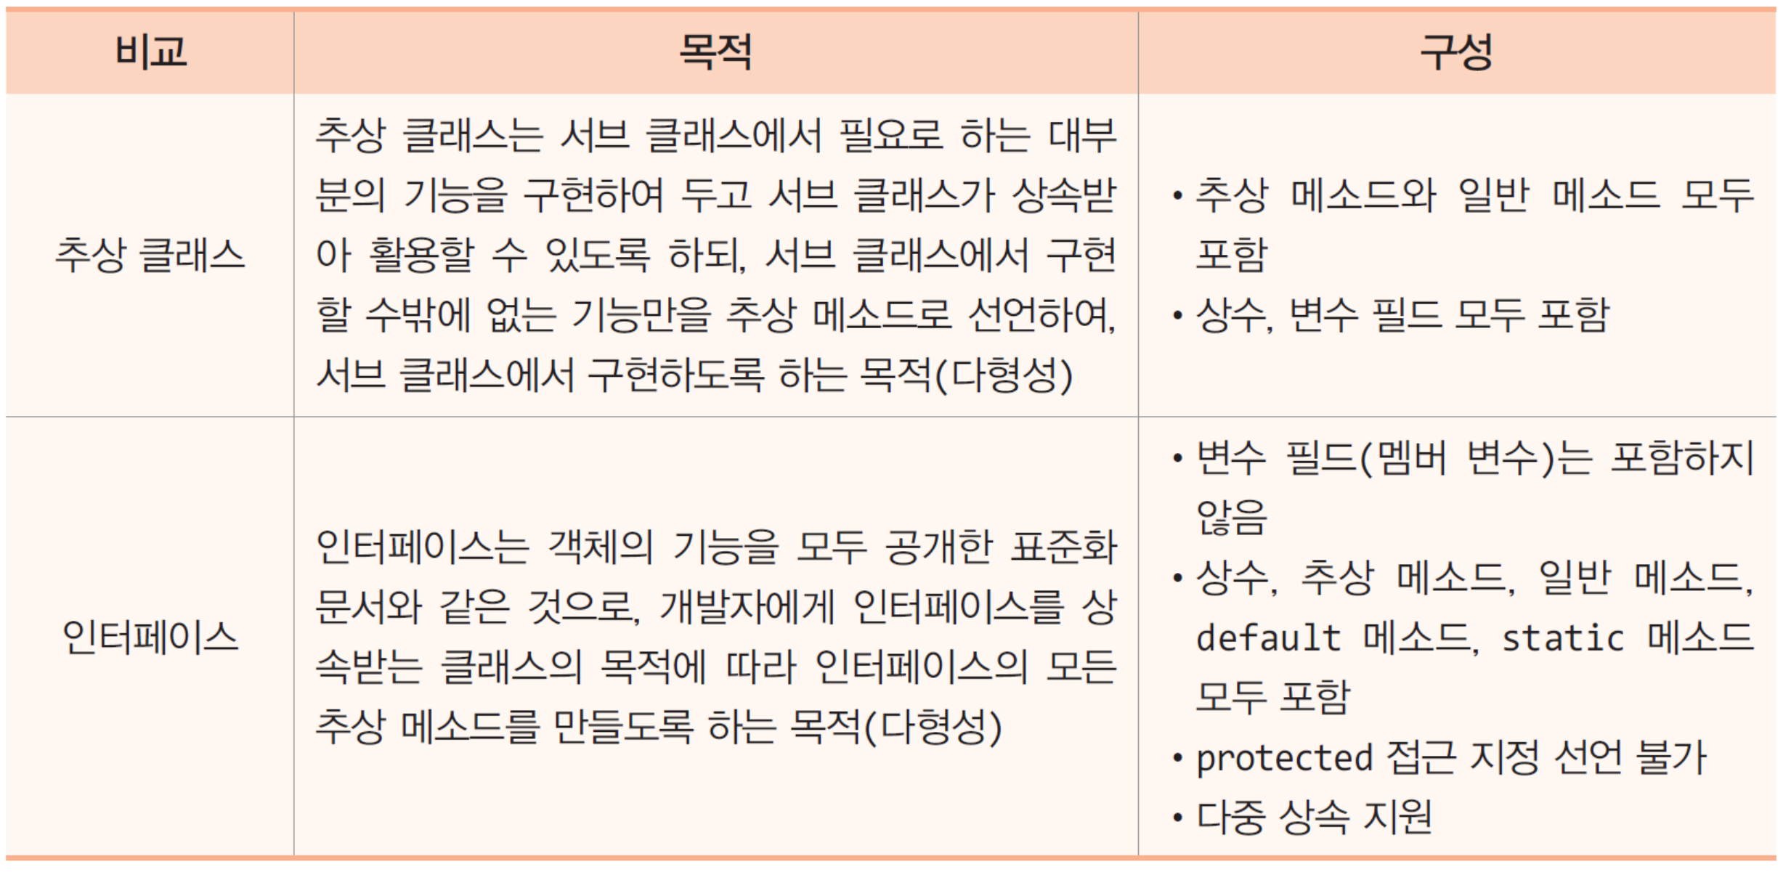
Review: 추상 클래스와 인터페이스 비교
유사점
객체를 생성할 수 없고, 상속을 위한 슈퍼 클래스로만 사용
클래스의 다형성을 실현하기 위한 목적
다른 점

Slide 8

중간 점검

Slide 9
JAVA: Inner Class

Slide 10
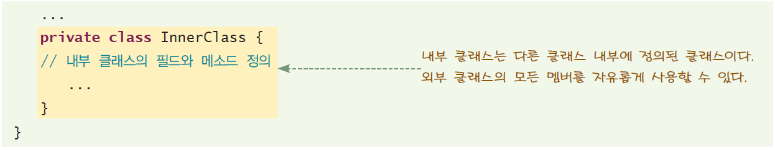
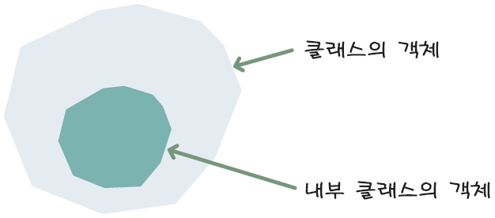
내부 클래스
내부 클래스(inner class): 클래스 안에 다른 클래스를 정의
그림12-10. 내부 클래스 객체는 객체 안에 위치한다.

Slide 11
왜 내부 클래스를 사용하는가?
멤버 변수를 private로 유지하면서 자유롭게 사용할 수 있다.
하나의 장소에서만 사용되는 클래스들을 한곳에 모을 수 있다
보다 읽기 쉽고 유지 보수가 쉬운 코드가 된다.

Slide 12
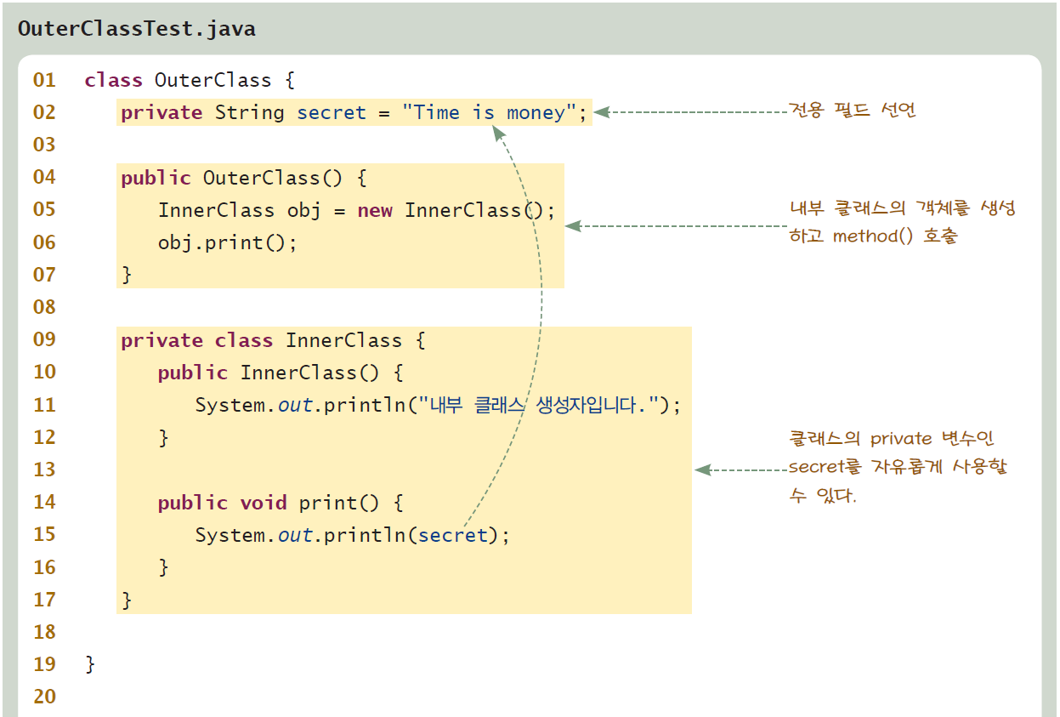
예제

Slide 13
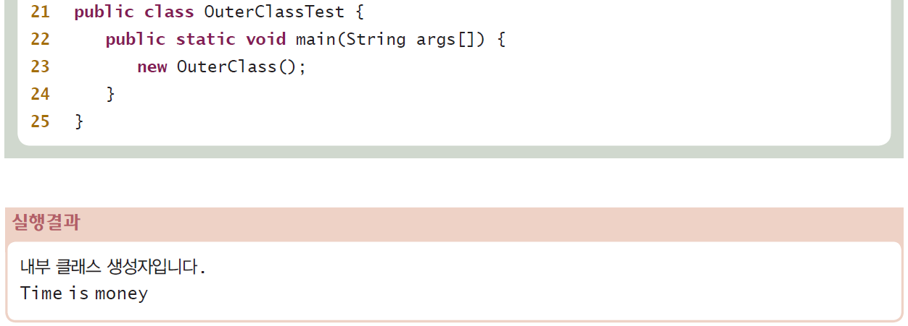
예제

Slide 14

중간 점검

Slide 15
JAVA: Anonymous Class

Slide 16
무명 클래스
무명 클래스(anonymous class): 클래스 몸체는 정의되지만 이름이 없는 클래스

Slide 17
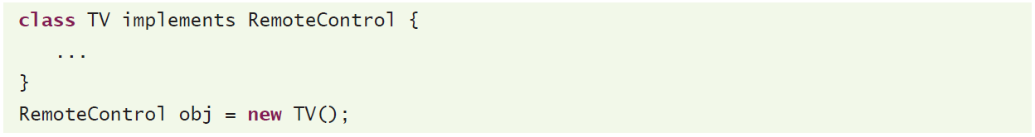
무명 클래스의 예
이름이 있는 클래스의 경우
무명 클래스의 경우

Slide 18
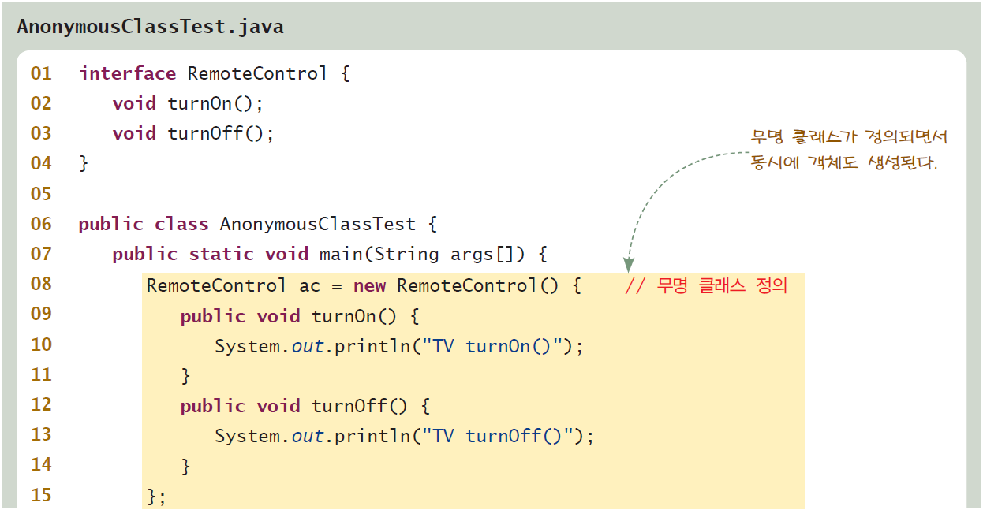
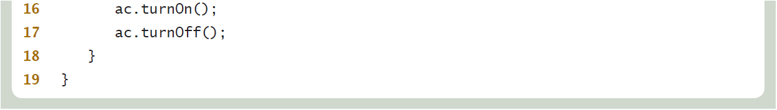
예제

Slide 19
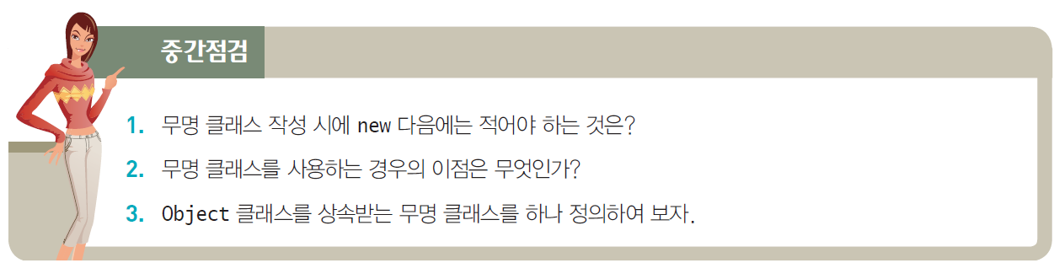
중간 점검

Slide 20
JAVA: Optional: Lambda Expressions

Slide 21
Outline
Introducing Lambda Expressions
Lambda Expression Fundamentals
Functional Interfaces
Some Lambda Expression Examples

Slide 22
Introducing Lambda Expressions
Key to understanding Java’s implementation of lambda expressions
lambda expression
functional interface
A lambda expression - an anonymous (unnamed) method
not executed on its own
Instead - implement a method defined by a functional interface.
results in a form of anonymous class

Slide 23
Introducing Lambda Expressions (cont.)
A functional interface is an interface that contains one and only one abstract method.
specifies the intended purpose of the interface.
typically represents a single action.
Furthermore, defines the target type of a lambda
expression.
a lambda expression can be used only in a context in which its target type is specified.
SAM type - Single Abstract Method.

Slide 24
Lambda Expression Fundamentals
The lambda expression - new syntax element and operator
the lambda operator or the arrow operator, is −>.
divides a lambda expression into two parts
The left side specifies any parameters required
by the lambda expression. (If no parameters are needed, an empty parameter list is used.)
The right side is the lambda body, which specifies the actions of the lambda expression.
−> verbalized as “becomes” or “goes to.”
Java defines two types of lambda bodies
single expression
block of code

Slide 25
Examples
It evaluates to a constant value
() -> 123.45
takes no parameters
returns the constant value 123.45
similar to the method:
double myMeth() { return 123.45; }
the method defined by a lambda expression does not have a name

Slide 26
Examples (cont.)
() -> Math.random() * 100
This lambda expression obtains a pseudo-random value from Math.random( ), multiplies it by 100, and returns the result
does not require a parameter.

Slide 27
Examples (cont.)
a lambda expression with a parameter
(n) -> (n % 2)==0
returns true if the value of parameter n is even. Although it is
possible to explicitly specify the type of a parameter
its type can be inferred.
a lambda expression can specify many parameters

Slide 28
Functional Interfaces
a functional interface is an interface that specifies only one abstract method
with JDK 8 – default behavior for a method declared in an interface called a default method.
an interface method is abstract only if it does not specify a default implementation
nondefault interface methods are implicitly abstract
no need to use the abstract modifier

Slide 29
Functional Interfaces (cont.)
interface MyNumber {
double getValue();
}
the method getValue( ) is implicitly abstract
the only method defined by MyNumber
MyNumber is a functional interface
its function is defined by getValue( ).

Slide 30
Functional Interfaces (cont.)
how a lambda expression can be used in an
assignment context
// Create a reference to a MyNumber instance.
MyNumber myNum;
// Use a lambda in an assignment context.
myNum = () -> 123.45;

Slide 31
Functional Interfaces (cont.)
When a lambda expression occurs in a target type context
an instance of a class is automatically created that implements the functional interface, with the lambda expression
defining the behavior of the abstract method declared by the functional interface
When that method is called through the target, the lambda expression is executed
a lambda expression gives a way to transform a code segment into an object

Slide 32
Functional Interfaces (cont.)
In the preceding example, the lambda expression becomes the implementation for the getValue( ) method
As a result, the following displays the value 123.45:
// Call getValue(), which is implemented by the previously assigned
// lambda expression.
System.out.println(myNum.getValue());
as the lambda expression assigned to myNum returns the value 123.45,

Slide 33
Functional Interfaces (cont.)
the type of the abstract method and the type of the lambda expression must be compatible.
For example, if the abstract method specifies two int parameters, then the lambda must specify two
parameters whose type either is explicitly int or can be implicitly inferred as int by the context
In general:
the type and number of the lambda expression’s parameters must be compatible with the method’s parameters
the return types must be compatible
any exceptions thrown by the lambda expression must be acceptable to the method

Slide 34
Some Lambda Expression Examples
some simple examples that illustrate
the basic lambda expression concepts

Slide 35
Example
puts together the pieces shown in
the foregoing section

Slide 36
interface MyNumber, class LambdaDemo
// Demonstrate a simple lambda expression.
// A functional interface.
interface MyNumber {
double getValue();
}
class LambdaDemo {
public static void main(String args[])
{
MyNumber myNum; // declare an interface reference
// Here, the lambda expression is simply a constant expression.
// When it is assigned to myNum, a class instance is
// constructed in which the lambda expression implements
// the getValue() method in MyNumber.
myNum = () -> 123.45;

Slide 37
class LambdaDemo
// Call getValue(), which is provided by the previously assigned
// lambda expression.
System.out.println("A fixed value: " + myNum.getValue());
// Here, a more complex expression is used.
myNum = () -> Math.random() * 100;
// These call the lambda expression in the previous line.
System.out.println("A random value: " + myNum.getValue());
System.out.println("Another random value: " + myNum.getValue());

Slide 38
class LambdaDema (cont.)
// A lambda expression must be compatible with the method
// defined by the functional interface. Therefore, this won't work:
// myNum = () -> "123.03"; // Error!
}
}

Slide 39
Output
A fixed value: 123.45
A random value: 88.90663650412304
Another random value: 53.00582701784129

Slide 40
Example: parameter with a lambda expression
the use of a parameter with a lambda expression

Slide 41
interface NumericTest, class LambdaDemo2
// Demonstrate a lambda expression that takes a parameter.
// Another functional interface.
interface NumericTest {
boolean test(int n);
}
class LambdaDemo2 {
public static void main(String args[])
{
// A lambda expression that tests if a number is even.
NumericTest isEven = (n) -> (n % 2)==0;
if(isEven.test(10)) System.out.println("10 is even");
if(!isEven.test(9)) System.out.println("9 is not even");

Slide 42
class LambdaDemo2 (cont.)
// Now, use a lambda expression that tests if a number
// is non-negative.
NumericTest isNonNeg = (n) -> n >= 0;
if(isNonNeg.test(1)) System.out.println("1 is non- negative");
if(!isNonNeg.test(-1)) System.out.println("-1 is negative");
}
}

Slide 43
Output
10 is even
9 is not even
1 is non-negative
-1 is negative

Slide 44
Explanations
(n) -> (n % 2)==0
the type of n is not specified - inferred from the context
inferred from the parameter type of test( ) as defined by the NumericTest
interface - int
It is also possible to explicitly specify the type of a parameter in a lambda expression
(int n) -> (n % 2)==0

Slide 45
Explanations (cont.)
with one parameter - not necessary to surround the parameter name with parentheses
n -> (n % 2)==0

Slide 46
Explanations (cont.)
A functional interface reference can be used to execute any lambda expression that is compatible with it.
the program defines two different lambda expressions that are compatible with the test( ) method of the functional interface NumericTest.
The first - isEven
determines if a value is even
The second - isNonNeg
checks if a value is non-negative.
each lambda expression is compatible with test( ), each can be executed through a NumericTest reference

Slide 47
Example: a lambda expression with two parameters
a lambda expression that takes two parameters.
the lambda expression tests if one number is a factor of another

Slide 48
interface NumericalTest2, class LambdaDemo3
// Demonstrate a lambda expression that takes two parameters.
interface NumericTest2 {
boolean test(int n, int d);
}
class LambdaDemo3 {
public static void main(String args[])
{
// This lambda expression determines if one number is
// a factor of another.
NumericTest2 isFactor = (n, d) -> (n % d) == 0;
if(isFactor.test(10, 2))
System.out.println("2 is a factor of 10");
if(!isFactor.test(10, 3))
System.out.println("3 is not a factor of 10");
}
}

Slide 49
Output
2 is a factor of 10
3 is not a factor of 10

Slide 50
An important point
about multiple parameters in a lambda expression:
If you need to explicitly declare the type of a parameter, then all of the parameters must have declared types
For example, this is legal:
(int n, int d) -> (n % d) == 0
But this is not:
(int n, d) -> (n % d) == 0

Slide 51
Block Lambda Expressions
The body of the lambdas consisting of a single expressions are referred to as expression bodies
lambdas that have expression bodies are sometimes called expression lambdas.

Slide 52
Block Lambda Expressions (cont.)
Java supports a second type of lambda expression
the code on the right side of the lambda operator consists of a block of code that can contain more than one statement.
called a block body.
Lambdas that have block bodies are sometimes referred to as block lambdas.

Slide 53
Note that
use a return statement to return a value. This is necessary because a block lambda body does not represent a single expression

Slide 54
Example
This example uses a block lambda to compute and return the factorial of an int value

Slide 55
interface NumericFunc, class BlockLambdaDemo
// A block lambda that computes the factorial of an int value.
interface NumericFunc {
int func(int n);
}
class BlockLambdaDemo {
public static void main(String args[])
{
// This block lambda computes the factorial of an int value.
NumericFunc factorial = (n) -> {
int result = 1;
for(int i=1; i <= n; i++)
result = i * result;
return result;
};

Slide 56
class BlockLambdaDemo
System.out.println("The factoral of 3 is " + factorial.func(3));
System.out.println("The factoral of 5 is " + factorial.func(5));
}
}

Slide 57
Output
The factorial of 3 is 6
The factorial of 5 is 120

Slide 58
Exdplanations
When a return statement occurs within a lambda expression, it simply causes a return from the lambda.
It does not cause an enclosing method to return

Slide 59
Example
reverses the characters in a string

Slide 60
interface NumericFunc, class BlockLambdaDemo
// A block lambda that computes the factorial of an int value.
interface NumericFunc {
int func(int n);
}
class BlockLambdaDemo {
public static void main(String args[])
{
// This block lambda computes the factorial of an int value.
NumericFunc factorial = (n) -> {
int result = 1;
for(int i=1; i <= n; i++)
result = i * result;
return result;
};

Slide 61
class BlockLambdaDemo
// A block lambda that reverses the characters in a string.
interface StringFunc {
String func(String n);
}
class BlockLambdaDemo2 {
public static void main(String args[])
{
// This block lambda reverses the characters in a string.
StringFunc reverse = (str) -> {
String result = "";
int i;
for(i = str.length()-1; i >= 0; i--)
result += str.charAt(i);
return result;
};

Slide 62
class BlockLambdaDemo
System.out.println("Lambda reversed is " +
reverse.func("Lambda"));
System.out.println("Expression reversed is " +
reverse.func("Expression"));
}
}

Slide 63
Output
Lambda reversed is adbmaL
Expression reversed is noisserpxE

Slide 64
Generic Functional Interfaces
A lambda expression, itself, cannot specify type parameters
a lambda expression cannot be generic
the functional interface associated with a lambda expression can be generic
the target type of the lambda expression is determined, in part, by the type argument or arguments specified when a functional interface reference is declared.

Slide 65
Example
The two examples in the previous section used two different functional interfaces; NumericFunc and StringFunc.
both defined a method func( )
took one parameter
returned a result.
In the first case,
type of the parameter and return type was int.
In the second case,
the parameter and return type was String

Slide 66
generic interface SomeFunc
// Use a generic functional interface with lambda expressions.
// A generic functional interface.
interface SomeFunc<T> {
T func(T t);
}

Slide 67
class GenericFunctionalInterfaceDemo
class GenericFunctionalInterfaceDemo {
public static void main(String args[])
{
// Use a String-based version of SomeFunc.
SomeFunc<String> reverse = (str) -> {
String result = "";
int i;
for(i = str.length()-1; i >= 0; i--)
result += str.charAt(i);
return result;
};
System.out.println("Lambda reversed is " +
reverse.func("Lambda"));
System.out.println("Expression reversed is " +
reverse.func("Expression"));

Slide 68
class GenericFunctionalInterfaceDemo (cont.)
// Now, use an Integer-based version of SomeFunc.
SomeFunc<Integer> factorial = (n) -> {
int result = 1;
for(int i=1; i <= n; i++)
result = i * result;
return result;
};
System.out.println("The factoral of 3 is " +
factorial.func(3));
System.out.println("The factoral of 5 is " +
factorial.func(5));
}
}

Slide 69
Output
Lambda reversed is adbmaL
Expression reversed is noisserpxE
The factoral of 3 is 6
The factoral of 5 is 120

Slide 70
Passing Lambda Expressions as Arguments
a lambda expression can be passed as an argument
a common use of lambdas
the type of the parameter receiving the lambda expression argument must be of a functional interface type compatible with the lambda

Slide 71
Example
illustrates the use of lambda expressions as an argument to a method

Slide 72
interface StringFunc, class LambdasAsArgumentsDemo
// Use lambda expressions as an argument to a method.
interface StringFunc {
String func(String n);
}
class LambdasAsArgumentsDemo {
// This method has a functional interface
// as the type of its first parameter.
// Thus, it can be passed a reference to
// any instance of that interface,
// including the instance created by a lambda expression.
// The second parameter specifies the string to operate on.
static String stringOp(StringFunc sf, String s) {
return sf.func(s);
}

Slide 73
class LambdasAsArgumentsDemo (cont.)
public static void main(String args[])
{
String inStr = "Lambdas add power to Java";
String outStr;
System.out.println("Here is input string: " +
inStr);
// Here, a simple expression lambda
// that uppercases a string
// is passed to stringOp( ).
outStr = stringOp((str) -> str.toUpperCase(),
inStr);
System.out.println("The string in uppercase: " +
outStr);

Slide 74
class LambdasAsArgumentsDemo (cont.)
// This passes a block lambda that removes spaces.
outStr = stringOp((str) -> {
String result = "";
int i;
for(i = 0; i < str.length(); i++)
if(str.charAt(i) != ' ')
result += str.charAt(i);
return result;
}, inStr);
System.out.println("The string with spaces removed: " + outStr);

Slide 75
class LambdasAsArgumentsDemo (cont.)
// Of course, it is also possible
// to pass a StringFunc instance
// created by an earlier lambda expression.
// For example, after this declaration executes,
// reverse refers to an instance of StringFunc.
StringFunc reverse = (str) -> {
String result = "";
int i;
for(i = str.length()-1; i >= 0; i--)
result += str.charAt(i);
return result;
};

Slide 76
class LambdasAsArgumentsDemo (cont.)
// Now, reverse can be passed
// as the first parameter to stringOp()
// since it refers to a StringFunc object.
System.out.println("The string reversed: " +
stringOp(reverse, inStr));
}
}

Slide 77
Output
Here is input string: Lambdas add power to Java
The string in uppercase: LAMBDAS ADD POWER TO JAVA
The string with spaces removed: LambdasaddpowertoJava
The string reversed: avaJ ot rewop dda sadbmaL

Slide 78
Lambda Expressions and Variable Capture
Variables defined by the enclosing scope of a lambda expression are accessible within the lambda expression.
For example, a lambda expression can use an instance or static variable defined by its enclosing class.
A lambda expression also has access to this (both explicitly and implicitly),
which refers to the invoking instance of the lambda expression’s enclosing class.
Thus, a lambda expression can obtain or set the value of an instance or static variable
and call a method defined by its enclosing class.

Slide 79
Lambda Expressions and Variable Capture (cont.)
local variables used in lambda expression from its enclosing scope - variable capture
local variables - effectively final.
whose value does not change after it is first assigned
no need to declare such a variable as final, although doing so would not be an error.
The this parameter of an enclosing scope is automatically effectively final
and lambda expressions do not have a this of their own.

Slide 80
Example
the difference between effectively final and mutable local variables

Slide 81
interface MyFunc, class VarCapture
// An example of capturing a local variable from the enclosing scope.
interface MyFunc {
int func(int n);
}
class VarCapture {
public static void main(String args[])
{
// A local variable that can be captured.
int num = 10;
MyFunc myLambda = (n) -> {
// This use of num is OK. It does not modify num.
int v = num + n;

Slide 82
class VarCapture (cont.)
// However, the following is illegal because it attempts
// to modify the value of num.
// num++;
return v;
};
// The following line would also cause an error, because
// it would remove the effectively final status from num.
// num = 9;
} // end main
} // end class

Slide 83
Explanations
As the comments indicate, num is effectively final and can, therefore, be used inside
myLambda.
However, if num were to be modified, either inside the lambda or outside of it,
num would lose its effectively final status.
This would cause an error, and the program would not compile.

Slide 84
Explanations (cont.)
a lambda expression can use and modify an instance variable from its invoking class.
It just can’t use a local variable of its enclosing scope unless that variable is effectively final.

Slide 85
SUMMARY: Lambda Expressions
Lambda expression
anonymous method
shorthand notation for implementing a functional interface.
The type of a lambda is the type of the functional interface that the lambda implements.
Can be used anywhere functional interfaces are expected.

Slide 86
SUMMARY: Lambda Expressions (Cont.)
A lambda consists of a parameter list followed by the arrow token and a body, as in:
(parameterList) -> {statements}
For example, the following lambda receives two ints and returns their sum:
(int x, int y) -> {return x + y;}
This lambda’s body is a statement block that may contain one or more statements enclosed in curly braces.
A lambda’s parameter types may be omitted, as in:
(x, y) -> {return x + y;}
in which case, the parameter and return types are determined by the lambda’s context.

Slide 87
SUMMARY: Lambda Expressions (Cont.)
A lambda with a one-expression body can be written as:
(x, y) -> x + y
In this case, the expression’s value is implicitly returned.
When the parameter list contains only one parameter, the parentheses may be omitted, as in:
value -> System.out.printf("%d ", value)
A lambda with an empty parameter list is defined with () to the left of the arrow token (->), as in:
() -> System.out.println("Welcome to lambdas!")
There are also specialized shorthand forms of lambdas that are known as method references.

