Slide 1

openToDo::Web DB Architecture
© 2024 Jeongwoo Kim, KNU CSE

Slide 2
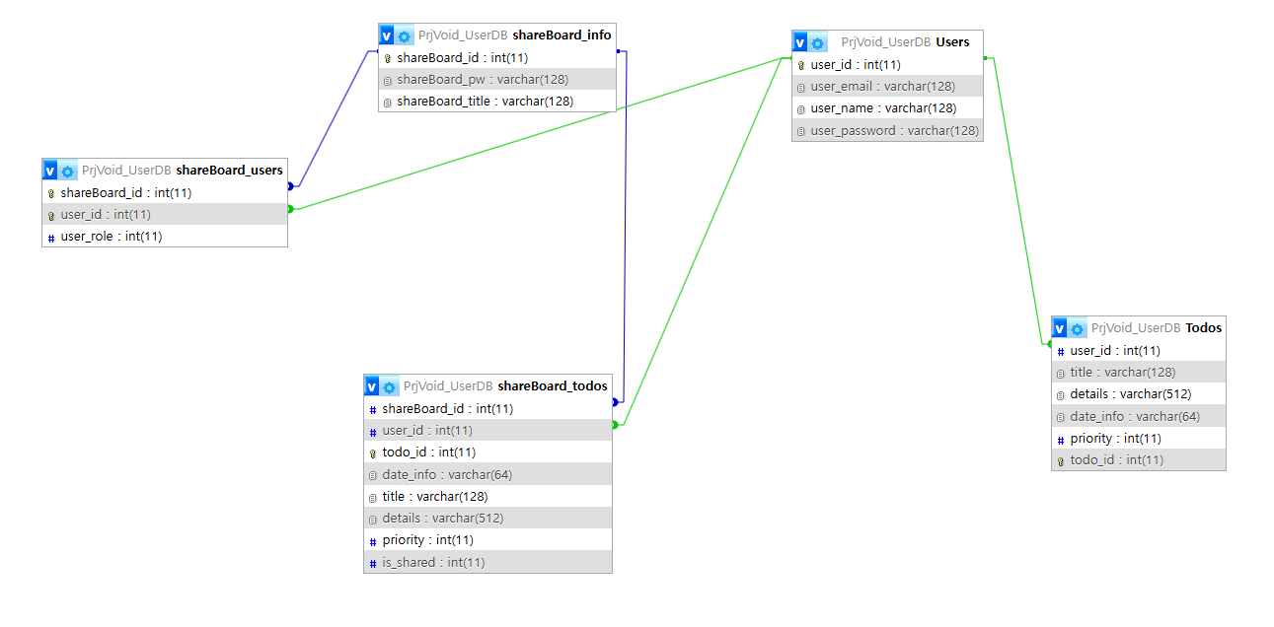
DBA

