Slide 1

openToDo::Web Architecture
© 2024 Jeongwoo Kim, KNU CSE

Slide 2
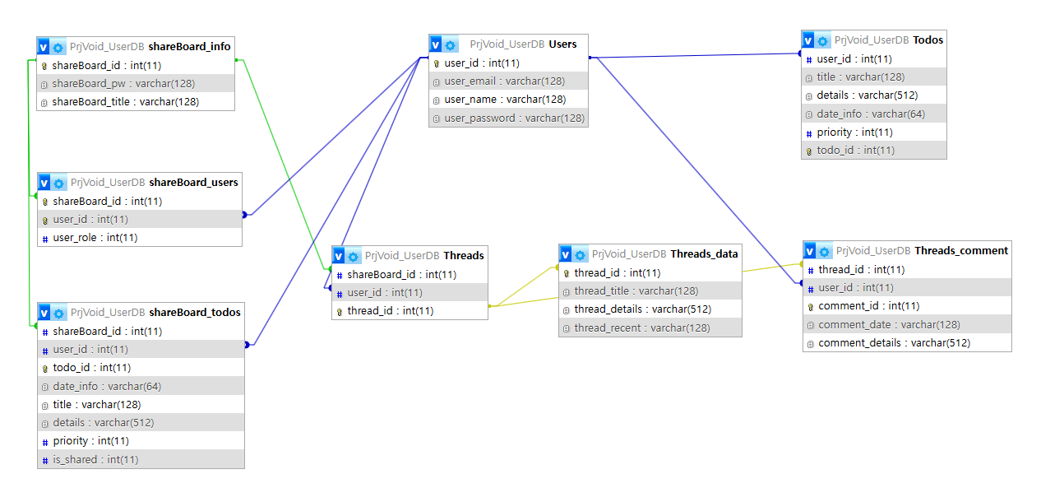
DB Schema

Slide 3
File Directory
/
accountInfoView.php
bootstrap.php
credits.php
dbaccess.php
Index.php
Login.php
Logout.php
Otd_shareBoard_validation_api.php
Otd_threads_validation_api.php
Otd_validation_api.php
Register.php
Starter-template.css
myTodo
Otd_add.php
Otd_del.php
Otd_edit.php
Otd_view.php
shareBoard
Otd_shareBoard_add.php
Otd_shareBoard_adminPage.php
Otd_shareBoard_boardDeletion.php
Otd_shareBoard_create.php
Otd_shareBoard_del.php
Otd_shareBoard_edit.php
Otd_shareBoard_join.php
Otd_shareBoard_list.php
Otd_shareBoard_view.php
Threads
Otd_threads_comment_del.php
Otd_threads_comment_edit.php
Otd_threads_create.php
Otd_threads_del.php
Otd_threads_edit.php
Otd_threads_view.php

