Slide 1
Week 5

Slide 2
Aruduino Due
-Compile Blink code-

Slide 3
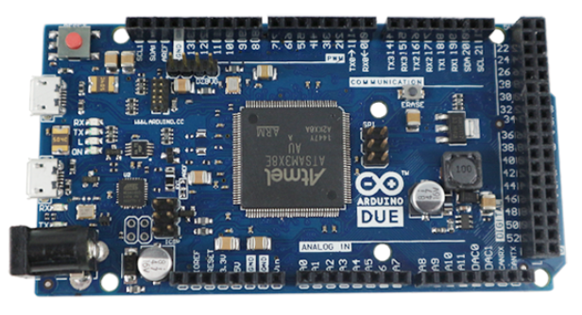
Arduino Due
Arudino Due
• Based on a 32-bit ARM core microcontroller
• Runs at 3.3V
• 2 DAC (Digtal to Analog Converter pin)
*ARM: Advnaced RISC Machine

Slide 4
Thank you
Questions?
Contact: email

