Slide 1
Crypto
Part 1 ⎯ Cryptography <number>
Notes:
1.Confidentiality(기밀성)
-허가 받지 않은 사람이 정보를 해독하지 못하도록 하는것

Slide 2
Crypto as Black Box
key
key
plaintext
encrypt
decrypt
plaintext
ciphertext
A generic use of crypto
Part 1 ⎯ Cryptography <number>
Notes:
1)Symmetric Key Cryptography(대칭키암호)
-암호할때 사용하는 키랑 복호할때 사용하는 키가 같음
2)Public Key Cryptography(공개키암호,비대칭키암호)
-암호할때 사용하는 키랑 복호할때 사용하는 키랑 다름
-사용자가 보낸 plaintext데이터를 key를 사용하여 encrypt(암호화)하여 보내면 ciphertext형식으로 네트워크를 통해전달되서 수신자 측에서 key를 사용하여 decrypt(복호화)하여 데이터를 얻어냄

Slide 3
How to Speak Crypto
A cipher or cryptosystem is used to encrypt the plaintext
The result of encryption is ciphertext
We decrypt ciphertext to recover plaintext
A key is used to configure a cryptosystem
A symmetric key cryptosystem uses the same key to encrypt as to decrypt
A public key cryptosystem uses a public key to encrypt and a private key to decrypt (sign)
Part 1 ⎯ Cryptography <number>

Slide 4
Crypto
Basis assumption
  The system is completely known to the attacker
  Only the key is secret
Also known as Kerckhoffs Principle
  Crypto algorithms are not secret
Why do we make this assumption?
  Experience has shown that secret algorithms are weak when exposed
  Secret algorithms never remain secret
  Better to find weaknesses beforehand
Part 1 ⎯ Cryptography <number>

Slide 5
1. Symmetric Key Crypto
(Block Ciphers)
Part 1 ⎯ Cryptography <number>

Slide 6
(Iterated) Block Cipher
Plaintext and ciphertext consists of fixed sized blocks
Ciphertext obtained from plaintext by iterating a round function
Input to round function consists of key and the output of previous round
Usually implemented in software
Part 1 ⎯ Cryptography <number>
Notes:
1)Symmetric Key Cryptography(대칭키암호)
-암호할때 사용하는 키랑 복호할때 사용하는 키가 같음
-Stream Ciphter(비트단위로 암호화)
-*Block Ciphers(블록단위로 암호화)
->round function을 반복함으로써 Ciphertext가 얻어짐
->round function의 입력값으로는 key와 이전 round의 output이 들어간다

Slide 7
Feistel Cipher
Feistel cipher refers to a type of block cipher design, not a specific cipher
Split plaintext block into left and right halves: Plaintext = (L₀,R₀)
For each round i=1,2,...,n, compute
L_{i}= R_{i−1}
R_{i}= L_{i−1} ⊕ F(R_{i−1},K_{i})
where F is round function and K_{i} is subkey
Ciphertext = (L_{n},R_{n})
Part 1 ⎯ Cryptography <number>
Notes:
-Feistel Cipher암호알고리즘: 특정한 암호알고리즘이 아닌 block cipher를 설계하는 방식

Slide 8
Feistel Cipher
Decryption: Ciphertext = (L_{n},R_{n})
For each round i=n,n−1,…,1, compute
R_{i−1} = L_{i}
L_{i−1} = R_{i} ⊕ F(R_{i−1},K_{i})
where F is round function and K_{i} is subkey
Plaintext = (L₀,R₀)
Formula “works” for any function F
But only secure for certain functions F
Part 1 ⎯ Cryptography <number>

Slide 9
1.1 Data Encryption Standard
DES developed in 1970’s
Based on IBM Lucifer cipher
U.S. government standard
DES development was controversial
  NSA was secretly involved
  Design process not open
  Key length was reduced
  Subtle changes to Lucifer algorithm
Part 1 ⎯ Cryptography <number>

Slide 10
DES Numerology
DES is a Feistel cipher
  64 bit block length
  56 bit key length
  16 rounds
  48 bits of key used each round (subkey)
Each round is simple (for a block cipher)
Security depends primarily on “S-boxes”
  Each S-boxes maps 6 bits to 4 bits
Part 1 ⎯ Cryptography <number>
Notes:
-DES(Data Encryption Standard) : Feistel Cipher의 일종
->Permutation(순서를 막 섞는 것) , Substitution(특정한 숫자나 문자를 대체)을 사용하는 방식

Slide 11
L
R
key
32
28
28
expand
shift
shift
One
Round
of
DES
32
48
28
28
K_{i}
⊕
48
48
compress
S-boxes
28
28
32
P box
32
32
⊕
32
L
R
key
Part 1 ⎯ Cryptography <number>

Slide 12
DES Expansion Permutation
Input 32 bits
0 1 2 3 4 5 6 7 8 9 10 11 12 13 14 15
16 17 18 19 20 21 22 23 24 25 26 27 28 29 30 31
Output 48 bits
31 0 1 2 3 4 3 4 5 6 7 8
7 8 9 10 11 12 11 12 13 14 15 16
15 16 17 18 19 20 19 20 21 22 23 24
23 24 25 26 27 28 27 28 29 30 31 0
Part 1 ⎯ Cryptography <number>

Slide 13
DES S-box
8 “substitution boxes” or S-boxes
Each S-box maps 6 bits to 4 bits
S-box number 1
input bits (0,5)
↓ input bits (1,2,3,4)
| 0000 0001 0010 0011 0100 0101 0110 0111 1000 1001 1010 1011 1100 1101 1110 1111
------------------------------------------------------------------------------------
00 | 1110 0100 1101 0001 0010 1111 1011 1000 0011 1010 0110 1100 0101 1001 0000 0111
01 | 0000 1111 0111 0100 1110 0010 1101 0001 1010 0110 1100 1011 1001 0101 0011 1000
10 | 0100 0001 1110 1000 1101 0110 0010 1011 1111 1100 1001 0111 0011 1010 0101 0000
11 | 1111 1100 1000 0010 0100 1001 0001 0111 0101 1011 0011 1110 1010 0000 0110 1101
Part 1 ⎯ Cryptography <number>

Slide 14
DES P-box
Input 32 bits
0 1 2 3 4 5 6 7 8 9 10 11 12 13 14 15
16 17 18 19 20 21 22 23 24 25 26 27 28 29 30 31
Output 32 bits
15 6 19 20 28 11 27 16 0 14 22 25 4 17 30 9
1 7 23 13 31 26 2 8 18 12 29 5 21 10 3 24
Part 1 ⎯ Cryptography <number>

Slide 15
DES Subkey
56 bit DES key, numbered 0,1,2,…,55
Left half key bits, LK
49 42 35 28 21 14 7
0 50 43 36 29 22 15
8 1 51 44 37 30 23
16 9 2 52 45 38 31
Right half key bits, RK
55 48 41 34 27 20 13
6 54 47 40 33 26 19
12 5 53 46 39 32 25
18 11 4 24 17 10 3
Part 1 ⎯ Cryptography <number>

Slide 16
DES Subkey
For rounds i=1,2,…,16
  Let LK = (LK circular shift left by r_{i})
  Let RK = (RK circular shift left by r_{i})
  Left half of subkey K_{i} is of LK bits
13 16 10 23 0 4 2 27 14 5 20 9
22 18 11 3 25 7 15 6 26 19 12 1
  Right half of subkey K_{i} is RK bits
12 23 2 8 18 26 1 11 22 16 4 19
15 20 10 27 5 24 17 13 21 7 0 3
Part 1 ⎯ Cryptography <number>

Slide 17
DES Subkey
For rounds 1, 2, 9 and 16 the shift r_{i} is 1, and in all other rounds r_{i} is 2
Bits 8,17,21,24 of LK omitted each round
Bits 6,9,14,25 of RK omitted each round
Compression permutation yields 48 bit subkey K_{i} from 56 bits of LK and RK
Key schedule generates subkey
Part 1 ⎯ Cryptography <number>

Slide 18
DES Last Word (Almost)
An initial perm P before round 1
Halves are swapped after last round
A final permutation (inverse of P) is applied to (R₁₆,L₁₆) to yield ciphertext
None of these serve any security purpose
Part 1 ⎯ Cryptography <number>

Slide 19
Security of DES
Security of DES depends a lot on S-boxes
  Everything else in DES is linear
Thirty years of intense analysis has revealed no “back door”
Attacks today use exhaustive key search
Inescapable conclusions
  Designers of DES knew what they were doing
  Designers of DES were ahead of their time
Part 1 ⎯ Cryptography <number>
Notes:
-DES (56Key) -> exhaustive key search : 2^56번 수행
->컴퓨터의 성능이 발달되며 이를 수행하는게 큰 어려움이 없어져 대책이 필요해짐
->solution?

Slide 20
Block Cipher Notation
P = plaintext block
C = ciphertext block
Encrypt P with key K to get ciphertext C
  C = E(P, K)
Decrypt C with key K to get plaintext P
  P = D(C, K)
Note that
  P = D(E(P, K), K) and C = E(D(C, K), K)
Part 1 ⎯ Cryptography <number>

Slide 21
Triple DES
Today, 56 bit DES key is too small
But DES is everywhere: What to do?
Triple DES or 3DES (112 bit key)
  C = E(D(E(P,K₁),K₂),K₁)
  P = D(E(D(C,K₁),K₂),K₁)
Why use Encrypt-Decrypt-Encrypt (EDE) with 2 keys?
  Backward compatible: E(D(E(P,K),K),K) = E(P,K)
  And 112 bits is enough
Part 1 ⎯ Cryptography <number>
Notes:
①3DES : 기존의 DES와 호환성 유지
-> 112bit key(두 개의 key)사용
C = E(D(E(P,K1,K2),K1)
D(E(P,K1),K2) = D(C,K1)
E(P,K1) = E(D(C,K1),K2)
P = D(E(D(C,K1),K2),K1)
P = D(E(D(C,K1,K2),K1)

Slide 22
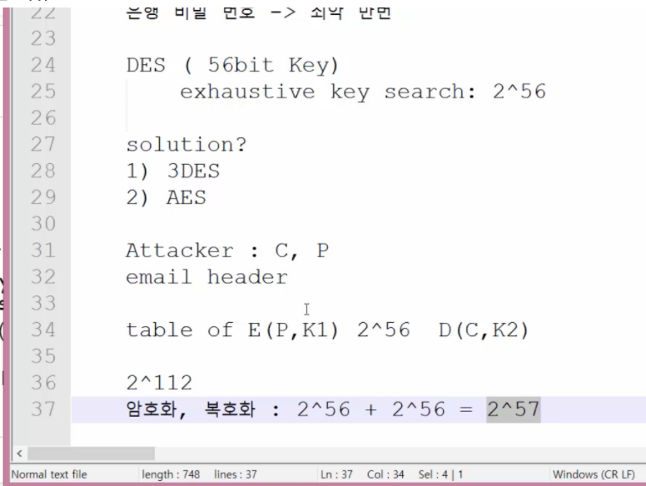
3DES
Why not C = E(E(P,K),K) ?
  Still just 56 bit key
Why not C = E(E(P,K₁),K₂) ?
A (semi-practical) known plaintext attack
  Precompute table of E(P,K₁) for every possible key K₁ (resulting table has 2⁵⁶ entries)
  Then for each possible K₂ compute D(C,K₂) until a match in table is found
  When match is found, have E(P,K₁) = D(C,K₂)
  Result is keys: C = E(E(P,K₁),K₂)
Part 1 ⎯ Cryptography <number>
Notes:
Attacker : C, P
Email header
Table of E(P,K1) 2^56 D(C,K2)
2^112
암호화, 복호화 : 2^56 + 2^56 = 2^57
->Attackerd에게 2^112 번으로 이론적으로 공격가능성이 존재하기 때문
->사실상은 2^56개의 테이블entry를 만들어 저장하는게 실제로 가능하지 않다

Slide 23
1.2 Advanced Encryption Standard
Replacement for DES
AES competition (late 90’s)
  NSA openly involved
  Transparent process
  Many strong algorithms proposed
  Rijndael Algorithm ultimately selected
    Pronounced like “Rain Doll” or “Rhine Doll”
Iterated block cipher (like DES)
Not a Feistel cipher (unlike DES)
Part 1 ⎯ Cryptography <number>
Notes:
※대칭키 암호 알고리즘(암호화키 = 복호화키)
1)DES(56bit key)
exhaustive key search:2^56
solution?
2)3DES(112bit key) : 2^112
3)AES(128,192,256 bit Key) -> 새로운 것으로 갈아엎음(실생활에서 가장 많이 사용됨!!!보안우수)

Slide 24
AES Overview
Block size: 128, 192 or 256 bits
Key length: 128, 192 or 256 bits (independent of block size)
10 to 14 rounds (depends on key length)
Each round uses 4 functions (in 3 “layers”)
  ByteSub (nonlinear layer)
  ShiftRow (linear mixing layer)
  MixColumn (nonlinear layer)
  AddRoundKey (key addition layer)
Part 1 ⎯ Cryptography <number>
Notes:
-각 라운드마다 4개의 function사용

Slide 25
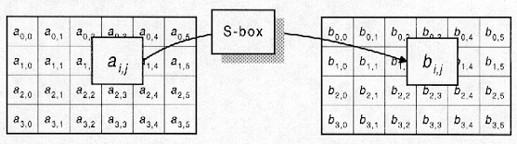
AES ByteSub
Assume 192 bit block, 4x6 bytes
ByteSub is AES’s “S-box”
Can be viewed as nonlinear (but invertible) composition of two math operations
Part 1 ⎯ Cryptography <number>
Notes:
Function1. ByteSub
-한 바이트를 S-Box를 통해서 대치된다<br>

Slide 26
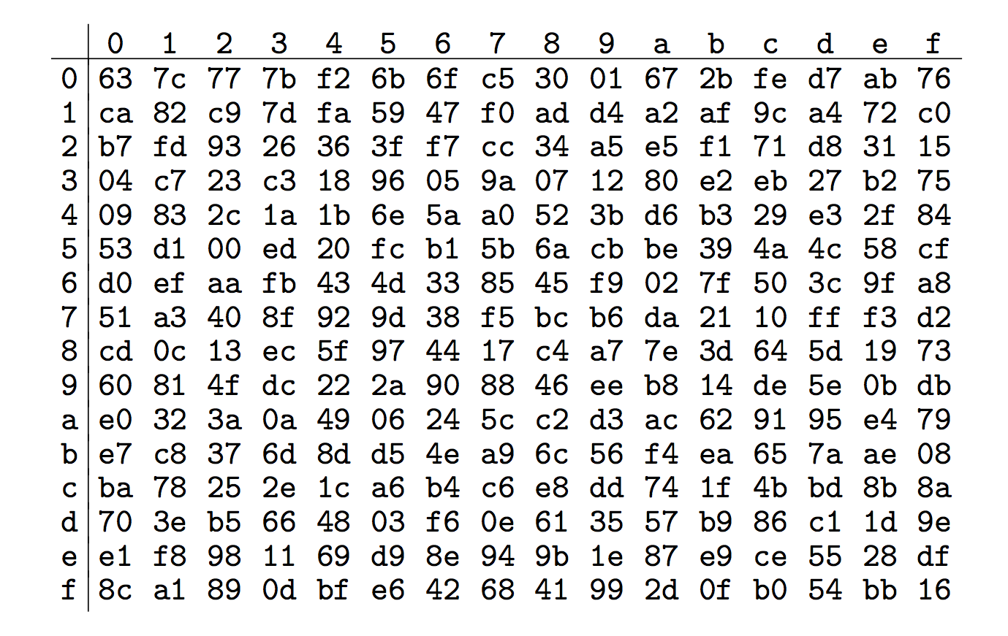
AES “S-box”
Last 4 bits of input
First 4
bits of
input
Part 1 ⎯ Cryptography <number>
Notes:
-Ex) 9a(16진수) ->b8(16진수)

Slide 27
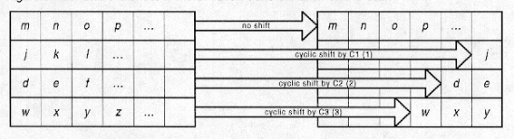
AES ShiftRow
Cyclic shift rows
Part 1 ⎯ Cryptography <number>
Notes:
Function2.ShiftRow
-행을 shift시킴
-첫행은 no shift
-둘째행은 한바이트, 셋째행은 두바이트 …
-역함수가 존재 -> 오른쪽으로 반대로 shift

Slide 28
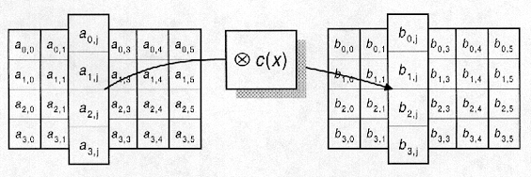
AES MixColumn
Nonlinear, invertible operation applied to each column
Implemented as a (big) lookup table
Part 1 ⎯ Cryptography <number>
Notes:
Function3.MixColumn
-c(x)라는 행렬을 곱해서 새로운 행렬을 만들어냄
-역함수 존재

Slide 29
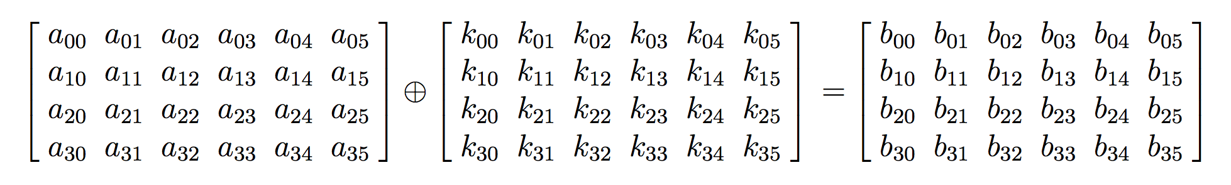
AES AddRoundKey
XOR subkey with block
Block
Subkey
RoundKey (subkey) determined by key schedule algorithm
Part 1 ⎯ Cryptography <number>
Notes:
Function4.AddRoundKey
-SubKey를 만들어서 xor시켜 만들어냄
A XOR K XOR K = A

Slide 30
AES Decryption
To decrypt, process must be invertible
Inverse of MixAddRoundKey is easy, since ⊕ is its own inverse
MixColumn is invertible (inverse is also implemented as a lookup table)
Inverse of ShiftRow is easy (cyclic shift the other direction)
ByteSub is invertible (inverse is also implemented as a lookup table)
Part 1 ⎯ Cryptography <number>
Notes:
복호화 하기 위해서는 역함수 형태로 처리해주면 됨

Slide 31
1.3 Block Cipher Modes
Part 1 ⎯ Cryptography <number>
Notes:
여러 블락들을 암호화하는 3가지 모드

Slide 32





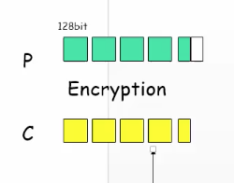
Multiple Blocks
How to encrypt multiple blocks?
A new key for each block?
  As bad as (or worse than) a one-time pad!
Encrypt each block independently?
Make encryption depend on previous block(s), i.e., “chain” the blocks together?
-> encryption을 그전의 블락과 연관하여 만드는게 어떻겠냐?
How to handle partial blocks?
Part 1 ⎯ Cryptography <number>

Slide 33



Modes of Operation
Many modes of operation ⎯ we discuss three
Electronic Codebook (ECB) mode
  Obvious thing to do
  Encrypt each block independently
  There is a serious weakness
Cipher Block Chaining (CBC) mode
  Chain the blocks together
  More secure than ECB, virtually no extra work
Counter Mode (CTR) mode
  Acts like a stream cipher
  Popular for random access
Part 1 ⎯ Cryptography <number>
Notes:
1.ECB mode
-각각의 블락들을 독립적으로 encryption
-치명적인 약점 가지고있음
2.CBC mode
-더 안전하고 추가적인 작업이 거의 들어가지 않는다
3.CTR mode
random access : 임의의 지점으로 부터 복호화 하는 부분

Slide 34
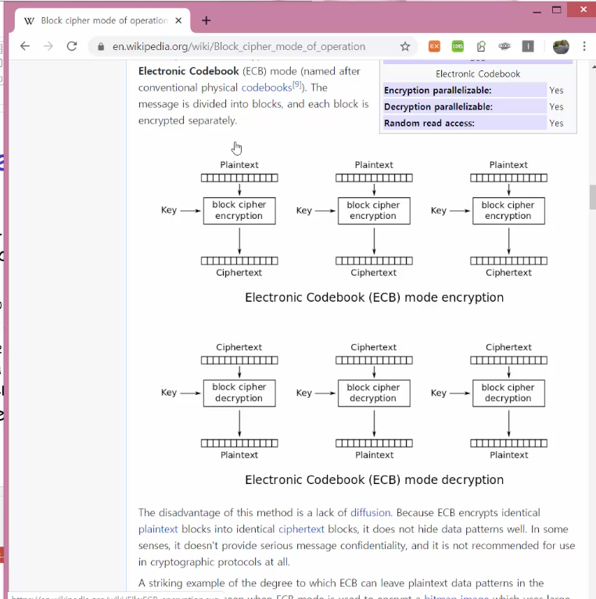

ECB Mode
Notation: C=E(P,K)
Given plaintext P₀,P₁,…,P_{m},…
Obvious way to use a block cipher is
Encrypt Decrypt
C₀ = E(P₀, K), P₀ = D(C₀, K),
C₁ = E(P₁, K), P₁ = D(C₁, K),
C₂ = E(P₂, K),… P₂ = D(C₂, K),…
For a fixed key K, this is an electronic version of a codebook cipher
A new codebook for each key
Part 1 ⎯ Cryptography <number>
Notes:
Code book cipher
apple -> 01
Banana ->02
전자적인 책을 바탕으로 하여 문자를 암호화하는 방식

Slide 35

ECB Cut and Paste Attack
Suppose plaintext is
Alice digs Bob. Trudy digs Tom.
Assuming 64-bit blocks and 8-bit ASCII:
P₀ = “Alice di”, P₁ = “gs Bob. ”,
P₂ = “Trudy di”, P₃ = “gs Tom. ”
Ciphertext: C₀,C₁,C₂,C₃
Trudy cuts and pastes: C₀,C₃,C₂,C₁
Decrypts as
Alice digs Tom. Trudy digs Bob.
Part 1 ⎯ Cryptography <number>
Notes:
공격의 가능성이 있음 (Cut and Paste Attack)
1.

Slide 36

ECB Weakness
Suppose P_{i} = P_{j}
Then C_{i} = C_{j} and Trudy knows P_{i} = P_{j}
This gives Trudy some information, even if she does not know P_{i} or P_{j}
Trudy might know P_{i}
Is this a serious issue?
Part 1 ⎯ Cryptography <number>
Notes:
Trudy 는 암호문 블락이 똑같으면 평문도 같겠구나 라고 생각 할 수 있다

Slide 37
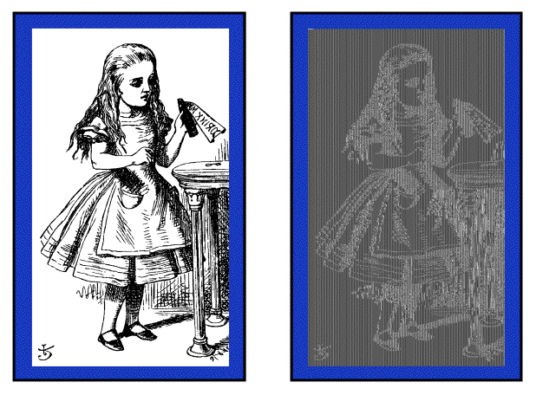

Alice Hates ECB Mode
Alice’s uncompressed image, Alice ECB encrypted (TEA)
Why does this happen?
Same plaintext block ⇒ same ciphertext!
Part 1 ⎯ Cryptography <number>

Slide 38
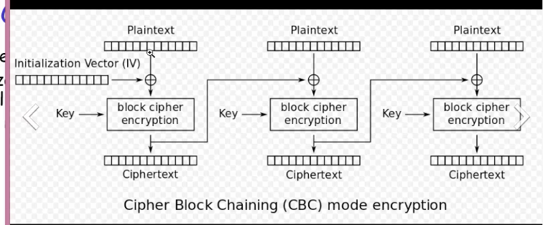


CBC Mode
Blocks are “chained” together
A random initialization vector, or IV, is required to initialize CBC mode
IV is random, but need not be secret
Encryption Decryption
C₀ = E(IV ⊕ P₀, K), P₀ = IV ⊕ D(C₀, K),
C₁ = E(C₀ ⊕ P₁, K), P₁ = C₀ ⊕ D(C₁, K),
C₂ = E(C₁ ⊕ P₂, K),… P₂ = C₁ ⊕ D(C₂, K),…
Part 1 ⎯ Cryptography <number>

Slide 39

CBC Mode
Identical plaintext blocks yield different ciphertext blocks->이전암호문이 들어가므로
Cut and paste is still possible, but more complex (and will cause garbles)
If C₁ is garbled to, say, G then
P₁ ≠ C₀ ⊕ D(G, K), P₂ ≠ G ⊕ D(C₂, K)
But P₃ = C₂ ⊕ D(C₃, K), P₄ = C₃ ⊕ D(C₄, K),…
-> P₁, P₂ 만 영향을 주고 그뒤로는 영향을 주지않는다.(큰 장점 에러propagation이 없음)
Automatically recovers from errors!
Part 1 ⎯ Cryptography <number>

Slide 40
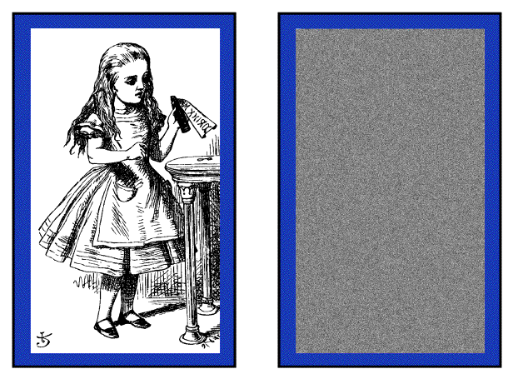


Alice Likes CBC Mode
Alice’s uncompressed image, Alice CBC encrypted (TEA)
Why does this happen?
Same plaintext yields different ciphertext!
Part 1 ⎯ Cryptography <number>

Slide 41
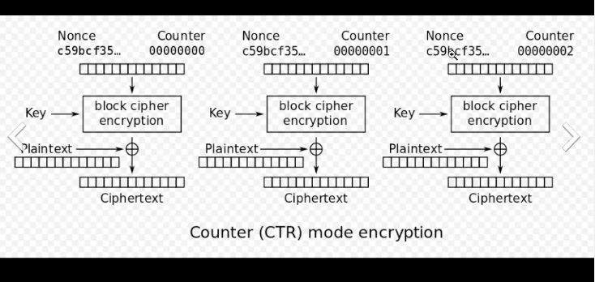
Counter Mode (CTR)
CTR is popular for random access
Use block cipher like stream cipher
Encryption Decryption
C₀ = P₀ ⊕ E(IV, K), P₀ = C₀ ⊕ E(IV, K),
C₁ = P₁ ⊕ E(IV+1, K), P₁ = C₁ ⊕ E(IV+1, K),
C₂ = P₂ ⊕ E(IV+2, K),… P₂ = C₂ ⊕ E(IV+2, K),…
CBC can also be used for random access!!!
Part 1 ⎯ Cryptography <number>
Notes:
-CBC는 체인을 형성해놔서 그전 Cipher Text값을 모르면 복호화가 불가능 하므로 random access가 불가능하다.
-CTR은 단순히 공개된IV만 있으면 되기에 random access(임의 지점부터 복호화)가 가능하다
또한 에러가 전파되지 않는다.

