Slide 1
Introduction
Chapter 1 ⎯ Introduction <number>
Notes:
정보보안의 전반적인 구성요소
1.Cryptography(암호학)
-"secret codes"
①symmetric key crytograhphy(대칭키암호)
AES 암호알고리즘
②public key crytograhphy(공개키암호)
RSA 암호알고리즘
③hash function(해쉬암호)
SHA1 hash function
2.Access control
①Authentication
-passwords
-biometrices
②Authorization
-Access Control List 자원(file)을 중심으로 해서 누가 접근할 수 있느냐
사람이 중심으로 해서 누가 접근할 수 있느냐
-Firewall
3.Protocols
-인증과 관련된 부분에서 다양한 프로토콜사용
-프로토콜의 특성으로 조금만 변경만해도 security 측면에선 치명적효과를 가져올 수 있음(butterfly effect)
-프로토콜에서 암호학이 사용됨
-★SSL, IPSec, Kerberos, GSM security
4.Software
-security-critical flaws : 소프트웨어의 결함이 보안적측면에서 치명적일지
ex)Buffer overflow
-Malware : viruses 나 worms들을 어떻게 방지하고 탐지해낼 것 인가
-SRE(soft ware reverse engineering) : binary -> source
-DRM(digital rights management) :mp3 , e-book , 완벽하게는 어려움이 있음 mp3를 틀고 핸드폰으로 녹음할수 있기에
-OS
※OWASP(sw의 보안성을 개선하기 위해 노력하는 비영리재단) 에서 제안한 10개의 웹 취약점 분석을 통해 웹에 안전하단걸 검증하고 웹 서비스를 배포해야함

Slide 2
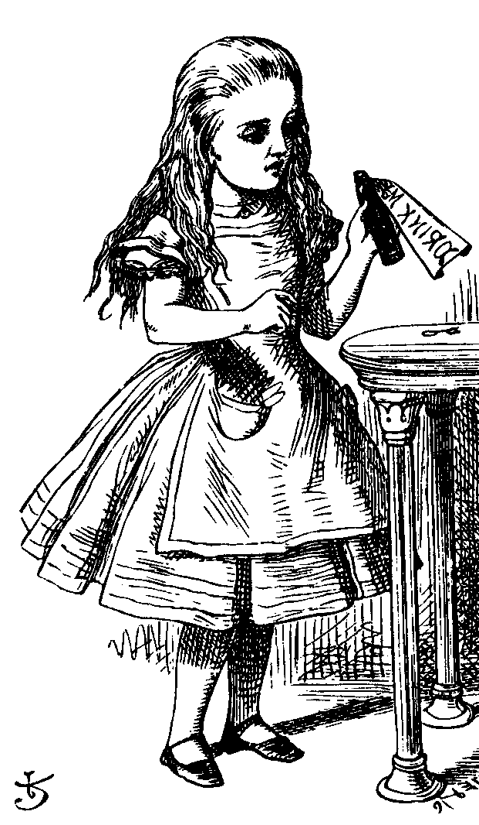
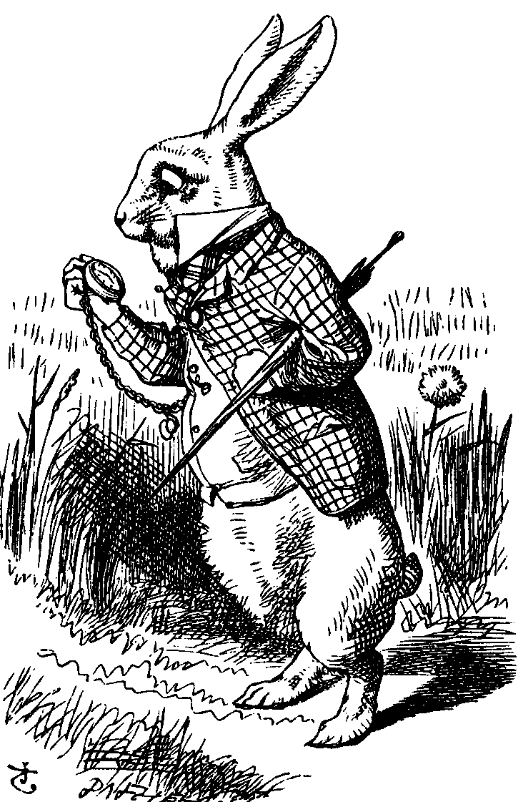
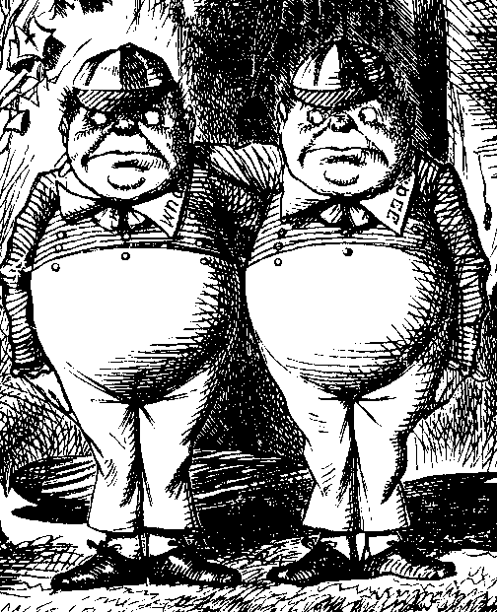
The Cast of Characters
Alice and Bob are the good guys
Trudy is the bad guy
Trudy is our generic “intruder”
Chapter 1 ⎯ Introduction <number>
Notes:
alice:은행 설립자
bob:은행 고객
trudy:침입자
AOB(Alice open Bank)

Slide 3
Alice’s Online Bank
Alice opens Alice’s Online Bank (AOB)
What are Alice’s security concerns?
If Bob is a customer of AOB, what are his security concerns?
How are Alice and Bob concerns similar? How are they different?
How does Trudy view the situation?
Chapter 1 ⎯ Introduction <number>

Slide 4
CIA
Confidentiality, Integrity, and Availability
AOB must prevent Trudy from learning Bob’s account balance
Confidentiality: prevent unauthorized reading of information
Chapter 1 ⎯ Introduction <number>
Notes:
①Confidentiality(기밀성)
-정보를 허가 받지 않는 사람이 읽는 걸 막아야함
-아예 접근을 하지 못하게하는방법 + 암호를 하여 읽더라도 해석을 못하게 하는방법
-trudy가 bob의 계좌정보를 함부로 조회(reading)해선 안됨
②Integrity(무결성)
-허가받지 않은 사람이 정보를 쓰는 걸 막아야함
-trudy가 bob의 잔고를 함부로 변경해선 안됨
-bob이 자기자신의 잔고를 수정,변조(writing)해선 안됨
-해쉬함수를 통해서 원본을 저장하여 만약에 변경이 되었을 경우엔 최소한 발견할 수 있어야함
③Availability(가용성)
-항상 서비스가 필요할때 마다 항상 이용가능해야함
-거래를 해야하는데 증명서가 계속 다운 되면 안됨
-새로운 security concern
-Dos(denial of service)공격 같은 걸 막아야함

Slide 5
CIA
Trudy must not be able to change Bob’s account balance
Bob must not be able to improperly change his own account balance
Integrity: prevent unauthorized writing of information
Chapter 1 ⎯ Introduction <number>

Slide 6
CIA
AOB’s information must be available when needed
Alice must be able to make transaction
  If not, she’ll take her business elsewhere
Availability: Data is available in a timely manner when needed
Availability is a “new” security concern
  In response to denial of service (DoS)
Chapter 1 ⎯ Introduction <number>

Slide 7
Beyond CIA
How does Bob’s computer know that “Bob” is really Bob and not Trudy?
Bob’s password must be verified
  This requires some clever cryptography
What are security concerns of pwds?
Are there alternatives to passwords?
Chapter 1 ⎯ Introduction <number>

Slide 8
Beyond CIA
When Bob logs into AOB, how does AOB know that “Bob” is really Bob?
As before, Bob’s password is verified
Unlike standalone computer case, network security issues arise
What are network security concerns?
Protocols are critically important
Crypto also important in protocols
Chapter 1 ⎯ Introduction <number>

Slide 9
Beyond CIA
Once Bob is authenticated by AOB, then AOB must restrict actions of Bob
  Bob can’t view Charlie’s account info
  Bob can’t install new software, etc.
Enforcing these restrictions is known as authorization
Access control includes both authentication and authorization
Chapter 1 ⎯ Introduction <number>
Notes:
2.그외 보안과 관련된 측면
①.Acess Controll(접근 제어) ①-1.Authentication(인증) -네트워크가 수반되지 않는 경우 -Bob의 컴퓨터에서 Bob인지 Trudy인지 구분
-암호학을 사용해서 password를 사용해야함
-password가 보안적측면에서 그렇게 안전하지만은 않음
-password의 대안 -> 스마트폰 패턴, 지문인식과 같은 다양한 생체인식통한 인증
-네트워크가 수반되는 경우 -AOB입장에서 어떻게 Bob이 접근한게 맞는지 어떻게 구분을 하는가?
->예전엔 password방식을 많이 사용하지만 이경우엔 network security issuse가 발생
->프로토콜이 굉장히 중요
->프로토콜에서도 암호학은 굉장히 중요하다
①-2. Authorization(인가) -Bob이 AOBdㅔ 인증햇을때 밥의 행동들을 제한해야함
-Bob은 Charile's의 잔고를 볼수 없어야함
-Bob은 새로운 sw를 설치할 수 없어야함
-이런 제한을 두는게 Authorization이다
※Access Control은 authentication과 authorization 둘 다 포함한다.
②non-repudiation(부인봉쇄)
-Bob이 Charile에게 자동이체를 했는데 언제 자동이체를 했냐고 발뺌을 하는것을 방지
-나중에 계약을 발뺌하는 것을 방지
-offline에선 인감을 통해 부인봉쇄함
-★online에선 전자서명을 통해 부인봉쇄야해줘야함

Slide 10
Beyond CIA
Cryptography, protocols, and access control are implemented in software
What are security issues of software?
  Most software is complex and buggy
  Software flaws lead to security flaws
  How to reduce flaws in software development?
Chapter 1 ⎯ Introduction <number>
Notes:
3.SoftWare Issue
①secure coding
-위의 보안관련된 측면들은 소프트웨어 속에서 구현됨
-대부분 소프트웨어는 복잡해지고 버그가 많아지고 있음
-그럴 경우 소프트웨어 상의 결함은 보안상 결함으로 발전하게 됨
-어떻게 소프트웨어 상의 결함을 줄이느냐가 관건

Slide 11
Beyond CIA
Some software is intentionally evil
  Malware: computer viruses, worms, etc.
What can Alice and Bob do to protect themselves from malware?
What can Trudy do to make malware more “effective”?
Chapter 1 ⎯ Introduction <number>
Notes:
②malware
-몇몇 소프트웨어들은 인위적으로 사악한 소프트웨어가 있을 수 있음(Malware: viruses, worms 등등)
-aclice와 bob입장에선 어떻게 malware로 부터 보호해야하는가? -trudy입장에선 어떻게 malware를 효과적으로 사용할 수 있는가?

Slide 12
Beyond CIA
Operating systems enforce security
  For example, authorization
OS: large and complex software
  Win XP has 40,000,000 lines of code!
  Subject to bugs and flaws like any other software
  Many security issues specific to OSs
  Can you trust an OS?
Chapter 1 ⎯ Introduction <number>
Notes:
③OS
-OS도 점차 복잡해지는 이에 대한 보안을 강화해줘야함

Slide 13
My Book
The text consists of four major parts
  Cryptography
  Access control
  Protocols
  Software
Chapter 1 ⎯ Introduction <number>

Slide 14
Cryptography
“Secret codes”
The book covers
  Classic cryptography
  Symmetric ciphers
  Public key cryptography
  Hash functions
  Advanced cryptanalysis
Chapter 1 ⎯ Introduction <number>

Slide 15
Access Control
Authentication
  Passwords
  Biometrics and other
Authorization
  Access Control Lists and Capabilities
  Multilevel security (MLS), security modeling, covert channel, inference control
  Firewalls and Intrusion Detection Systems
Chapter 1 ⎯ Introduction <number>

Slide 16
Protocols
Simple authentication protocols
  “Butterfly effect” ⎯ small change can have drastic effect on security
  Cryptography used in protocols
Real-world security protocols
  SSL, IPSec, Kerberos
  GSM security
Chapter 1 ⎯ Introduction <number>

Slide 17
Software
Software security-critical flaws
  Buffer overflow
  Other common flaws
Malware
  Specific viruses and worms
  Prevention and detection
  The future of malware
Chapter 1 ⎯ Introduction <number>

Slide 18
Software
Software reverse engineering (SRE)
  How hackers “dissect” software
Digital rights management (DRM)
  Shows difficulty of security in software
  Also raises OS security issues
Limits of testing
  Open source vs closed source
Chapter 1 ⎯ Introduction <number>

Slide 19
Software
Operating systems
  Basic OS security issues
  “Trusted” OS requirements
  NGSCB: Microsoft’s trusted OS for PC
Software is a big security topic
  Lots of material to cover
  Lots of security problems to consider
Chapter 1 ⎯ Introduction <number>

Slide 20
Think Like Trudy
In the past, no respectable sources talked about “hacking” in detail
It was argued that such info would help hackers
Very recently, this has changed
  Books on network hacking, how to write evil software, how to hack software, etc.
Chapter 1 ⎯ Introduction <number>

Slide 21
Think Like Trudy
Good guys must think like bad guys!
A police detective
  Must study and understand criminals
In information security
  We want to understand Trudy’s motives
  We must know Trudy’s methods
  We’ll often pretend to be Trudy
Chapter 1 ⎯ Introduction <number>

Slide 22
Think Like Trudy
Is all of this security information a good idea?
“It’s about time somebody wrote a book to teach the good guys what the bad guys already know.” ⎯ Bruce Schneier
Chapter 1 ⎯ Introduction <number>

Slide 23
Think Like Trudy
We must try to think like Trudy
We must study Trudy’s methods
We can admire Trudy’s cleverness
Often, we can’t help but laugh at Alice and Bob’s stupidity
But, we cannot act like Trudy
Chapter 1 ⎯ Introduction <number>

Slide 24
In This Course…
Always think like the bad guy
Always look for weaknesses
Strive to find a weak link
It’s OK to break the rules
Think like Trudy!
But don’t do anything illegal…
Chapter 1 ⎯ Introduction <number>

