Slide 1
Project: Surveillance
Aditya Harikrish - 2020111009 Anusha Nath Roy - 2020101124 Gaurav Singh - 2020111014 Yash Anil Bhatia - 2020101007

Slide 2
What we Built
We built
a radar with an ultrasonic distance sensor, and
a motion detection warning system integrated into a Telegram (a popular messaging app) bot for the end user to interact with.

Slide 3
Implementation
Our circuit is spread across two nodes—let’s call them Node 1 and Node 2—due to the constraints of distance learning.

Slide 4
Implementation – Node 1
This has the radar. The radar cycles through 7 angles even spread from 0° and 180°.
The ultrasonic distance sensor measures the distance measured in each of these distances.
This data is uploaded to oneM2M and plotted as a spider plot using Plotly, a Python module.

Slide 5
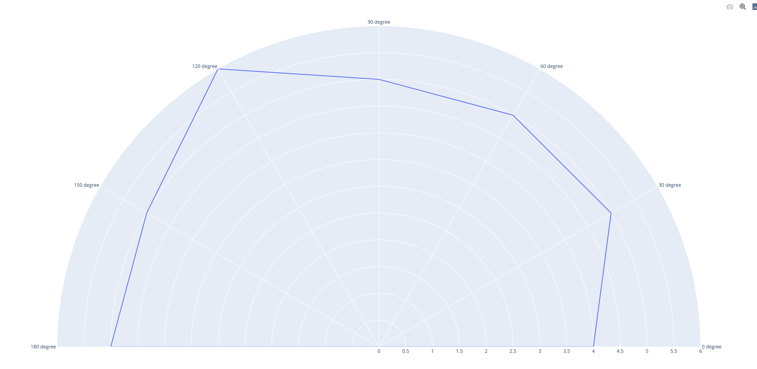
Implementation – Node 1

Slide 6
Implementation – Node 2
Node 2 has the motion detection system.
It has a PIR motion sensor along with a buzzer and an LED.
A graph of the number of times motion is detected is plotted on ThingSpeak as a function of time.
Node 2 runs the Telegram bot that enables the end-user to run commands.

Slide 7
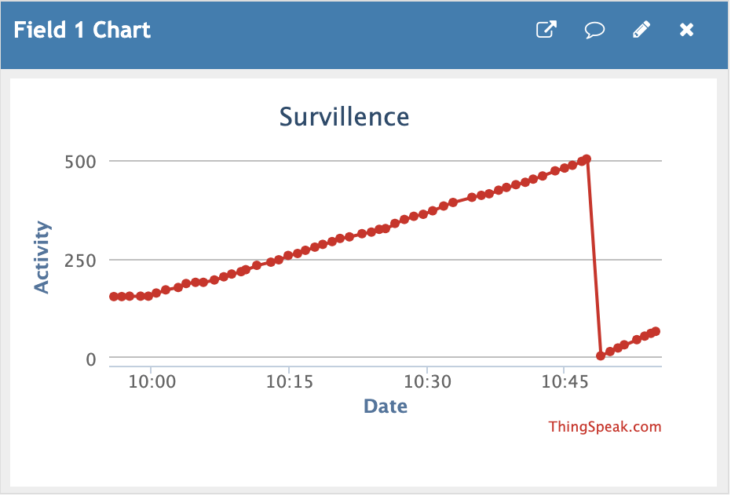
Implementation – Node 2

Slide 8
Implementation – Node 2
The bot can run the following commands:
/start or /help for a list of commands that can be executed,
/led warn to turn the LED on and /led off to turn the LED off,
/buzzer warn to turn the buzzer on and /buzzer off to turn the buzzer off, and
/led state and /buzzer state to learn about the status of the LED and the buzzer respectively (i.e. whether they are on or off)

Slide 9
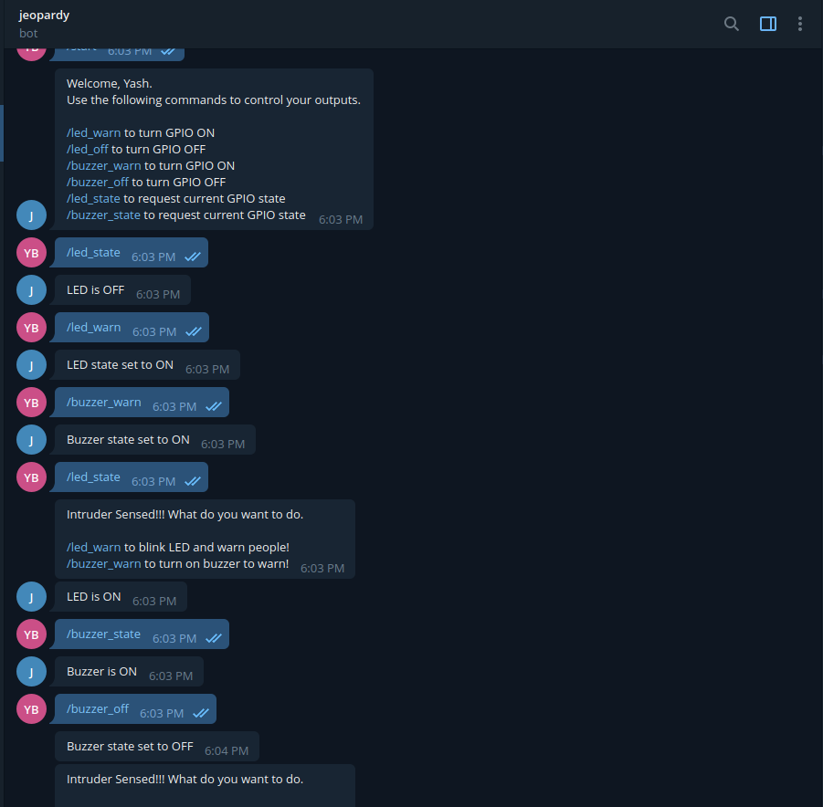
Implementation – Node 2

Slide 10
Thank You

