Slide 1
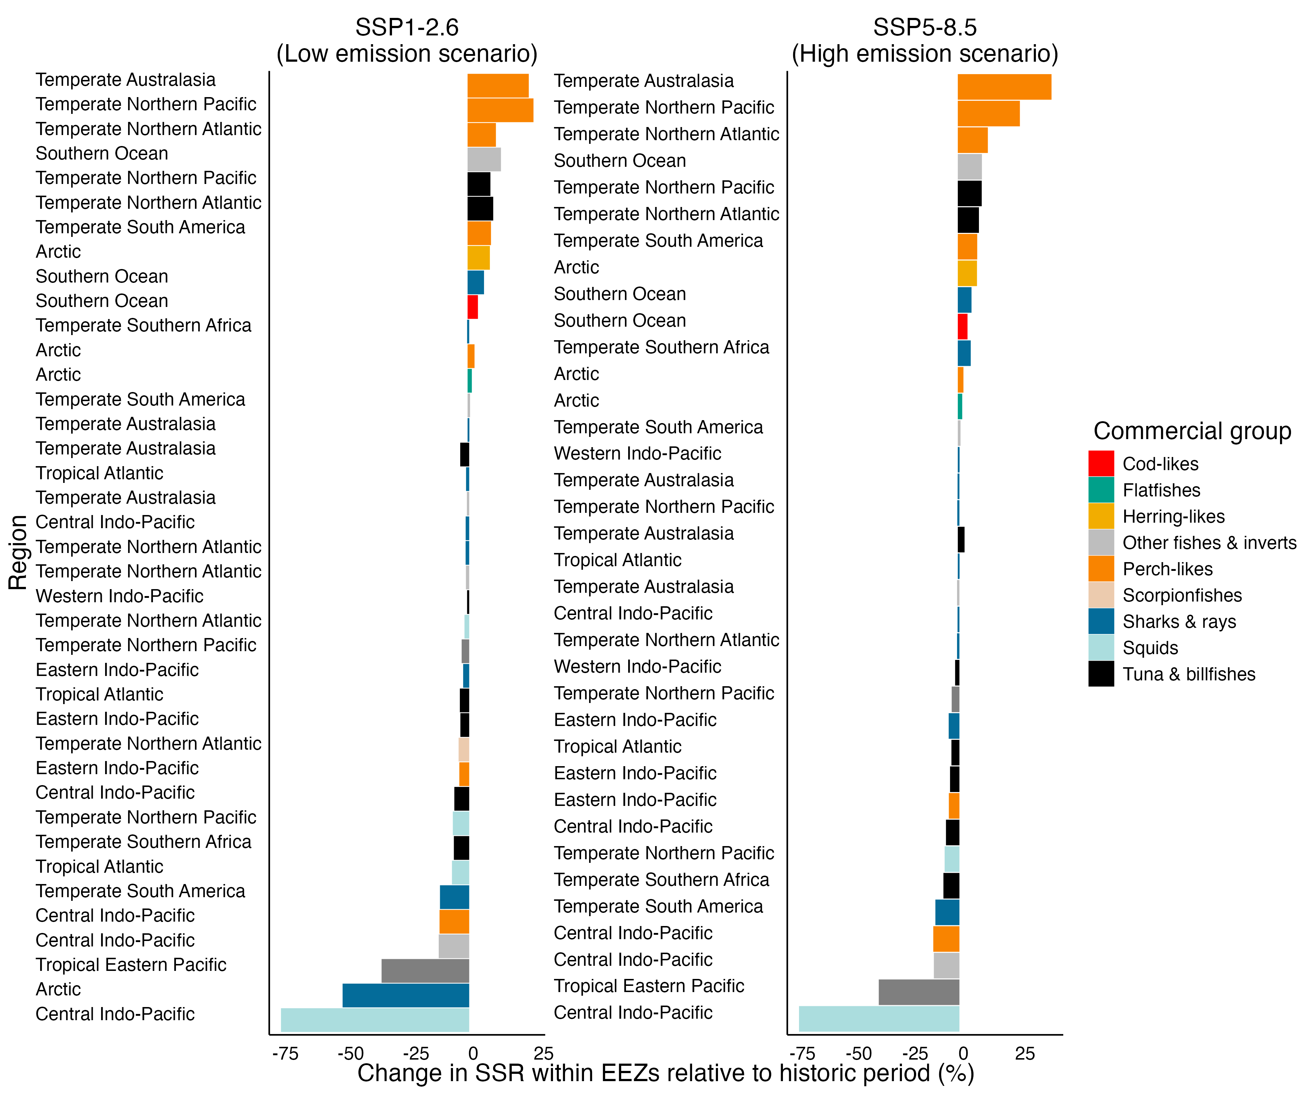
Direction of change
High
Seas
EEZ
-100
0
100

Slide 2
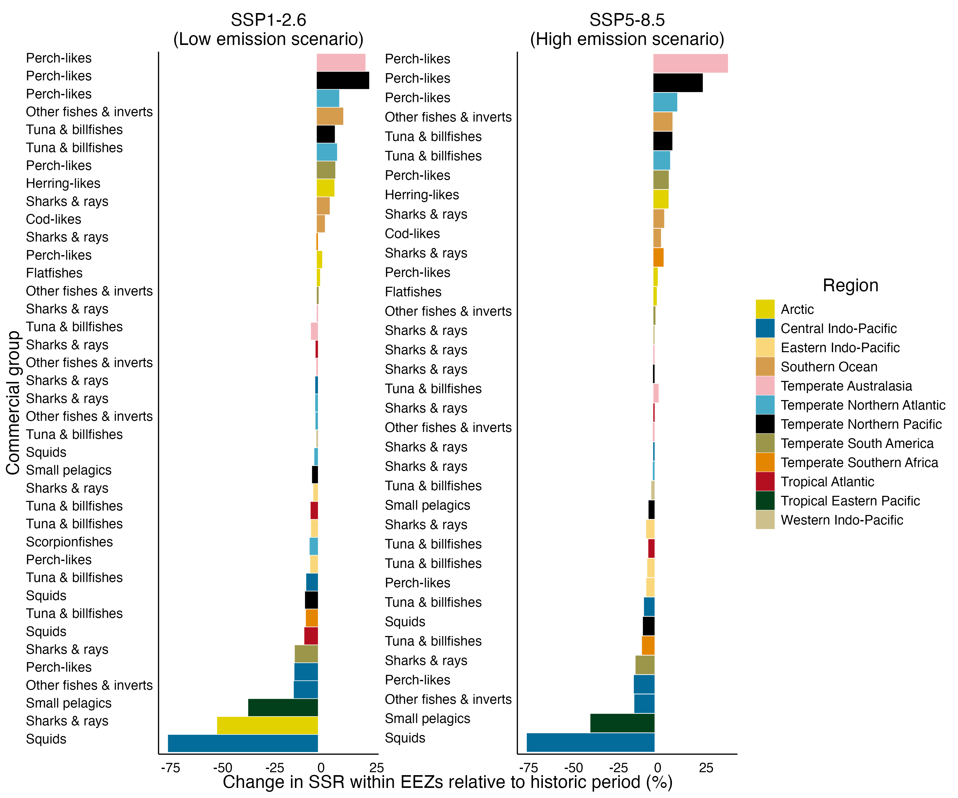
Direction of change
High
Seas
EEZ
-100
0
100

