Slide 1
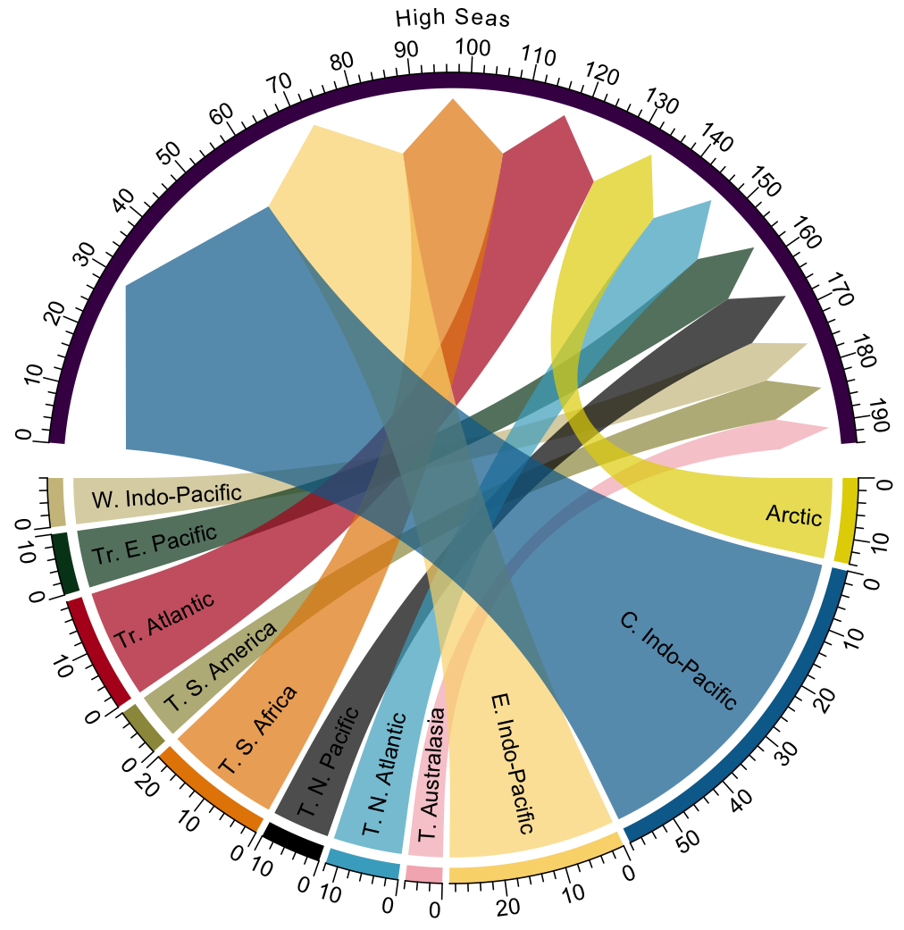
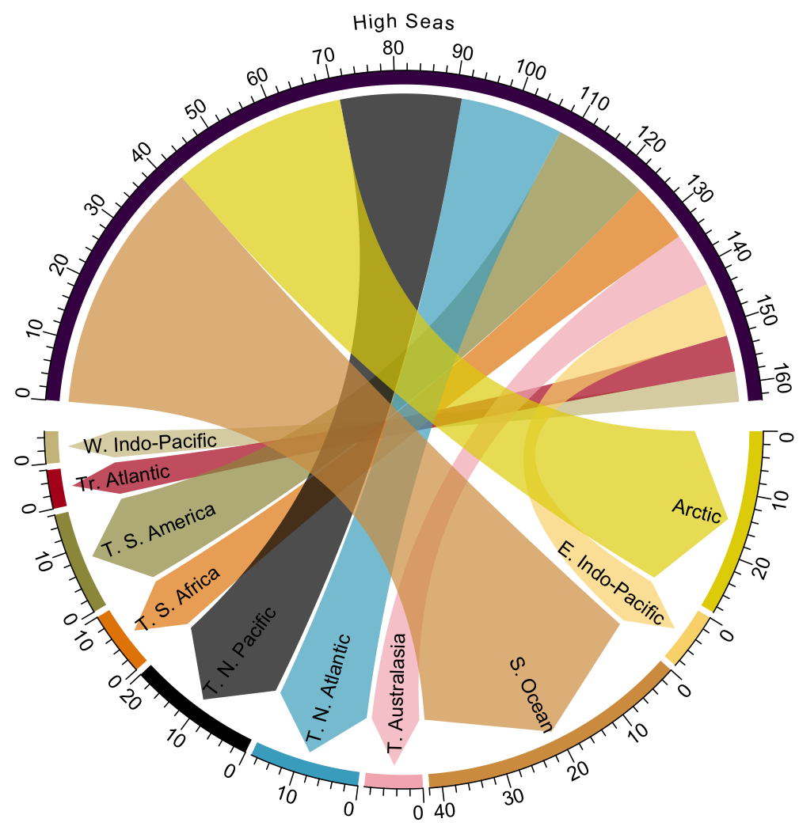
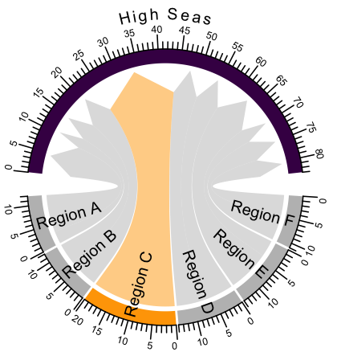
SSP 126, early
A
B
Legend key
Direction of shift
Name of LME
Name of
LME
Color of LME across figures
Proportion of all stocks shifting

Slide 2
Legend key
Direction of shift
Name of LME
Name of LME
Color of LME across figures
Proportion of all stocks shifting

Slide 3
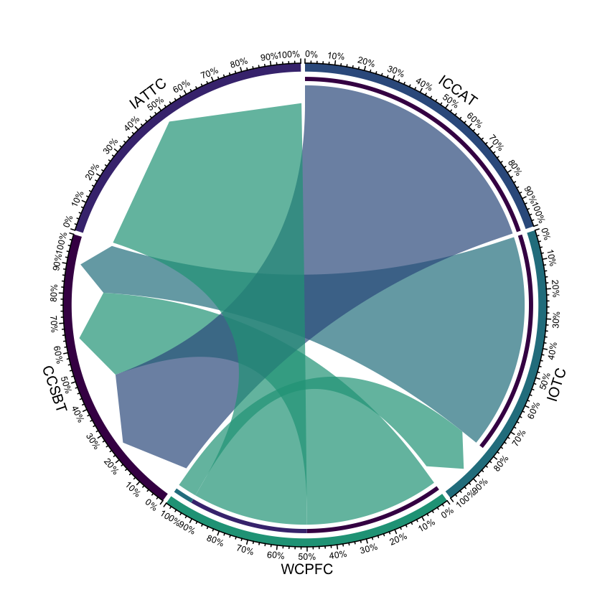
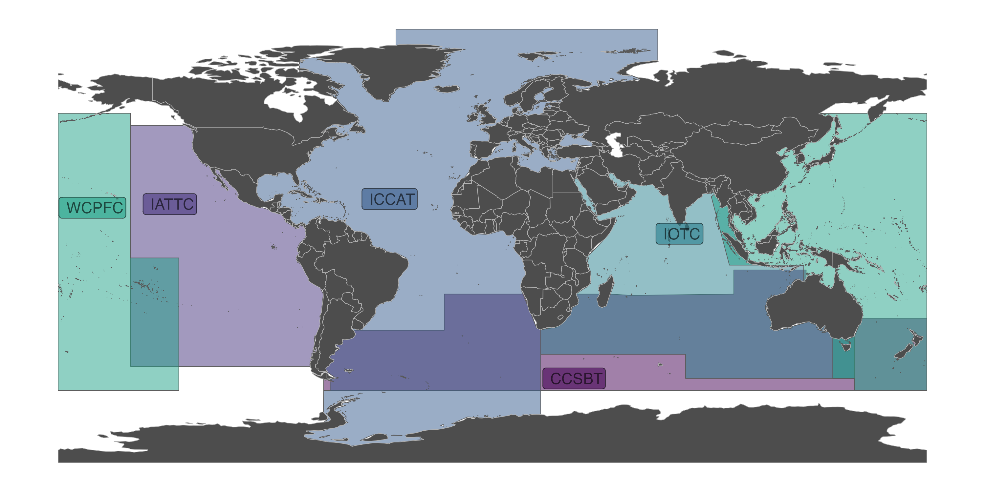
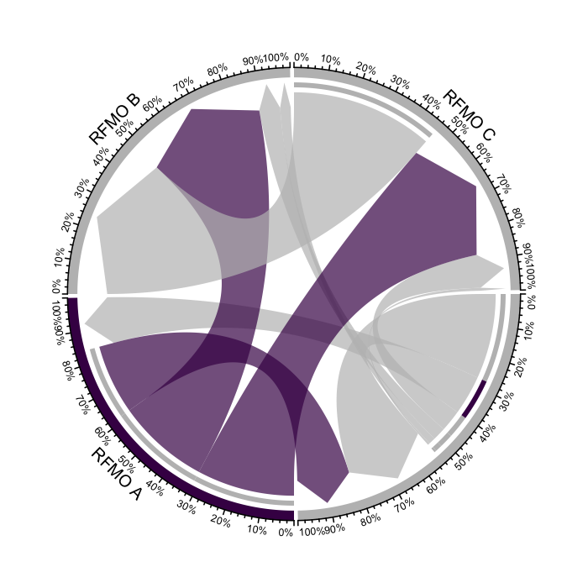
RFMO location
Figure key
Direction of shift
Name of RFMO
Percentage of stock going to RFMO A
Percentage of stock going to RFMO C

Slide 4
Direction of shift
Name of RFMO
Percentage of stock going to RFMO A
Percentage of stock going to RFMO C

Slide 8
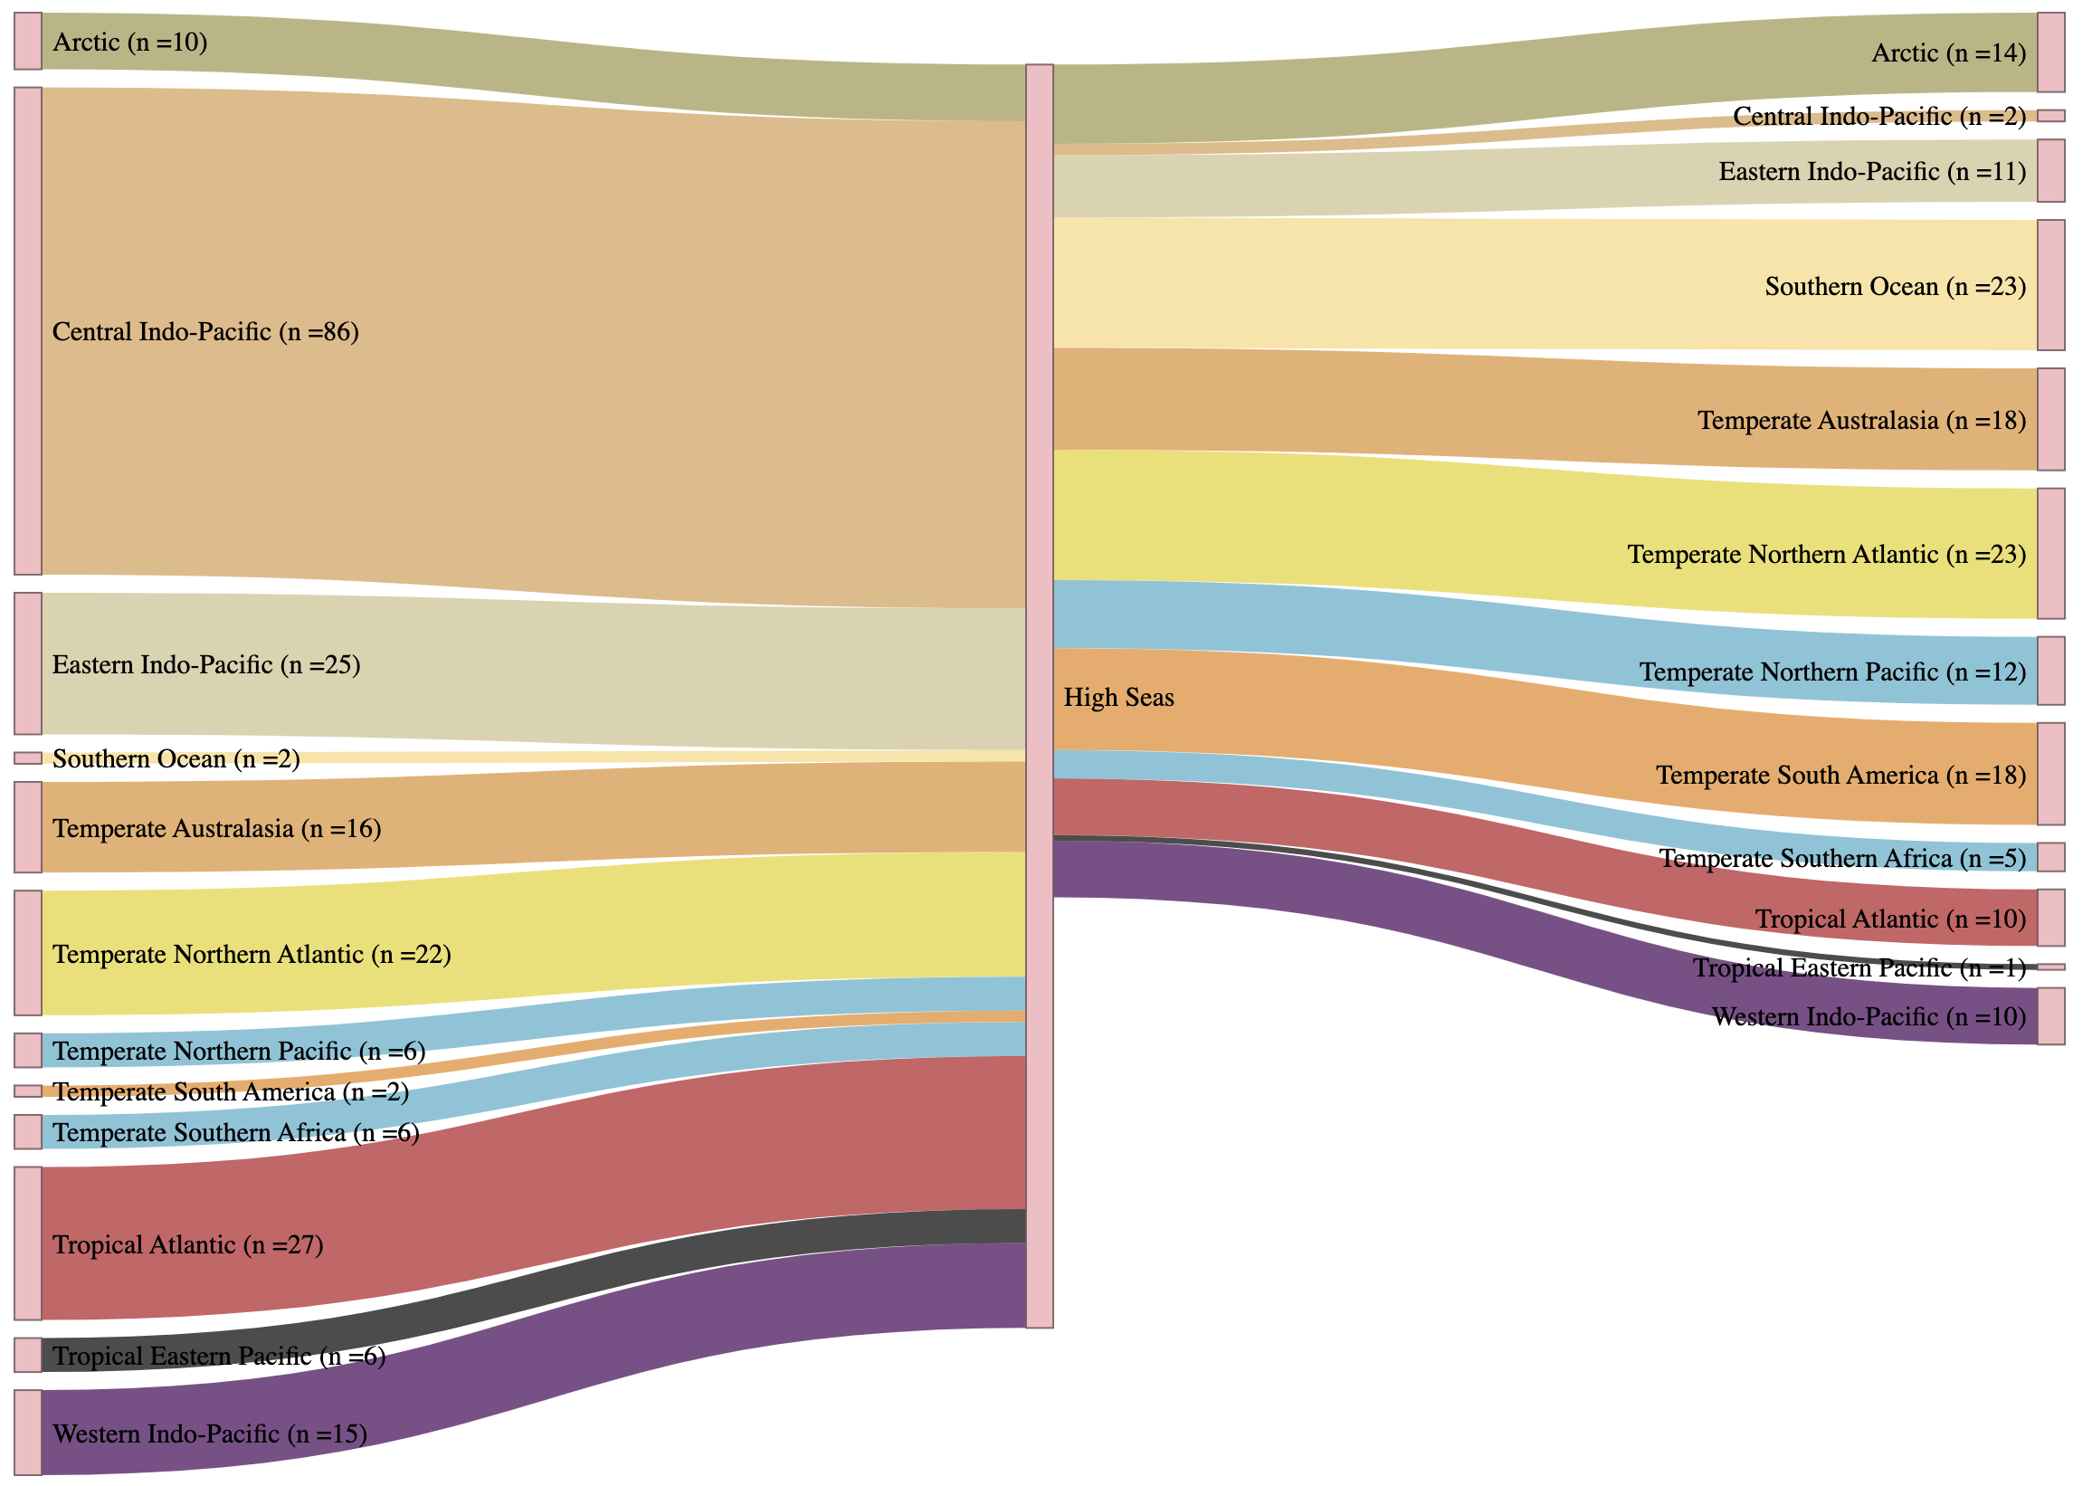
Direction of change
High seas Direction
EEZ Direction

