Slide 1
KJM COFFEE SHOP | CUSTOMER JOURNEY
Customer System
Flowcharts
End-to-end mobile customer experience, verified against the implemented Flutter app and Laravel backend.
Main journey • Checkout & payment • Order tracking • Membership & rewards • Customer service
Flow diagrams are supplied as high-resolution images; Mermaid source files are included for editing.

Slide 2
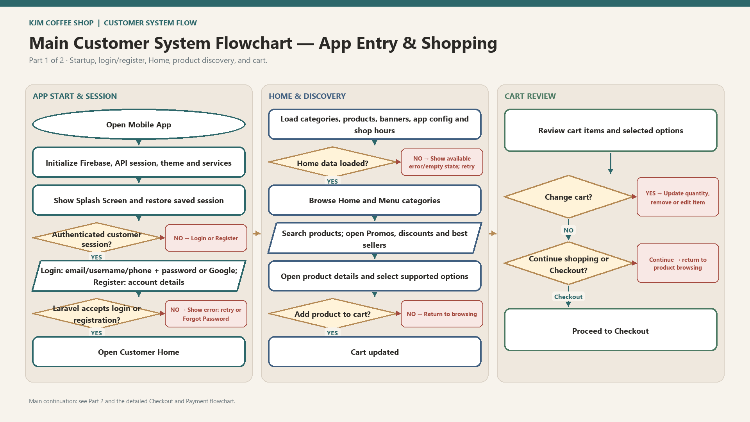

Slide 3
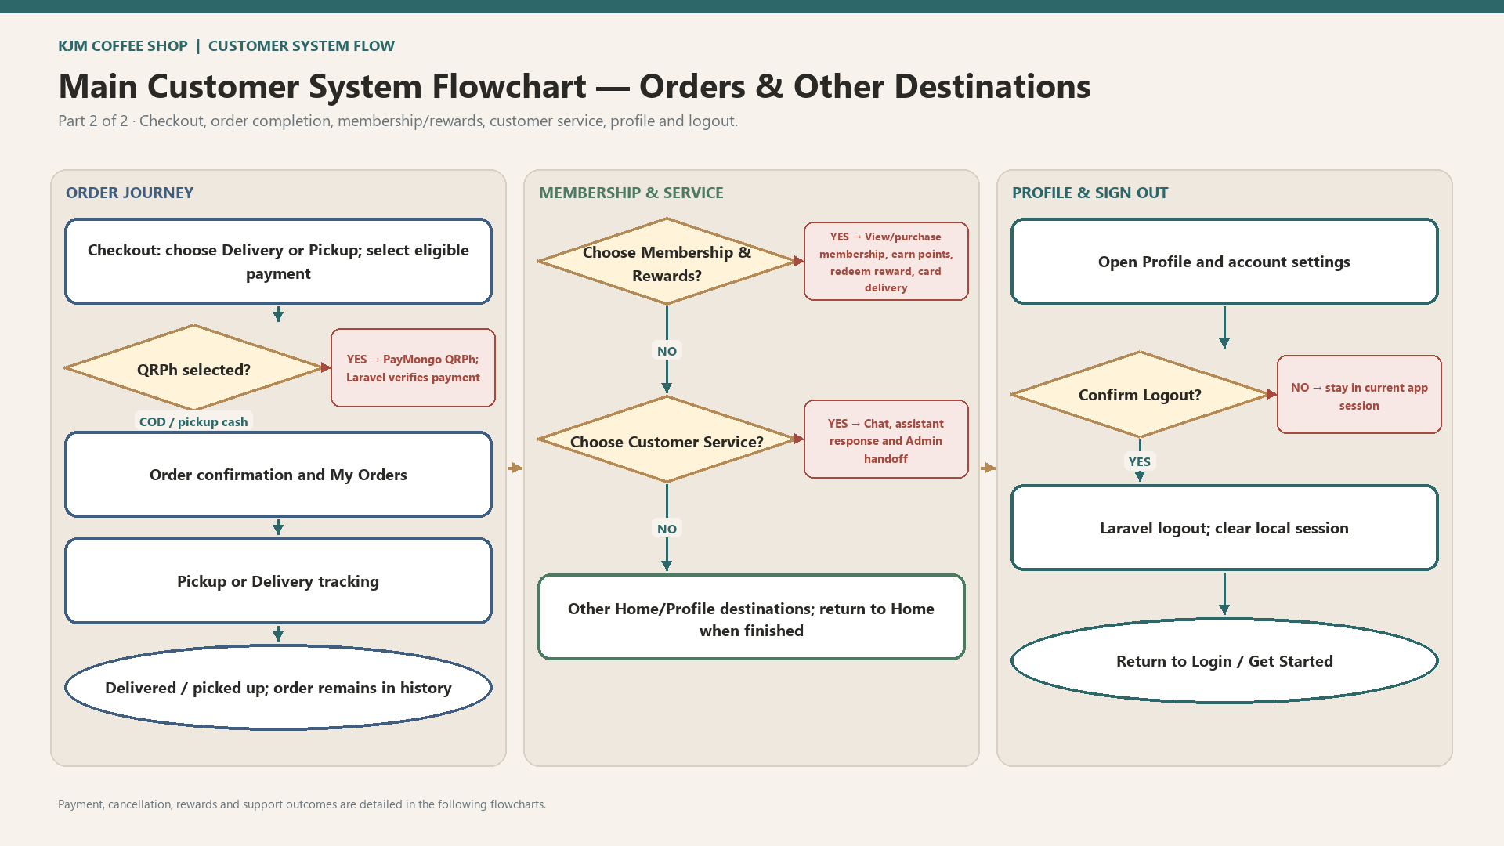

Slide 4
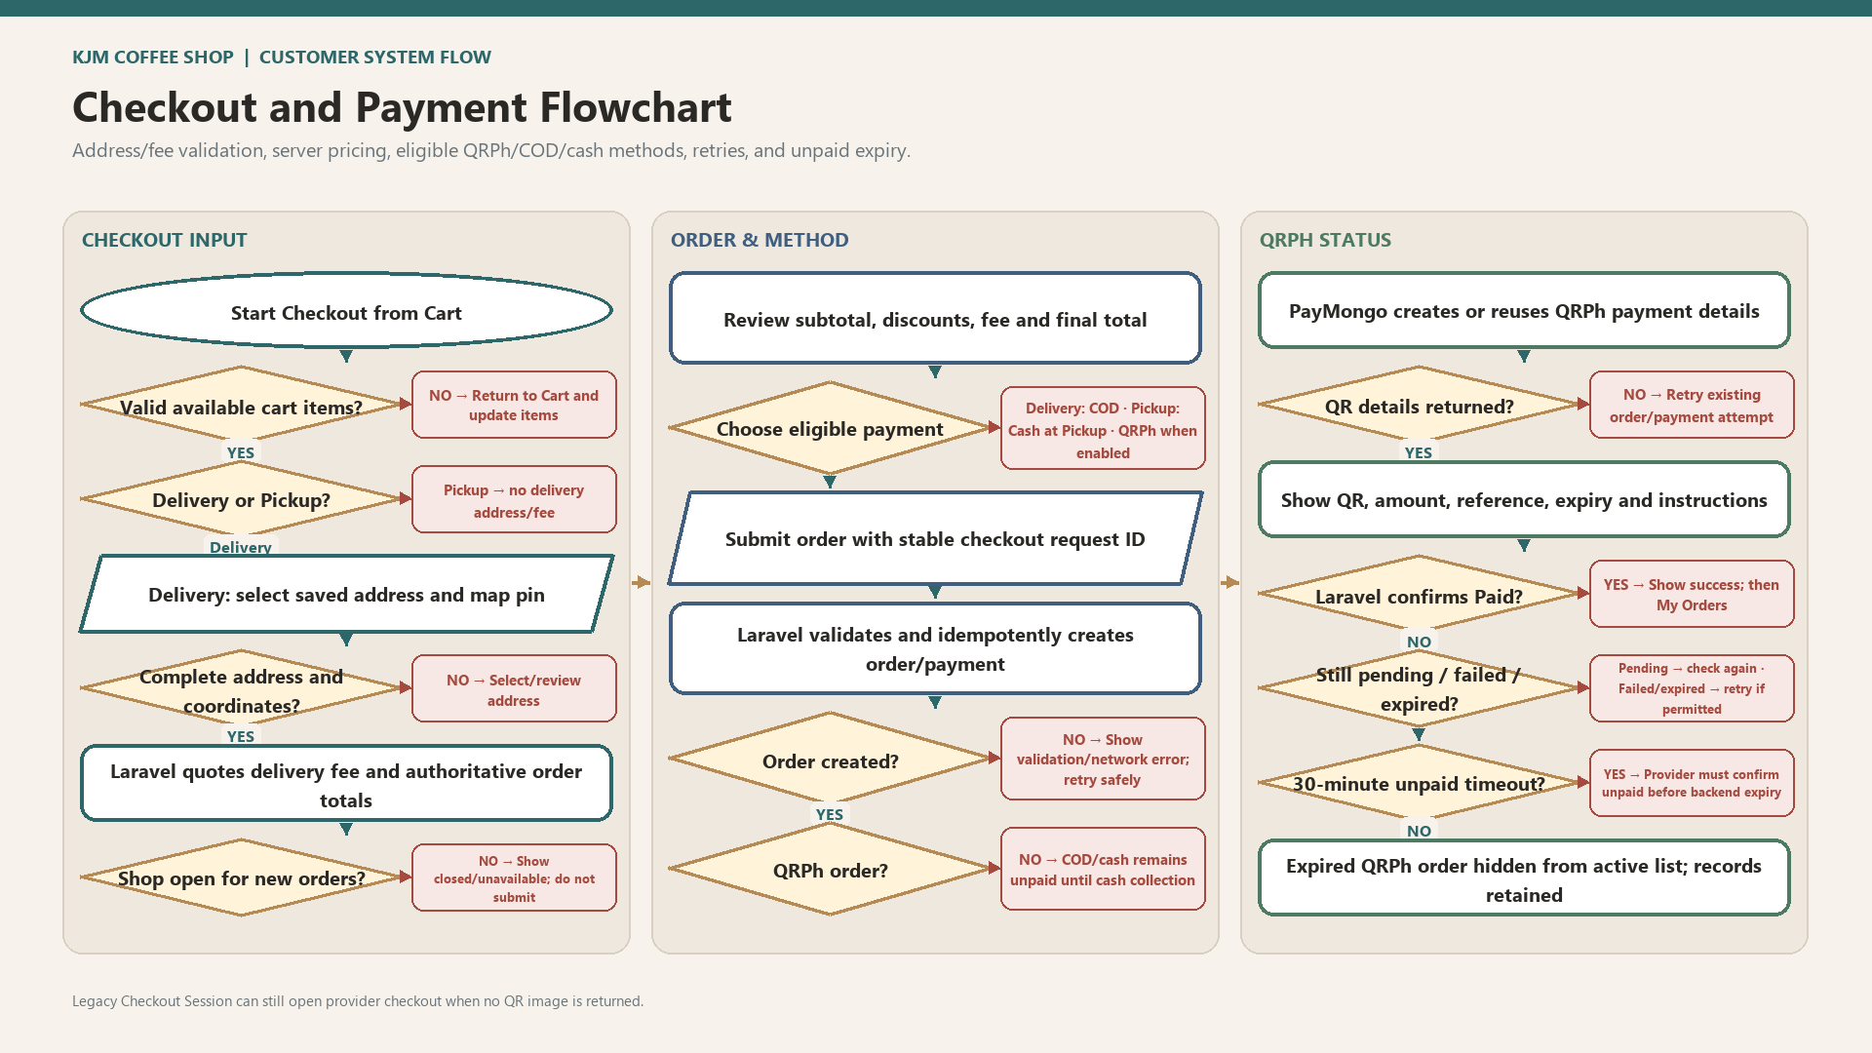

Slide 5
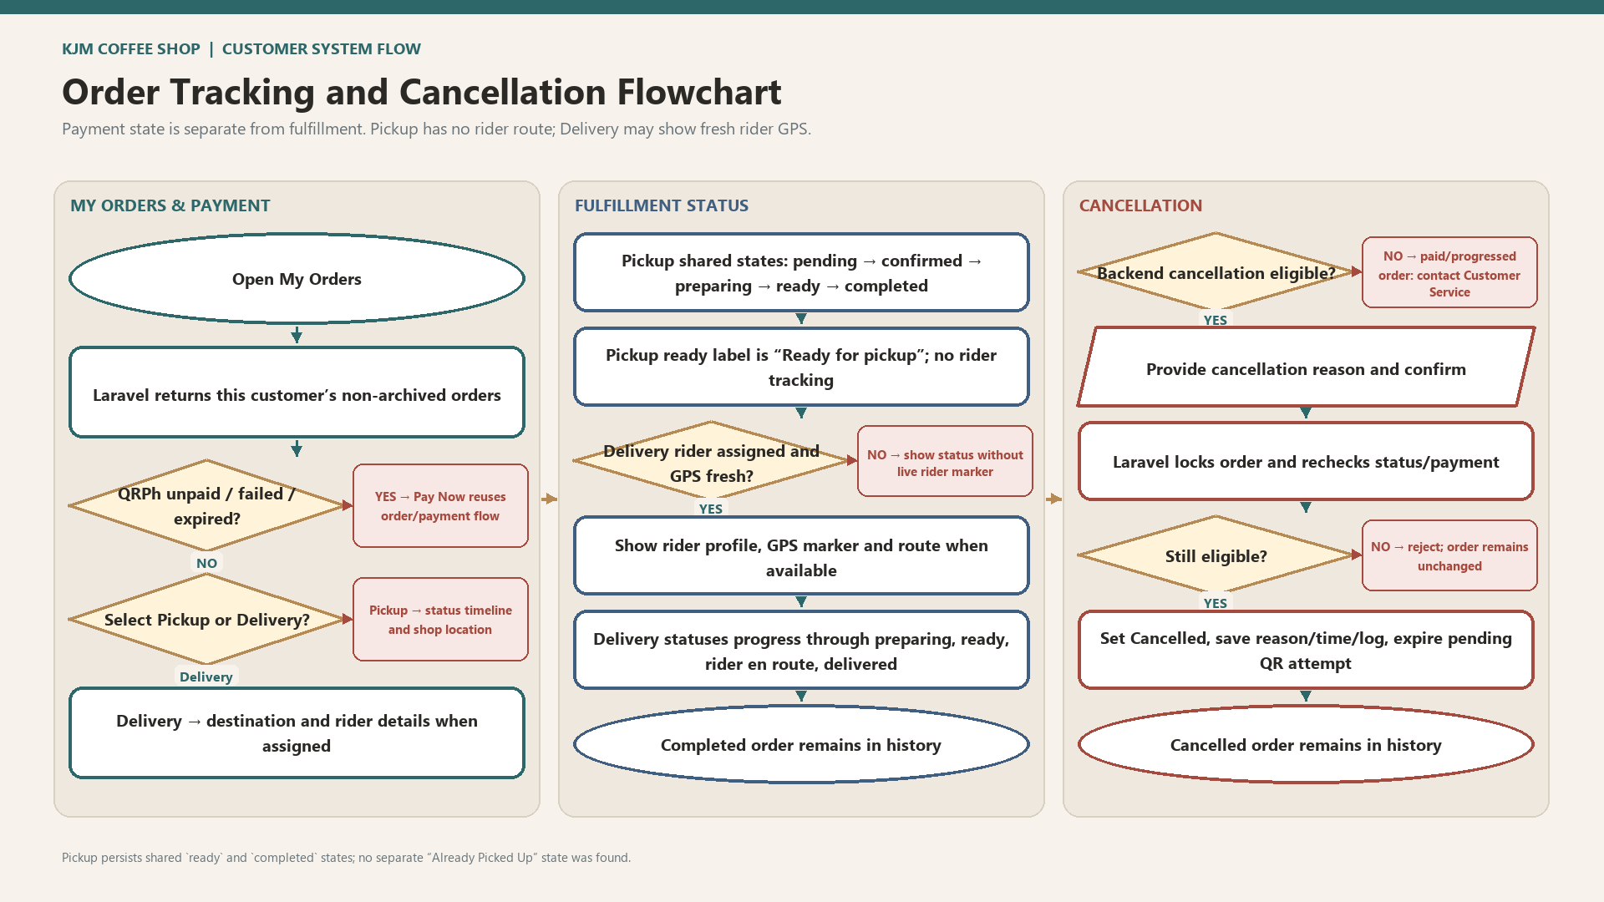

Slide 6
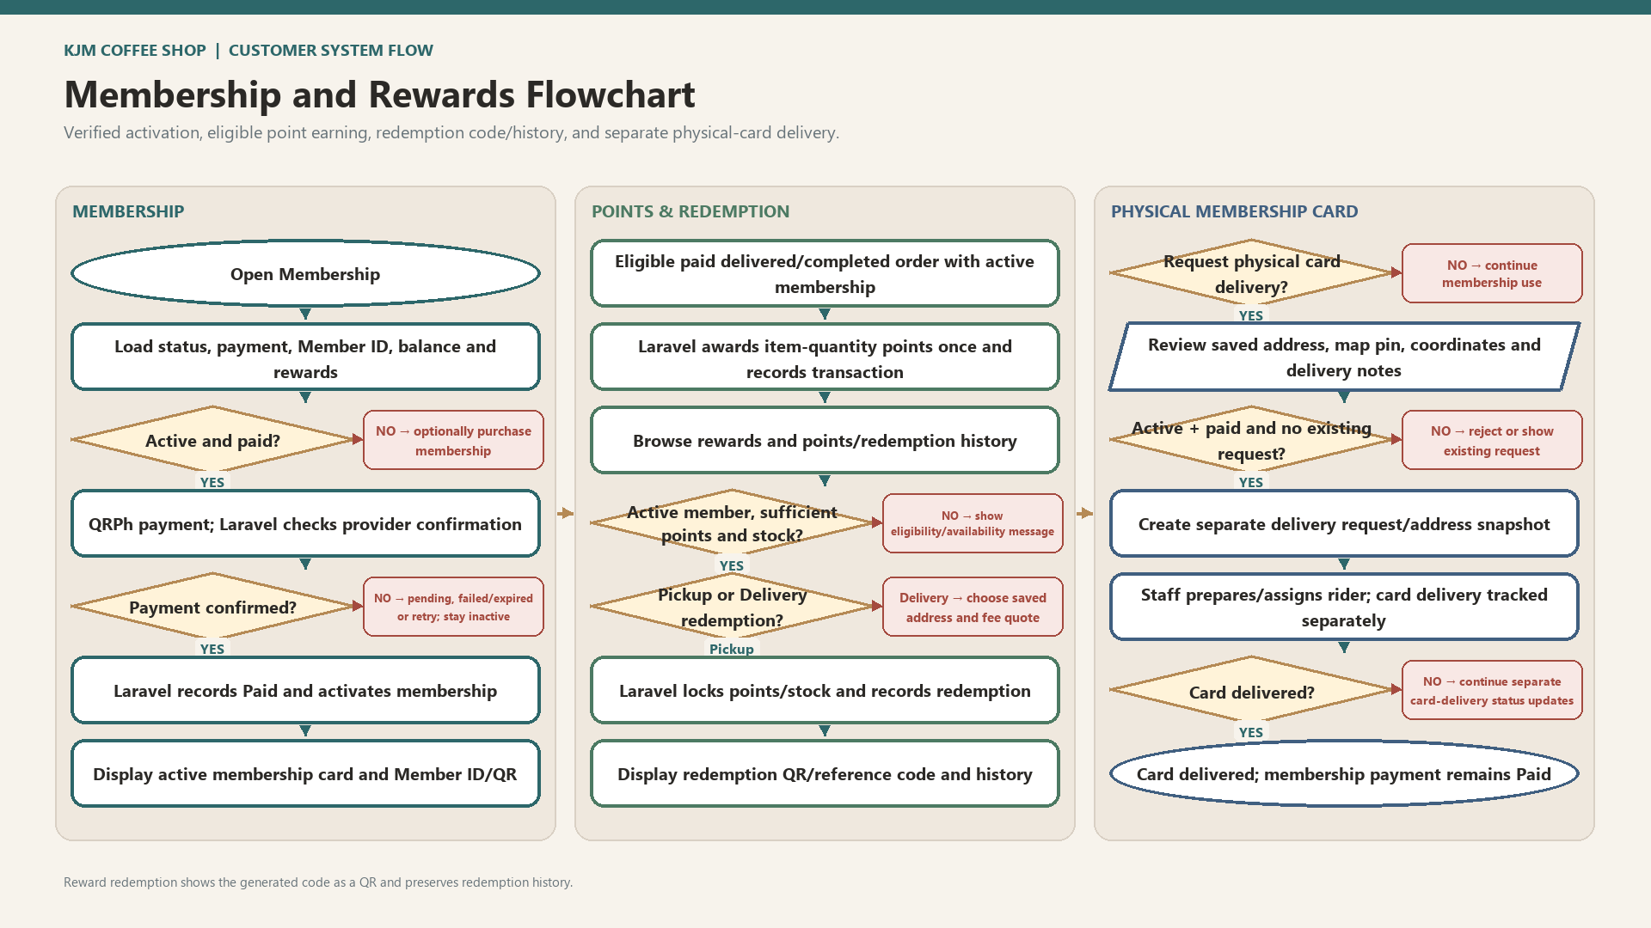

Slide 7


