Slide 1
Business Rule Engine
Jare
Java Rule Engine
Uwe Geercken
April 2016
http://github.com/uwegeercken

Slide 2
Business Rule Engine: General
Rule Engine – Apply tests/checks to data by using rules: Files, Databases, Streams, any data
Rules/group of rules and actions created through web user interface
Rules and group of rules to define complex rule scenarios
Actions to update/modify data or other actions after rules are processed
All parts situated in a project and can be exported to a Zip file – one file that can be executed by the ruleengine
Can be used to test data, for quality checks, KPI's, to filter data, to update data

Slide 3
Business Rule Engine: Usage
Written in Java. Runs everywhere, small footprint
Extendible: additional checks, rules, actions easily created
Universal – any Java Objekt can be evaluated
Use cases:
Standalone applications
Embedded in applications ; also web applications
Runs on a server, in a virtual machine (VM) or as a container (Docker)
Plugin available for Pentaho Data Integration tool
Run as a standalone Socket Server, waiting for connections

Slide 4
Business Rule Engine: Groups and Rules
Groups and Rules connected with and/or conditions
Rules check data against an expected value or against another field
Group of rules can pass the tests/checks although some rules might have failed (when using „or“ conditions)
Results of a test/check can trigger one or multiple actions
Several actions are already pre-defined
Actions can be any Java code – e.g. update of data/database, send messages, calculations, etc.

Slide 5
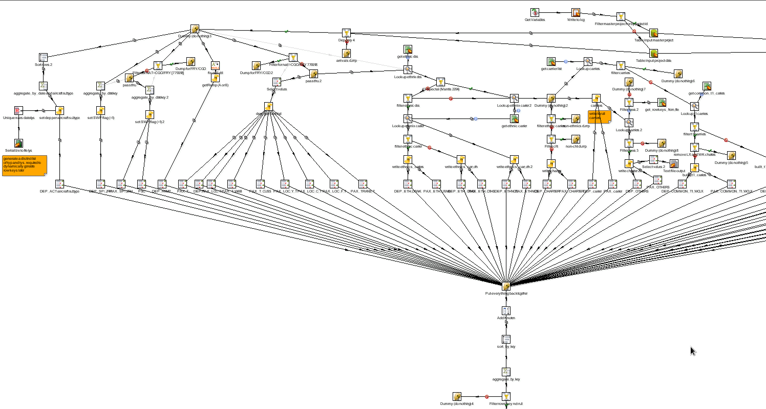
without Rule Engine: ETL example

Slide 6
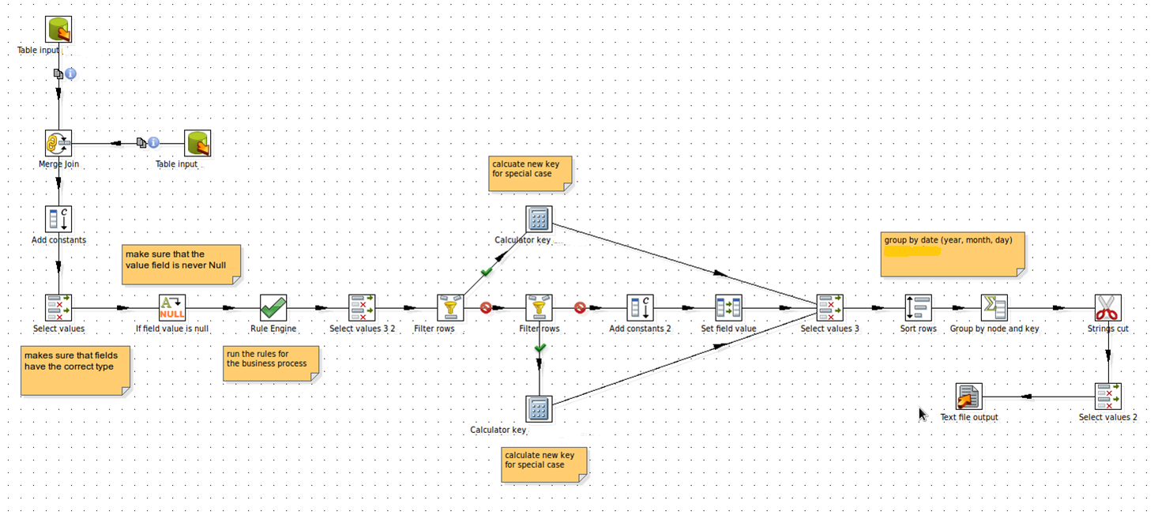
with Rule Engine: same ETL

Slide 7
Business Rule Engine: Advantages
Enforces the seperation of responsibilities
Any level of complexity for the logic is possible
Rules are external to ETL tool, application code, web code and NOT embedded/mixed with code or IT processes
Maintenance of rules and actions can be done externally: Business user, superuser, developer
Application code, ETL processes and code in general is simplified and easier to overview and maintain; big plus for quality and reducing cost
Logic is transparent to the user (separated from IT code)
Universally usable and extendible
Open Source & free of licence cost

Slide 8
Business Rule Engine: Status
Rule Engine stand-alone or server: available
Pentaho Data Integration Plugin Step: available
Documentation on core design, checks, actions, web gui: available
Web GUI for the maintenance of rules and actions: available

