Slide 1
Required:
Server that can run NodeJS
Express/NodeJS will be the scraper application.
[Input] URL
Scraper will have different scrapers that will depend on the URL
REST api will return the fields found in page 4.
IG API Fetcher
IG Scraper
FB Graph Fetcher
Ytube API Fetcher
OG / SEO Scaper
Express REST web service
/contextScraper?url=<URL>
HTML / CSS / JS for the pages (slide 2 and 3)

Slide 2
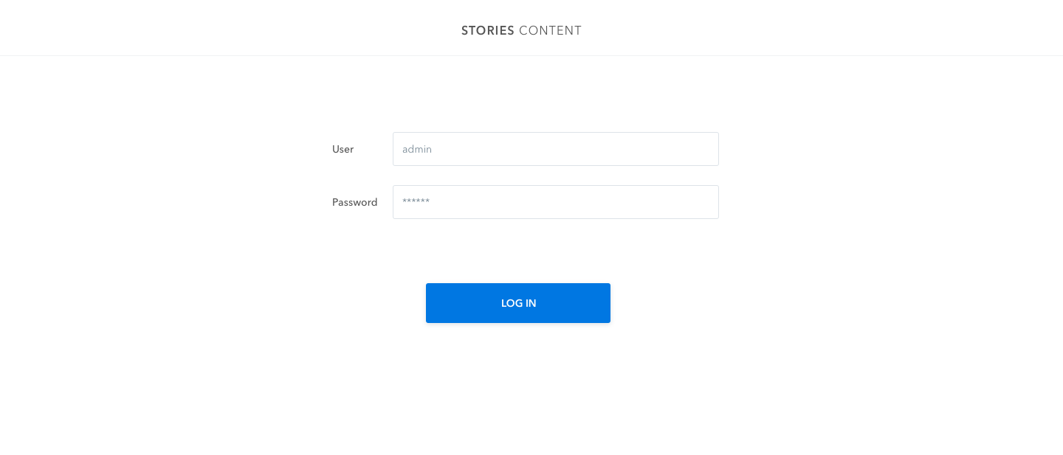

Slide 3
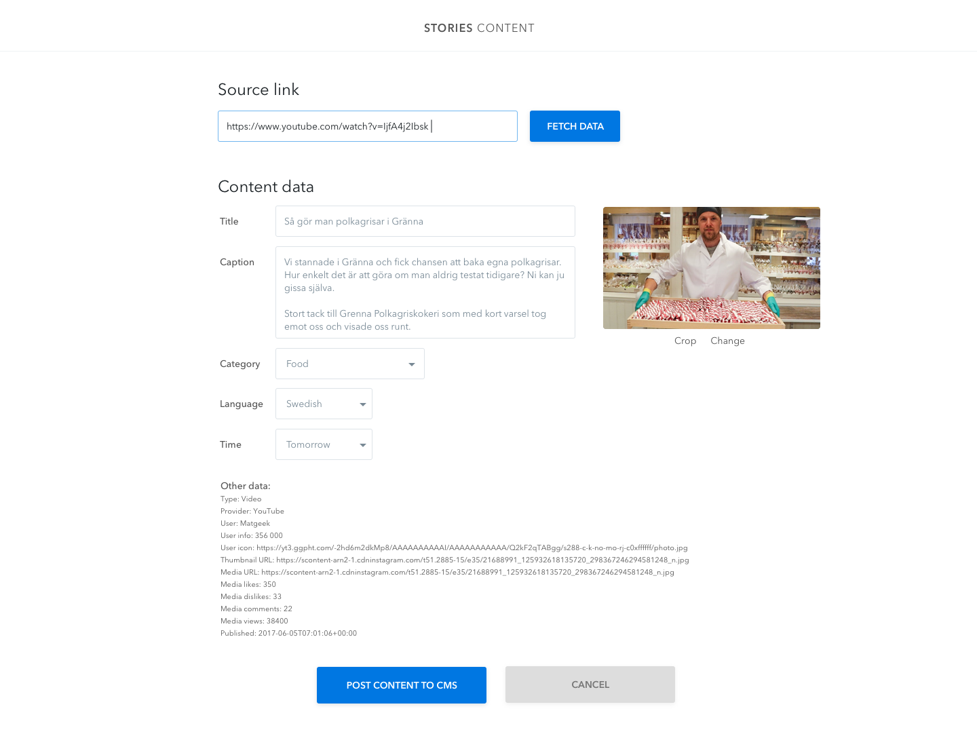

Slide 4
