Slide 1
Upwise
Strong foundations in maths and English — built session by session.
Jesse, Founder · April 2026 · upwise.com.au
Notes:
Hi. I'm Jesse, founder of Upwise. In the next ten minutes I want to show you a business that I think is the clearest consumer opportunity in Australian education in a generation. Let's start with the problem every Australian parent already knows.

Slide 2
In a class of 28, your child doesn't stand a chance of being seen.
42%
82% of primary teachers report their job damages their mental health
1 in 3 Year 3 students below literacy proficiency
Victoria's A$1.2B catch-up tutoring program 'did not significantly improve outcomes'
— Auditor-General, 2024. The problem isn't money. It's the delivery model.
of Australian schools teach with qualified teacher shortage (2025)
Notes:
Imagine a parent sitting at the kitchen table. Their Year 3 child hands them a report card that says 'Developing — needs additional support.' They call the school. The teacher is managing 28 kids with one aide and has no time for intervention. This isn't hypothetical. 35% of Australian parents already pay for tutoring to close the gap. They're not buying ambition. They're buying reassurance that their child won't be left behind.

Slide 3
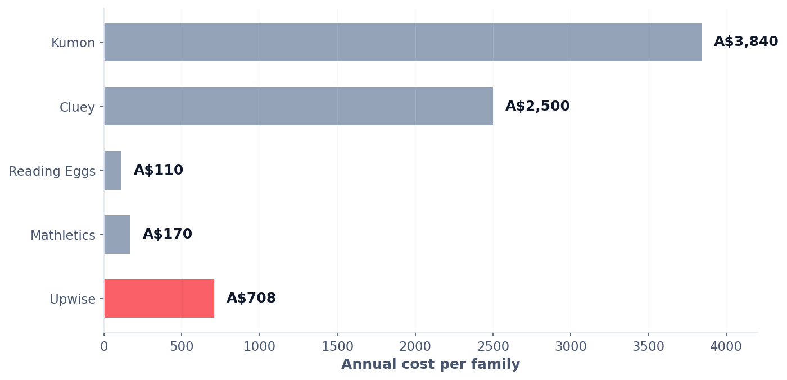
A$2.2 billion is already leaving Australian parents' wallets.
Here's what families actually pay for supplemental learning:
35% of Australian parents already pay for tutoring. 18% spend A$100–150 per week.
Our job is redirection, not creation.
Notes:
Note what this slide is not. It's not a hockey-stick forecast or a TAM calculation from a McKinsey report. It's the money Australian parents are spending right now, today, on supplemental learning that isn't built for them. Our job is redirection, not creation.

Slide 4
Why Now: Three Forces Converging
The 2-Sigma solution, finally economical.
1
2
3
The Science
The Economics
The Adoption
Bloom proved 1:1 mastery tutoring produces +2.0 standard deviations — 40 years of settled science.
LLM inference 150–1000× cheaper in 5 years. Personalised tutoring now affordable at consumer subscription price.
Parents normalised digital-first learning during lockdowns. Willingness to pay for purposeful screen education at all-time highs.
Notes:
Bloom's 2-Sigma Problem, 1984: one-on-one mastery tutoring produces outcomes that classroom teaching can't match. We've known this for forty years. We couldn't do anything about it because one tutor per child wasn't economical. That changed, quietly, in the last eighteen months.

