Slide 1
Upwise
Strong foundations in maths and English — built session by session.
Jesse, Founder · April 2026 · upwise.com.au
Notes:
Hi. I'm Jesse, founder of Upwise. In the next ten minutes I want to show you a business that I think is the clearest consumer opportunity in Australian education in a generation. Let's start with the problem every Australian parent already knows.

Slide 2
In a class of 28, your child doesn't stand a chance of being seen.
42%
82% of primary teachers report their job damages their mental health
1 in 3 Year 3 students below literacy proficiency
Victoria's A$1.2B catch-up tutoring program 'did not significantly improve outcomes'
— Auditor-General, 2024. The problem isn't money. It's the delivery model.
of Australian schools teach with qualified teacher shortage (2025)
Notes:
Imagine a parent sitting at the kitchen table. Their Year 3 child hands them a report card that says 'Developing — needs additional support.' They call the school. The teacher is managing 28 kids with one aide and has no time for intervention. This isn't hypothetical. 35% of Australian parents already pay for tutoring to close the gap. They're not buying ambition. They're buying reassurance that their child won't be left behind.

Slide 3
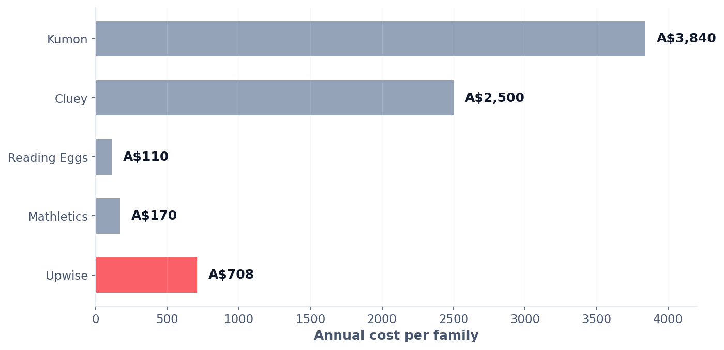
A$2.2 billion is already leaving Australian parents' wallets.
Here's what families actually pay for supplemental learning:
35% of Australian parents already pay for tutoring. 18% spend A$100–150 per week.
Our job is redirection, not creation.
Notes:
Note what this slide is not. It's not a hockey-stick forecast or a TAM calculation from a McKinsey report. It's the money Australian parents are spending right now, today, on supplemental learning that isn't built for them. Our job is redirection, not creation.

Slide 4
Why Now: Three Forces Converging
The 2-Sigma solution, finally economical.
1
2
3
The Science
The Economics
The Adoption
Bloom proved 1:1 mastery tutoring produces +2.0 standard deviations — 40 years of settled science.
LLM inference 150–1000× cheaper in 5 years. Personalised tutoring now affordable at consumer subscription price.
Parents normalised digital-first learning during lockdowns. Willingness to pay for purposeful screen education at all-time highs.
Notes:
Bloom's 2-Sigma Problem, 1984: one-on-one mastery tutoring produces outcomes that classroom teaching can't match. We've known this for forty years. We couldn't do anything about it because one tutor per child wasn't economical. That changed, quietly, in the last eighteen months.

Slide 5
A mastery-based learning coach for every Australian child.
1
2
3
Diagnose
Learn
Master
Adaptive assessment pinpoints exact learning gaps
20 min/day in the 80% win-rate sweet spot
Skills lock after proven mastery
Scope: Maths, reading, writing, spelling, grammar. Prep–Year 6. ACARA-aligned.
Pricing: A$39/month single child · A$59/month family (up to 4 children)
Notes:
Twenty minutes a day. Adaptive. Mastery-based. The kid can't jump ahead until they've actually understood. Which means every session builds on solid ground — no accumulating gaps.

Slide 6
The parent is the guide. We give them the map.
Daily briefing
Before each session: what to watch for
Real-time nudges
Exact wording you can use when stuck
Weekly reports
Share directly with classroom teacher
No teaching degree required.
Every incumbent in Australia treats parents as data recipients. We treat them as the guide — which is where the research evidence is strongest.
Notes:
This is the deliberate bet. We're not replacing parents. We're not replacing teachers. We're giving parents the one thing they've always lacked: a map. What to say when their child is stuck. What to reinforce at dinner. Where the real gap is. The research — Bloom, Kulik, RAND, the 2025 meta-analysis — consistently finds the strongest outcomes come from AI-plus-human, not AI-alone.

Slide 7
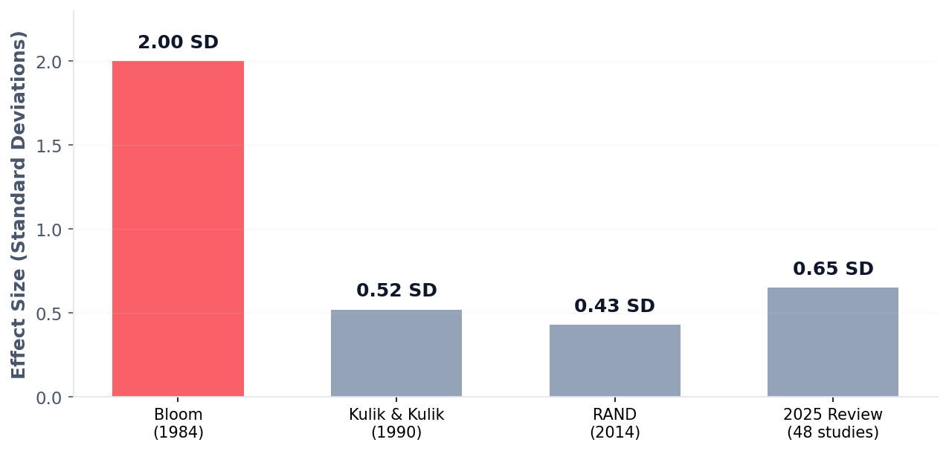
This isn't experimental. It's proven. Four times over.
Upwise is the first Australian operationalisation of forty years of validated learning science.
Sources: Bloom 1984 · Kulik & Kulik 1990 · Pane et al. (RAND) 2014 · 2025 AI tutoring meta-analysis (48 studies)
Notes:
Our credibility isn't 'we built an AI.' Our credibility is a forty-year research lineage that four generations of learning scientists agree on. Upwise is the first Australian operationalisation of it.

