Slide 1
Upwise
Strong foundations in maths and English — built session by session.
Jesse, Founder · April 2026 · upwise.com.au
Notes:
Hi. I'm Jesse, founder of Upwise. In the next ten minutes I want to show you a business that I think is the clearest consumer opportunity in Australian education in a generation. Let's start with the problem every Australian parent already knows.

Slide 2
In a class of 28, your child doesn't stand a chance of being seen.
42%
82% of primary teachers report their job damages their mental health
1 in 3 Year 3 students below literacy proficiency
Victoria's A$1.2B catch-up tutoring program 'did not significantly improve outcomes'
— Auditor-General, 2024. The problem isn't money. It's the delivery model.
of Australian schools teach with qualified teacher shortage (2025)
Notes:
Imagine a parent sitting at the kitchen table. Their Year 3 child hands them a report card that says 'Developing — needs additional support.' They call the school. The teacher is managing 28 kids with one aide and has no time for intervention. This isn't hypothetical. 35% of Australian parents already pay for tutoring to close the gap. They're not buying ambition. They're buying reassurance that their child won't be left behind.

Slide 3
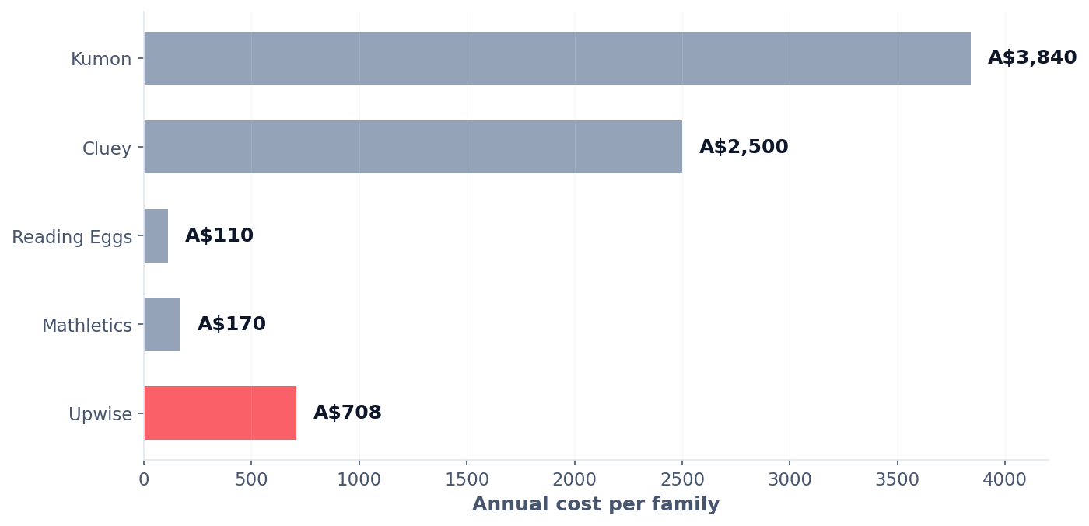
A$2.2 billion is already leaving Australian parents' wallets.
Here's what families actually pay for supplemental learning:
35% of Australian parents already pay for tutoring. 18% spend A$100–150 per week.
Our job is redirection, not creation.
Notes:
Note what this slide is not. It's not a hockey-stick forecast or a TAM calculation from a McKinsey report. It's the money Australian parents are spending right now, today, on supplemental learning that isn't built for them. Our job is redirection, not creation.

Slide 4
Why Now: Three Forces Converging
The 2-Sigma solution, finally economical.
1
2
3
The Science
The Economics
The Adoption
Bloom proved 1:1 mastery tutoring produces +2.0 standard deviations — 40 years of settled science.
LLM inference 150–1000× cheaper in 5 years. Personalised tutoring now affordable at consumer subscription price.
Parents normalised digital-first learning during lockdowns. Willingness to pay for purposeful screen education at all-time highs.
Notes:
Bloom's 2-Sigma Problem, 1984: one-on-one mastery tutoring produces outcomes that classroom teaching can't match. We've known this for forty years. We couldn't do anything about it because one tutor per child wasn't economical. That changed, quietly, in the last eighteen months.

Slide 5
A mastery-based learning coach for every Australian child.
1
2
3
Diagnose
Learn
Master
Adaptive assessment pinpoints exact learning gaps
20 min/day in the 80% win-rate sweet spot
Skills lock after proven mastery
Scope: Maths, reading, writing, spelling, grammar. Prep–Year 6. ACARA-aligned.
Pricing: A$39/month single child · A$59/month family (up to 4 children)
Notes:
Twenty minutes a day. Adaptive. Mastery-based. The kid can't jump ahead until they've actually understood. Which means every session builds on solid ground — no accumulating gaps.

Slide 6
The parent is the guide. We give them the map.
Daily briefing
Before each session: what to watch for
Real-time nudges
Exact wording you can use when stuck
Weekly reports
Share directly with classroom teacher
No teaching degree required.
Every incumbent in Australia treats parents as data recipients. We treat them as the guide — which is where the research evidence is strongest.
Notes:
This is the deliberate bet. We're not replacing parents. We're not replacing teachers. We're giving parents the one thing they've always lacked: a map. What to say when their child is stuck. What to reinforce at dinner. Where the real gap is. The research — Bloom, Kulik, RAND, the 2025 meta-analysis — consistently finds the strongest outcomes come from AI-plus-human, not AI-alone.

Slide 7
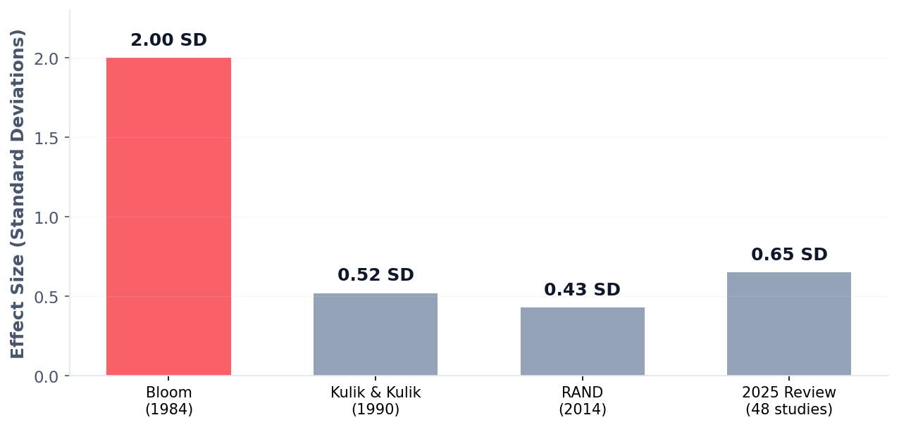
This isn't experimental. It's proven. Four times over.
Upwise is the first Australian operationalisation of forty years of validated learning science.
Sources: Bloom 1984 · Kulik & Kulik 1990 · Pane et al. (RAND) 2014 · 2025 AI tutoring meta-analysis (48 studies)
Notes:
Our credibility isn't 'we built an AI.' Our credibility is a forty-year research lineage that four generations of learning scientists agree on. Upwise is the first Australian operationalisation of it.

Slide 8
The Empty Quadrant
Parent-as-guide
(empty)
UPWISE
Breadth-first
Mastery-based
Kumon Cluey Matrix Kip McGrath
Mathspace Reading Eggs Mathletics Prodigy
Parent-invisible
Cluey (ASX:CLU): FY25 net loss A$5.5M — 1:1 human labour is broken. No Australian incumbent owns the top-right quadrant.
Notes:
Look at the quadrant Upwise sits in. Now look at how empty it is. Not because it's a bad quadrant — because no Australian incumbent has built for it. Cluey is losing money doing 1:1 human. Kumon is still running physical franchises in 2026. The IXLs and Mathletics of the world won't even look at you as a parent. That's our wedge.

Slide 9
17,100 active families = A$10M ARR.
1.1%
Unit economics
Software gross margins:
75–80%
LLM cost:
continues to fall
CAC payback:
<12 months target
Comparables:
3P Learning A$110M on software. Mathspace bootstrapped profitable.
of Australia's 1.52M primary-aged households
Notes:
17,000 families. In a country with 1.52 million primary-age households, of which 380,000 already pay for tutoring. This is not a moonshot. This is arithmetic.

Slide 10
Safe AI. Australian-built. Parent-visible.
Closed system
20-minute sessions
Parent-visible
Australian-operated
eSafety aligned
No open chat, no ads
Less screen than games
Mandatory, not optional
Data stays in AU
Designed to Commissioner guidance
The parents most concerned about AI safety are the ones most willing to pay once convinced. We don't dodge their concern — we lead with it.
Notes:
Every parent we've spoken to has the same question: is it safe? Is it just more screen time? Is it going to replace me as the parent? Our answer, on each: closed system, twenty minutes, parent-guided. Not a chatbot. Not an ad-driven app. Not a babysitter.

