Slide 1
Upwise
Strong foundations in maths and English — built session by session.
Jesse, Founder · April 2026 · upwise.com.au
Notes:
Hi. I'm Jesse, founder of Upwise. In the next ten minutes I want to show you a business that I think is the clearest consumer opportunity in Australian education in a generation. Let's start with the problem every Australian parent already knows.

Slide 2
In a class of 28, your child doesn't stand a chance of being seen.
42%
82%
1 in 3
of Australian schools teach with a qualified teacher shortage — up from 14% in 2018.
of primary teachers say their job damages their mental health.
Year 3 students sit below literacy proficiency.
Even Victoria's A$1.2 billion catch-up tutoring program "did not significantly improve outcomes" — Victorian Auditor-General, 2024.
The problem isn't money. It's the delivery model.
Notes:
Imagine a parent sitting at the kitchen table. Their Year 3 child hands them a report card that says 'Developing — needs additional support.' They call the school. The teacher is managing 28 kids with one aide and has no time for intervention. 35% of Australian parents already pay for tutoring to close the gap. They're not buying ambition — they're buying reassurance that their child won't be left behind. And when the government itself tried to fix it with a billion-dollar catch-up program, it didn't move the needle. The problem isn't money. It's the delivery model.

Slide 3
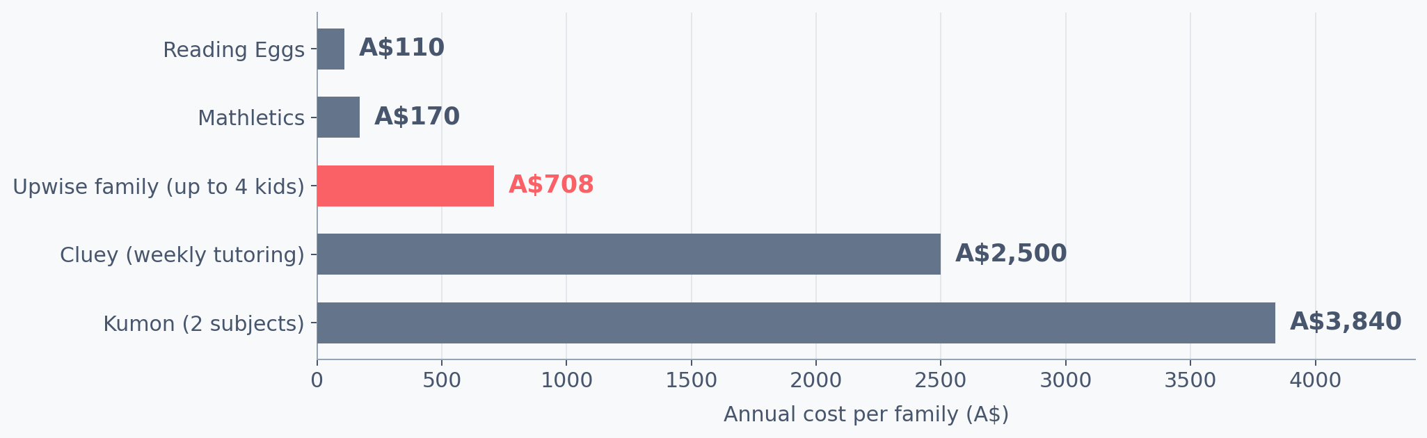
A$2.2 billion is already leaving Australian parents' wallets.
Annual cost per family across Australian supplemental learning:
35% of Australian parents already pay for tutoring. 18% spend A$100–150 per week.
Our job is redirection, not creation.
Notes:
Note what this slide is not. It's not a hockey-stick forecast or a TAM calculation from a McKinsey report. It's the money Australian parents are spending right now, today, on supplemental learning that isn't built for them. Kumon is nearly five times our family plan. Cluey is three times. Our job is redirection, not creation.

Slide 4
The 2-sigma solution, finally economical.
Three forces converging, for the first time in history.
1
2
3
The science is 40 years old.
The economics just flipped.
Parents are ready.
Benjamin Bloom (1984) proved 1:1 mastery tutoring produces +2.0 standard deviations of improvement — the 98th percentile of classroom-taught peers.
LLM inference costs fell 150–1000× in five years. Personalised adaptive tutoring just became viable at a consumer subscription price.
Post-COVID, Australian parents normalised digital-first learning for their children — and are actively looking for tools that work.
What Bloom called the "2-sigma problem" — the known solution that couldn't scale — is no longer a problem.
Notes:
Bloom's 2-Sigma Problem, 1984: one-on-one mastery tutoring produces outcomes classroom teaching can't match. We've known this for forty years. We couldn't do anything about it because one tutor per child wasn't economical. That changed, quietly, in the last eighteen months.

Slide 5
A mastery-based learning coach for every Australian child.
For the price of a family streaming subscription.
1
2
3
Diagnose
Learn
Master
A short adaptive assessment pinpoints exactly where the gaps are.
20-minute daily sessions adapt in real time — questions stay in the 80% win-rate zone.
Skills only lock in after proven mastery across multiple sessions. Spaced repetition holds them.
Free 7-day trial · A$39/mo single child · A$59/mo family (up to 4 kids) · ACARA-aligned
Notes:
Twenty minutes a day. Adaptive. Mastery-based. The kid can't jump ahead until they've actually understood. Which means every session builds on solid ground — no accumulating gaps. Free trial, then a subscription that costs less than a week of tutoring.

Slide 6
The parent is the guide. We give them the map.
Research consistently shows AI tutoring works best when paired with a human guide.
Daily briefing — Before each session — what your child's working on, what to watch for.
"No teaching degree required."
Real-time nudges — When they get stuck — with the exact wording you can use.
Weekly reports — Clear enough to share with their classroom teacher.
Conversation scripts — What to say at dinner to reinforce what they just learned.
Every parent gets the tools. No extra hours. No curriculum expertise needed.
Notes:
This is the deliberate bet. We're not replacing parents. We're not replacing teachers. We're giving parents the one thing they've always lacked — a map. What to say when their child is stuck. What to reinforce at dinner. Where the real gap is.

Slide 7
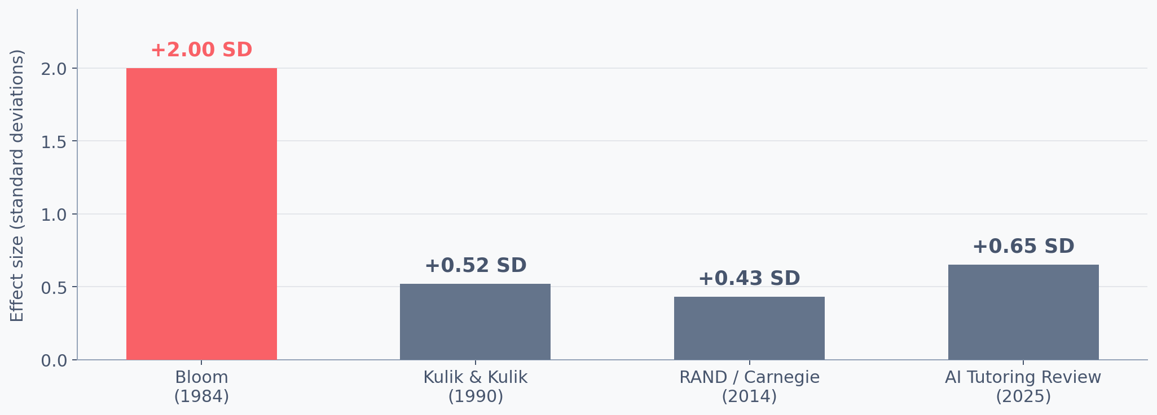
This isn't experimental. It's proven. Four times over.
Upwise is the first Australian operationalisation of 40 years of validated learning science.
Sources: Bloom (1984) · Kulik & Kulik (1990) · Pane et al. / RAND (2014) · 2025 AI tutoring systematic review (48 studies).
Notes:
Our credibility isn't 'we built an AI.' It's a forty-year research lineage that four generations of learning scientists agree on. Bloom proved the 2-sigma effect in 1984. Kulik and Kulik meta-analysed it in 1990. RAND validated computer-based mastery in 2014. A 2025 systematic review of 48 AI tutoring studies confirms the strongest gains come when AI is paired with a human guide. Upwise is the first Australian operationalisation of that stack.

Slide 8
No Australian product owns mastery + parent-as-guide.
Parent-as-guide
(empty)
UPWISE
Breadth-first
Mastery-based
Cluey
Mathspace
Kumon
Reading Eggs
Kip McGrath
Mathletics
Matrix
Prodigy
Kinetic Education
Matific
Parent-invisible
Cluey FY25: revenue down 15% to A$25.6M, net loss A$5.5M · Kumon: A$3,840/yr per child for maths + English
Notes:
Look at the quadrant Upwise sits in. Empty. Not because it's a bad quadrant — because no Australian incumbent has built for it. Cluey is losing money doing 1:1 human tutoring. Kumon is still running physical franchises in 2026. The IXLs and Mathletics of the world won't even look at you as a parent. That's our wedge.

Slide 9
17,000 families = A$10M ARR.
Not a moonshot. Arithmetic.
1.1%
PATH TO A$10M ARR
~17,100 active families
at A$39–59/mo blend
Software gross margin
75–80% (LLM cost falling)
Avg customer lifetime
~18 months (assumption)
of Australia's 1.52 million primary-aged households.
AU COMPARABLES
3P Learning (Mathletics):
A$110M rev, software margins ✓
Or 4.5% of the 380,000 already paying for supplemental learning.
Mathspace:
profitable, bootstrapped ✓
Cluey (1:1 human):
A$25.6M rev, A$5.5M loss ✗
Cluey's loss isn't evidence AU edtech is broken. It's evidence that 1:1 human tutoring is.
Notes:
17,000 families. In a country with 1.52 million primary-age households, of which 380,000 already pay for tutoring. This is not a moonshot. This is arithmetic. And the unit economics work because we're software, not labour. Cluey's story is the proof — their A$5.5M loss isn't evidence AU edtech is broken. It's evidence that 1:1 human tutoring is.

Slide 10
Safe AI. Australian-built. Parent-visible.
Every parent's first question about AI, answered in the product itself.
Closed system
20 min bounded
Parent-visible
Australian-owned
eSafety-aligned
No open chat. No user content. Curriculum-constrained.
Less screen time than YouTube. Designed to end on a win.
Every session observable. Nothing hidden.
AU data, AU servers. Techne AI Pty Ltd.
Designed to Australian eSafety Commissioner guidance.
No ads. No third-party tracking. No data sharing. Ever.
Notes:
Every parent we speak to has the same question: is it safe? Is it just more screen time? Is it going to replace me as the parent? Our answer, on each: closed system, twenty minutes, parent-guided. Not a chatbot. Not an ad-driven app. Not a babysitter.

Slide 11
Traction.
Replace with actual numbers before pitching. Angels reward precision over puffery.
[Waitlist count]
[Acquisition signal]
Growth rate per week
Organic or paid channel
[User engagement]
[School / advisor interest]
Retention, session count, NPS
LOIs, advisors, inbound press
Notes:
Founder to draft based on actual numbers. Be honest — angels reward precision about early signals more than they reward puffed-up vanity metrics.

Slide 12
Team.
Angels invest in people. Be specific about why you, why now, why this.
[Headshot]
[Headshot]
[Headshot]
[Founder]
[Co-founder / Key hire]
[Advisors]
[Name + 1-line credential]
[Name + credential]
[Names + committed angels]
optional
Notes:
Founder-specific. Angels invest in people. Be specific about why you, why now, why this.

Slide 13
Raising A$[XXX]
to reach A$[X]M ARR by [milestone]
A generation of Australian children that never fall behind.
USE OF FUNDS
Product 40%
Growth 40%
Ops 20%
MILESTONES
→ Product launch
→ Waitlist conversion (>60%)
→ A$[X]k ARR
That's what we're here to build.
→ CAC payback proof
Runway: [X] months
jesse@activedigital.fund · upwise.com.au
Notes:
Here's the ask. Here's what it funds. Here's what you get back — not in dollar terms, though I'm happy to walk through projections. This funds the build and the first twelve months of disciplined growth. A generation of Australian kids that don't fall behind. That's the thing worth building.

