Slide 1
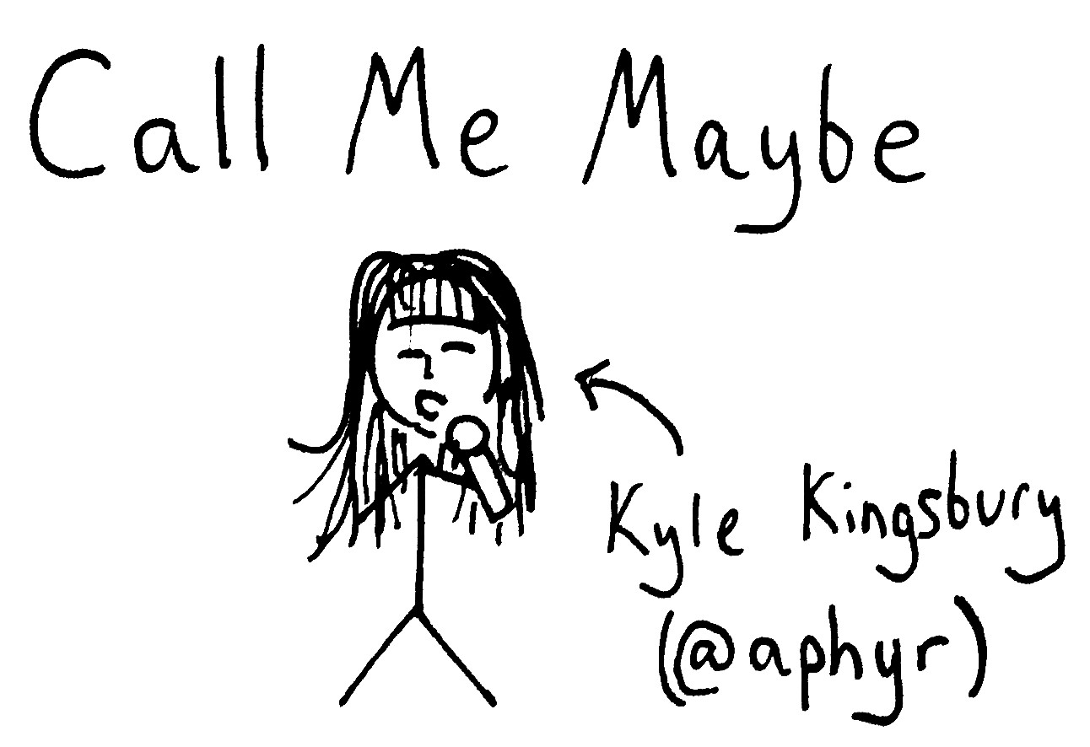

Slide 2
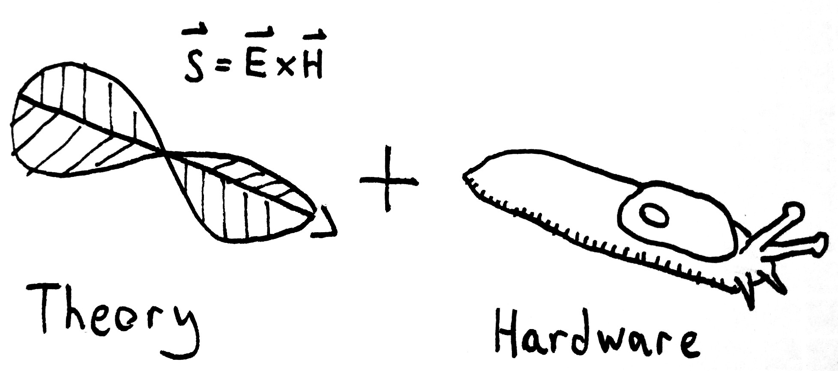

Slide 3
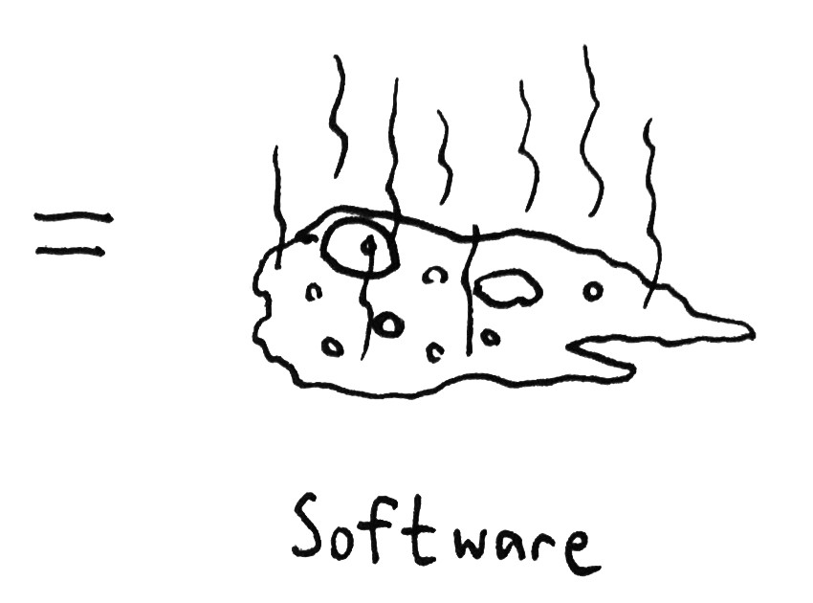

Slide 4
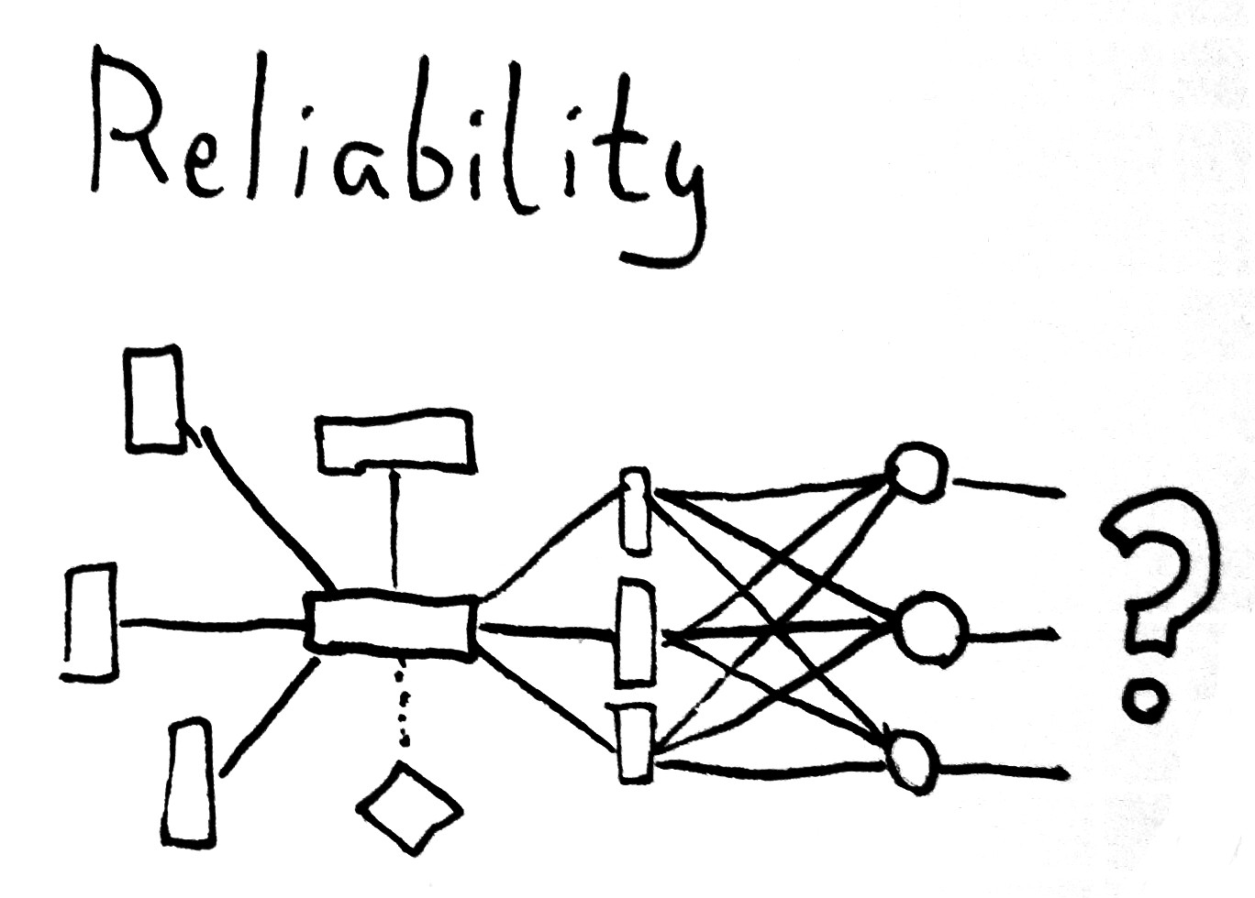

Slide 5
PARTITION
TOLERANCE

Slide 6

MY CONVERSATION HAS RUN DRY

Slide 7
Many systems degrade,
or otherwise change state,
under partition

Slide 8

BRING THE PIECES BACK TOGETHER
REDISCOVER COMMUNICATION

Slide 9
A EXAMPLE
ANPLICATION

Slide 10

N1 N2 N3 N4 N5

Slide 11
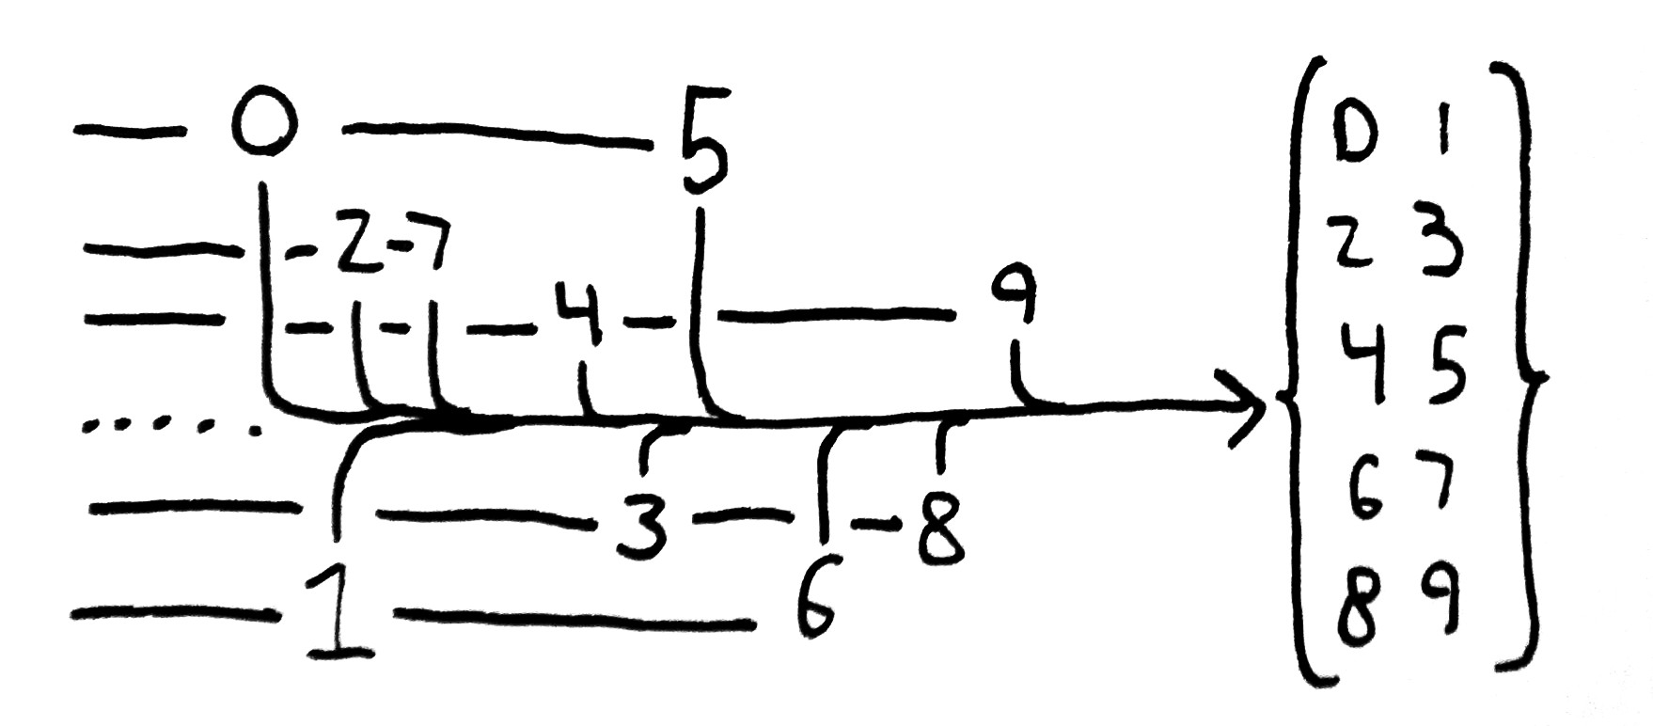
5 clients add N integers to a list

Slide 12

HEY I JUST MET YOU
THE NETWORK'S LAGGY

Slide 13

BUT HERE'S MY DATA
SO STORE IT MAYBE

Slide 14
POSTGRES

Slide 15
Classic “ACID” relational DB
Support for synchronous transaction replication
Hard CP system

Slide 16
Even though [Postgres] is strongly consistent...
[Postgres + client] may not be!

Slide 17
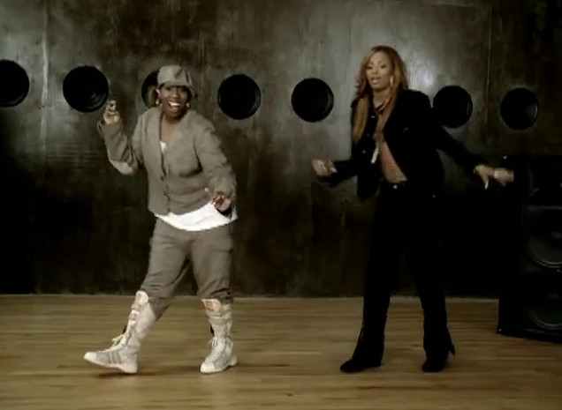
LET ME SEE TWO
PHASE COMMIT
t

Slide 18
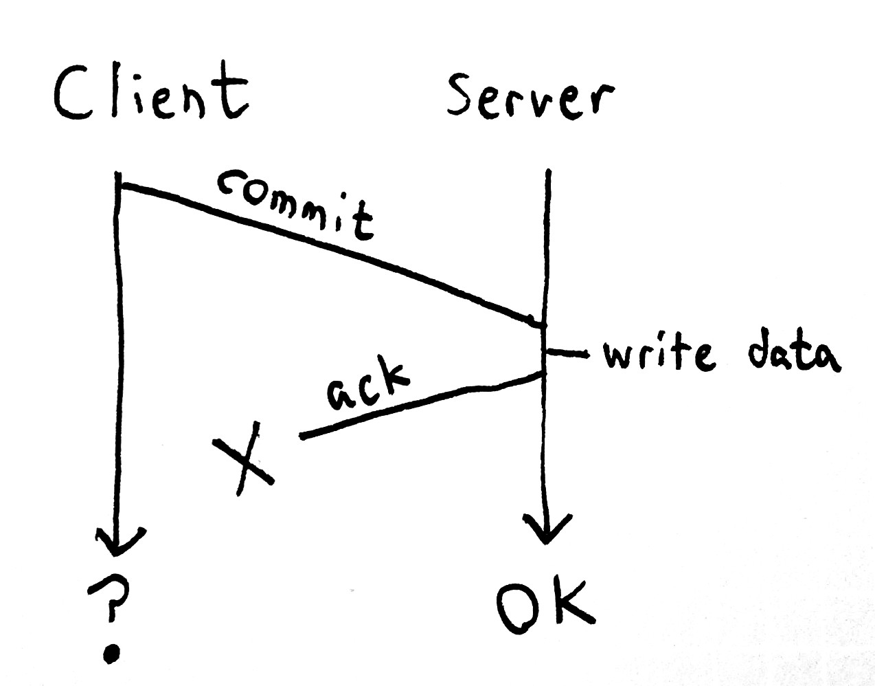

Slide 19
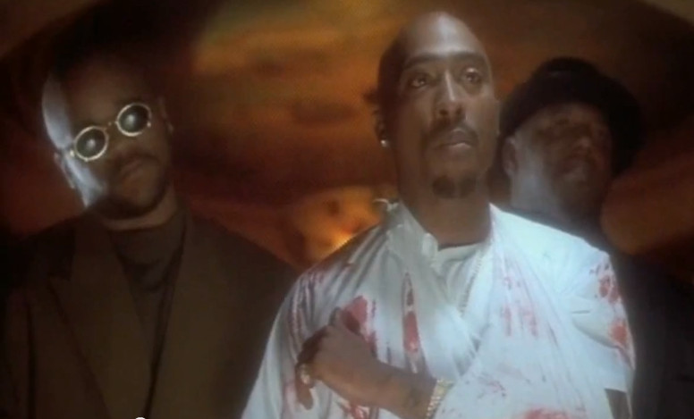
YOU HAPPY TO SEE ME?
(2PaC)

Slide 20
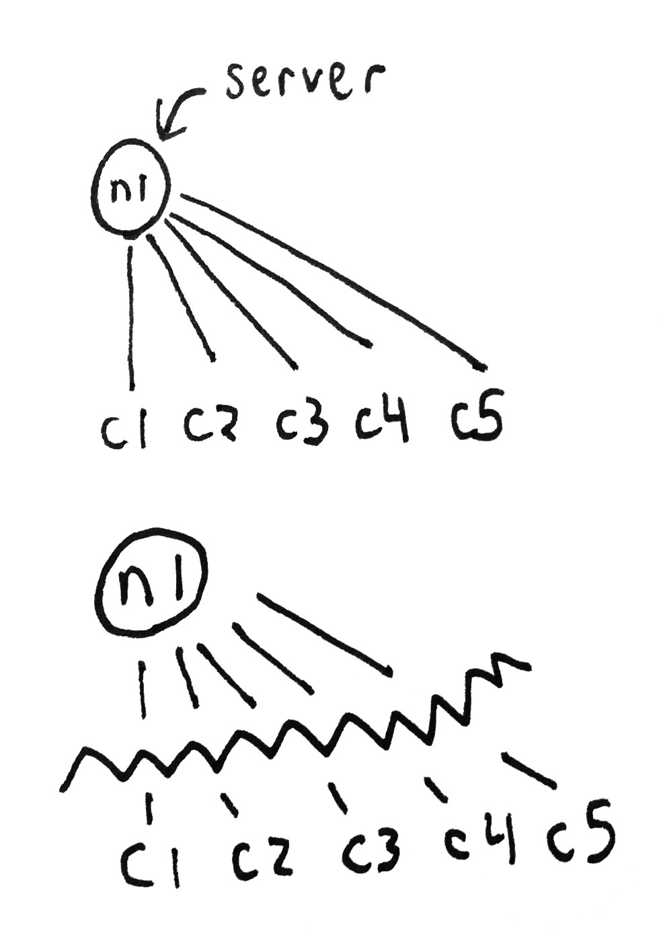

Slide 21
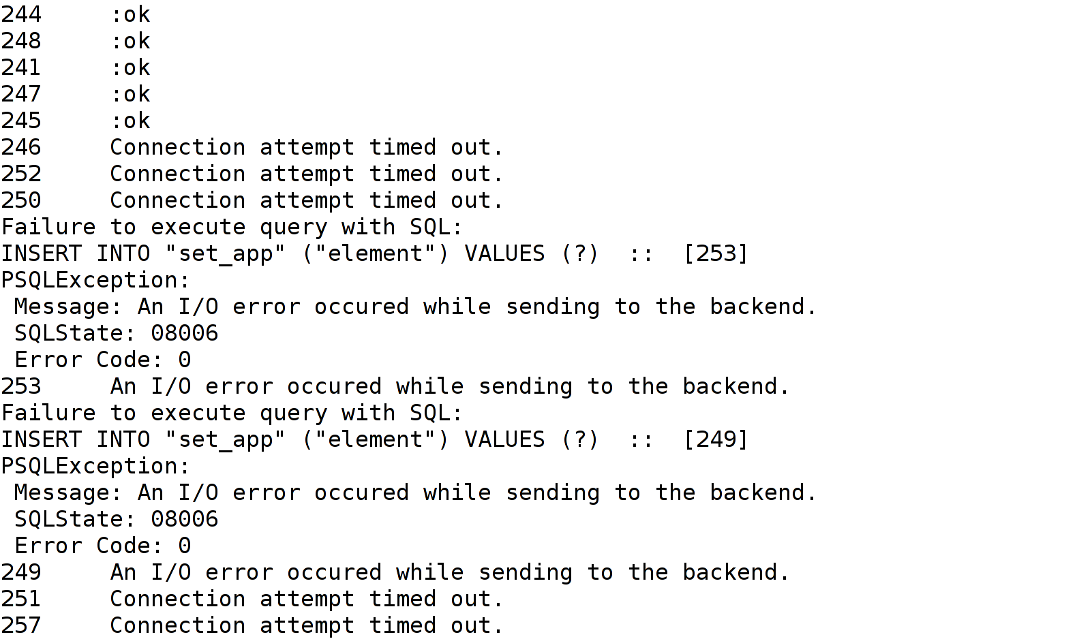

Slide 22
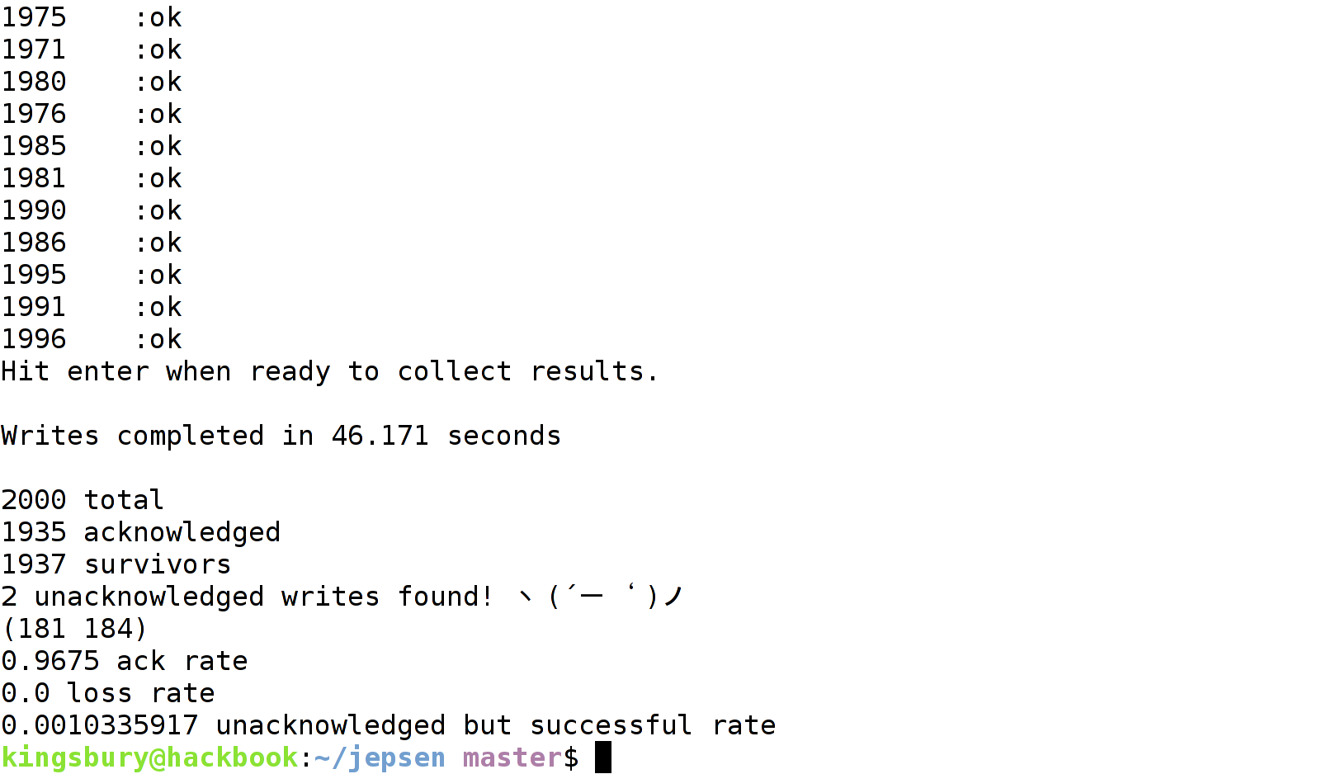

Slide 23
Strategies
Network errors mean “I don't know!”
  Different than “It failed!”
False negatives are not the end of the world
Retry with idempotent operations
Fetch transaction ID, write TXID to table, read back later

Slide 24
REDIS

Slide 25
Redis is a data structure server
Linearizable consistency on a single node
Write to primary
Async replication to N secondaries

Slide 26
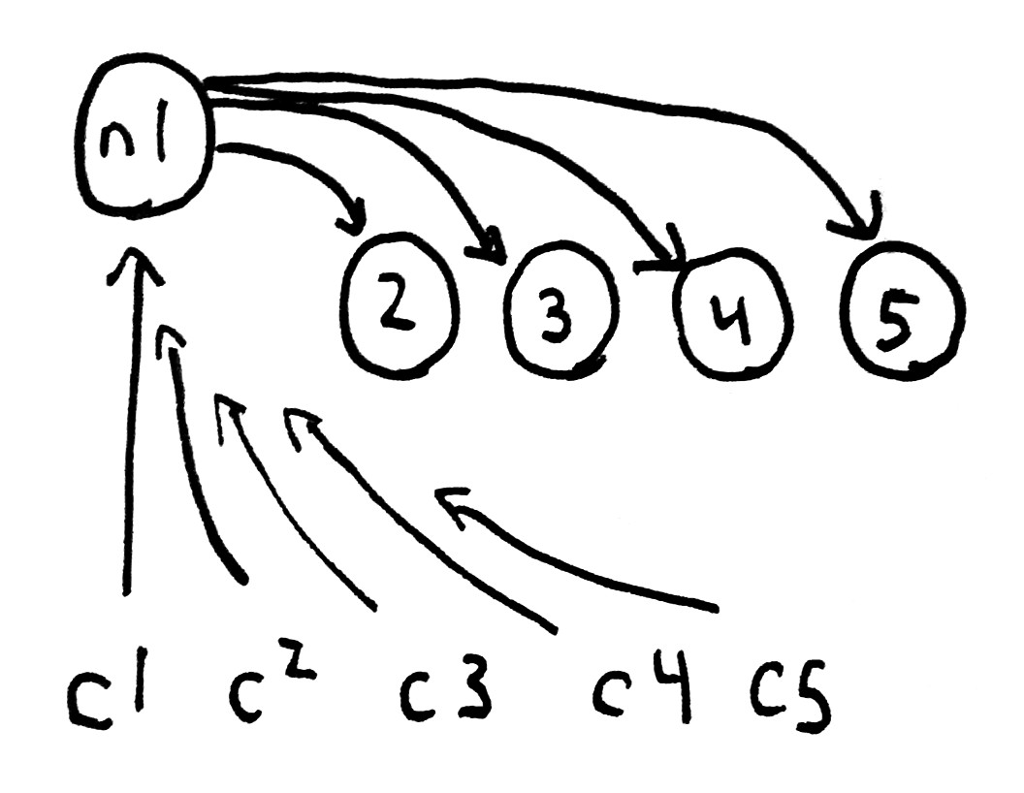

Slide 27
When a primary is inaccessible,
we can promote a secondary

Slide 28
“Redis Cluster for instance is a system biased towards consistency than availability. Redis Sentinel itself is an HA solution with the dogma of consistency and master slave setups.”
antirez

Slide 29
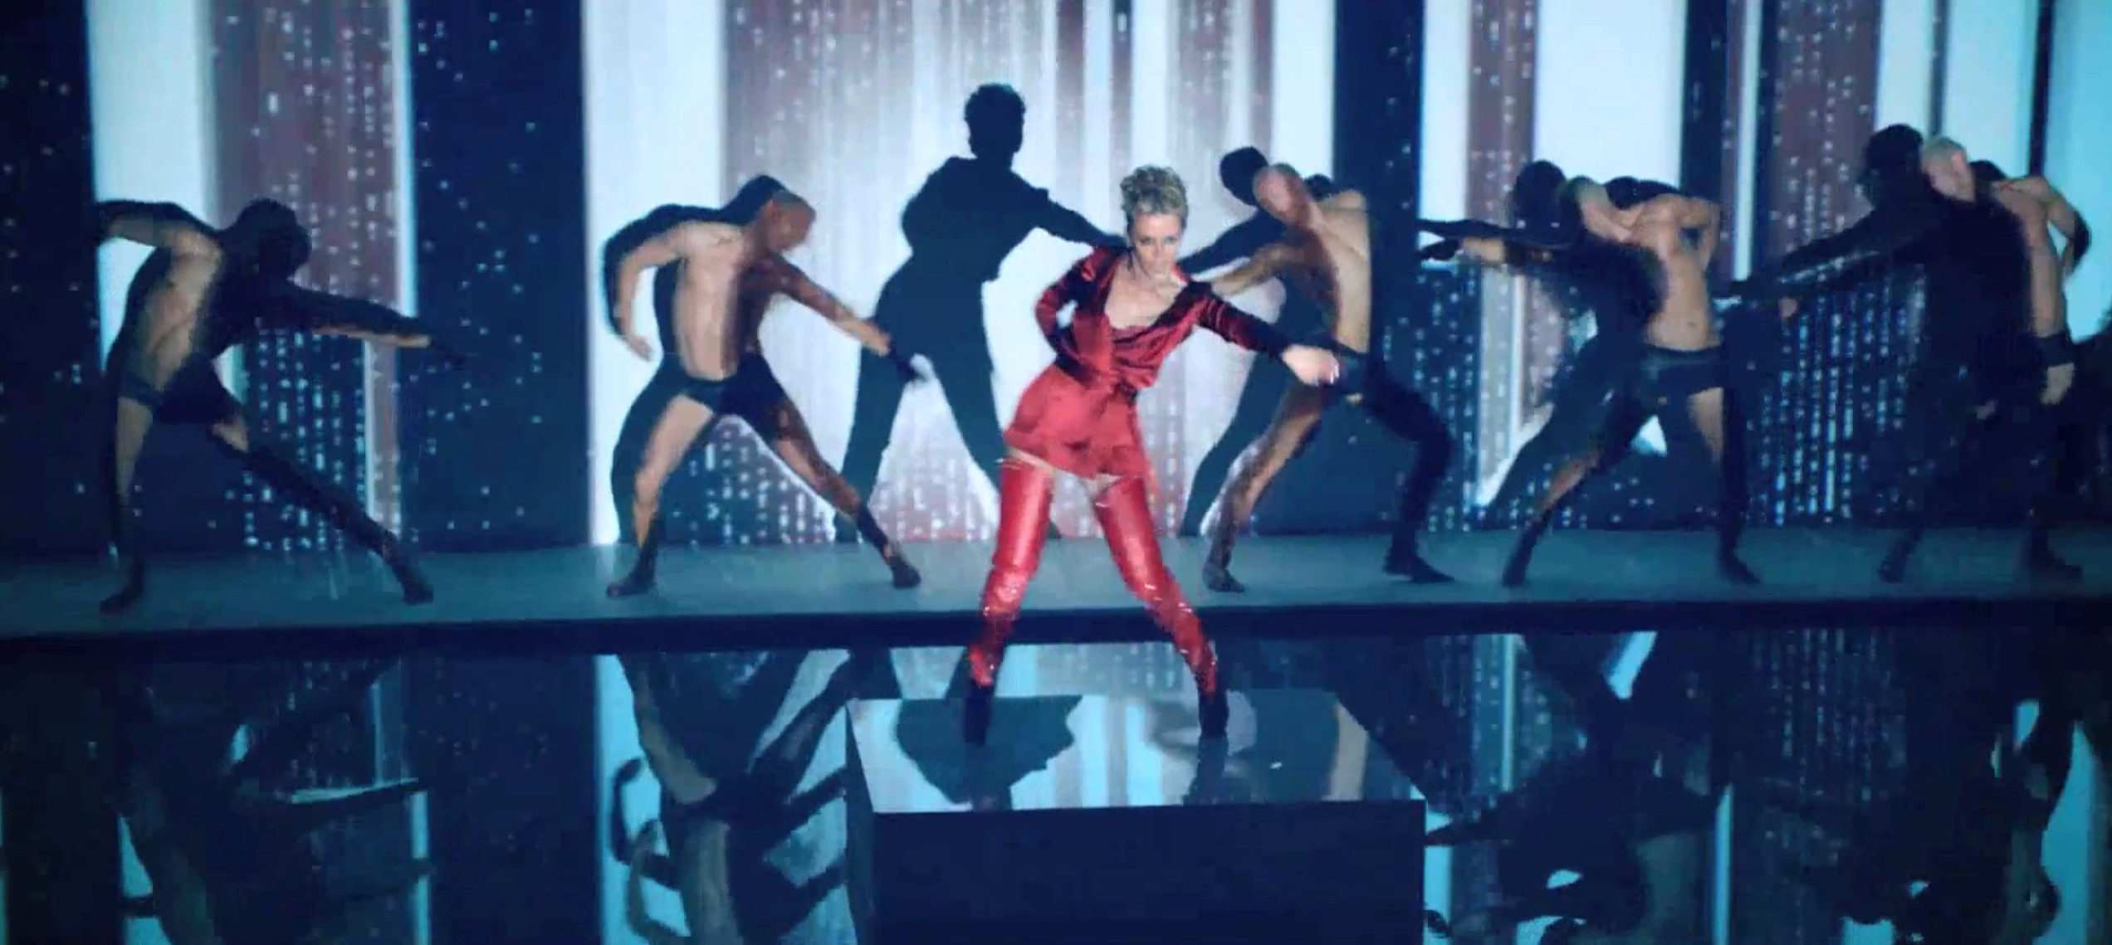
LEAVE YOU
MOVE ON TO
A PERFECT STRANGER

Slide 30
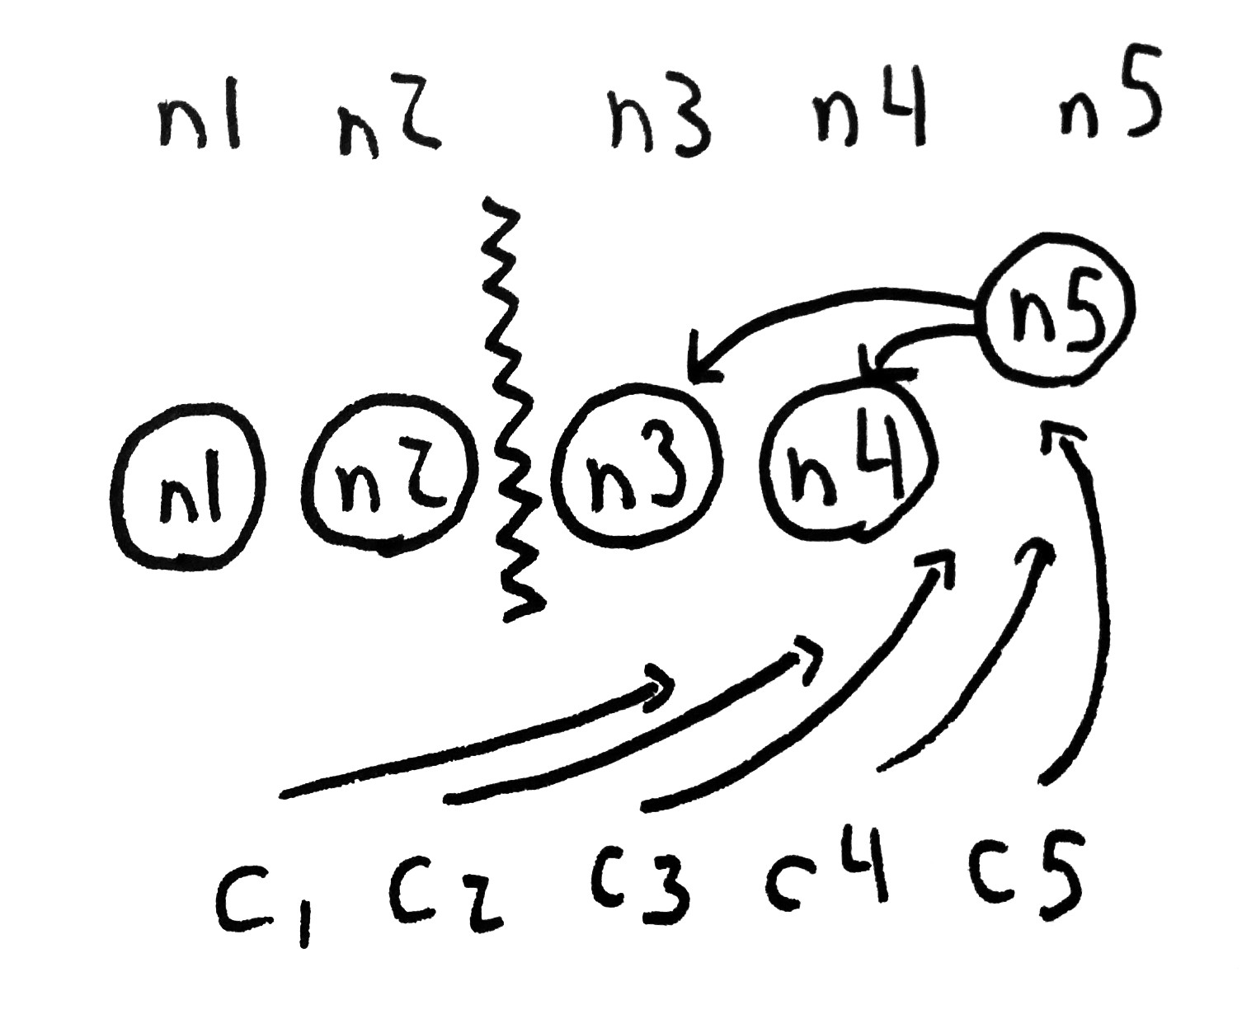

Slide 31
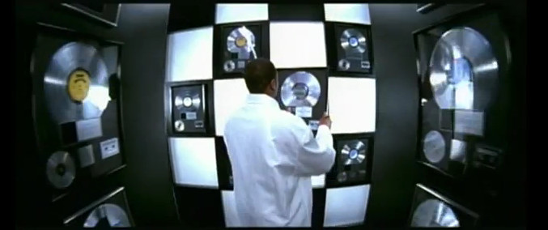
FORGOT ABOUT DURABILITY

Slide 32
Since disk syncs and replication are asynchronous, can lose up to N seconds of data.

Slide 33
LET'S DO IT

Slide 34
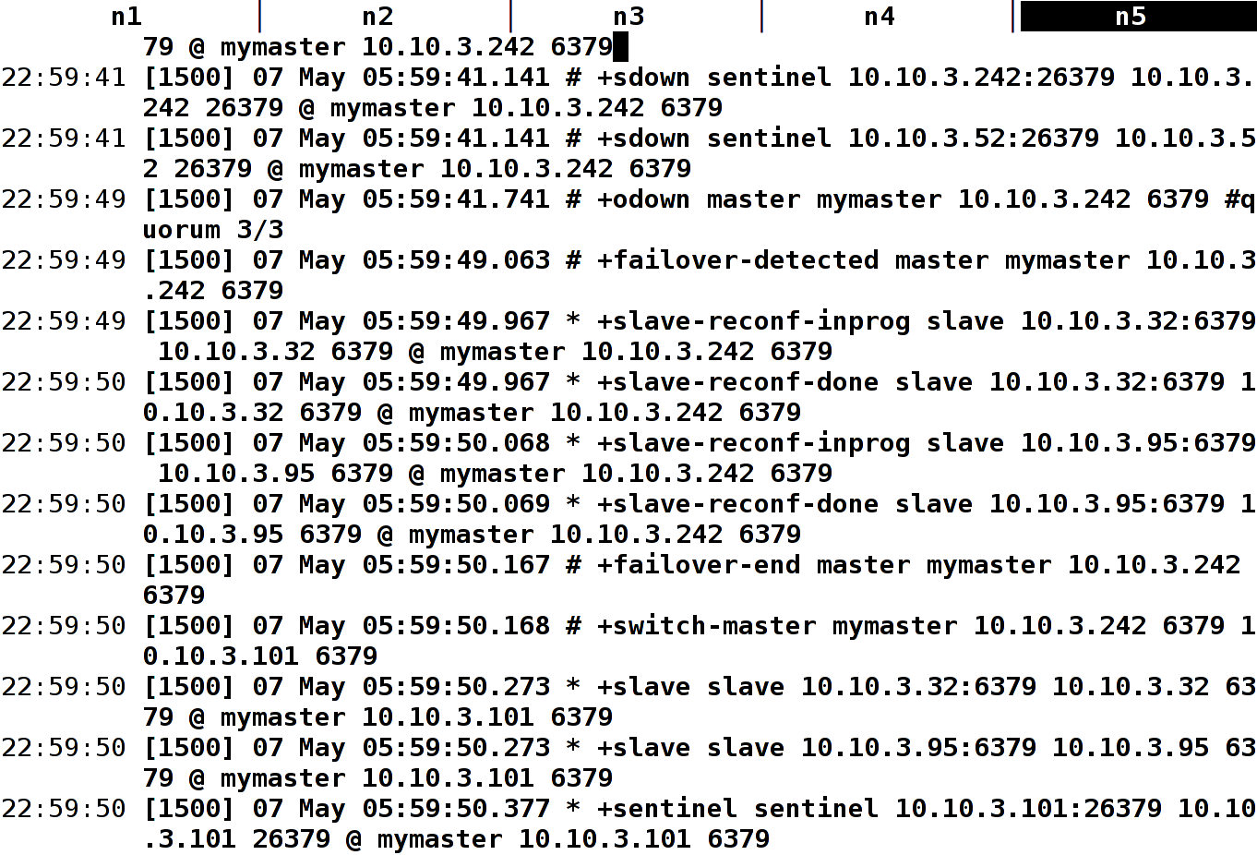

Slide 35
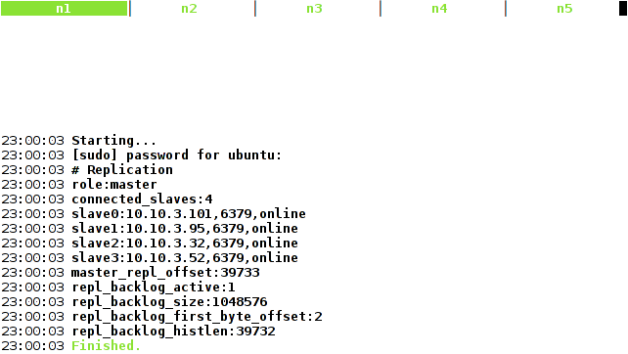

Slide 36
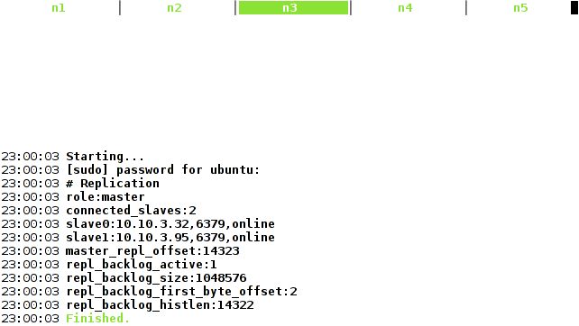

Slide 37
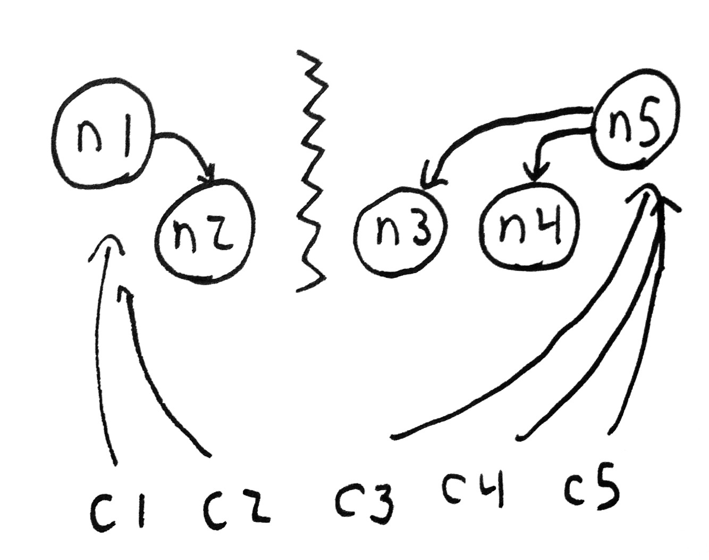

Slide 38
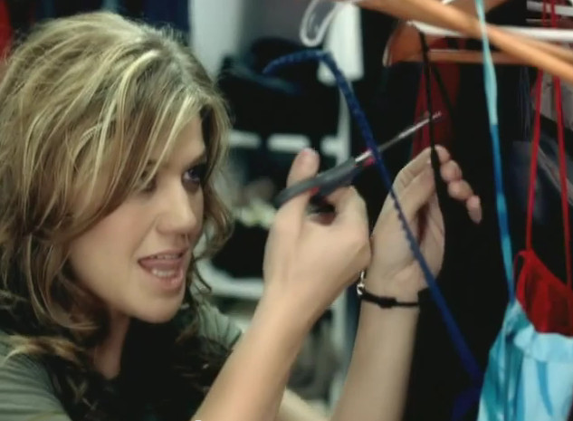
SINCE YOU BEEN GONE

Slide 39
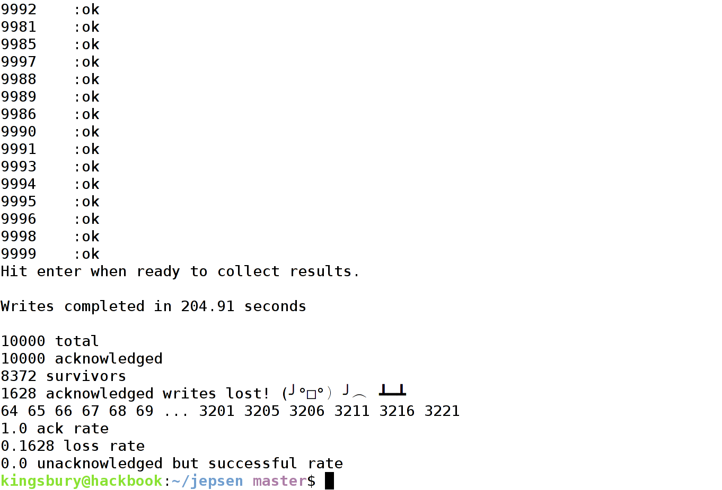

Slide 40
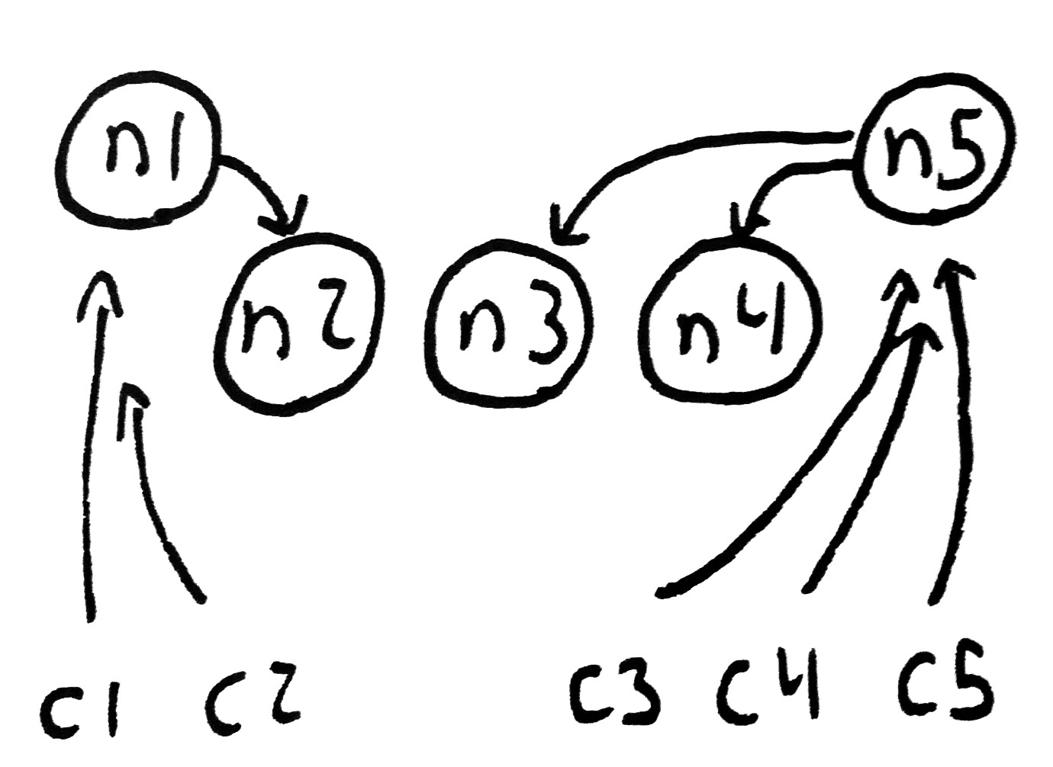

Slide 41

NOW YOU'RE JUST A PRIMARY
I USED TO KNOW

Slide 42
Strategies
Partitions mean loss of consistency
  Redis is not a database
  Redis is not a queue
  Redis is not a lock server
Brains for everyone!
Ensure you can tolerate dropped writes and inconsistent data between nodes
Makes an excellent distributed cache

Slide 43
MONGO

Slide 44
MongoDB is a document store
Similar distribution design to Redis
  Single writable primary
  Asynchronous replication
Leader election is built in
  Reduces chances of odd partition topologies screwing things up
Can await acks/errors from secondary nodes

Slide 45

I'LL BE YOUR COMMANDER

Slide 47

SHE'S GONE, OH I,
WHAT WENT WRONG

Slide 49
UN
AC
KNOWLEDGED

Slide 50

I THREW A WISH IN THE WELL
DON'T ASK ME I'LL NEVER TELL

Slide 51
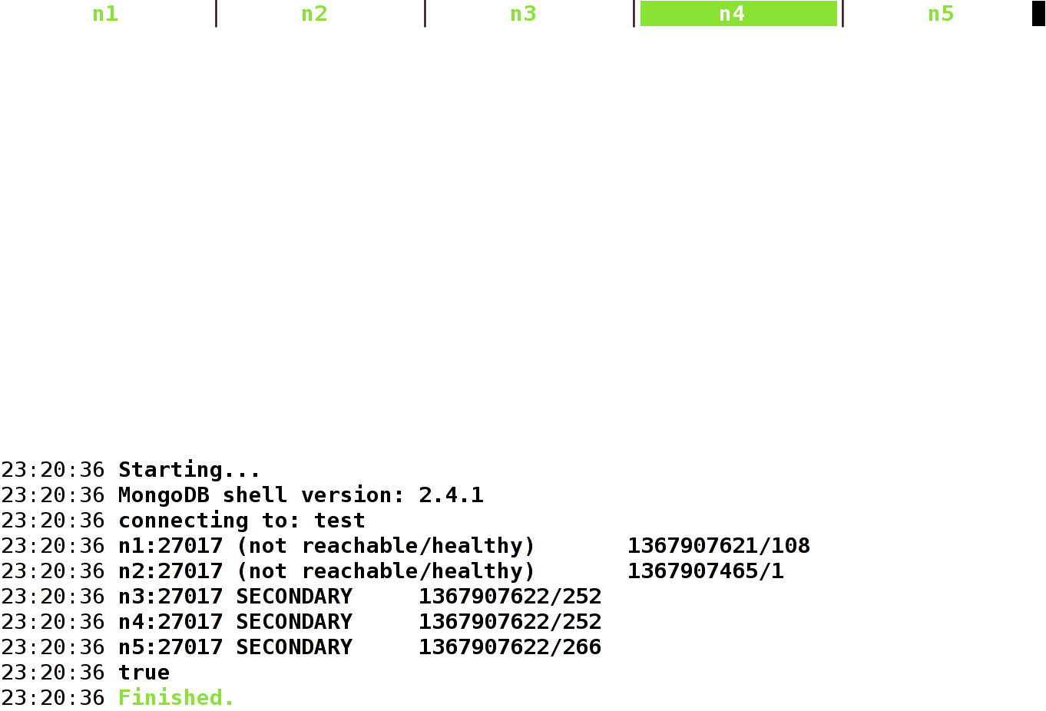

Slide 52
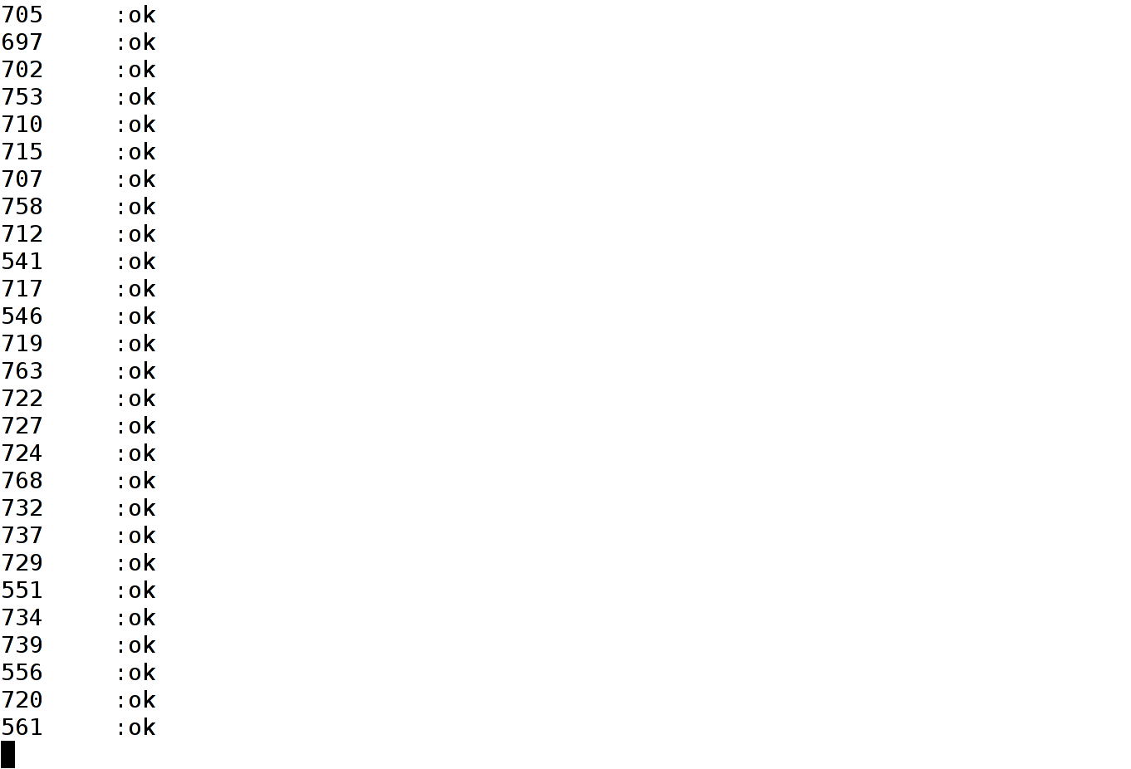

Slide 53
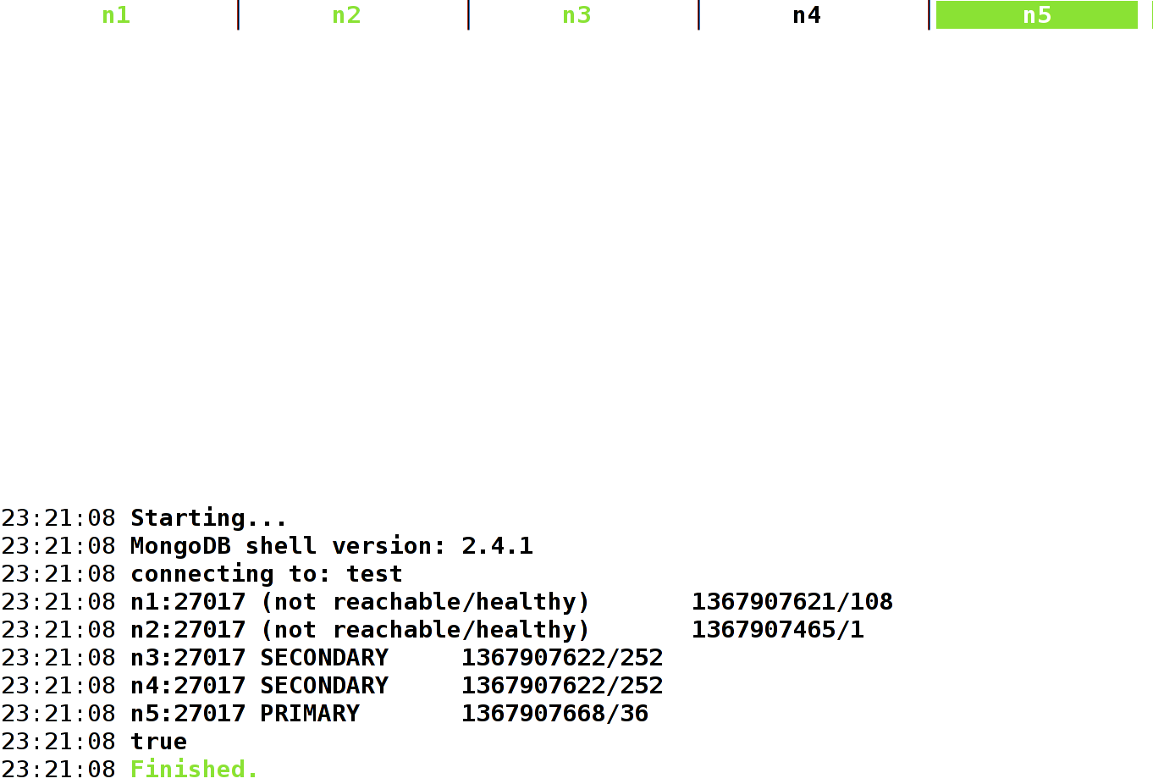

Slide 54

CAUGHT IN A NETSPLIT
NO OBJECTIVE REALITY

Slide 55
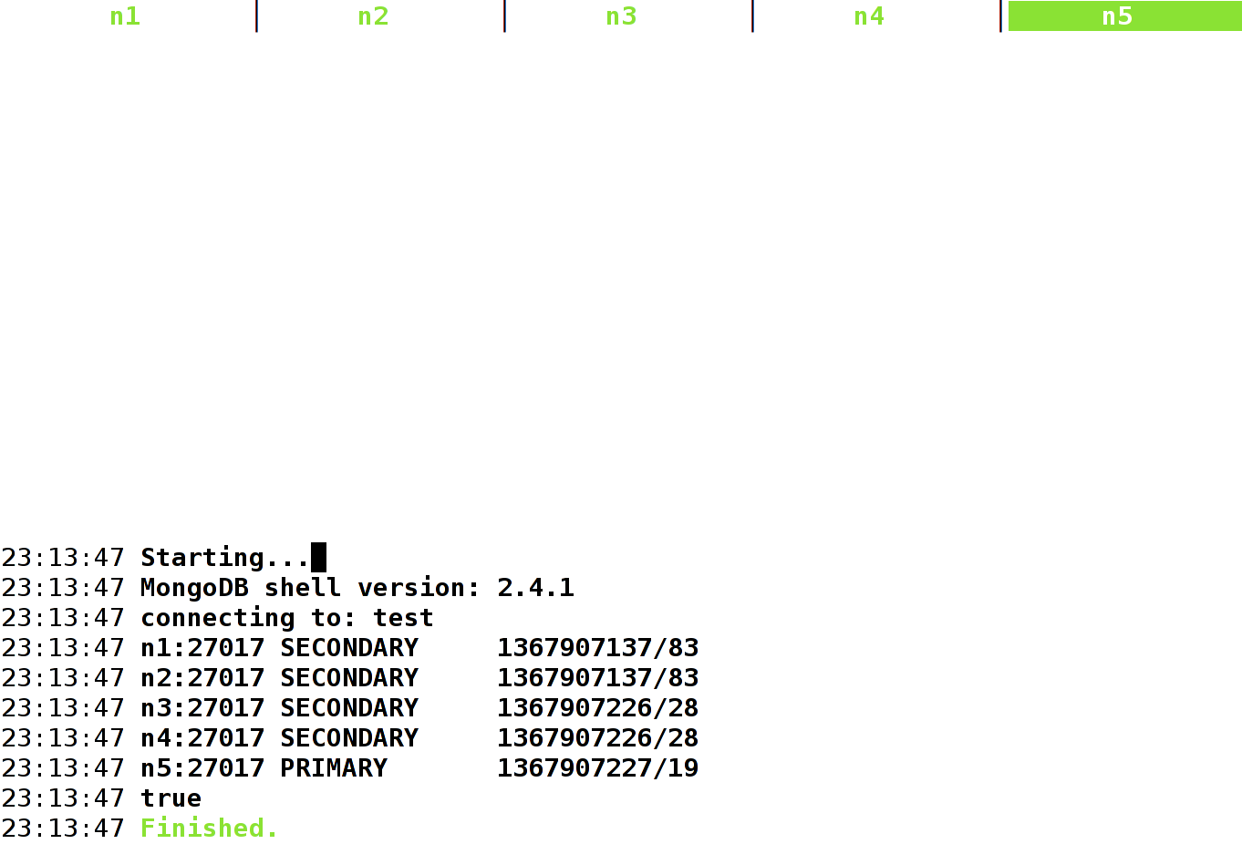

Slide 56
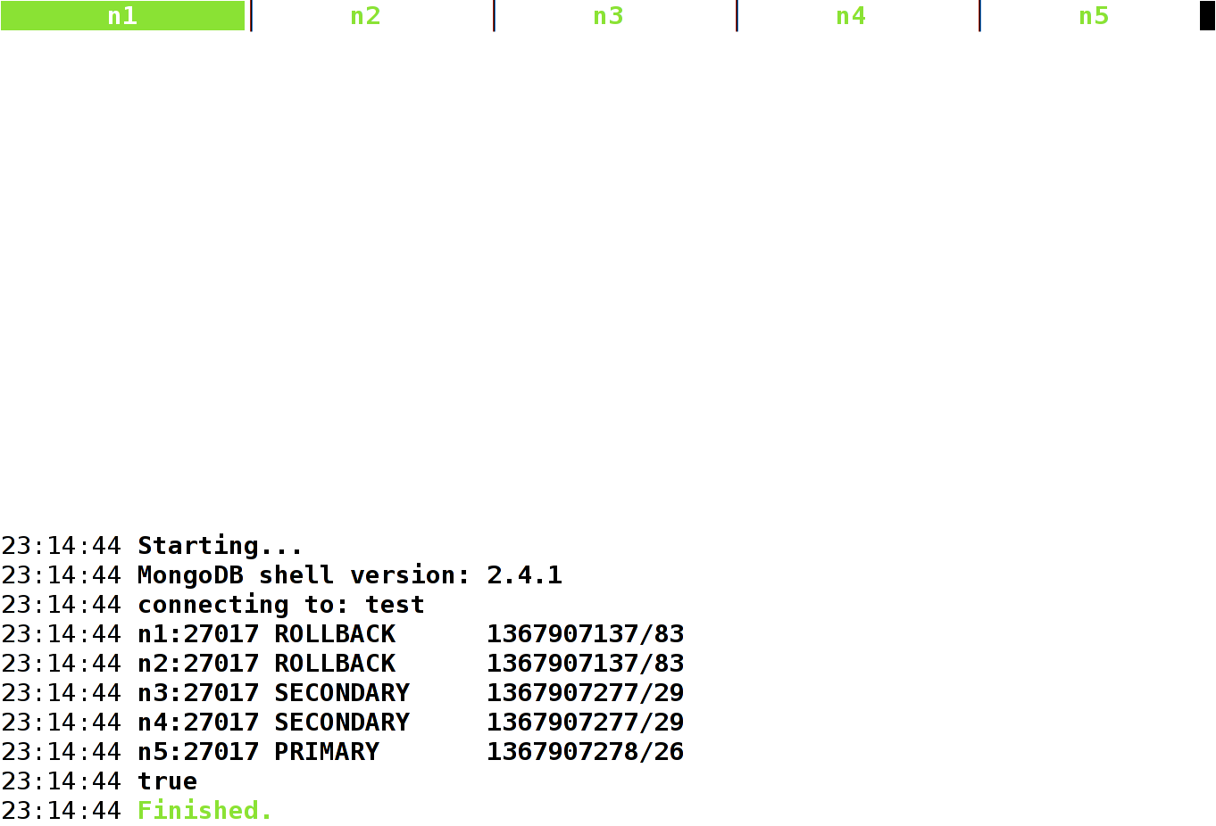

Slide 57
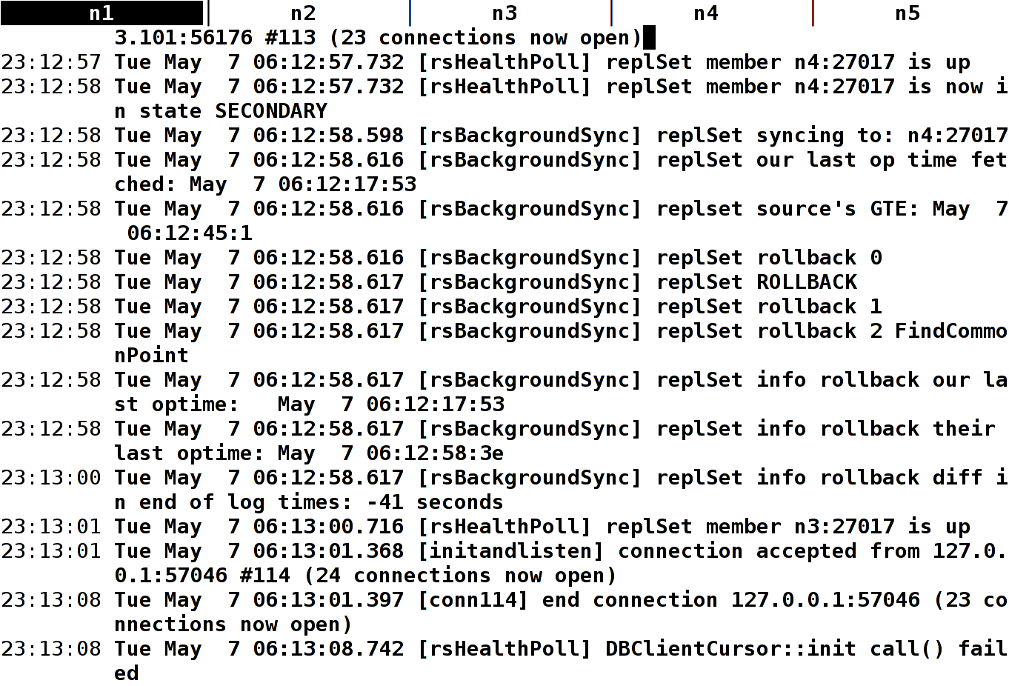

Slide 58
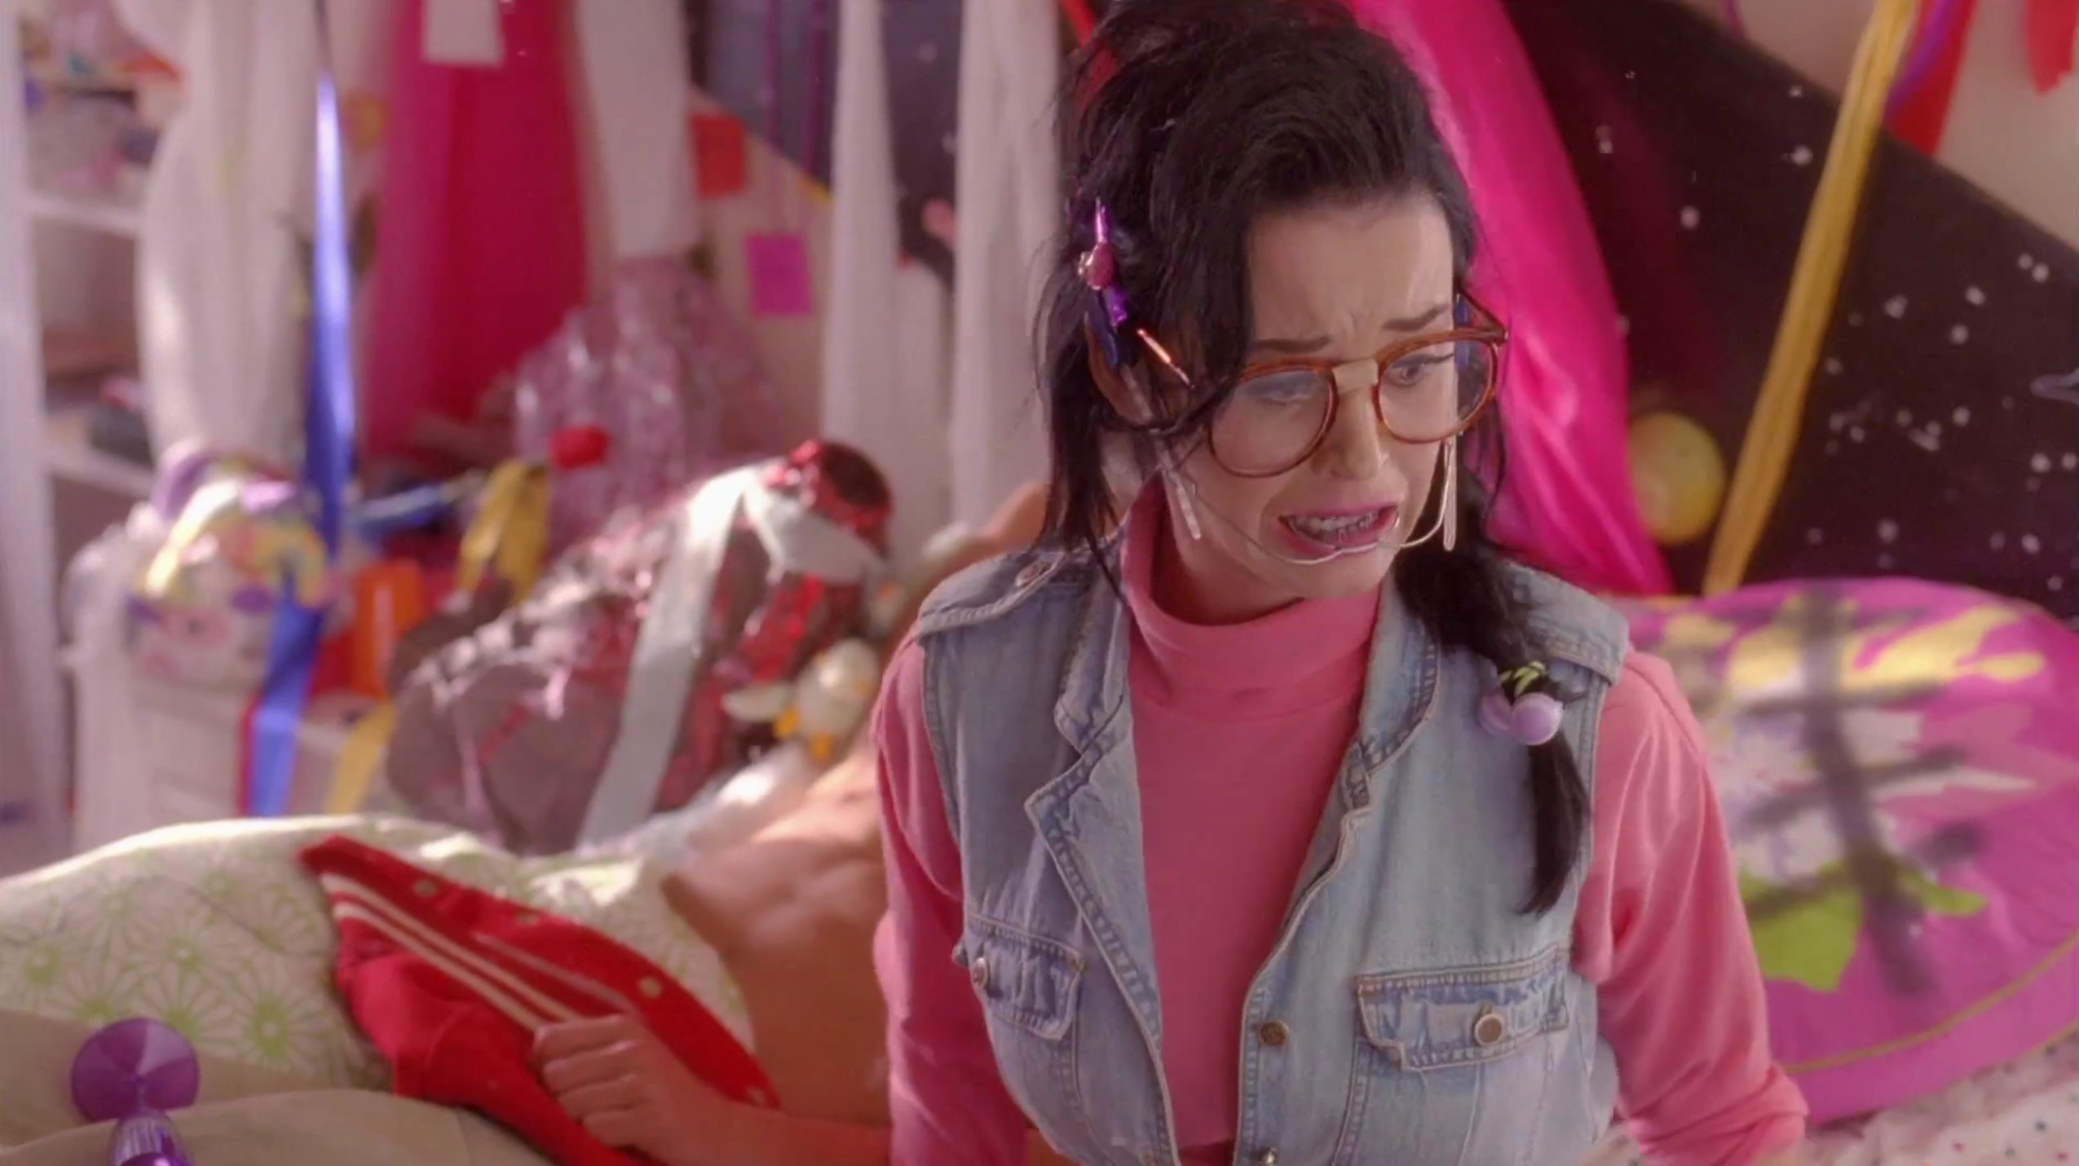
THINK WE DIVERGED
BUT I FORGOT

Slide 59
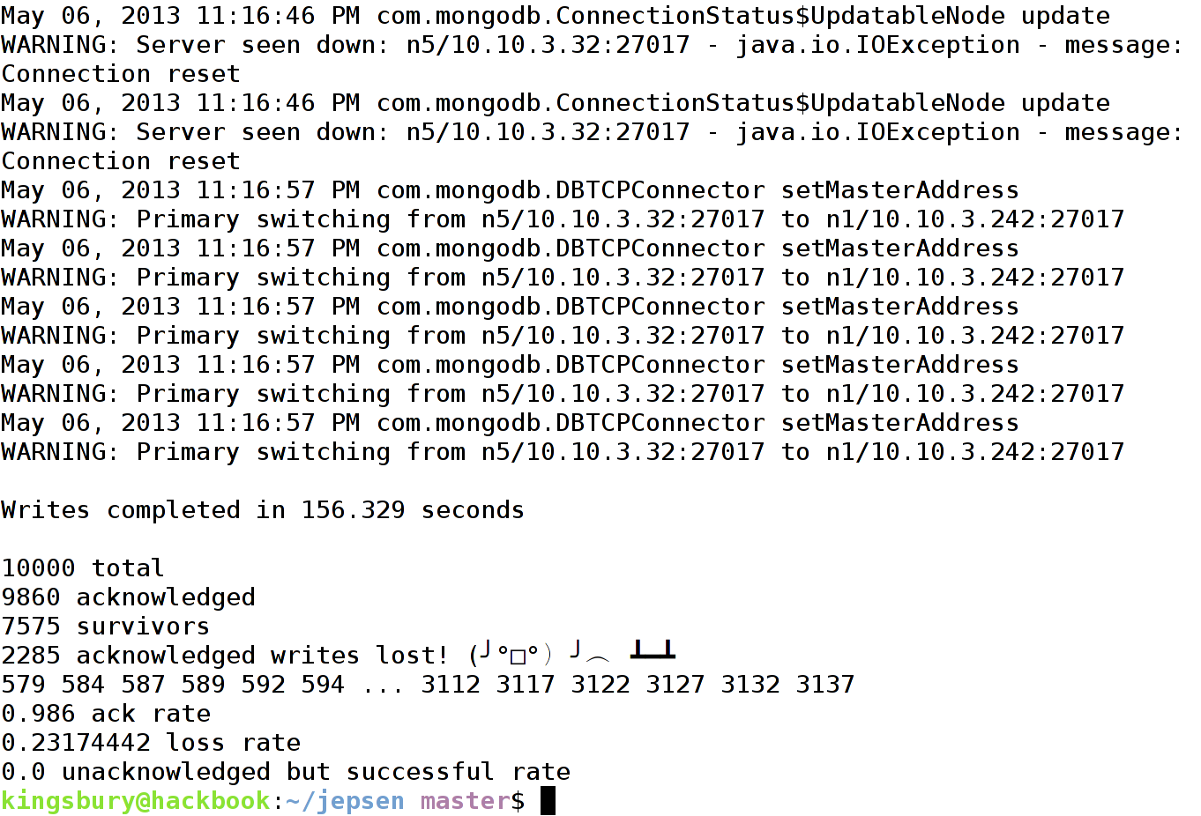

Slide 60
SAFE

Slide 61
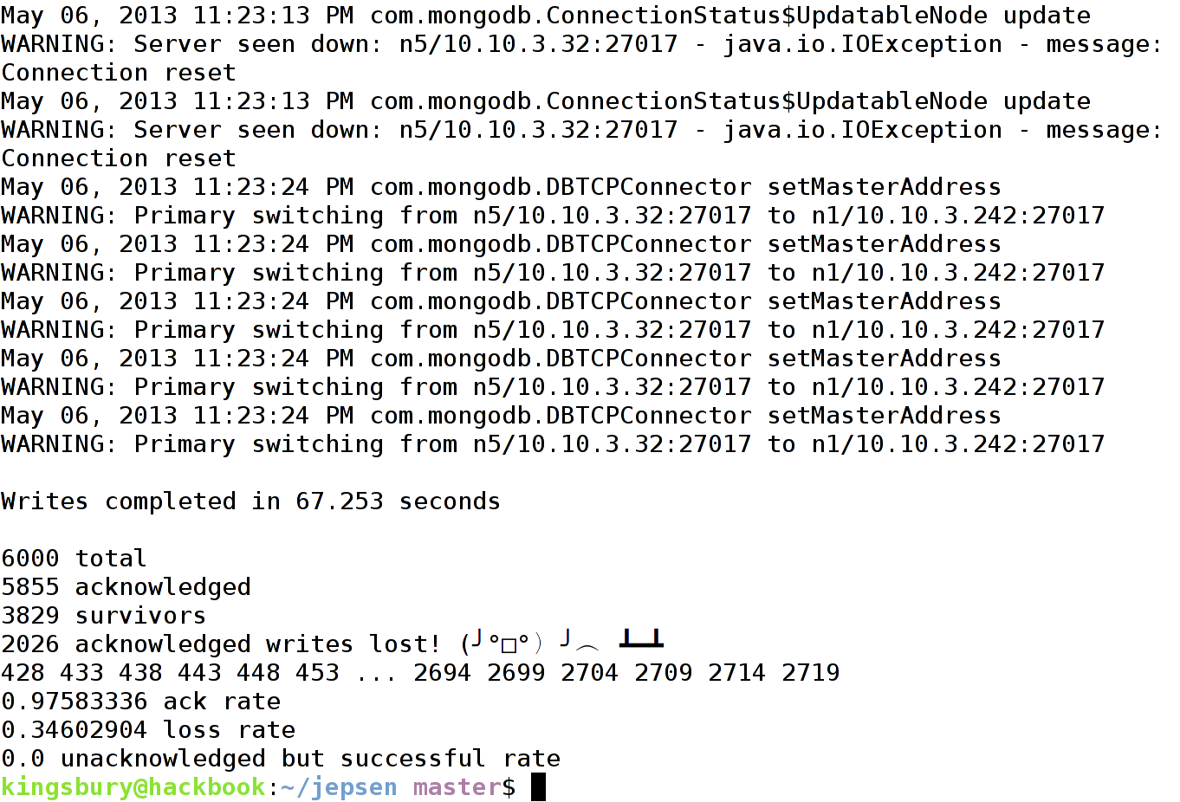

Slide 62

AND NOW YOU WON'T
STOP CALLING ME
I'M KINDA BUSY

Slide 63
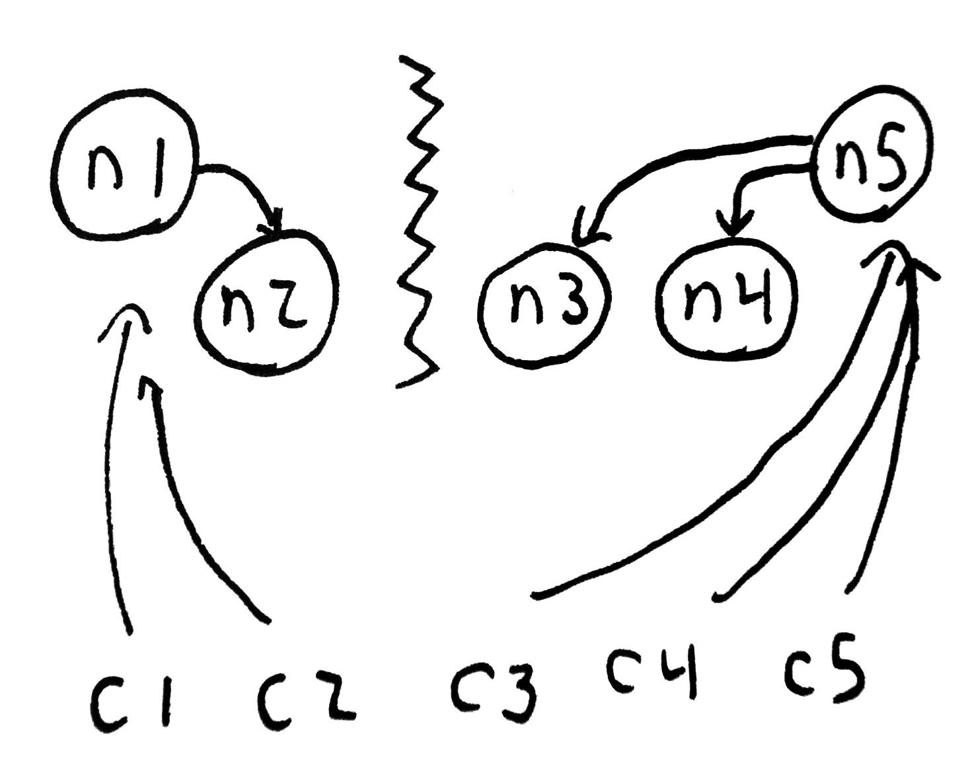

Slide 64
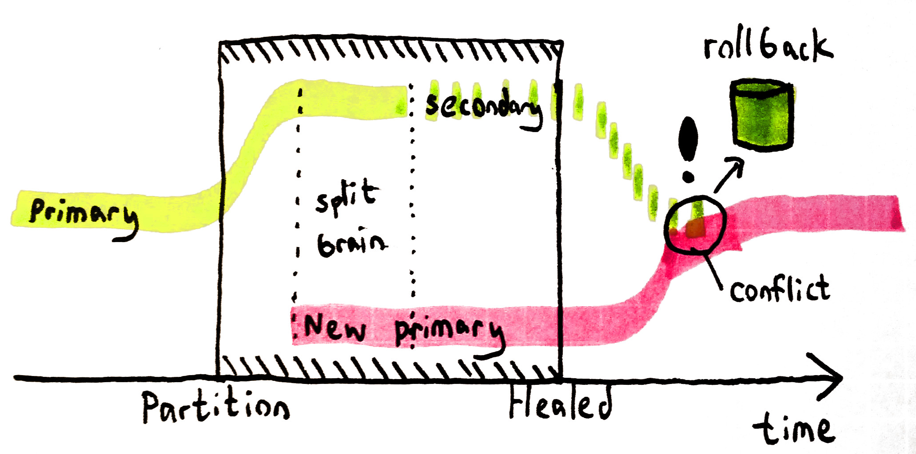

Slide 65
REPLICAS_SAFE

Slide 66
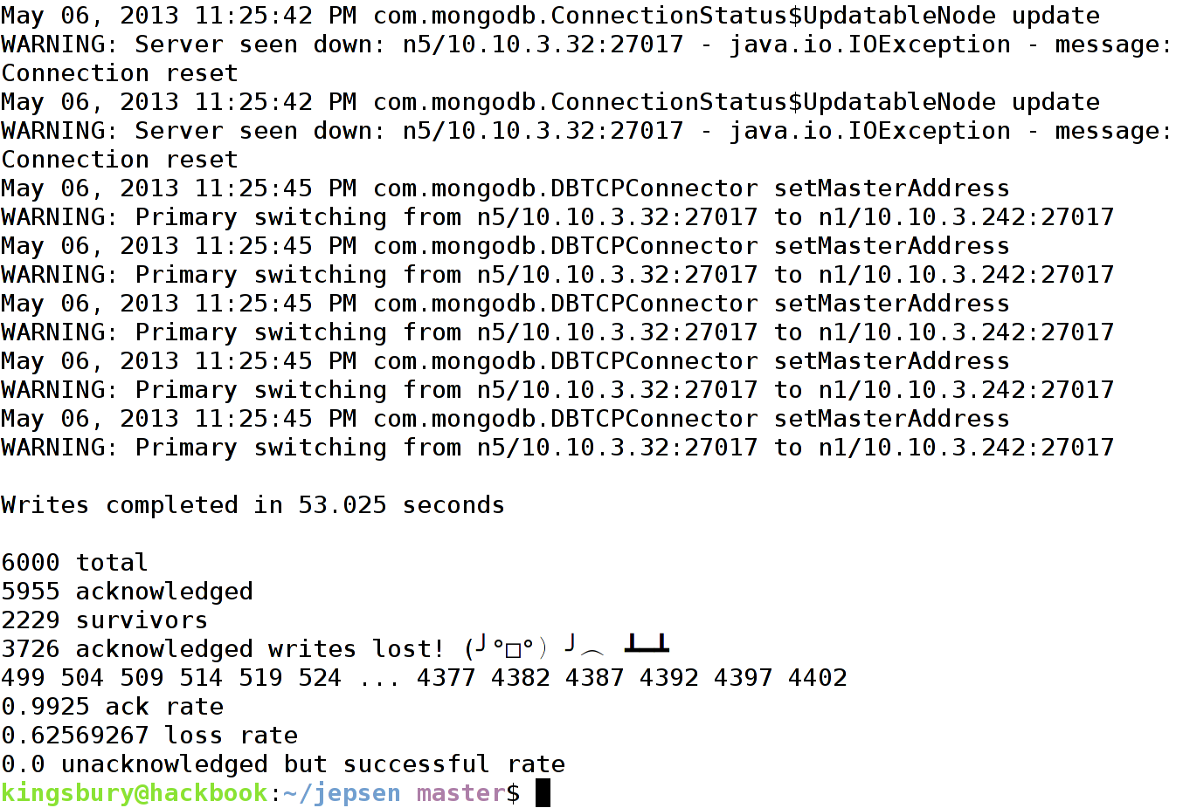

Slide 67

ROLL-ROLL-ROLL-
ROLL THAT OPLOG BACK

Slide 68
MAJORITY

Slide 69
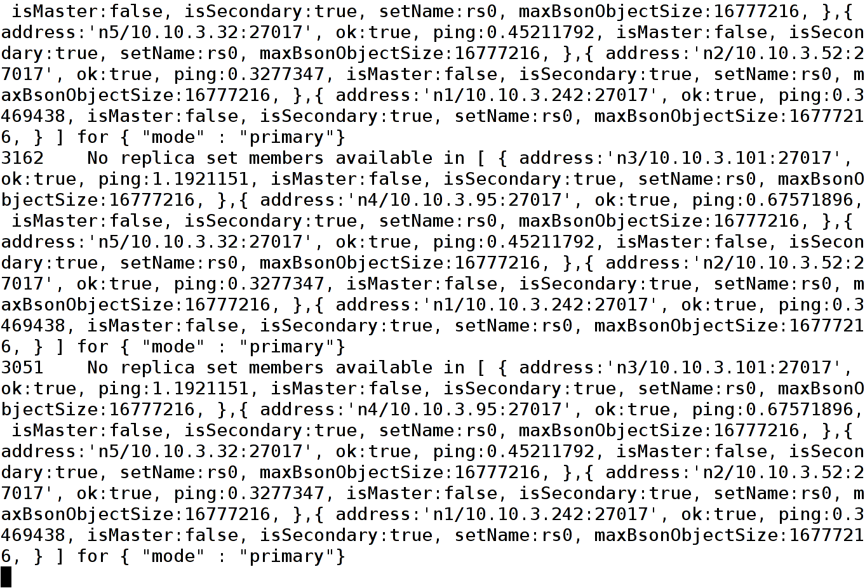

Slide 70
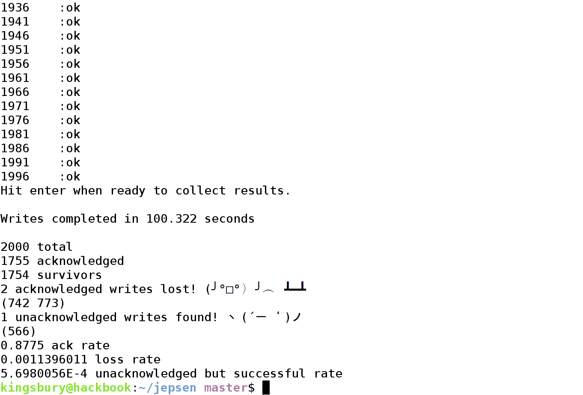

Slide 71

CUT MY NODES INTO PIECES
TRANSACTIONS SHOULD ABORT

Slide 72
Strategies
Accept data loss
Handle rollback files yourself
Write with MAJORITY

Slide 73
RIAK

Slide 74

IF YOU
LIKE IT
THEN YOU
DYNAMO
A RING
ON IT

Slide 75
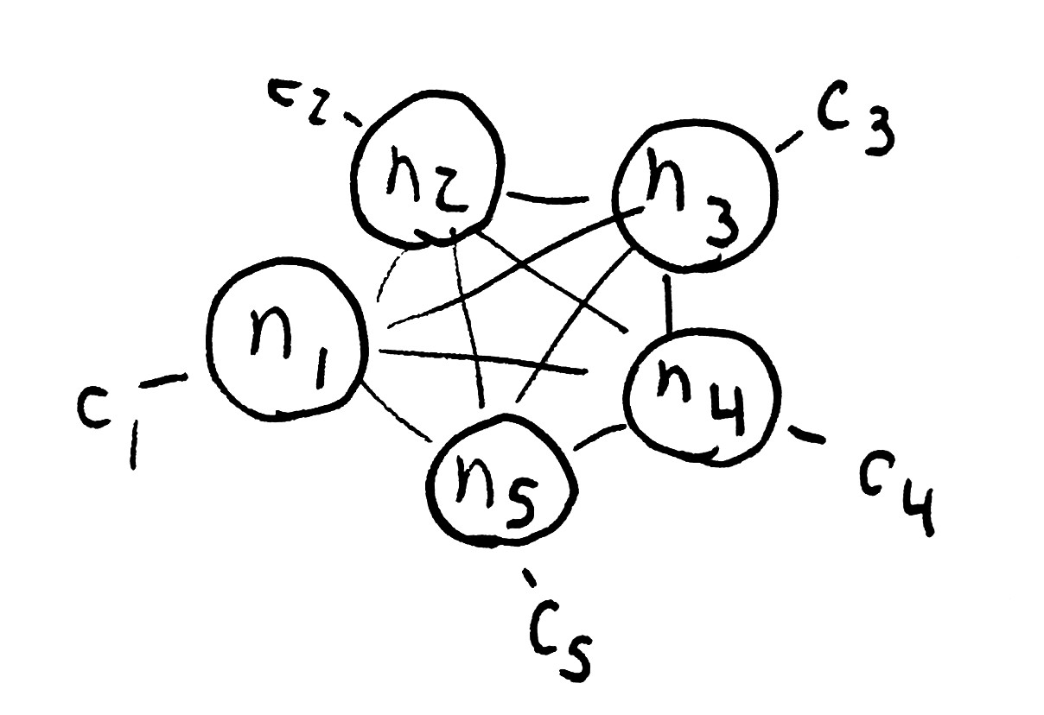

Slide 76
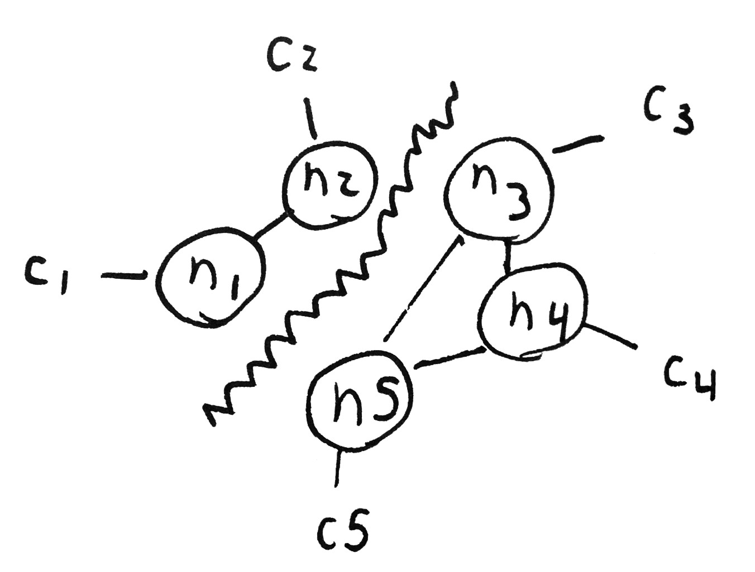

Slide 77
Riak is an AP system
“Tunable CAP controls”
R + W > N implies CP, right?

Slide 78
LAST
WRITE
WINS

Slide 79
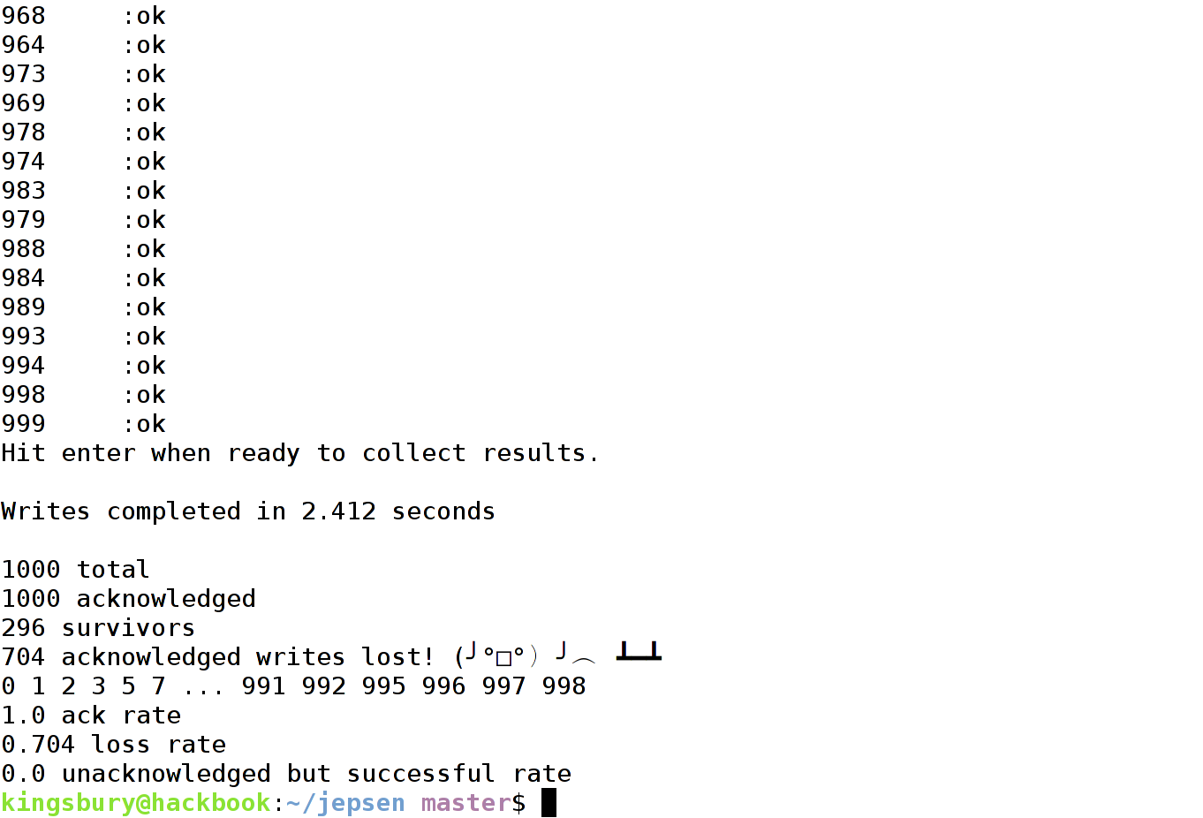

Slide 80

CAN'T READ MY
DATA RACE

Slide 81
LAST
WRITE
WINS
WITH A PERFECT DISTRIBUTED LOCK

Slide 82
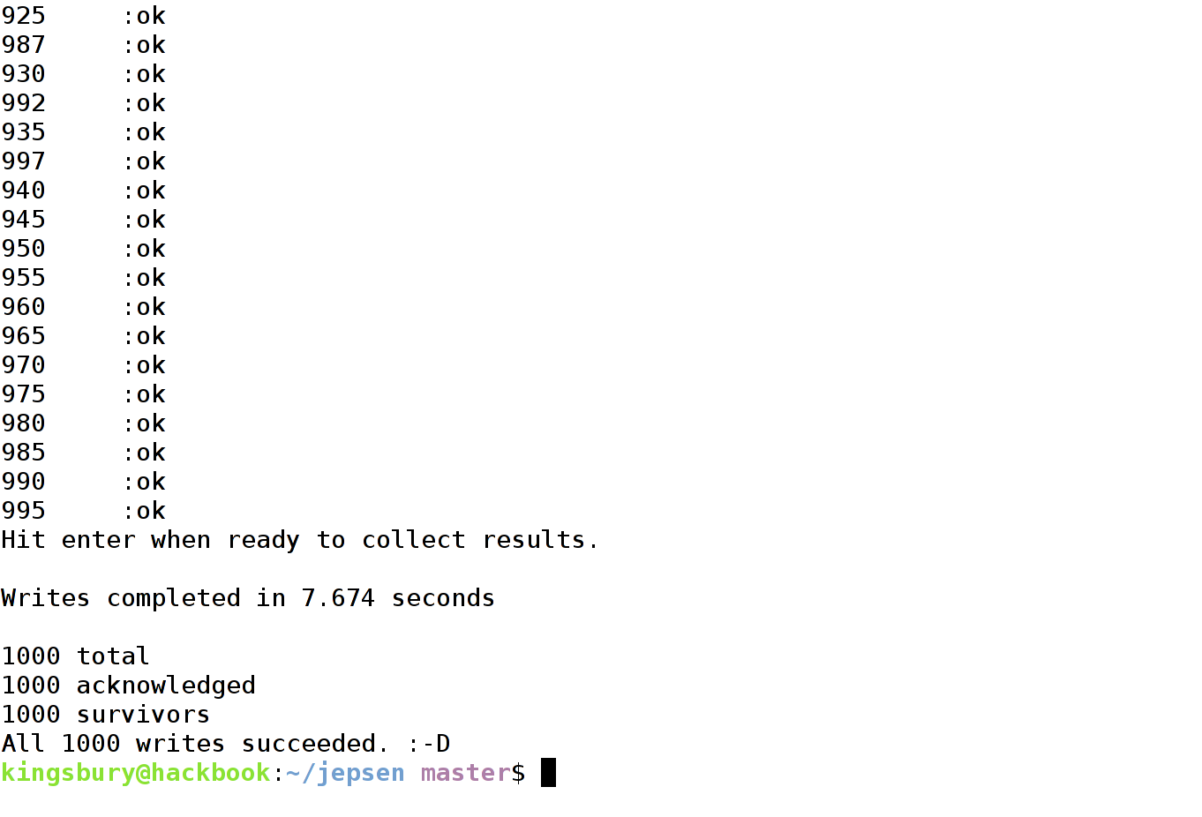

Slide 83
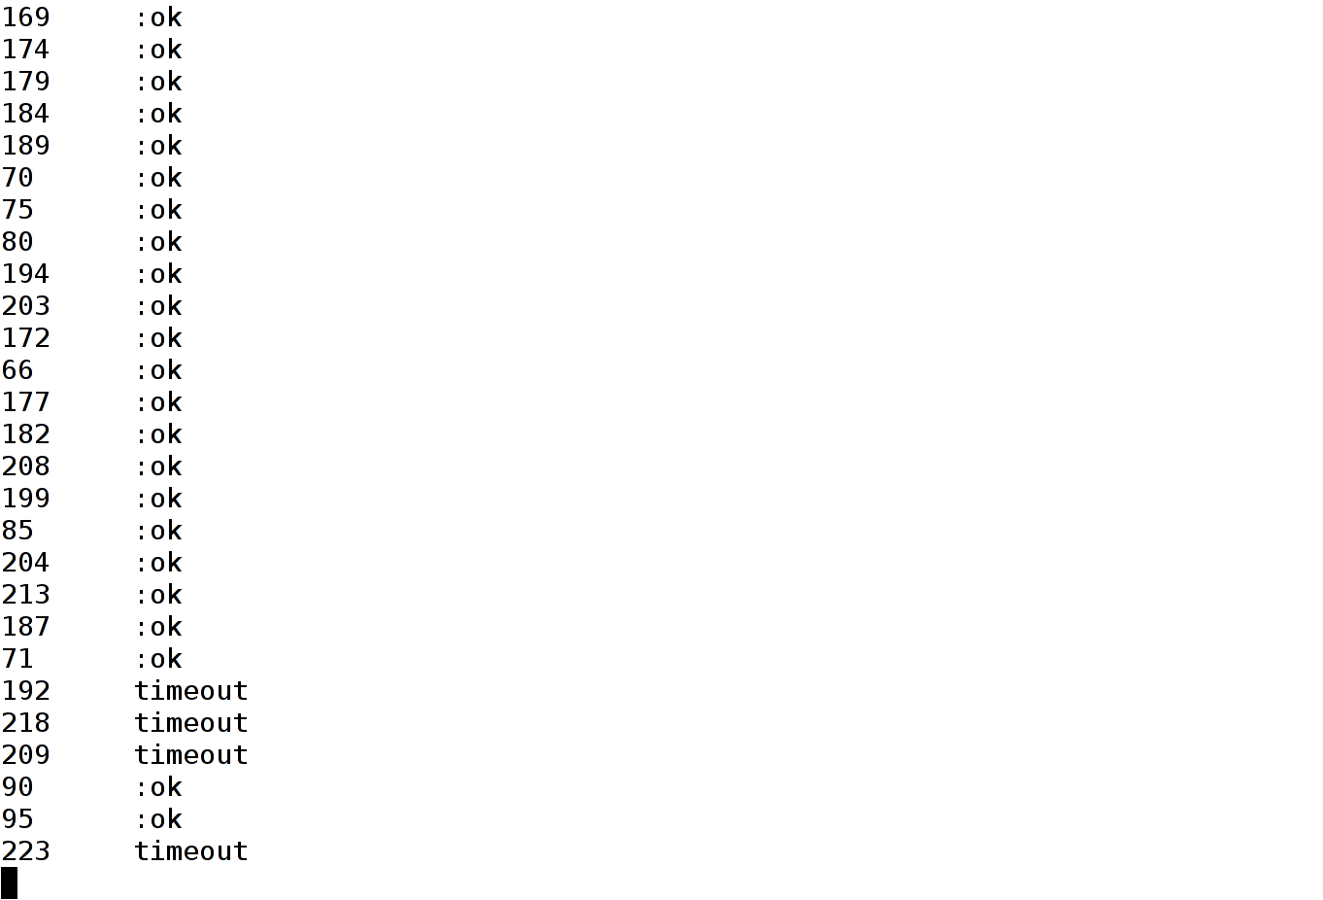

Slide 84
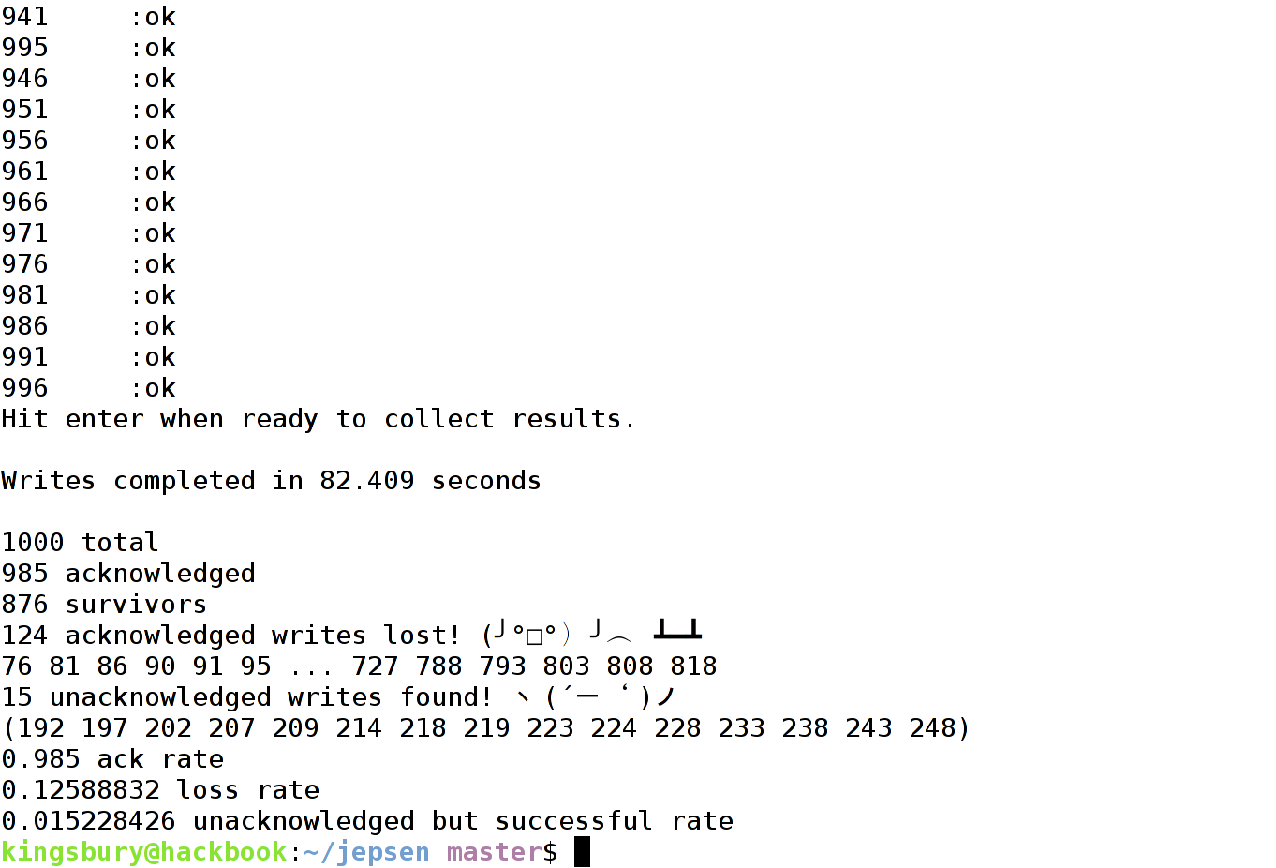

Slide 85

AND ALL THE OTHER NODES
CONFLICT WITH ME

Slide 86
LAST
WRITE
WINS
WITH A PERFECT DISTRIBUTED LOCK
AND PR+PW > N

Slide 87
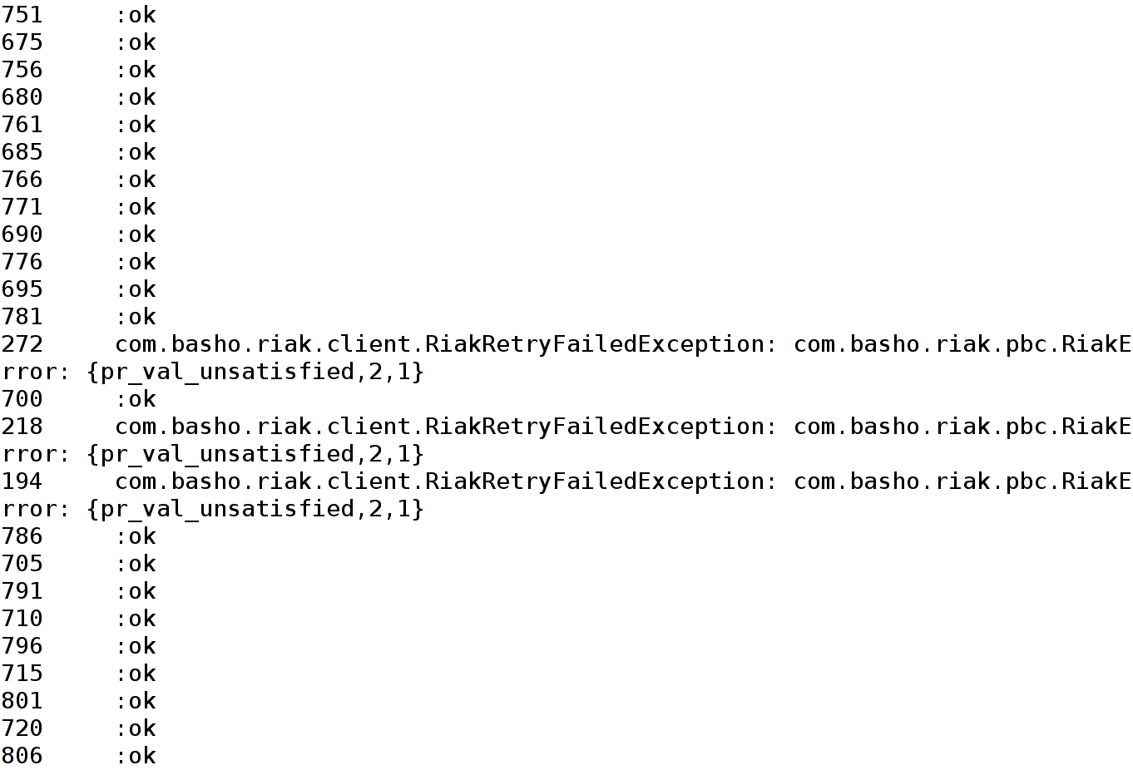

Slide 88
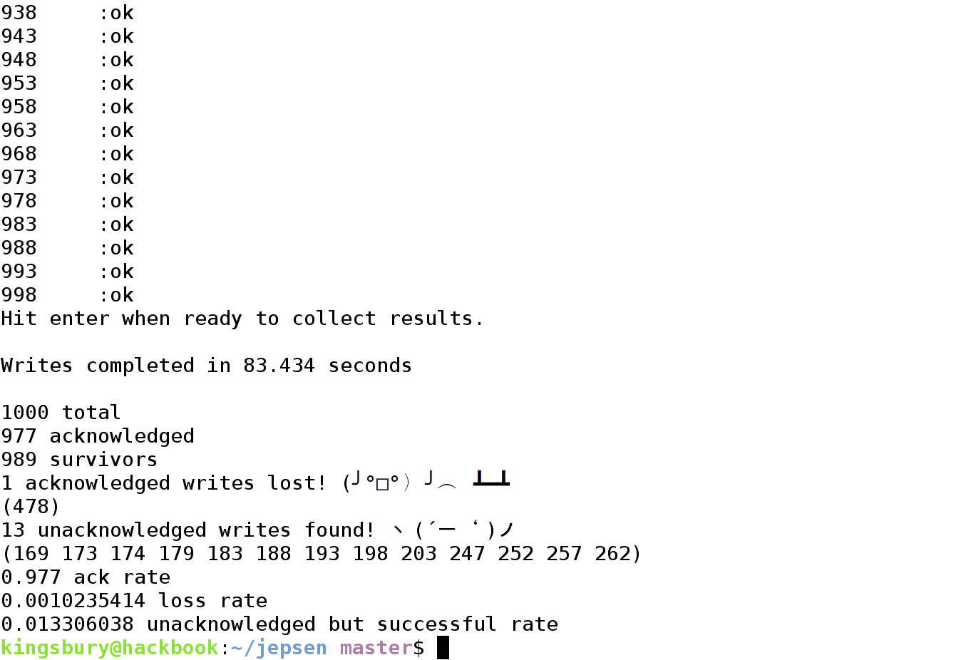

Slide 89

YOU
MUST
NOT
KNOW
CP

Slide 90
Failed writes
May succeed in part
Then, conflicts

Slide 91
Change is coming

Slide 92

I CAN'T
HELP
FEELING
WE COULD
HAVE HAD
IT ALL

Slide 93
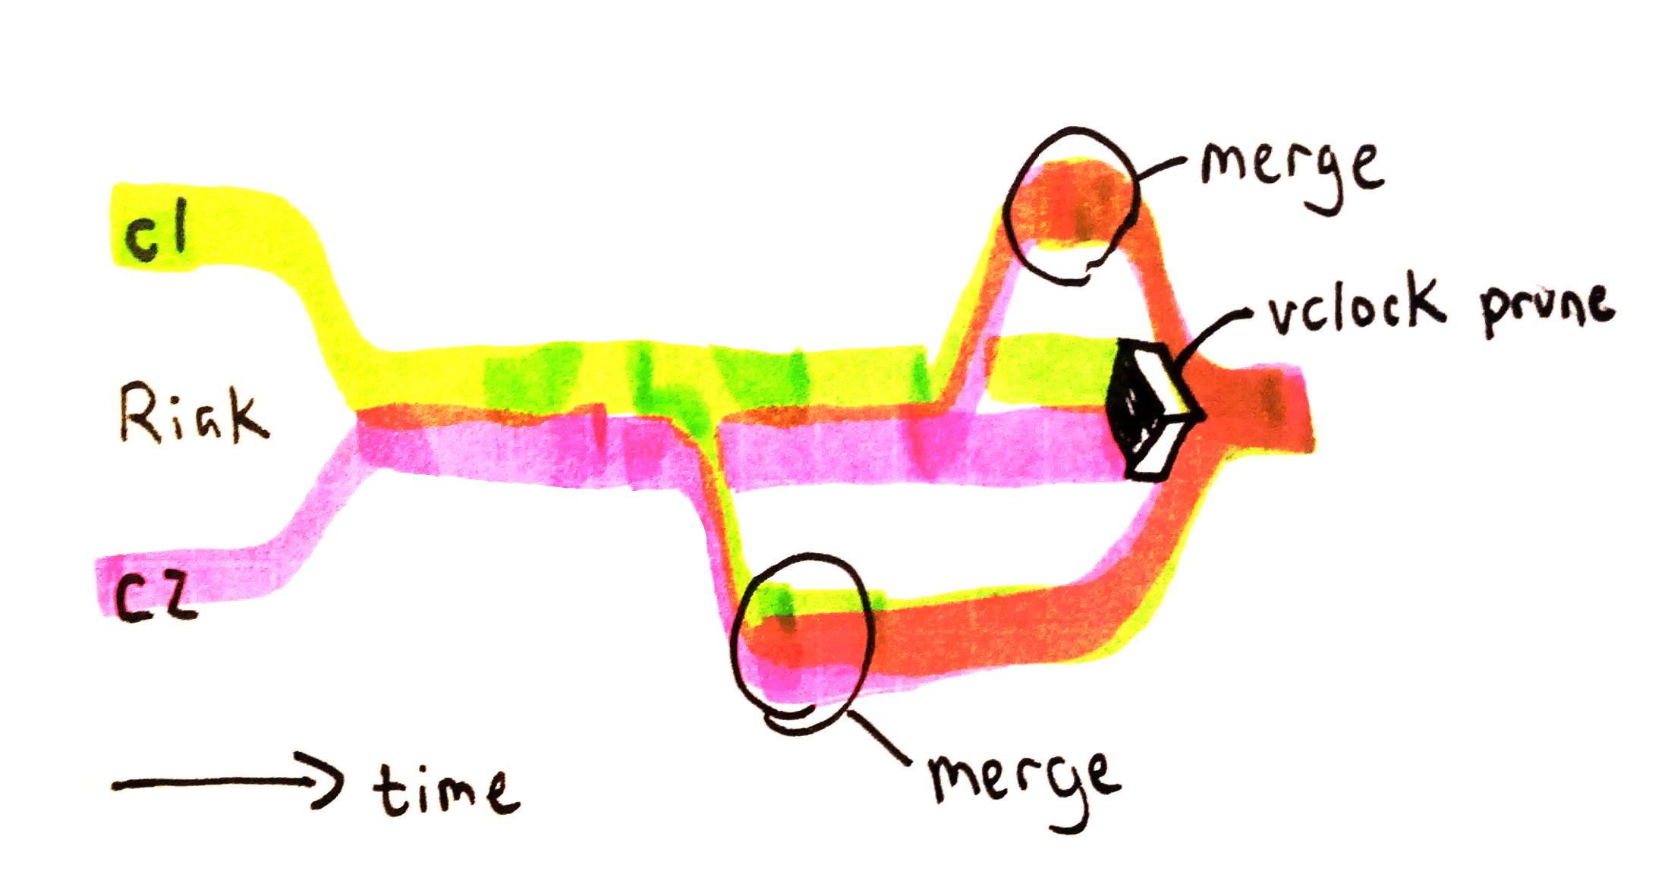
CRDTs

Slide 94
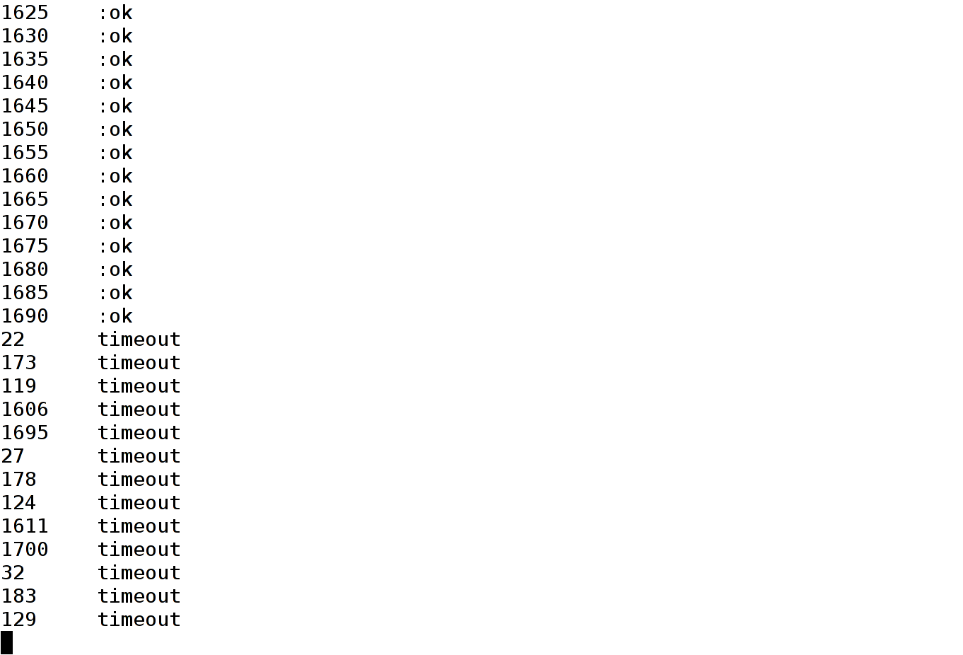

Slide 95
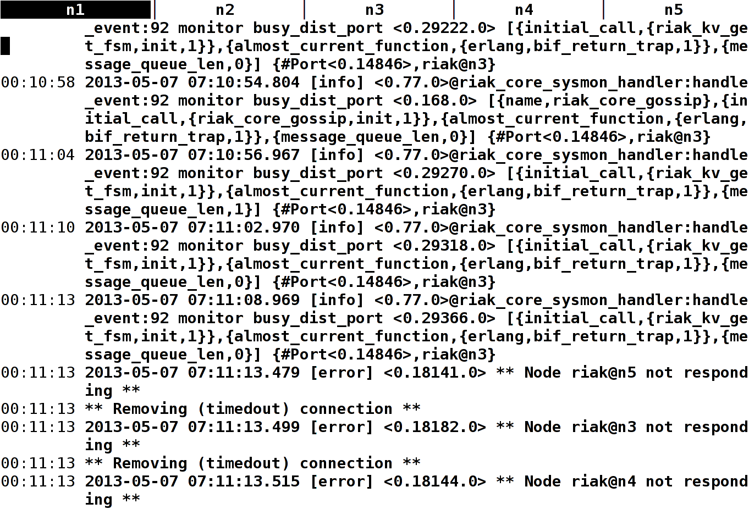

Slide 96
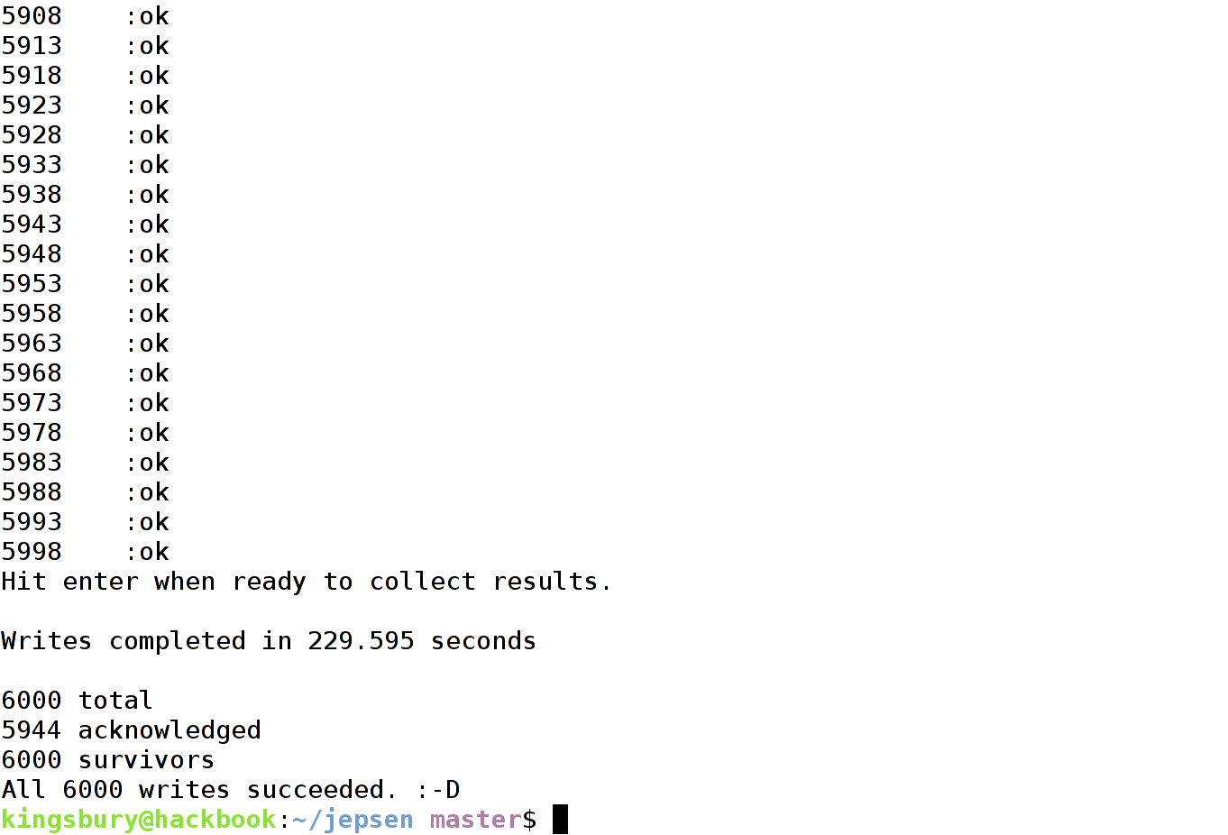

Slide 97

ALL
OF
THE
WRITES

Slide 98
TO RE-CAP

Slide 99
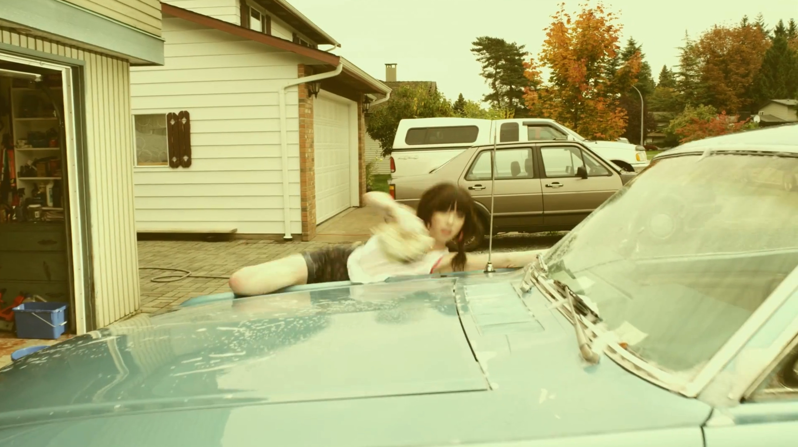
MODELING FAILURE MODES

Slide 100
Postgres&
Redis&
MongoDB&
Riak&

Slide 101
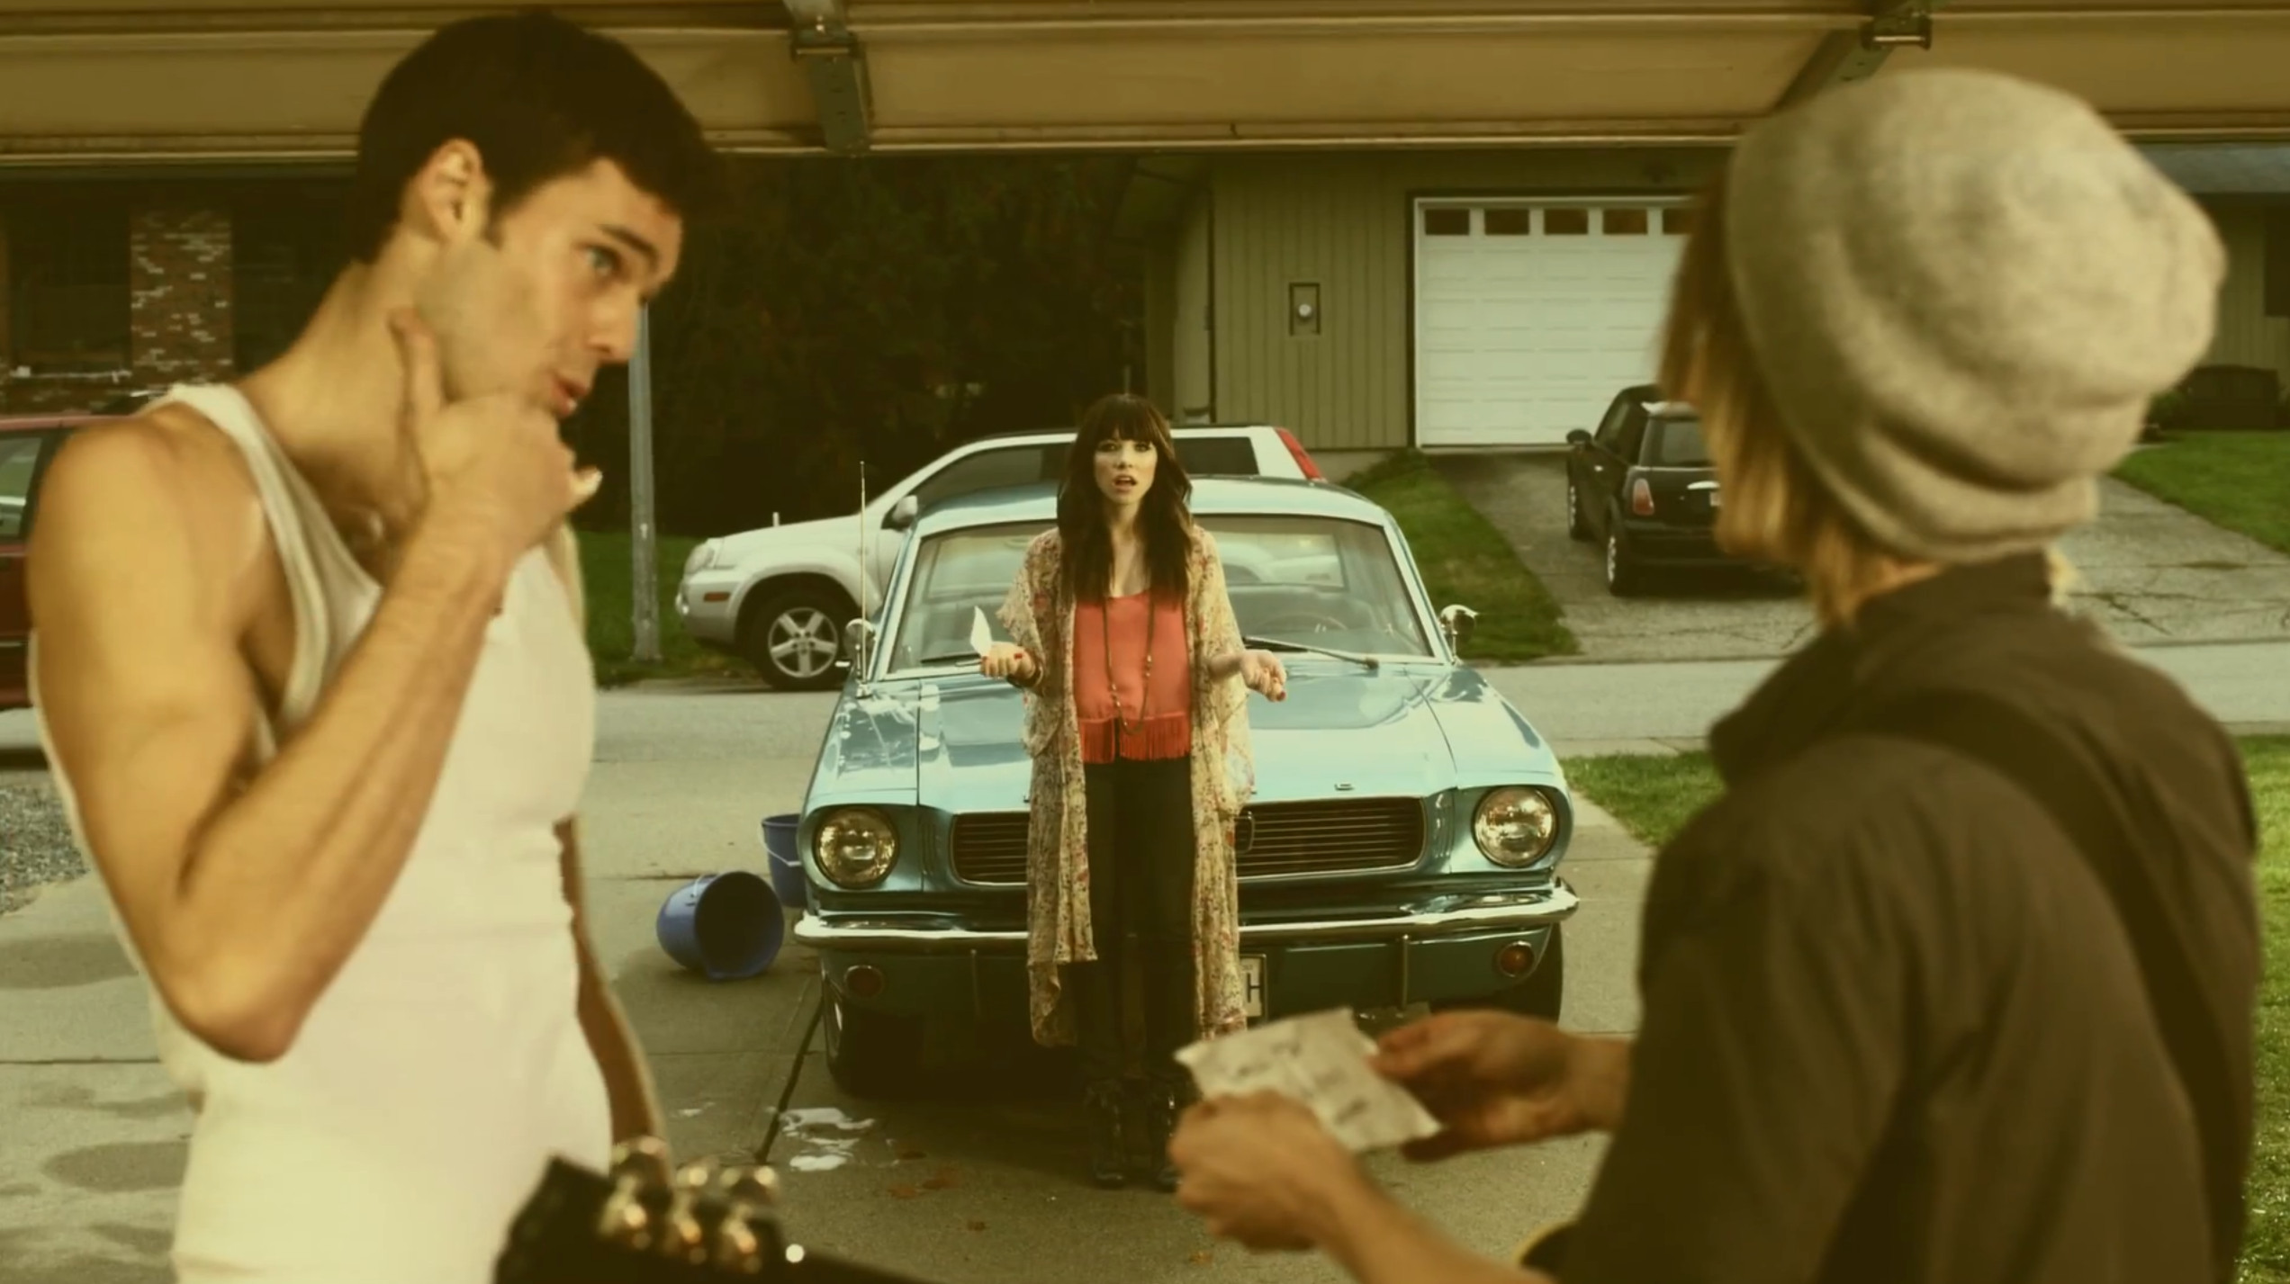
UNEXPECTED
CONSEQUENCES

Slide 102
How do you
know your app
does what you
think it does?

Slide 103

HOW DO COMPUTERS
EVEN WORK

Slide 104
measure
assumptions?

Slide 105

HAKUNA MY DATA

Slide 106
Consider simplicity over safety
Drop or GC inconsistent writes
Little white lies
Performance can trump correctness
Code you can reason about is better than code you can't
Probabilistic bounds

Slide 107
Thanks to...
Dietrich Featherston
Salvatore Sanfilippo
Evan Vigil-McClanahan
Jordan West
Tom Santero
John Muellerleile
Mark Phillips
Zach Tellman
Sean Cribbs
Joseph Blomstedt
10Gen
Basho
… and everyone else who helped along the way! <3
http://github.com/aphyr/jepsen

