Slide 1
A bit about clouds
Jeff Epstein, on the occasion of the Fitzwilliam Graduate Student Conference, March 19 2011

Slide 2
The multiuser model

Slide 3
The personal computer

Slide 4
The cloud

Slide 5
What is the cloud?
The National Institute of Standards and Technology says:
"Cloud computing is a model for enabling convenient, on-demand network access to a shared pool of configurable computing resources (e.g., networks, servers, storage, applications, and services) that can be rapidly provisioned and released with minimal management effort or service provider interaction.

Slide 6
What is the cloud?
Software as a service, rather than a product.

Slide 7
Parallelism

Slide 8
Fault tolerance, redundancy

Slide 9
What I do
I'm creating a ”framework”: a tool for software developers
Its goal is to let programmers develop software for the cloud quickly and easily
This is a hot topic in industry, and also has some interesting technical challenges

Slide 10
My framework
Cloud application
My framework
Cloud
server 1
Cloud
server 2
Cloud
server 3
Cloud
server 4
Cloud
server 5
Internet
Bob's PC
Jane's PC
Jaroslav's PC
Zoltan's PC
Bob's PC
Browser
Browser
Browser
Browser
Web app
Web app
Web app
Web app

Slide 11
A real example: K-means
Statistical algorithm for locating natural clusters in data points
  Input: data points
  Output: assignment of points to clusters
Highly parallel: each node in the cloud computes part of the algorithm simultaneously; their results are then combined
Coordinating all the nodes is complicated, especially in case of failure

Slide 12
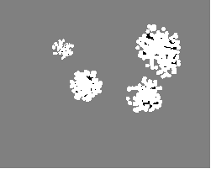
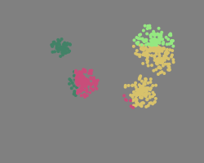
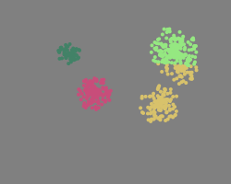


K-means example
0
0
Initial input:
1
2
2
3
Intermediary results:
4
Final result:

Slide 13
K-means in overview
MapReduce
Mapper 1
Mapper 2
Reducer 1
converged?
Master
Mapper 3
Reducer m
Result
Mapper n

Slide 14
How does my framework make implementing k-means easier?
We introduce the idea of a ”task”
  a restartable, locality-neutral block of code
  Failure transparency: programmer doesn't care if computer explodes, just give me results!
Communication framework for sending data between tasks
Resolves data dependencies with the notion of a ”promise”
  represents a value that has yet to be computed

Slide 15
Framework abstraction
What the application programmer sees
The framework translates that into
Tasks with data dependencies
An allocation of tasks to currently available hardware resources
MapReduce
Mapper 1
Master
Mapper 2
Reducer 1
converged?
Mapper 3
Reducer m
Mapper n
Result

Slide 16
Okay, so what?
Cloud application and web services will be more reliable, more available
Programmers will be less stressed, more social
The PC revolutions ends and we finish where we started: centralized computing services

