Slide 1
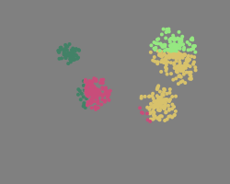
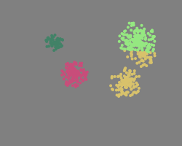



K-means clustering
The k-means clustering algorithm takes a set of data points and groups them into clusters by spacial proximity. It does this iteratively, adjusting mappings from the previous cycle. The algorithm is seeded with an initial pseudorandom guess. Eventually the results will converge.
Initial clusters have random centroids
After first iteration
After second iteration
After third iteration
Computationally demanding algorithm that can be broken into independent pieces, so is ideal for distributed computing! But how to implement it?
Converged

Slide 2
K-means iteratively invokes MapReduce over n Mapper nodes nodes and m Reducer nodes until the result converges.
Each node runs on a separate computer.
MapReduce
Mapper 1
Mapper 2
Reducer 1
converged?
Master
Mapper 3
Reducer m
Result
Mapper n
Each Mapper processes a disjoint subset of data points, assigning each point to a cluster based on which has the nearest centroid. Each Reducer calculates the centroid of these new clusters. The new centroids are used in subsequent iteration.

Slide 3
Performance of k-means under Remote Haskell
Data points | # reducers | # mappers | Time (s)
170000 | 2 | 17 | 204
370000 | 2 | 37 | 248
560000 | 3 | 56 | 289
750000 | 4 | 75 | 353
In this case, each data point is a 100-dimensional vector. The uniform data set is generated randomly.

