Slide 1
Git Workflow: Xeniapp
• Raj, Shruthi, Manasa

Slide 2
Overview
High level Convention and Change Types
Why use Branching?
Stable Branches
Branching Strategy
Steps for Feature Development
Release Process
Versioning

Slide 3
What is Workflow:
Version Control workflow handles, features on your code base aimed to run on multiple environments while keeping a clean and sane history.
Git is a tool for designing and building workflows
It helps write code without affecting the rest of the team

Slide 4
Why use Branching?

Slide 5
Why use Branching?
So you can push unstable code
Work independently
Still use remote version control
Only merge stable/functioning code
To deal with multiple people working on same feature
Helps breaking code and halt everyone workflow

Slide 6
High Level Convention and Change Types

Slide 7
High Level Convention
Master reflects production code
Staging reflects the next release code
Release reflects a specific release (grouped features) code.
Release reflects a specific feature
New features off planned releases

Slide 8
Types of Changes vs Branches:
Depending on the type of change, the below type of branches can be created:
Feature branch
This is to launch any new feature or any enhancement to the existing functionality.
Bugfix
This type is to fix any issue with the existing functionality.
Chore
This is to for the tasks like version update, a minor update
Hotfix
To fix a breaking issue of the code that is live or in production
Release
To group all the changes that go out in a single release timeline

Slide 9
Stable Branches

Slide 10
Stable branches
We should always have master as stable branch.
Master
It should be the main branch where the source code reflects with the one that is currently on production.
Staging
This is the branch that always reflects a state with latest code changes and bug fixes for next targeted release.
Release
Each time when changes are released to production, this branch should be merged back to master
Tags
It is a good practice to maintain tags for every release that is deployed to production

Slide 11
Branching Strategy

Slide 12
Approach 1

Slide 13
Github Branching Strategy 1:
While working with the Github flow branching strategy, there are six principles we should all adhere to ensure maintaining a good code.
Any code in the master/staging branch should be deployable.
Create new descriptive named branches off of main/staging/release for new work
feature/add-payment-method
Commit new work to our local branch and regularly push code to remote
To create PR for review
Merge the branch to targeted branch.
Once merged, should be deployed immediately.

Slide 14
Steps for Feature Development
Pull to update your local from release branch
Checkout a new feature from release
Update code in our feature branch
Commit code early and often
Rebase to incorporate upstream changes
Squash your commits
Push the code up to your feature branch
Create PR and merge changes to release branch
Push your merged feature release branch upstream.

Slide 15
Release Process

Slide 16
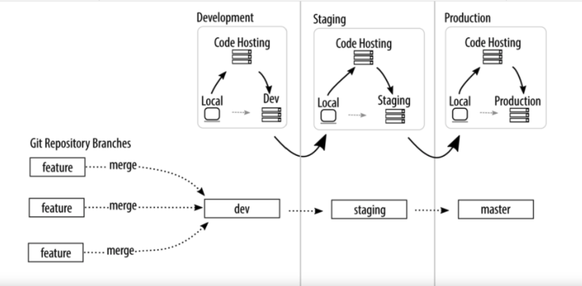

Slide 17
Versioning
Tag the current state of the code
Can easily work with a previous version if needed
Use versioning on master

Slide 18
Steps for Release
Once the release is complete, merge it to staging
Push it upstream and test it
Once it looks good, create a final tag
Push it upstream and test it
Once it looks good, push it to Production
Once the production code is stable, merge the tag to master
Delete all stale or merged branches for clean maintenance. (this includes all feature, bugfix, hotfix , chore and release branches)

Slide 19
Approach 2

Slide 20
Github Branching Strategy 2:
In this strategy we will use feature flags to enable or disable features.
All commits go into dev branch with feature flag
When flag is off the route / component should not display
We can have a flag on for dev but not prod
If a feature branch is needed create short-lived branch off of dev
feature/add-payment-method
Rebase from dev on regular basis
To create PR for review
Once merged, should be deployed immediately to dev environment.

Slide 21
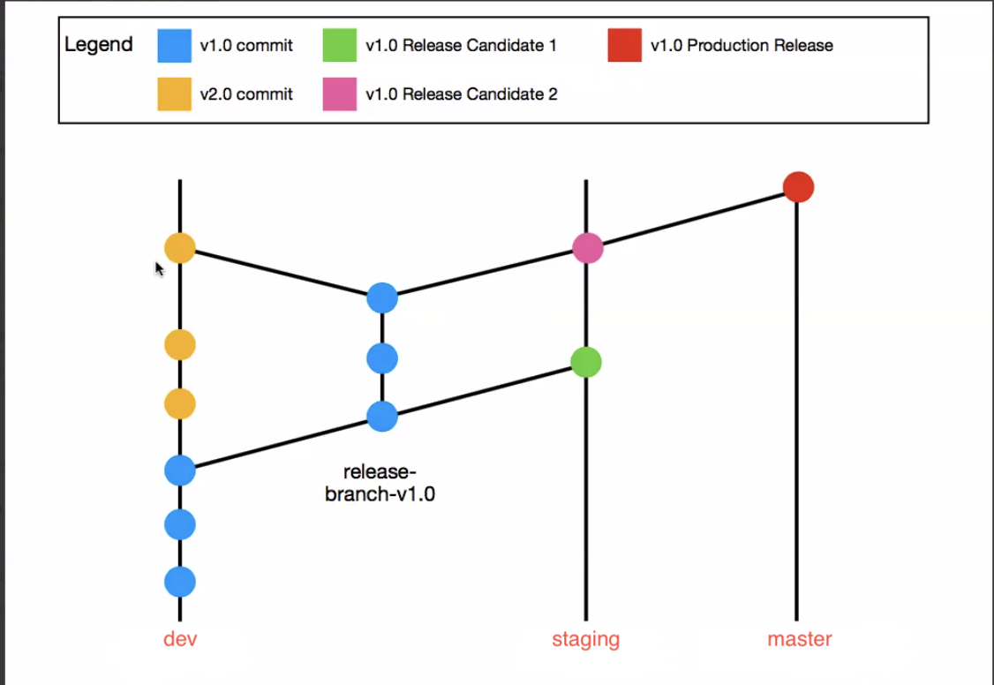

Slide 22
Steps for Feature Development
The commits happen to dev on day to day basis
Once the team is comfortable, create a release branch out of dev (for e.g: release/1.0.0)
Run unit tests on release branch
Check if feature flags and configs are correct
Merge the release branch into staging with merge commit to show release candidate for the release
Any defects identified in test environment will be fixed on release and merged into staging

Slide 23
Release Process

Slide 24
Steps for Release
As soon as code is in staging, deploy to test
And save the deployable to be deployed to production
Validate changes in test environment
After production deployment, merge the staging to master and tag

Slide 25
Decision
Feedback

