Slide 1
Orbyte
DecisionOS
Owner-controlled procurement for Malaysian SMEs
Team Us! · Domain 2 · Orbyte Smart SME Challenge · SDG 8
Notes:
Working synthetic prototype by registered team Us!. Product/build direction supplied by the user; substantial code and documentation assisted by Codex. Leader/member details and declarations require confirmation. No live Orbyte API or genuine MiroFish simulation is claimed.

Slide 2
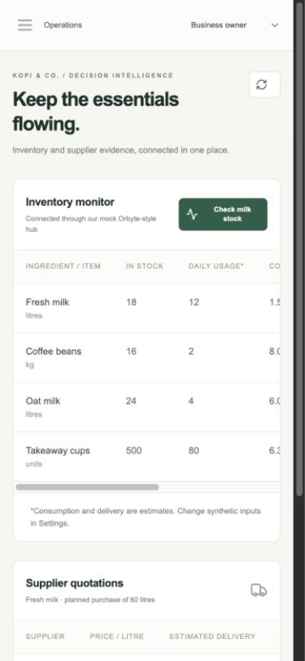
The daily procurement decision
1.5 days
of milk coverage in the reference case
Owners must compare cost with delivery timing, then record a decision they can explain.
18 litres in stock ÷ 12 litres/day
All records are synthetic
Notes:
Problem hypothesis from Domain 2 brief and the supplied synthetic cafe scenario. No SME field study. Screenshot: original app, docs/screenshots/mobile-operations.jpg.

Slide 3
The cheaper quote arrives later
For 60 litres | Supplier A | Supplier B
Unit price | RM9.50 | RM11.00
Quoted total | RM570 | RM660
Estimated delivery | 4 days | 1 day
Arrival vs. stock coverage | 2.5 days after | 0.5 days before
RM90 premium for earlier estimated delivery
Owner decides. Shipping, tax, spoilage and delivery guarantees are not provided.
Notes:
Source: backend/services/rules.py and seed.py. Exact quote arithmetic for 60 litres. Delivery and daily usage are assumptions. RM90 is a premium, not savings.

Slide 4
A complete approval journey
01
Trigger
Run the inventory check
02
Connect
Read stock and supplier quotes
03
Evaluate
Calculate coverage, cost and risk
04
Approve
Owner selects an option and reason
05
Record
Save a draft and persistent audit
Notes:
Source: API/procurement service and native browser verification in docs/TESTING.md. Simulated roles. No external order or payment. Deterministic comparison independent of MiroFish.

Slide 5
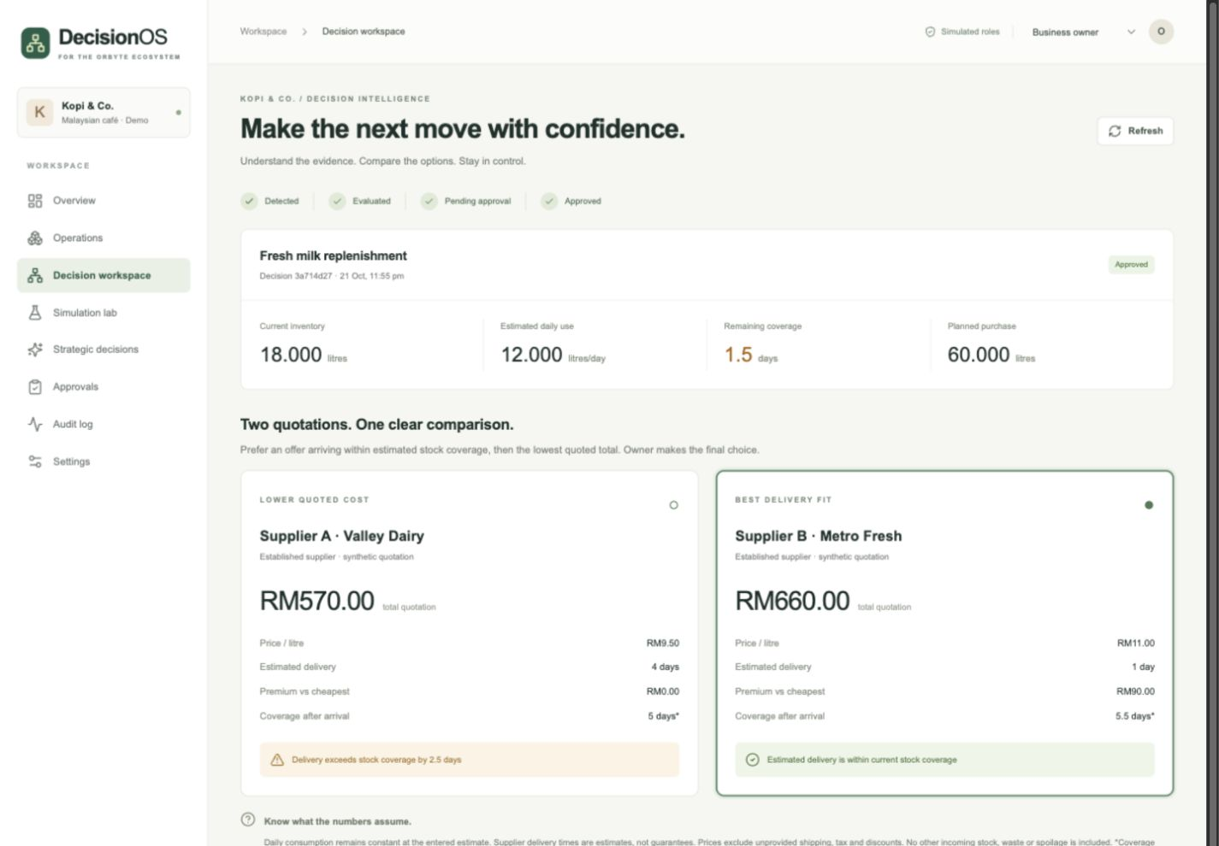
Demo step 1 · Compare the evidence
Presenter cue: point to 1.5 days of coverage, RM570 versus RM660, and 4 days versus 1 day.
Notes:
Actual synthetic DecisionOS run. This screenshot shows the approved state because the shared demo persists prior actions. During the recorded walkthrough, create a new decision and show the same comparison before approval. No real supplier data or transaction.

Slide 6
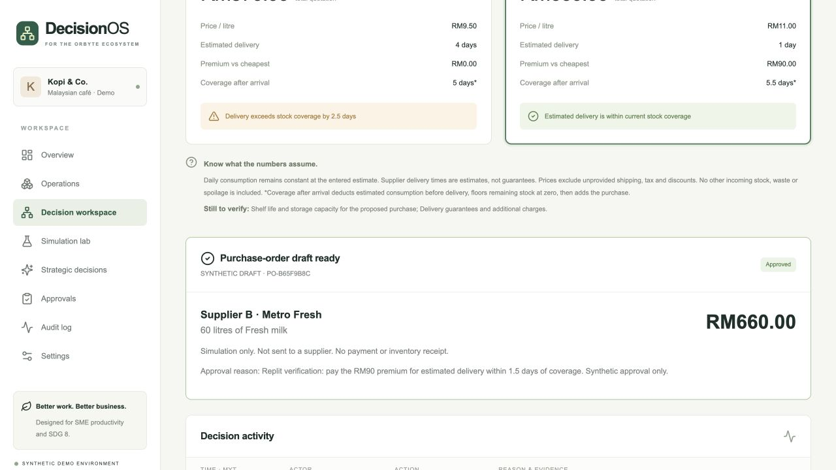
Demo step 2 · The owner approves
Presenter cue: explain the approval reason and that the purchase order remains a draft.
Notes:
Actual synthetic Replit run. Supplier B was selected for estimated arrival within stock coverage. The RM90 amount is a premium, not a measured saving. Simulated roles are not production authentication. No external order or payment.

Slide 7
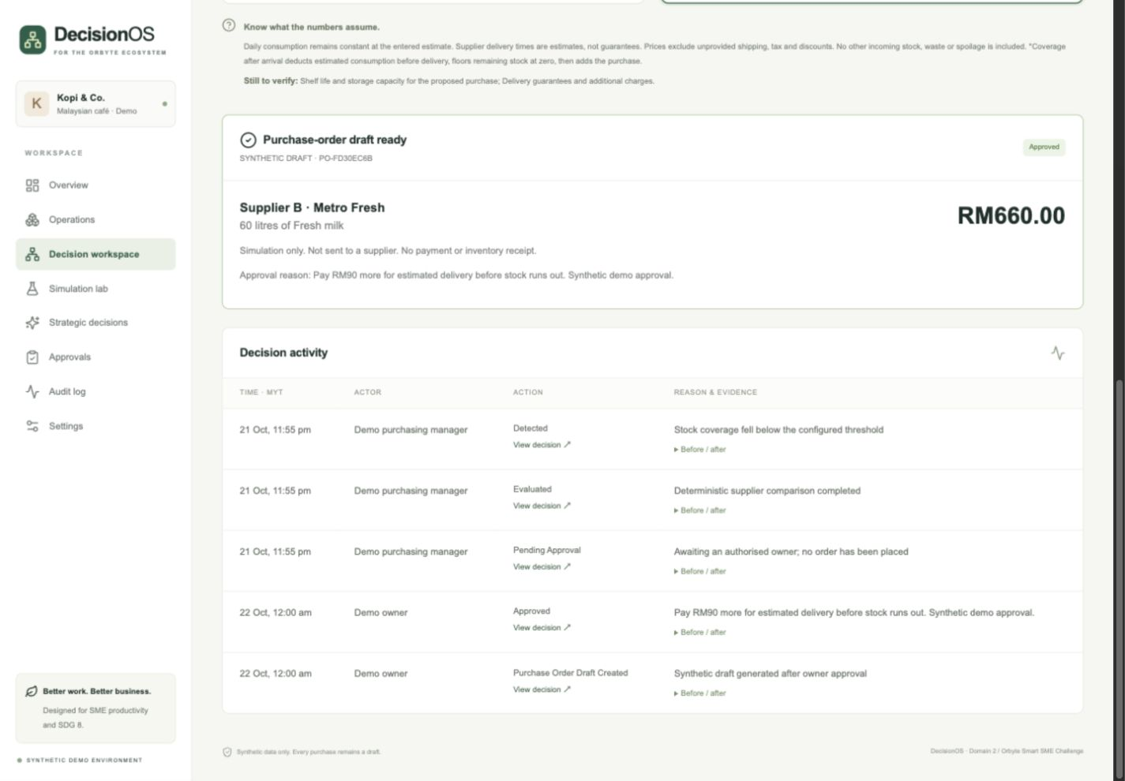
Demo step 3 · Draft and audit persist
Presenter cue: reload the page, then open Audit log to show the saved actor, reason and outcome.
Notes:
Original evidence: docs/screenshots/purchase-draft-audit.jpg. Synthetic decision 3a714d27; Supplier B RM660; PO FD30EC6B. Reload and server restart preserved it. Actual software screenshot, not a mock-up.

Slide 8
Architecture and the Orbyte boundary
Operational path
Optional scenario path
Next.js interface
↓
FastAPI + deterministic rules
↓
Owner approval transaction
↓
SQLite: draft + audit + snapshot
Persistent request
↓
Separate worker
↓
Pinned MiroFish service
↓
Approved LLM + Zep
Mock Orbyte-style connector: our own interface assumption, not an official integration.
Notes:
Source: docs/ARCHITECTURE.md, API.md and https://github.com/666ghj/MiroFish/tree/7657031ac01184afe2cb220f5ee3545573b5e843 . Original HTTP adapter; no upstream code bundled. Editable diagram.

Slide 9
Simulation explores uncertain complications
What if ingredient delivery is delayed by three days?
Fictional perspectives: owner, purchasing manager, supplier, delivery coordinator and customers.
Explore menu changes, extra workload and possible mitigation.
Do not turn agent opinions into demand forecasts.
Current state: Gemini check passed; Zep key and live simulation pending.
Notes:
Source: scenarios.py and docs/MIROFISH.md. Social-agent environments adapted to fictional business perspectives. Upstream environment installed; small Gemini provider checks passed, but the locally saved Zep value is masked and invalid. No genuine report, live latency or token totals.

Slide 10
Impact to measure
30%
SDG 8.2 / 8.3
Less repetitive administration
Traceable owner decisions
A reusable SME workflow
proposed reduction in task time
Planning baseline: 10 minutes
Target: 7 minutes or less
Neither has been measured yet
Pilot: same synthetic task, alternating task order, recorded errors and assistance.
Notes:
UN source: https://sdgs.un.org/goals/goal8 . 8.2: productivity through technology; 8.3: SME development. Numbers are planning assumptions/targets, not measured results. Source: docs/BENEFITS.md.

Slide 11
Verified build and live demo
Working procurement MVP
33 backend + 3 component + 4 browser tests passed
GitHub CI passed; public Replit demo live
Owner approval and draft persisted after reload
Still to complete
Team review, signatures, video and Core eligibility
Optional MiroFish run · timed SME usability study
Notes:
In Replit on 23 October 2026: 33 backend tests, 3 component tests, typecheck, build and 4 Playwright tests passed. Browser tests used installed Chromium 152.0.7977.64. GitHub CI passed. On 24 October the public synthetic Replit demo passed security checks and an inventory-check, owner-approval, draft and reload check. Live URL: https://orbyte-decisionos--jeremyjunxuanta.replit.app/ . Team declarations, video, committee GitHub access and Core-voucher eligibility remain pending. No genuine MiroFish run is claimed.

