Slide 1
Orbyte
DecisionOS
Owner-controlled procurement for Malaysian SMEs
Domain 2 · Orbyte Smart SME Challenge · SDG 8
Notes:
Working synthetic prototype. Product/build direction supplied by the user; substantial code and documentation assisted by Codex. Team details and declarations require confirmation. No live Orbyte API or genuine MiroFish simulation is claimed.

Slide 2
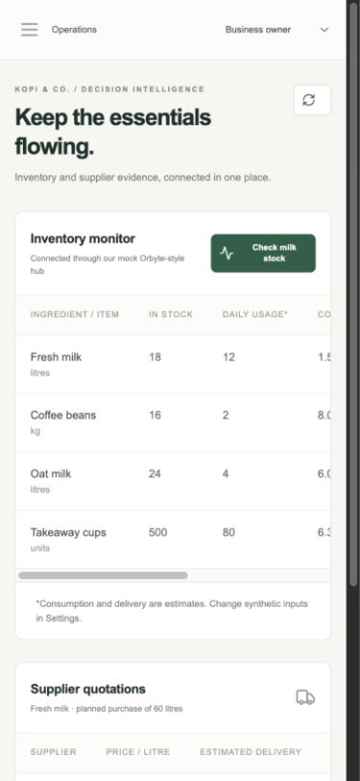
The daily procurement decision
1.5 days
of milk coverage in the reference case
Owners must compare cost with delivery timing, then record a decision they can explain.
18 litres in stock ÷ 12 litres/day
All records are synthetic
Notes:
Problem hypothesis from Domain 2 brief and the supplied synthetic cafe scenario. No SME field study. Screenshot: original app, docs/screenshots/mobile-operations.jpg.

Slide 3
The cheaper quote arrives later
For 60 litres | Supplier A | Supplier B
Unit price | RM9.50 | RM11.00
Quoted total | RM570 | RM660
Estimated delivery | 4 days | 1 day
Arrival vs. stock coverage | 2.5 days after | 0.5 days before
RM90 premium for earlier estimated delivery
Owner decides. Shipping, tax, spoilage and delivery guarantees are not provided.
Notes:
Source: backend/services/rules.py and seed.py. Exact quote arithmetic for 60 litres. Delivery and daily usage are assumptions. RM90 is a premium, not savings.

Slide 4
A complete approval journey
01
Trigger
Run the inventory check
02
Connect
Read stock and supplier quotes
03
Evaluate
Calculate coverage, cost and risk
04
Approve
Owner selects an option and reason
05
Record
Save a draft and persistent audit
Notes:
Source: API/procurement service and native browser verification in docs/TESTING.md. Simulated roles. No external order or payment. Deterministic comparison independent of MiroFish.

Slide 5
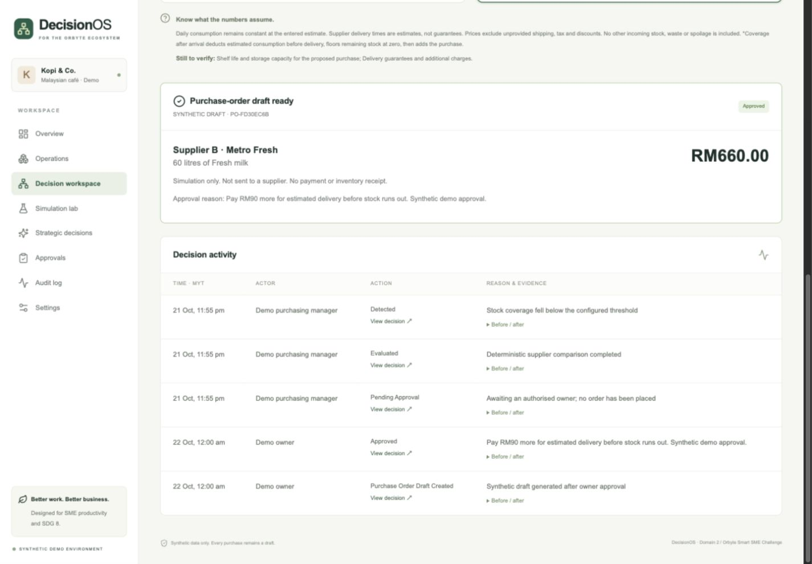
A visible, persistent outcome
Notes:
Original evidence: docs/screenshots/purchase-draft-audit.jpg. Synthetic decision 3a714d27; Supplier B RM660; PO FD30EC6B. Reload and server restart preserved it. Actual software screenshot, not a mock-up.

Slide 6
Architecture and the Orbyte boundary
Operational path
Optional scenario path
Next.js interface
↓
FastAPI + deterministic rules
↓
Owner approval transaction
↓
SQLite: draft + audit + snapshot
Persistent request
↓
Separate worker
↓
Pinned MiroFish service
↓
Approved LLM + Zep
Mock Orbyte-style connector: our own interface assumption, not an official integration.
Notes:
Source: docs/ARCHITECTURE.md, API.md and https://github.com/666ghj/MiroFish/tree/7657031ac01184afe2cb220f5ee3545573b5e843 . Original HTTP adapter; no upstream code bundled. Editable diagram.

Slide 7
Simulation explores uncertain complications
What if ingredient delivery is delayed by three days?
Fictional perspectives: owner, purchasing manager, supplier, delivery coordinator and customers.
Explore menu changes, extra workload and possible mitigation.
Do not turn agent opinions into demand forecasts.
Current state: adapter tested; live execution pending credentials and budget.
Notes:
Source: scenarios.py and docs/MIROFISH.md. Social-agent environments adapted to fictional business perspectives. Upstream environment installed; credential preflight stops without keys. No genuine report, live latency or token totals.

Slide 8
Impact to measure
30%
SDG 8.2 / 8.3
Less repetitive administration
Traceable owner decisions
A reusable SME workflow
proposed reduction in task time
Planning baseline: 10 minutes
Target: 7 minutes or less
Neither has been measured yet
Pilot: same synthetic task, alternating task order, recorded errors and assistance.
Notes:
UN source: https://sdgs.un.org/goals/goal8 . 8.2: productivity through technology; 8.3: SME development. Numbers are planning assumptions/targets, not measured results. Source: docs/BENEFITS.md.

Slide 9
Verified today; next validation steps
Working procurement MVP
33 backend + 3 component + 4 browser tests passed
Type checking and production build passed
Replit approval and reload persistence verified
Still to validate
GitHub CI and publication · team review
One approved MiroFish run · timed SME usability study
Notes:
In Replit on 23 October 2026: 33 backend tests, 3 component tests, typecheck, build and 4 Playwright tests passed. Browser tests used installed Chromium 152.0.7977.64 after bundled Chromium lacked libglib. Native approval and reload verified. GitHub CI, team declarations and remote publication pending. Workspace: https://replit.com/@jeremyjunxuanta/orbyte-decisionos . User will record video.

