Slide 1

AI-Powered Artist
Promotion Assistant Poc
Final
ArtInsight AI Consulting | November 24, 2025
Jeran Kilpack

Slide 2

Gameplan
Goal:
.A lightweight but functional system that shows:
end-to-end intelligence from monitoring
AI analysis
opportunity scoring
suggested responses →
analytics.

Slide 3
Project Architecture
Data Monitoring layer
AI Analysis layer
Reddit via praw or API-free search endpoints
Pinterest via keyword scrapers or API-free public search
Runs periodically (every X minutes) or on-demand (for demo)
Uses OpenAI API (GPT-4.1 or 4 mini)
Tasks:
Classify whether post matches opportunity
Score opportunity (0–100)
Extract post needs/trends
Summarize sentiment
Generate suggested responses in brand voice

Slide 4
Artist Dashboard
Dashboard includes
Analytics & KPIs. We’ll track:
Posts detected
Their opportunity score
AI-suggested responses
Approve / reject buttons
Logging of approved responses
Posts monitored
Opportunities detected
Conversion rate (approved / total opportunities)
CTR simulation (POC)
Sentiment trends
Response style analysis
Visualization: matplotlib

Slide 5
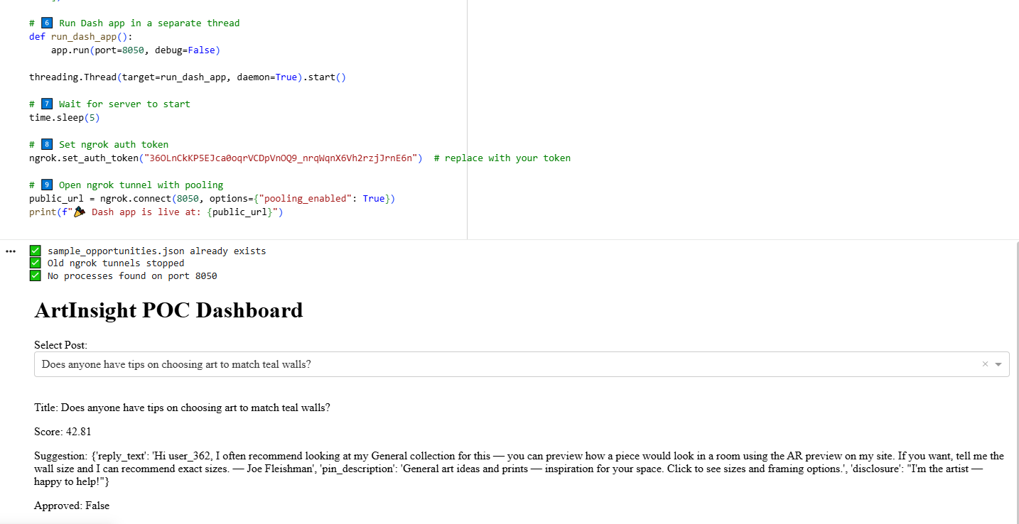
Example POC dashboard.

Slide 6
Concerns for Joe Fleishman
“It looked kind of barebones and I would like to have less technical text, more graphics and more interactivity”
Very understandable! This was just a WORKING proof of concept to show that it’s possible for us to retrieve data in the backend and display it in the frontend on a website
The actual frontend (what you see and interact with) dashboard will look much more professional and will show you everything you’d want to be displayed intuitively.
The backend (what we work on) will also be more advanced since the poc was just using example data and would use real time api retrieval.

Slide 7
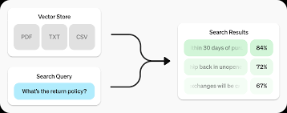
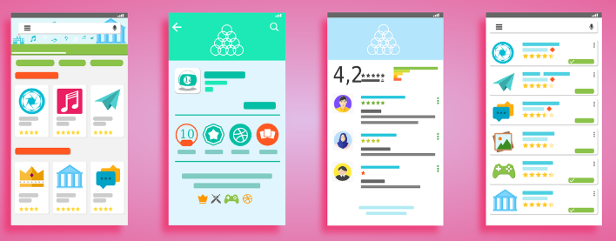
Plans for the future.
Dynamic retrieval of insights of social media for art that goes beyond just reddit and pinterest.
A very pretty and intuitive website UI. (Also an app if ArtInsight AI Consulting could grow more)

Slide 8
Shortcomings and lessons learned from the POC.
I used google collab instead of vscode(or other code compiling software), since it’s easier to work with libraries using different python versions since collab’s environment is seamless and it is a easier way to show a POC
Problems:
Not having it be hosted on your own device causes a lot of network and firewall issues for hosting the dashboard
Limited customizability and freedom with the backend
Limited front end options

