Slide 1

AI-Powered Artist
Promotion Assistant
Midterm Proposal for Joe Fleishman
ArtInsight AI Consulting | November 24, 2025
Jeran Kilpack

Slide 2

Executive Summary
The Solution
The Challenge
We propose an AI-Powered Assistant that ethically monitors Reddit and Pinterest. Using a "Human-in-the-Loop" model, it identifies high-intent buyers and drafts contextual engagement for Joe's final approval.
Joe Fleishman's art is professional and unique, but his online presence suffers from low visibility. With no marketing budget and limited time, finding qualified buyers in a crowded digital space is inefficient.

Slide 3

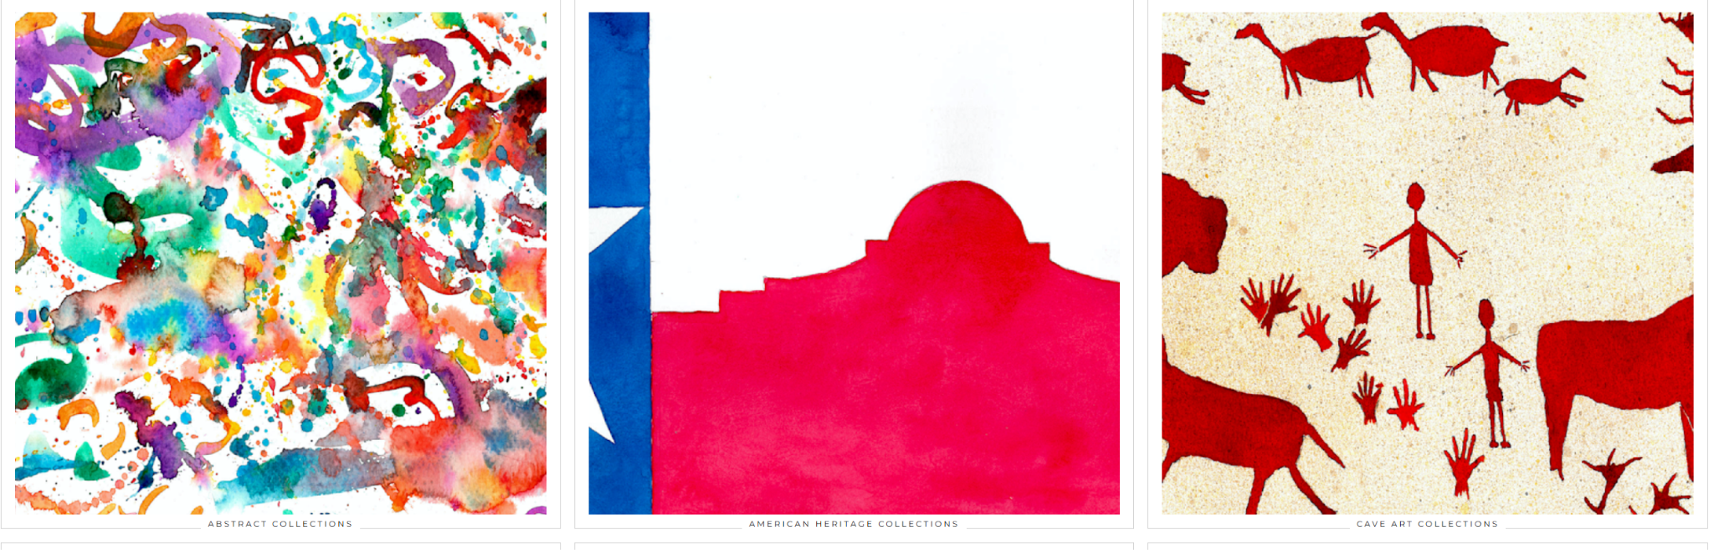
Client & Brand Analysis
Joe Fleishman's Art
Diverse Collections: Abstract, American Heritage, Cave Art, Floral, Nature, Sea.
USP: Professional "Art Storefronts" site with AR preview features, bridging the gap between affordable prints and high-value originals.
Goal: Ethical growth without aggressive sales tactics.
https://www.joefleishmanart.com/

Slide 4



Target Audience Personas
"Home Decor Hannah"
"Office Designer Dana"
30-45, Homeowner. Uses Pinterest for mood boards. actively searches for "living room art" and "modern decor".
35-55, Business Manager. Uses Reddit (r/Entrepreneur) for advice. Needs bulk orders and professional aesthetics.

Slide 5

Platform Strategy
Pinterest
Reddit
Why: High purchase intent (e.g., "Where can I buy...")
Very accessible API retrieval and varied sources of ideas.
Why: Visual discovery engine matching Joe's aesthetic.
Norms: Subreddit "No Self-Promotion" rules. Requires value-first engagement (advice/critique) and mandatory disclosure.
Norms: Visual-first. Content must be "How-to" or inspirational. Direct product links are acceptable if relevant.

Slide 6

System Architecture
Human-in-the-Loop Design
The system is designed in three distinct phases to ensure ethical compliance and control:
1. Ingestion: Ethical monitoring via Reddit API and Pinterest Scraping.
2. Analysis: AI scores leads for intent and drafts responses.
3. Action: Joe reviews and approves on the dashboard. The final approval.

Slide 7






Technology Stack
Python
Streamlit
LLM (AI)
The core engine. Chosen for robust data processing, PRAW API support, and seamless AI integration.
The user interface. Provides a simple, zero-friction dashboard for the artist without complex frontend code.
The intelligence. GPT-4 or Claude 3 used for sentiment analysis, scoring, and brand voice drafting.

Slide 8
Monitoring & AI Analysis
Intelligent Filtering
Prompt Engineering
We don't just look for keywords; we look for intent.
Goal: Authentic Engagement.
The Monitoring Engine uses PRAW to fetch discussions. The AI then evaluates each post using a "Relevance Score" (0-10) based on Joe's brand keywords and a "Purchase Intent Score" (0-10) based on user language. Then Joe can review and assess clients.
Our prompt instructs the LLM to adopt a "Value-First, Educational" tone. It is explicitly forbidden from generating "salesy" spam. It drafts a helpful response that provides context before subtly linking a specific, relevant collection.

Slide 9
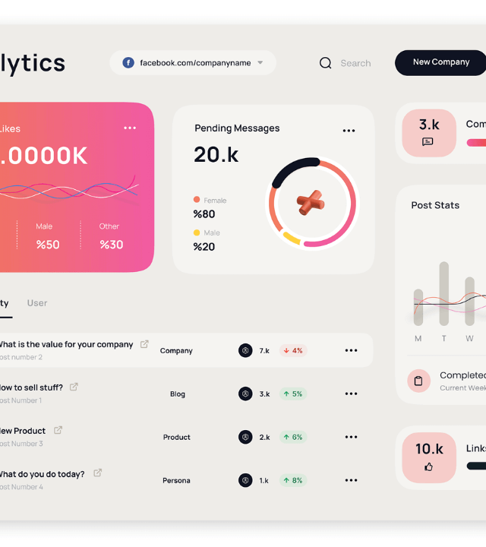
Artist Workflow
Zero-Friction Approval
The Streamlit dashboard simplifies the process into three steps, taking seconds per lead:
Alert: View prioritized, high-scoring opportunities.
Review: Read the source post and the AI-drafted reply.
Action: Click "Approve & Send", "Edit", or "Reject".

Slide 10
Ethical Framework & Compliance
Human-in-the-Loop (Mandatory): Nothing is posted automatically. Joe must explicitly approve every engagement, ensuring full accountability.
Transparency: We advise "Assisted by AI" disclosure where appropriate to maintain community trust.
Value-First Policy: Zero spam. Engagement must offer genuine advice, critique, or context before linking.
Strict Compliance: The system is hard-coded to respect Reddit and Pinterest Terms of Service regarding automation and rate limits.

Slide 11
Business Model & ROI
Hypothetical
Metric | Month 1 (Ramp-up) | Month 3 (Net Positive) | Month 6 (Optimized)
Traffic (Clicks) | 40 | 250 | 500
Sales (Units) | 2 | 9 | 40
Revenue (@ $150) | $300 | $1350 | $6000
Commission (max at 10%) | $0 | $67 | $600
System Cost | $50 | $50 | $50
Joe's Gross profit | $250 | $1233 | $6350

Slide 12
Project Roadmap
Week 1
Week 2
Week 3
Week 4
Setup & Ingestion
Core AI Analysis
Dashboard & HIL
Final & Launch

Slide 13
Q & A
Addressing questions on Ethics, Tech, and ROI.
ArtInsight AI Consulting
"I'm already struggling to find time to paint. How much time is this tool really going to take up every day? Does 'Human-in-the-Loop' just mean I'm doing all the work?"
"This sounds technically complex—Python, Streamlit, LLMs... What happens when something breaks? Will I need to hire a programmer to manage this, or will I lose my data?"
The whole point of the AI is to eliminate the heavy lifting—the searching, filtering, and drafting. The 'Human-in-the-Loop' feature is designed to take less than five minutes a day.
"We handle all of the technical complexity. You never see the code. This is delivered as a fully managed service.
The 'Streamlit' dashboard is designed for ultimate simplicity—it looks and feels like a basic web app. If the system goes down, ArtInsight's team fixes it. Your only responsibility is to log in, review the leads, and hit 'Approve.' It is designed to be as effortless as checking your email."
"My art is deeply personal, and I have a strict 'no spam' policy. How can I be sure this AI isn't going to make me look like a desperate online salesperson or get me banned from a community?"
You have the final veto. The AI can never, under any circumstance, post a single word without you explicitly hitting the 'Approve' button first. If a draft doesn't sound like you, you edit it or reject it.

Slide 14





Image Sources
https://3pmedia.leroymerlin.co.za/SOURCE/3648903e35c74b3496d6971a713f541f?tr=if-iar_ne_1,w-566,h-566,cm-pad_resize,if-else,w-566,h-566,if-end
Source: leroymerlin.co.za
https://cdn.shopify.com/s/files/1/0634/4353/3982/files/Wallroom-Neutral-colours.jpg?v=1702412766
Source: wallroom.co.za
https://www.decorilla.com/online-decorating/wp-content/uploads/2022/03/modern-office-design-for-a-large-conference-room.jpeg
Source: decorilla.com
https://assets.justinmind.com/wp-content/uploads/2020/02/dashboard-examples-social-media.png
Source: www.justinmind.com

