Slide 1
Metodologías para el desarrollo de proyecto en data science
Based on CRIPS-DM - Jae Hong Kil
Francisco Gómez Jaramillo
Departamento de Matemáticas
Matemáticas Aplicadas – Ciencias de la Computación

Slide 2
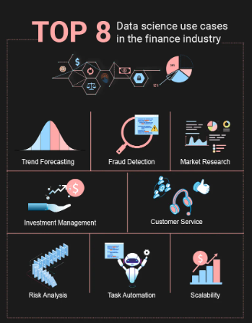
Data science for bussiness
Three key elements of any business?
the customer
the product/service
the package that links the customer to the product / service

Slide 3
Key bussiness functions
Marketing → Promoción
Customer services → Servicio al cliente
Sales → Ventas
R&D → Investigación y desarrollo
Purchasing → Compras
Production → Producción
Distribution → Distribución
IT → Tecnologías de información
HR → Recursos humanos
Legal → Área legal
Finance → Finanzas
Senior management → Alta dirección
Operations → Actividades operativas y lógisticas

Slide 4
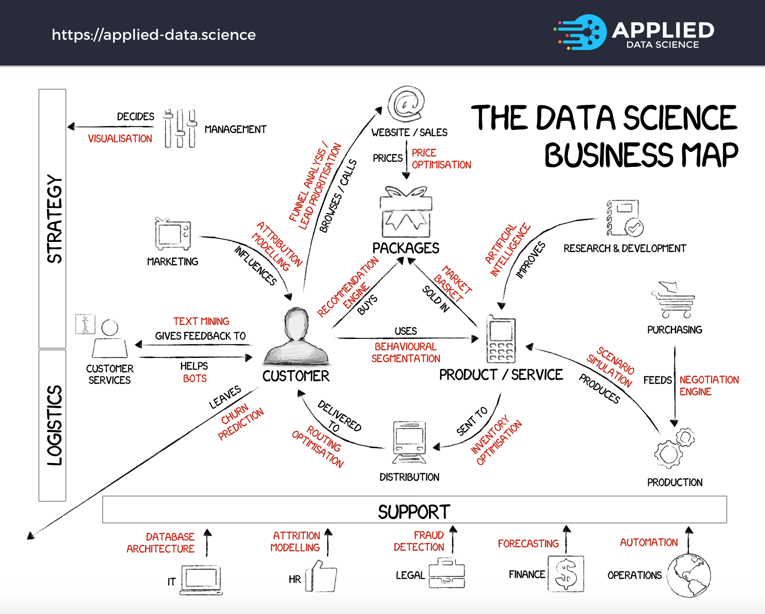

Slide 5
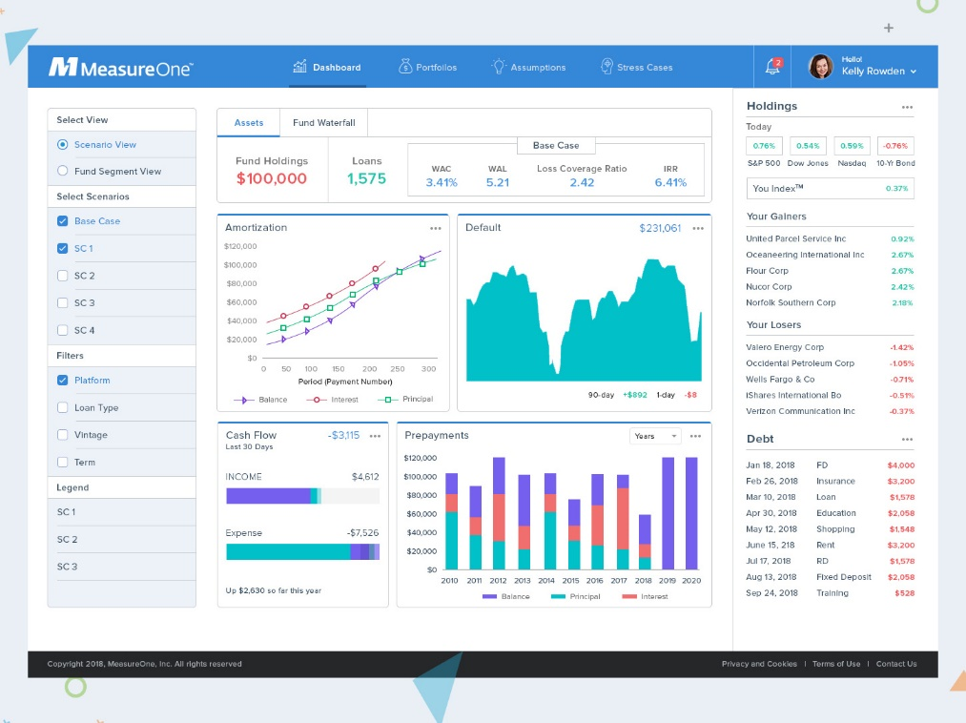

Slide 6
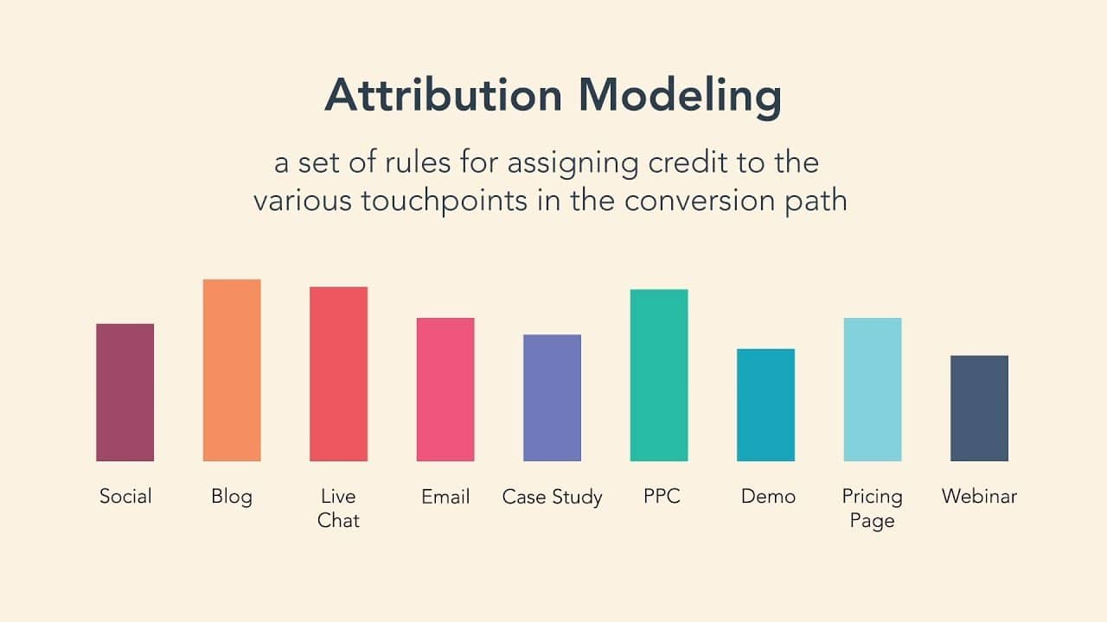
For example, assume a coffee-maker manufacturer is trying to figure out what kind of digital advertising is most compelling to their target consumers. An attribution model might reveal that consumers are more likely to buy their coffee maker (e.g., convert) when they see a TikTok video by an influencer, rather than an ad they see on YouTube while watching videos.
This knowledge can inform the manufacturer’s strategy, focus their approach, and align their advertising spend accordingly.

Slide 7
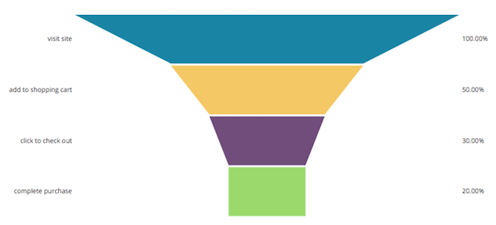
El análisis de embudo, también conocido como "funnel analysis" en inglés, es una técnica utilizada en marketing y análisis de datos para evaluar y comprender el proceso por el cual los usuarios o clientes potenciales pasan a través de diferentes etapas en su camino hacia la conversión o la realización de una acción deseada, como una compra, registro o suscripción.

Slide 8
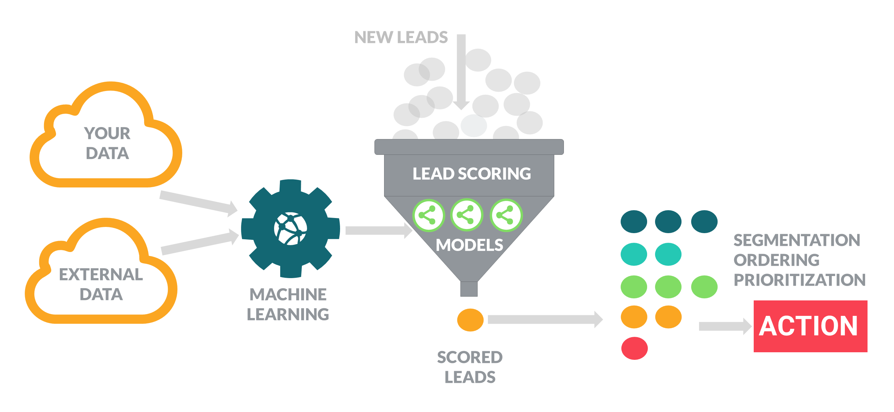
La "lead prioritization", o priorización de leads en español, se refiere al proceso de clasificar y ordenar los leads (clientes potenciales) según su probabilidad de conversión y su valor potencial para una empresa.

Slide 9
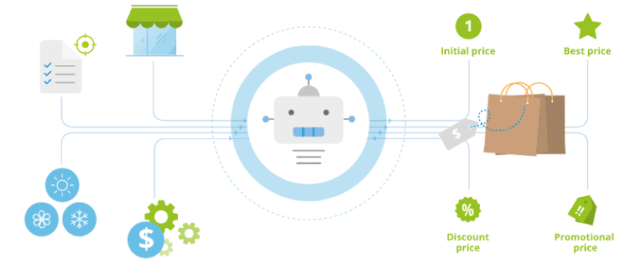
La "price optimization" (optimización de precios) es una estrategia y proceso que las empresas utilizan para determinar el precio ideal de sus productos o servicios con el objetivo de maximizar los ingresos y la rentabilidad..

Slide 10

Un "recomendation engine" (motor de recomendación) es un sistema de software que utiliza algoritmos y técnicas de análisis de datos para ofrecer recomendaciones personalizadas a los usuarios sobre productos, servicios o contenido que puedan interesarles.

Slide 11
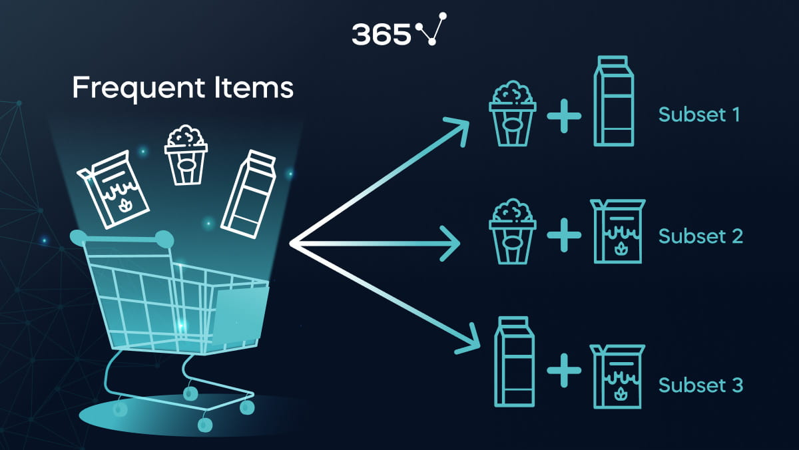
El término "market basket“ se refiere a la colección de productos o artículos que un consumidor compra en una sola transacción o visita a una tienda.
El análisis de la cesta de mercado es valioso para comprender los patrones de compra de los consumidores y cómo los productos están relacionados entre sí.

Slide 12
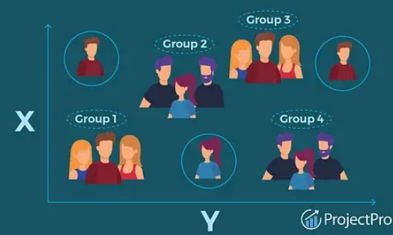
La "behavioral segmentation" (segmentación conductual) es una estrategia de segmentación de mercado en la que los consumidores se dividen en grupos en función de sus comportamientos, acciones y patrones de compra.

Slide 13

La "behavioral segmentation" (segmentación conductual) es una estrategia de segmentación de mercado en la que los consumidores se dividen en grupos en función de sus comportamientos, acciones y patrones de compra.

Slide 14
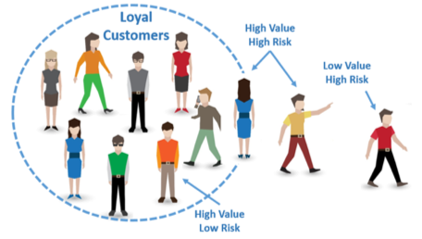
El "churn prediction", o predicción de abandono en español, se refiere a una técnica analítica utilizada por las empresas para predecir cuáles de sus clientes actuales son más propensos a dejar de utilizar sus productos o servicios en un período determinado.

Slide 15
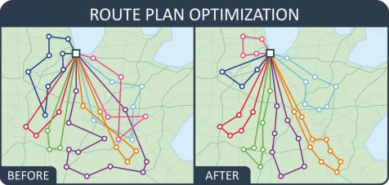
La "routing optimization", o optimización de rutas en español, es un proceso utilizado en logística y gestión de flotas para encontrar las rutas más eficientes y rentables para que vehículos, como camiones o repartidores, lleguen a sus destinos de manera rápida y efectiva.

Slide 16
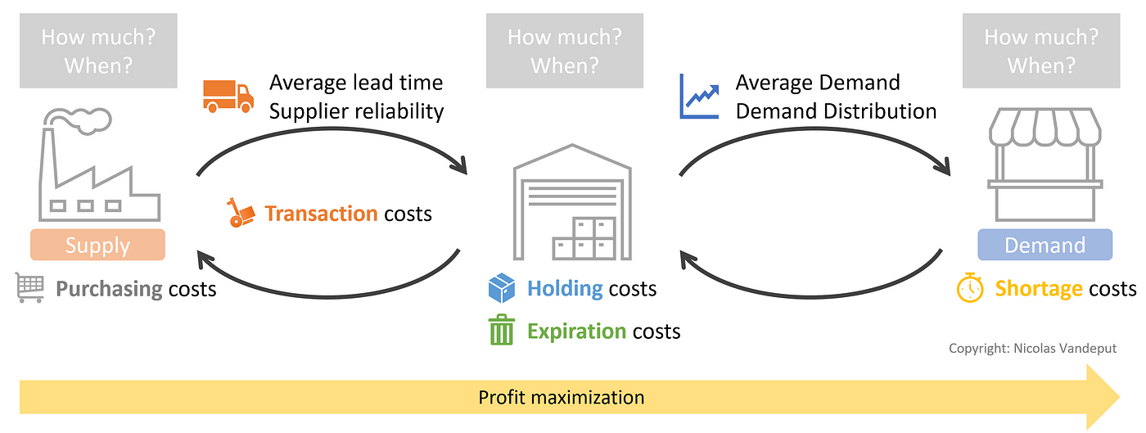
La "inventory optimization", o optimización de inventario en español, se refiere a un conjunto de estrategias y técnicas utilizadas para gestionar y mantener el inventario de una empresa de manera eficiente y rentable. El inventario incluye los productos o materiales que una empresa mantiene en stock para satisfacer la demanda de los clientes. La optimización de inventario busca equilibrar la disponibilidad de los productos con los costos asociados al almacenamiento y la gestión del inventario.

Slide 17
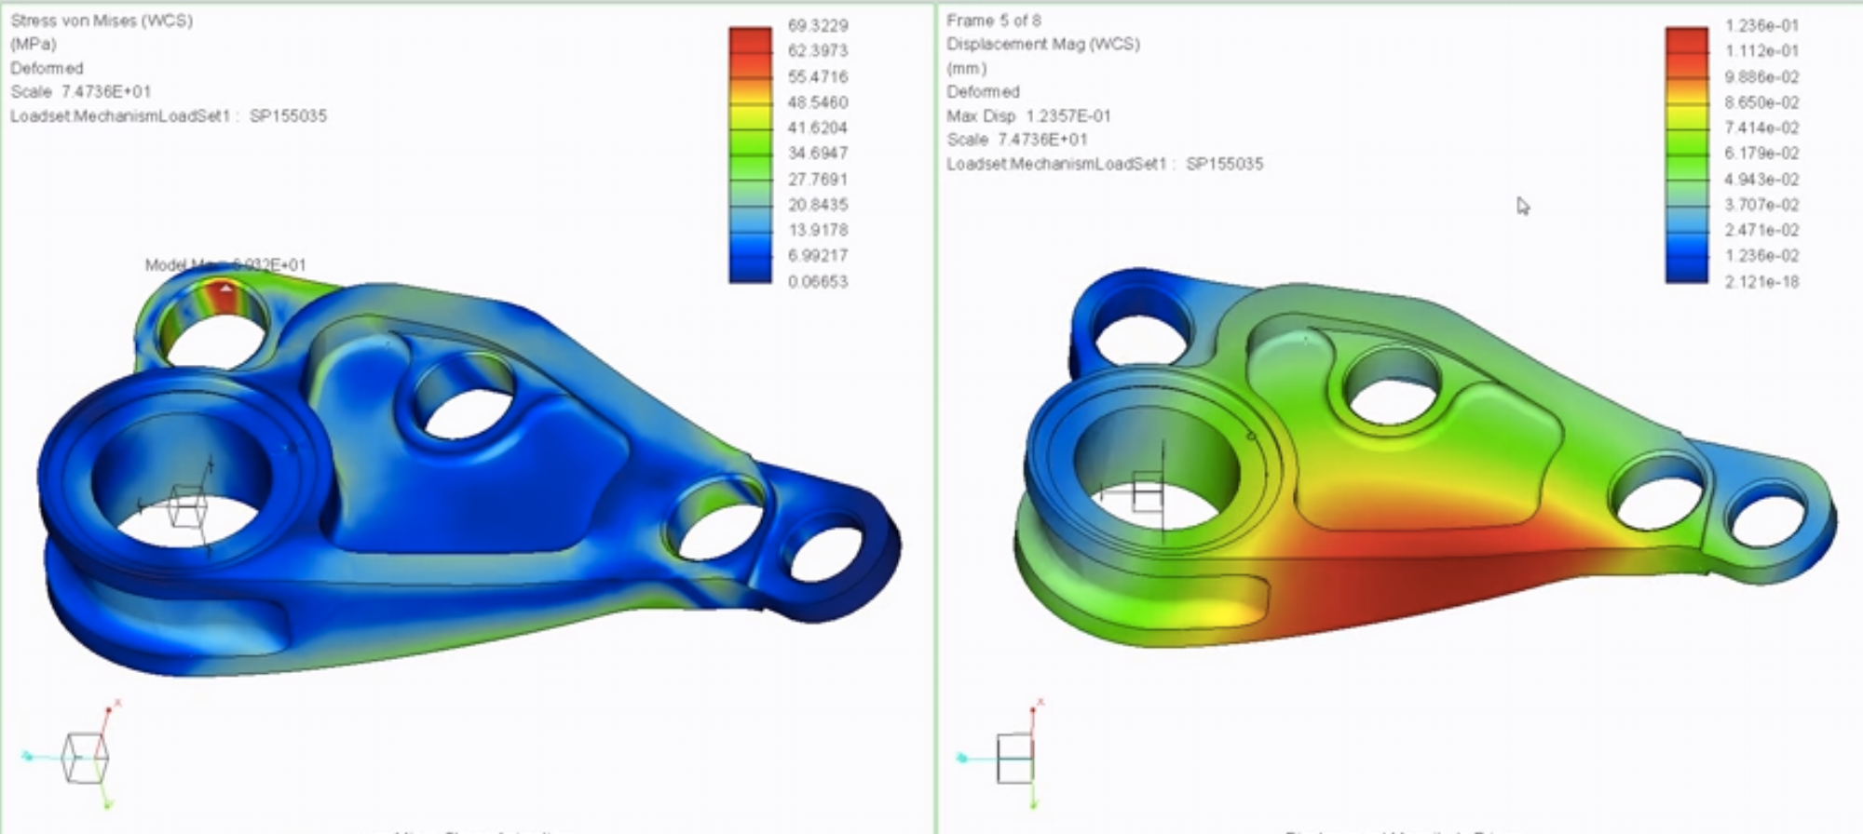
La "simulación de escenarios" es una técnica utilizada en diversos campos, como la planificación estratégica, la toma de decisiones y la investigación, para modelar y explorar cómo diferentes variables y factores pueden interactuar y afectar los resultados en diferentes situaciones. En esencia, consiste en crear modelos computacionales que simulan el comportamiento de un sistema en situaciones específicas y, a través de estas simulaciones, analizar cómo podrían evolucionar los resultados en diferentes condiciones.

Slide 18
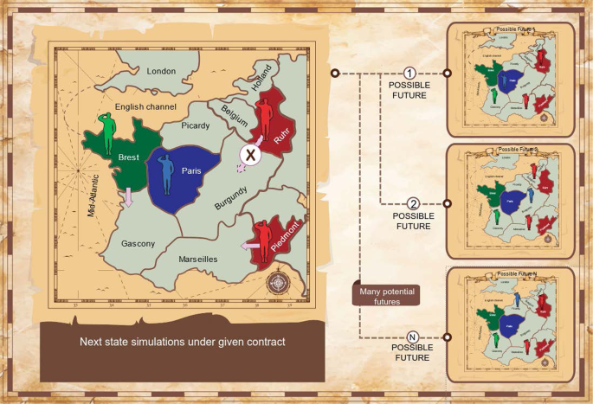

Slide 19
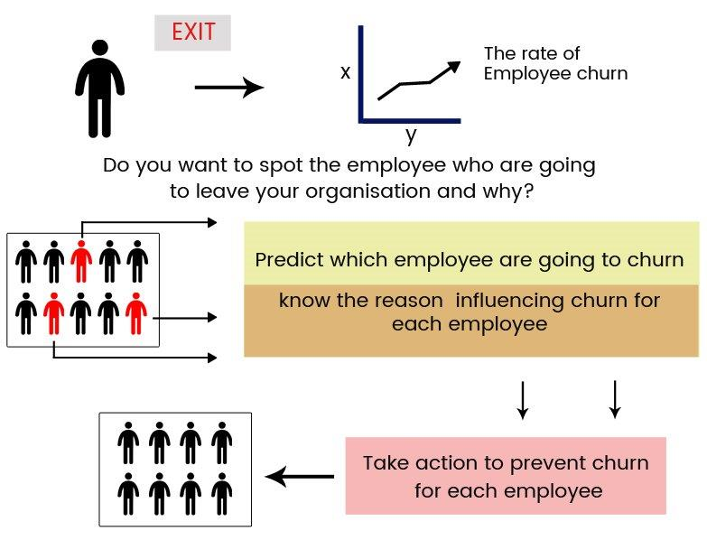
Un "attrition model" (modelo de atrición), también conocido como "churn model" (modelo de abandono) es un tipo de modelo analítico utilizado para predecir cuándo y por qué los empleados pueden abandonar una empresa.

Slide 20
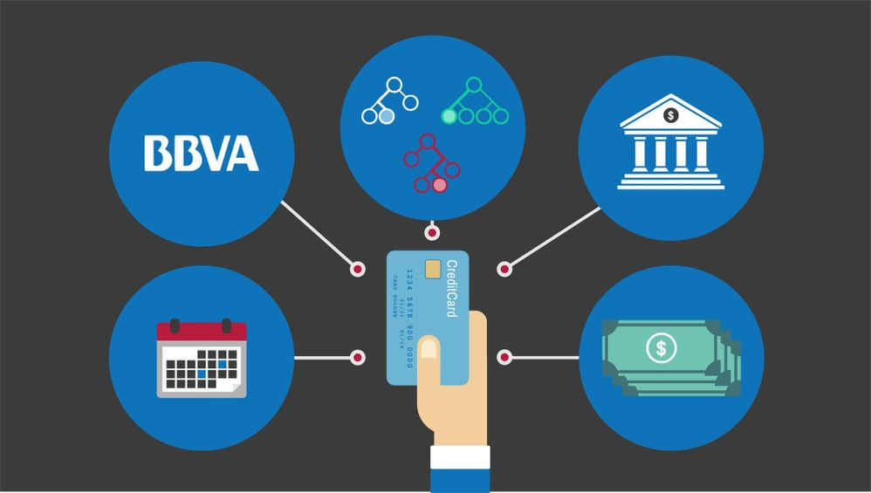
Un "modelo de detección de fraudes" es un tipo de modelo analítico diseñado para identificar patrones y comportamientos anómalos en transacciones, actividades o eventos que puedan indicar la presencia de actividades fraudulentas o engañosas. Estos modelos se utilizan en diversas industrias, como servicios financieros, comercio electrónico, seguros y más, para prevenir y mitigar el riesgo de fraudes.

Slide 21

Un "modelo de forecasting", también conocido como "modelo de pronóstico" en español, es un enfoque analítico utilizado para prever futuros eventos, tendencias o resultados basados en datos históricos y patrones observados. Los modelos de pronóstico se aplican en una variedad de industrias y campos para prever la demanda de productos, el comportamiento del mercado, los ingresos futuros, el tráfico de sitios web, el clima y más.

Slide 22
¿Por qué una metodología de desarrollo de proyectos?
“El objetivo general de la metodología de gestión de proyectos es ser capaces de estandarizar, estructurar y organizar la manera de trabajar. Así se ayuda a enfocar todos los proyectos de la misma forma y nos permite ser capaces de repetir los éxitos y aprender de los errores, por lo que hay un proceso de mejora continua.”
https://nae.global/

Slide 23
¿Por qué una metodología de desarrollo de proyectos?
Organizar los tiempos de proyecto
Proporcionar herramientas para estimar de forma correcta tiempos y costes
Ayudar a gestionar y minimizar los riesgos del proyecto
Mejorar la relación entre coste y beneficio de los recursos
Desarrollar las habilidades del equipo

Slide 24
Por que debe ser un proceso estandarizado
El proceso de minería de datos debe ser confiable y repetible para personas con poca experiencia en minería de datos.

Slide 25
Estandarización de los proyectos
Initiative launched in late 1996 by three “veterans” of data mining market.
Daimler Chrysler (then Daimler-Benz), SPSS (then ISL) , NCR
Developed and refined through series of workshops (from 1997-1999)
Over 300 organization contributed to the process model
Published CRISP-DM 1.0 (1999)
Over 200 members of the CRISP-DM SIG worldwide
- DM Vendors - SPSS, NCR, IBM, SAS, SGI, Data Distilleries, Syllogic, etc.
- System Suppliers / consultants - Cap Gemini, ICL Retail, Deloitte & Touche, etc.
- End Users - BT, ABB, Lloyds Bank, AirTouch, Experian, etc.

Slide 26

CRISP-DM
Non-proprietary
Application/Industry neutral
Tool neutral
Focus on business issues
As well as technical analysis
Framework for guidance
Experience base
Templates for Analysis

Slide 27
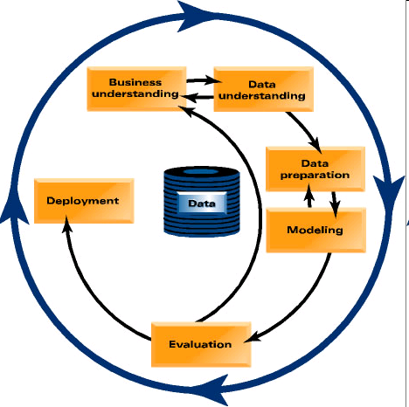
CRISP-DM: Overview
Data Mining methodology
Process Model
For anyone
Provides a complete blueprint
Life cycle: 6 phases

Slide 28
CRISP-DM: Phases
Business Understanding
Project objectives and requirements understanding, Data mining problem definition
Data Understanding
Initial data collection and familiarization, Data quality problems identification
Data Preparation
Table, record and attribute selection, Data transformation and cleaning
Modeling
Modeling techniques selection and application, Parameters calibration
Evaluation
Business objectives & issues achievement evaluation
Deployment
Result model deployment, Repeatable data mining process implementation

Slide 29
Phases and Tasks
Business
Understanding
Data
Understanding
Data
Preparation
Modeling
Evaluation
Deployment
Determine
Business
Objectives
Collect
Initial
Data
Select
Data
Select
Modeling
Technique
Evaluate
Results
Plan
Deployment
Assess
Situation
Describe
Data
Clean
Data
Generate
Test Design
Review
Process
Plan Monitering
&
Maintenance
Determine
Data Mining
Goals
Explore
Data
Construct
Data
Build
Model
Determine
Next Steps
Produce
Final
Report
Produce
Project Plan
Verify
Data
Quality
Integrate
Data
Assess
Model
Review
Project
Format
Data

Slide 30
Phase 1. Business Understanding
Statement of Business Objective
Statement of Data Mining Objective
Statement of Success Criteria
Focuses on understanding the project objectives and requirements from a business perspective, then converting this knowledge into a data mining problem definition and a preliminary plan designed to achieve the objectives

Slide 31
Phase 1. Business Understanding
Determine business objectives
- thoroughly understand, from a business perspective, what the client really wants to accomplish
- uncover important factors, at the beginning, that can influence the outcome of the project
- neglecting this step is to expend a great deal of effort producing the right answers to the wrong questions
Assess situation
- more detailed fact-finding about all of the resources, constraints, assumptions and other factors that should be considered
- flesh out the details

Slide 32
Phase 1. Business Understanding
Determine data mining goals
- a business goal states objectives in business terminology
- a data mining goal states project objectives in technical terms
ex) the business goal: “Increase catalog sales to existing customers.”
a data mining goal: “Predict how many widgets a customer will buy, given their purchases over the past three years, demographic information (age, salary, city) and the price of the item.”
Produce project plan
- describe the intended plan for achieving the data mining goals and the business goals
- the plan should specify the anticipated set of steps to be performed during the rest of the project including an initial selection of tools and techniques

Slide 33
Phase 2. Data Understanding
Explore the Data
Verify the Quality
Find Outliers
Starts with an initial data collection and proceeds with activities in order to get familiar with the data, to identify data quality problems, to discover first insights into the data or to detect interesting subsets to form hypotheses for hidden information.

Slide 34
Phase 2. Data Understanding
Collect initial data
- acquire within the project the data listed in the project resources
- includes data loading if necessary for data understanding
- possibly leads to initial data preparation steps
- if acquiring multiple data sources, integration is an additional issue, either here or in the later data preparation phase
Describe data
- examine the “gross” or “surface” properties of the acquired data
- report on the results

Slide 35
Phase 2. Data Understanding
Explore data
- tackles the data mining questions, which can be addressed using querying, visualization and reporting including:
distribution of key attributes, results of simple aggregations
relations between pairs or small numbers of attributes
properties of significant sub-populations, simple statistical analyses
- may address directly the data mining goals
- may contribute to or refine the data description and quality reports
- may feed into the transformation and other data preparation needed
Verify data quality
- examine the quality of the data, addressing questions such as:
“Is the data complete?”, Are there missing values in the data?”

Slide 36
Phase 3. Data Preparation
Takes usually over 90% of the time
- Collection
- Assessment
- Consolidation and Cleaning
- Data selection
- Transformations
Covers all activities to construct the final dataset from the initial raw data. Data preparation tasks are likely to be performed multiple times and not in any prescribed order. Tasks include table, record and attribute selection as well as transformation and cleaning of data for modeling tools.

Slide 37
Phase 3. Data Preparation
Select data
- decide on the data to be used for analysis
- criteria include relevance to the data mining goals, quality and technical constraints such as limits on data volume or data types
- covers selection of attributes as well as selection of records in a table
Clean data
- raise the data quality to the level required by the selected analysis techniques
- may involve selection of clean subsets of the data, the insertion of suitable defaults or more ambitious techniques such as the estimation of missing data by modeling

Slide 38
Phase 3. Data Preparation
Construct data
- constructive data preparation operations such as the production of derived attributes, entire new records or transformed values for existing attributes
Integrate data
- methods whereby information is combined from multiple tables or records to create new records or values
Format data
- formatting transformations refer to primarily syntactic modifications made to the data that do not change its meaning, but might be required by the modeling tool

Slide 39
Phase 4. Modeling
Select the modeling technique
(based upon the data mining objective)
Build model
(Parameter settings)
Assess model (rank the models)
Various modeling techniques are selected and applied and their parameters are calibrated to optimal values. Some techniques have specific requirements on the form of data. Therefore, stepping back to the data preparation phase is often necessary.

Slide 40
Phase 4. Modeling
Select modeling technique
- select the actual modeling technique that is to be used
ex) decision tree, neural network
- if multiple techniques are applied, perform this task for each techniques separately
Generate test design
- before actually building a model, generate a procedure or mechanism to test the model’s quality and validity
ex) In classification, it is common to use error rates as quality measures for data mining models. Therefore, typically separate the dataset into train and test set, build the model on the train set and estimate its quality on the separate test set

Slide 41
Phase 4. Modeling
Build model
- run the modeling tool on the prepared dataset to create one or more models
Assess model
- interprets the models according to his domain knowledge, the data mining success criteria and the desired test design
- judges the success of the application of modeling and discovery techniques more technically
- contacts business analysts and domain experts later in order to discuss the data mining results in the business context
- only consider models whereas the evaluation phase also takes into account all other results that were produced in the course of the project

Slide 42
Phase 5. Evaluation
Evaluation of model
- how well it performed on test data
Methods and criteria
- depend on model type
Interpretation of model
- important or not, easy or hard depends on algorithm
Thoroughly evaluate the model and review the steps executed to construct the model to be certain it properly achieves the business objectives. A key objective is to determine if there is some important business issue that has not been sufficiently considered. At the end of this phase, a decision on the use of the data mining results should be reached

Slide 43
Phase 5. Evaluation
Evaluate results
- assesses the degree to which the model meets the business objectives
- seeks to determine if there is some business reason why this model is deficient
- test the model(s) on test applications in the real application if time and budget constraints permit
- also assesses other data mining results generated
- unveil additional challenges, information or hints for future directions

Slide 44
Phase 5. Evaluation
Review process
- do a more thorough review of the data mining engagement in order to determine if there is any important factor or task that has somehow been overlooked
- review the quality assurance issues
ex) “Did we correctly build the model?”
Determine next steps
- decides how to proceed at this stage
- decides whether to finish the project and move on to deployment if appropriate or whether to initiate further iterations or set up new data mining projects
- include analyses of remaining resources and budget that influences the decisions

Slide 45
Phase 6. Deployment
Determine how the results need to be utilized
Who needs to use them?
How often do they need to be used
Deploy Data Mining results by
Scoring a database, utilizing results as business rules,
interactive scoring on-line
The knowledge gained will need to be organized and presented in a way that the customer can use it. However, depending on the requirements, the deployment phase can be as simple as generating a report or as complex as implementing a repeatable data mining process across the enterprise.

Slide 46
Phase 6. Deployment
Plan deployment
- in order to deploy the data mining result(s) into the business, takes the evaluation results and concludes a strategy for deployment
- document the procedure for later deployment
Plan monitoring and maintenance
- important if the data mining results become part of the day-to-day business and it environment
- helps to avoid unnecessarily long periods of incorrect usage of data mining results
- needs a detailed on monitoring process
- takes into account the specific type of deployment

Slide 47
Phase 6. Deployment
Produce final report
- the project leader and his team write up a final report
- may be only a summary of the project and its experiences
- may be a final and comprehensive presentation of the data mining result(s)
Review project
- assess what went right and what went wrong, what was done well and what needs to be improved

Slide 48
Summary
Why CRISP-DM?
The data mining process must be reliable and repeatable by people with little data mining skills
CRISP-DM provides a uniform framework for
- guidelines
- experience documentation
CRISP-DM is flexible to account for differences
- Different business/agency problems
- Different data

Slide 49
