Slide 1

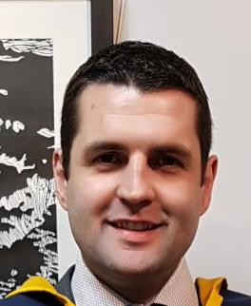



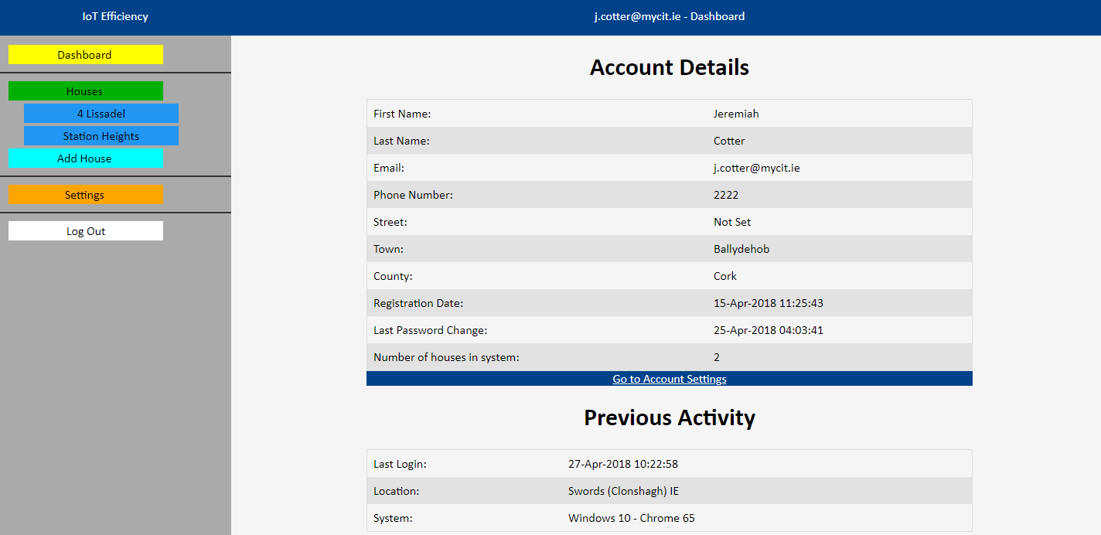
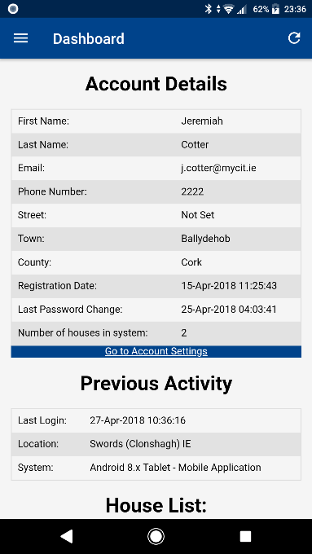


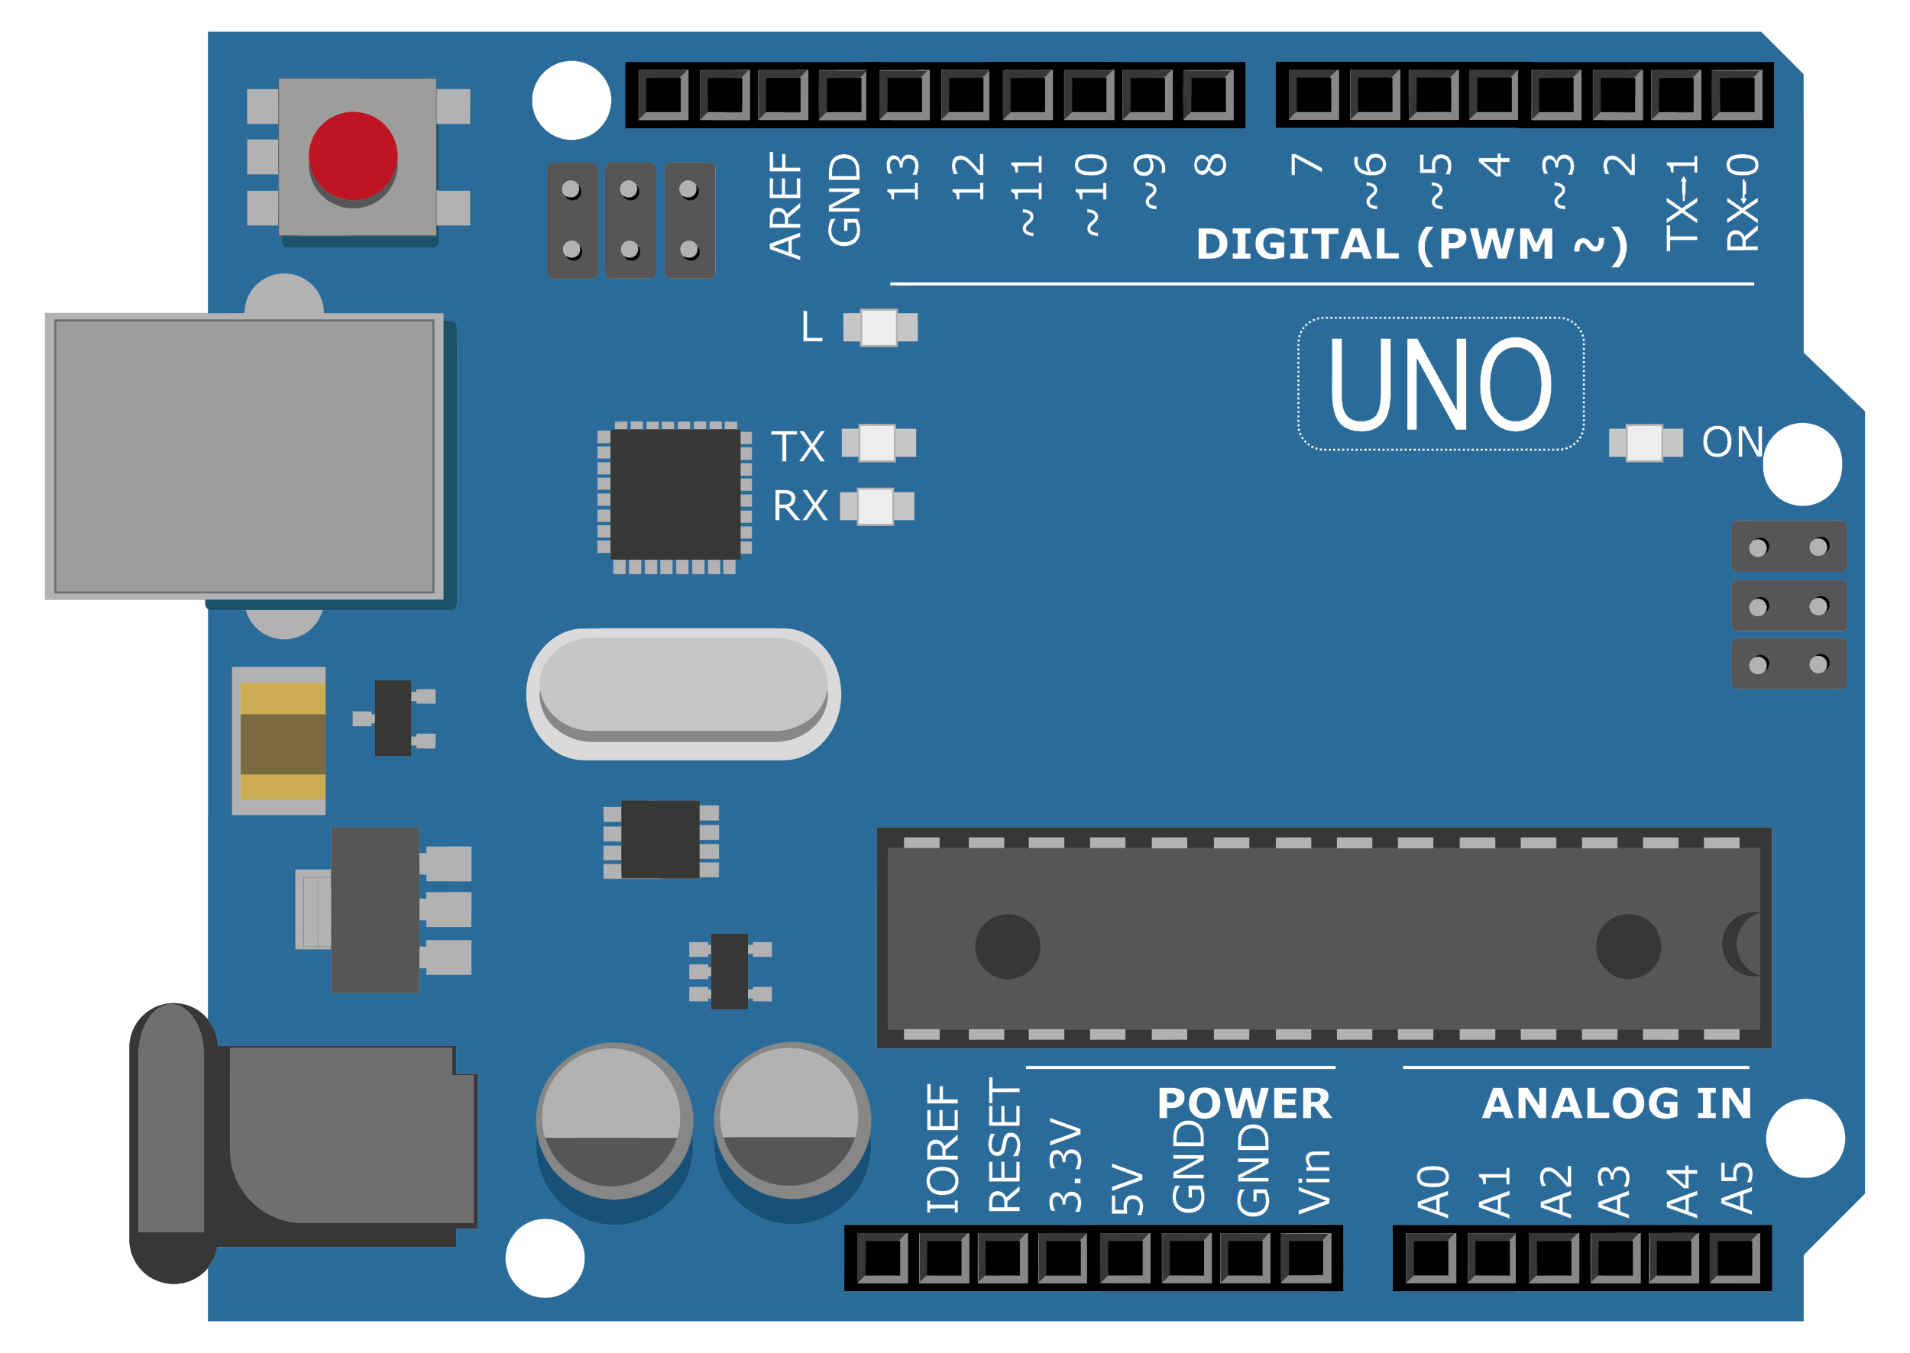
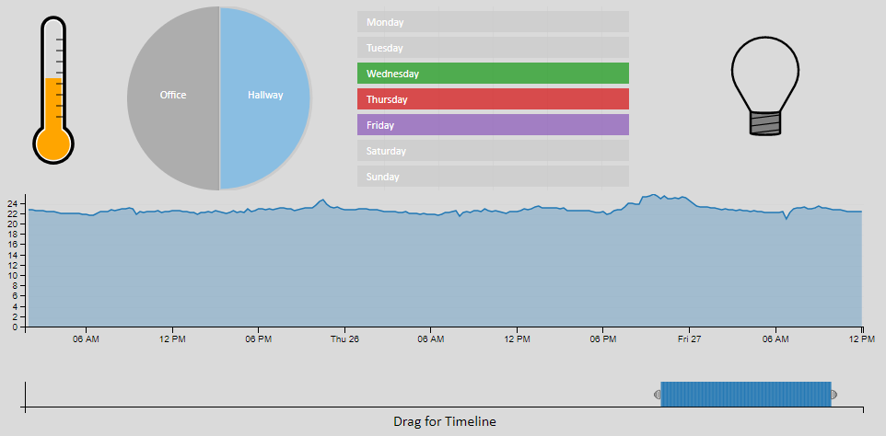

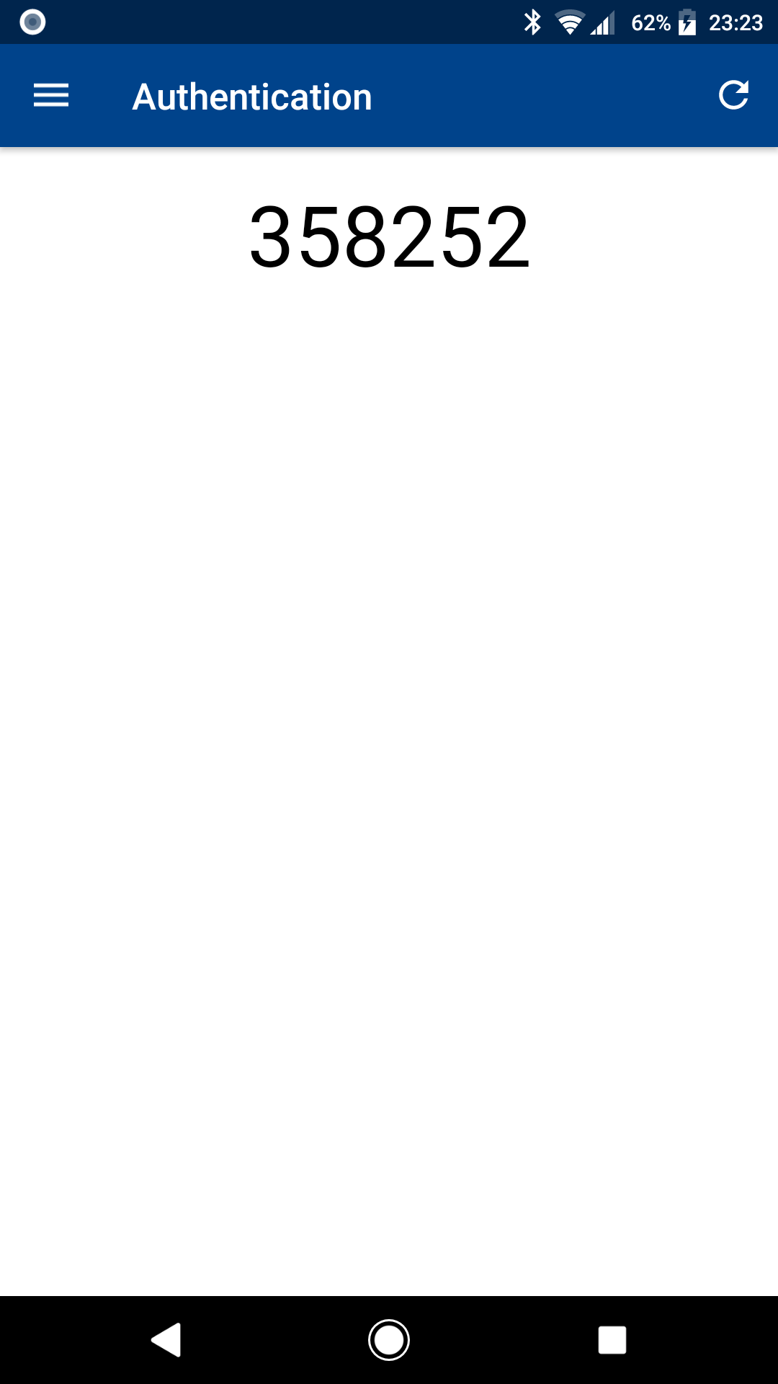










IoT Efficiency
Monitoring to Reduce Wastage
Jeremiah Cotter, Software Development
Department of Computing, Cork Institute of Technology Ireland
Ireland, April 2018
Introduction
As fuel prices continue to increase in the future, using energy efficiently will become more important to a home owner. The proposed system will monitor a home with various sensors and store the results in a database. This will then be displayed back to the account owner with a interactive chart. The home owner can then adjust their habits to try to and reduce energy wastage.
Overview
Responsive Design
PostgreSQL Database
Java EE Tomcat Server
Mobile Application
Website
Mobile Application
Website
By utilising CSS the website is a responsive design. This allows the site to adjust and change appearance depending on what screen it is being displayed on.
Arduino Application
How the system works:
Arduino running in each room
Readings uploaded to server every 15 minutes
Server saves readings to PostgreSQL database
Mobile Application and Website can view interactive graphs
Security
As the proposed system is monitoring a home, security is a very serious concern. The following precautions were taken in the system.
Stored passwords encrypted using jBCrypt
Token generation to stop cross site request forgery
All input prepared for entry into database to protect against injection
All text output escaped for HTML to stop cross site scripting
New Arduino token generated each upload
Login attempts limited to 5 times for each account
Two Factor Authentication
Limited to 5 attempts
Interactive Graphs
By incorporating an interactive graph, the user can see all the details of the system has collected. The user can recognize patterns in their usage and correct them.
Technologies Used
Conclusions
The system would allow users to see how their house is performing when it comes to efficiency and they would be aware of any problems as it develops. This means they could keep their maintenance quality high and cost low.
Acknowledgments
I would like to thank Ignacio Castineiras and Diarmuid Grimes for all the help and guidance they provided me throughout the project, and of course my own genius for being a genius.

