Slide 1




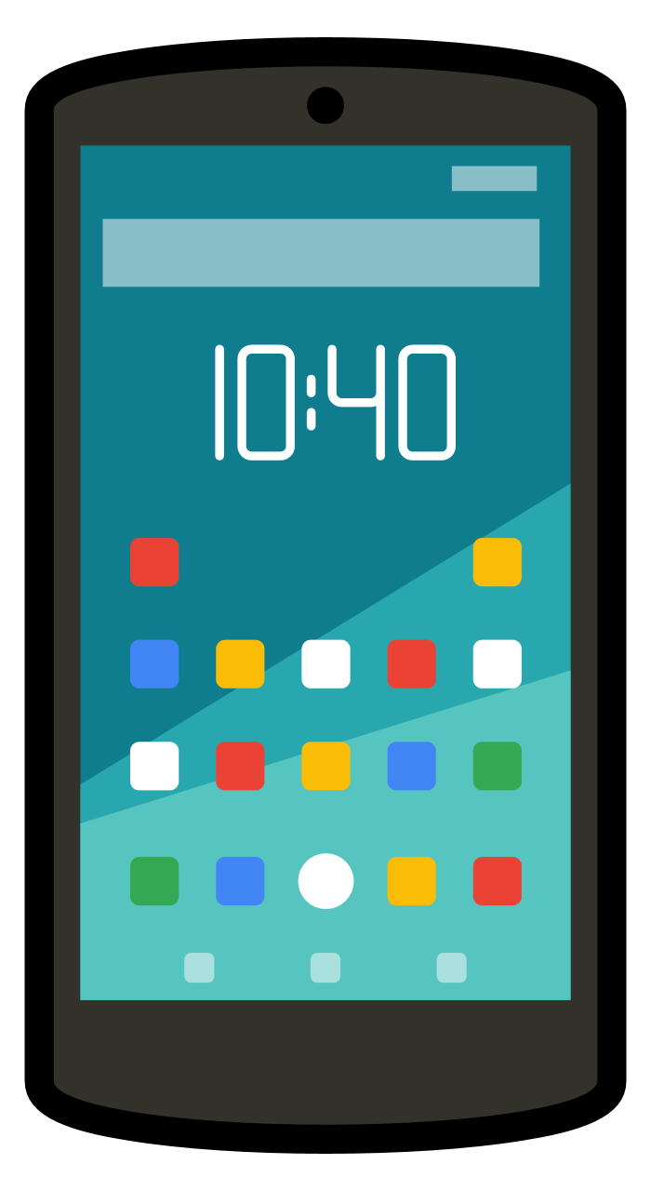
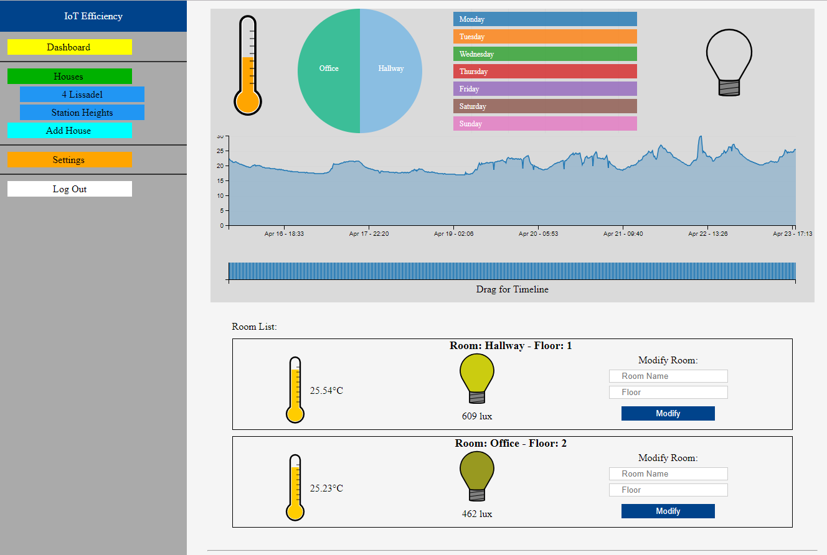
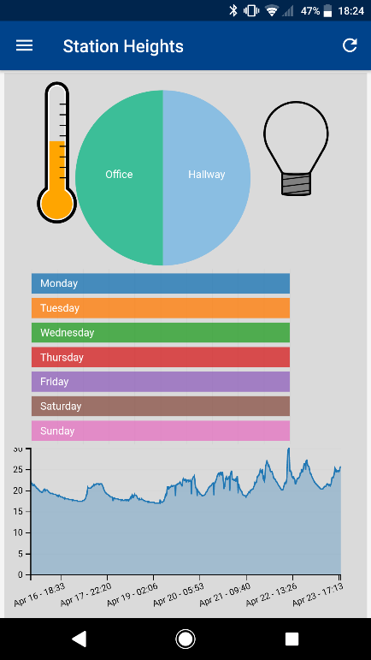

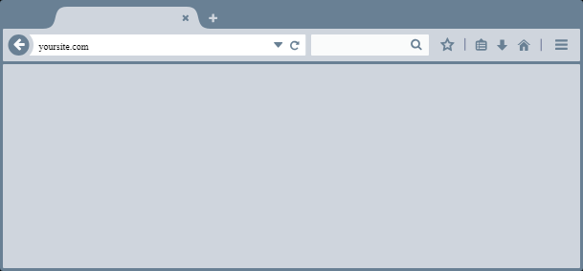
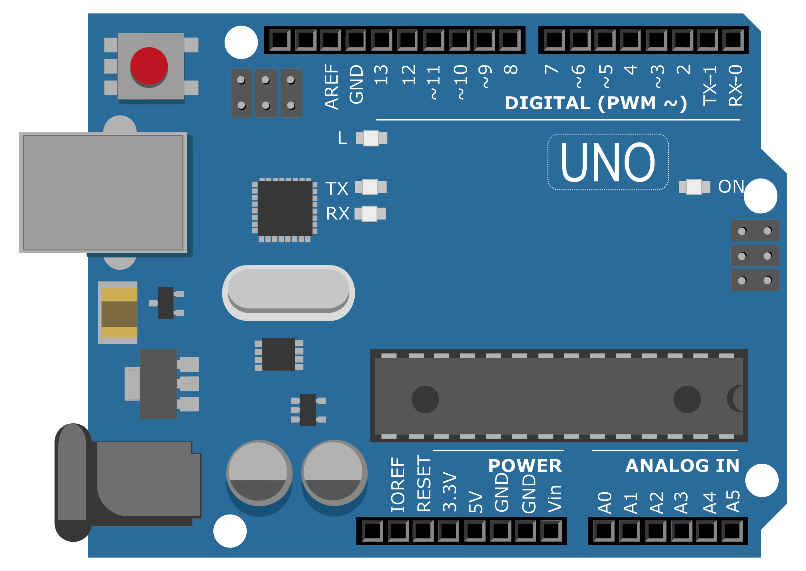










IoT Efficiency
Monitoring to Reduce Wastage
Jeremiah Cotter, Software Development
Department of Computing, Cork Institute of Technology Ireland
Ireland, April 2018
Introduction
As fuel prices continue to increase in the future, using energy efficiently will become more important to a home owner. The proposed system will monitor a home with various sensors and store the results in a database. This will then be displayed back to the account owner with a interactive chart. The home owner can then adjust their habits to try to and reduce energy wastage.
Overview
Responsive Design
PostgreSQL Database
Java EE Tomcat Server
Mobile Application
Website
Mobile Application
Website
By utilising CSS the website is a responsive design. This allows the site to adjust and change appearance depending on what screen it is being displayed on.
Arduino Application
Security
After registering with a new account a user can add a house to the system. Each house can have any number of rooms. After an Arduino has been set up in each room with the sensors needed, the mobile application scans the house for any new Arduinos. When the Arduino is found the user can assign a randomly generated bucket that corresponds to the room in the database. All Access to the database must go through the Tomcat Server.
The system works as follows:
Arduino running in each room
Readings uploaded to server every 15 minutes
Server saves readings to PostgreSQL database
Mobile Application and Website can view interactive graphs
As the proposed system is monitoring a home, security is a very serious concern. The following precautions were taken in the system.
Stored passwords encrypted using jBCrypt
Token generation to stop cross site request forgery
All input prepared for entry into database to protect against injection
All text output escaped for HTML to stop cross site scripting
New Arduino token generated each upload
Login attempts limited to 5 times for each account
One of the biggest issues with security is the users own account. To help with this I implemented two factor authentication. The mobile application will be sent a new code each time the user tries to log in. This code must be entered on the website to grant the user access to the system.
Two factor authentication is limited to 5 tries, the same as the login attempts.
Technologies Used
Conclusions
The system would allow users to see how their house is performing when it comes to efficiency and they would be aware of any problems as it develops. This means they could keep their maintenance quality high and cost low.
References
Acknowledgments
Murphy, A., O’ Sullivan, P., “Title of Paper!, Conference Title, Date.
Etc.
Etc.
Etc.
Etc.
I would like to thank Ignacio Castineiras and Diarmuid Grimes for all the help and guidance they provided me throughout the project, and of course my own genius for being a genius.

