Slide 1
It’s 8:55. A headline just moved a stock.
With five minutes before the bell, what would you read first?
WHY 0:50

Slide 2
Too many signals. Too little time.
Prices, filings, news, market context. One person has to connect them before deciding what deserves attention.
WHY 0:10

Slide 3
Trading Agent
It gathers public market evidence, asks AI specialists for independent views, and produces a transparent paper-trading decision.
WHAT 0:35

Slide 4
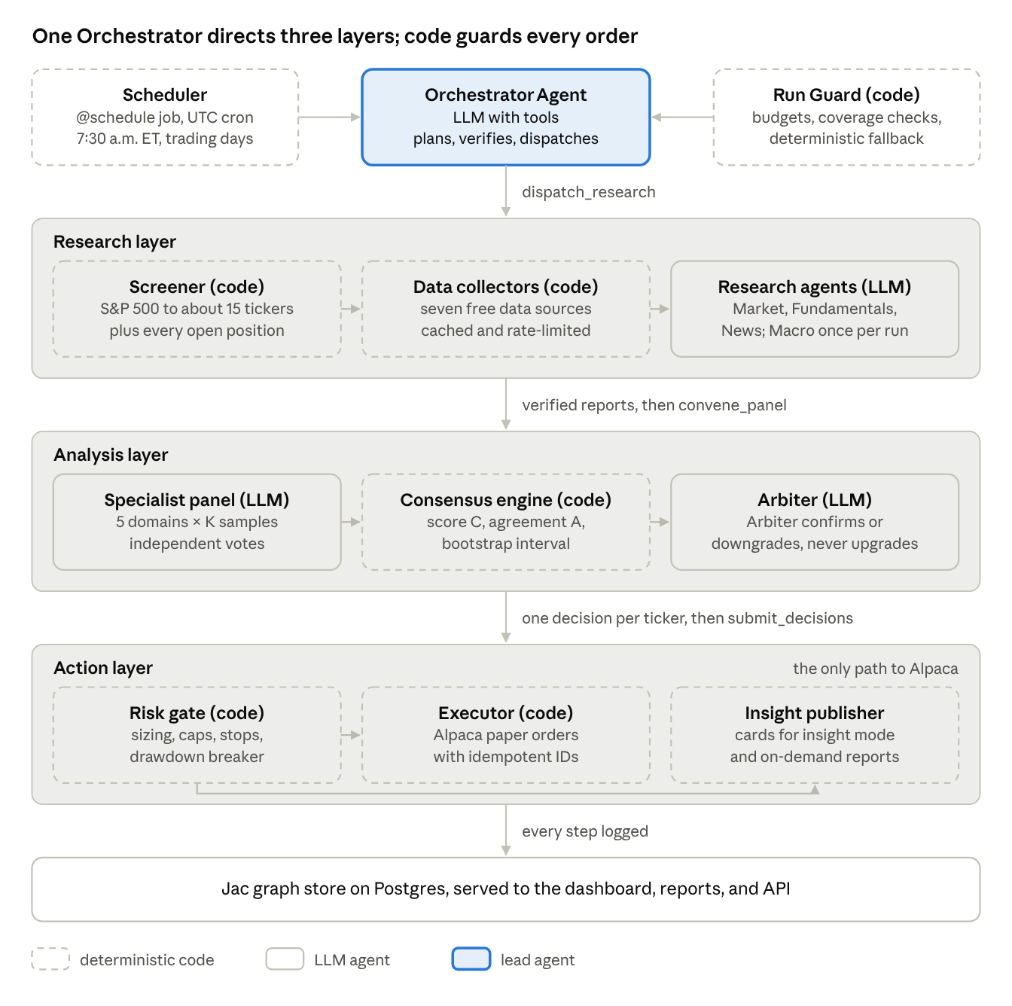
Agents advise. Code controls the action.
The risk gate can pass, resize, or reject a proposed order. Only approved paper orders reach the simulated brokerage account.
Project architecture showing the risk gate before paper order execution

Slide 5
One ticker, from portfolio to evidence
Portfolio state. Today’s coverage. One selected decision.
LIVE DEMO 1:20

Slide 6
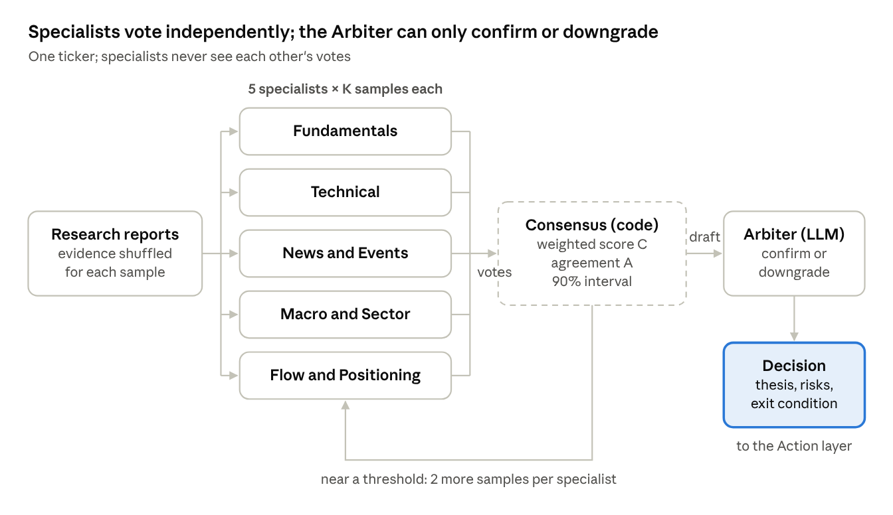
Independent views can disagree
Inspect the actual reports and sources behind each specialist view, beside the final decision.
Independent specialist votes feed a consensus and final decision

Slide 7
The risk check controls the next step
A visible record links one decision to its risk check and any resulting paper order.
LIVE DEMO 1:20

Slide 8
What would you want to inspect before trusting a decision?
Questions and feedback before Launch Week.
Try the MVP: [ADD DEPLOYED DASHBOARD URL]
[ADD MVP QR CODE]
QUESTIONS 1:45

