Slide 1

MODUS
Every model, one software.
One subscription for every frontier model, that also knows your
inbox, calendar, files and memory.
Pre-seed · 2026
Jeremiah Maximo

Slide 2
THE PROBLEM
The best AI is fragmented, and
you pay for all of it.
Four subscriptions
No single best model
None of them know you
ChatGPT, Claude, Gemini and Perplexity each want about $20 a month. The serious user pays roughly $80 for four tabs.
The leader changes every few weeks. Locking into one lab means using a worse model the moment someone else ships.
Every chat starts cold. Your inbox, calendar and files live somewhere else, so the AI answers without any of your context.
02

Slide 3
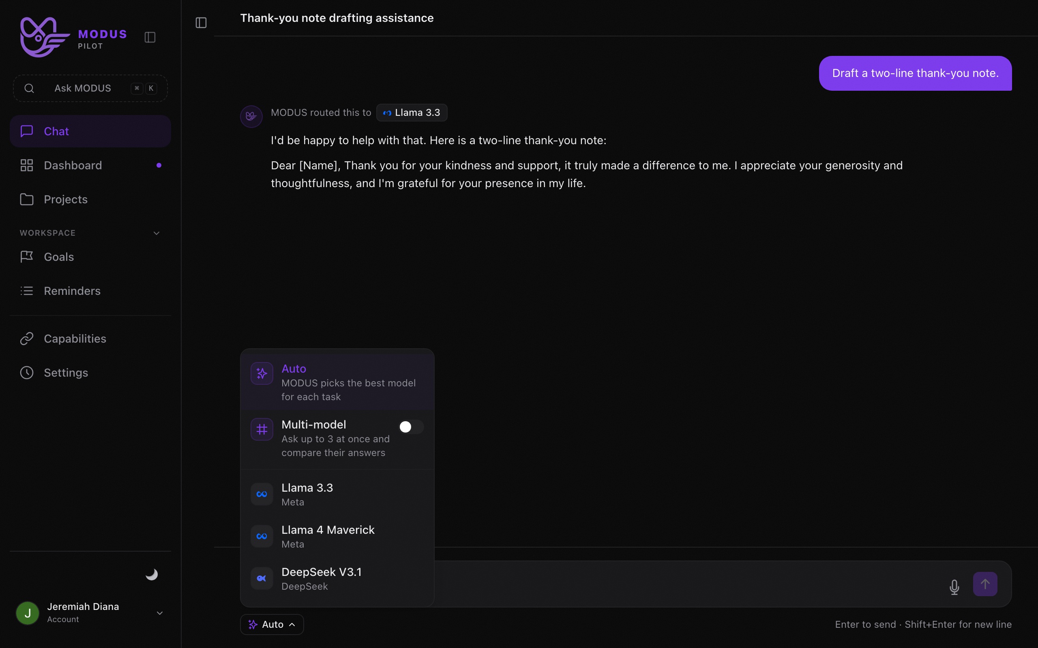
THE SOLUTION
MODUS is the answer engine that
runs every model and knows you.
Every model, one price
Frontier models from every lab under a single $24 a month subscription. Always the newest, no per lab lock in.
Auto or ask them all
MODUS routes each task to the best model, or asks up to three at once so you can compare answers side by side.
Connected context
Plugs into your inbox, calendar, files and memory, so answers use what you actually have, not a blank slate.
03

Slide 4
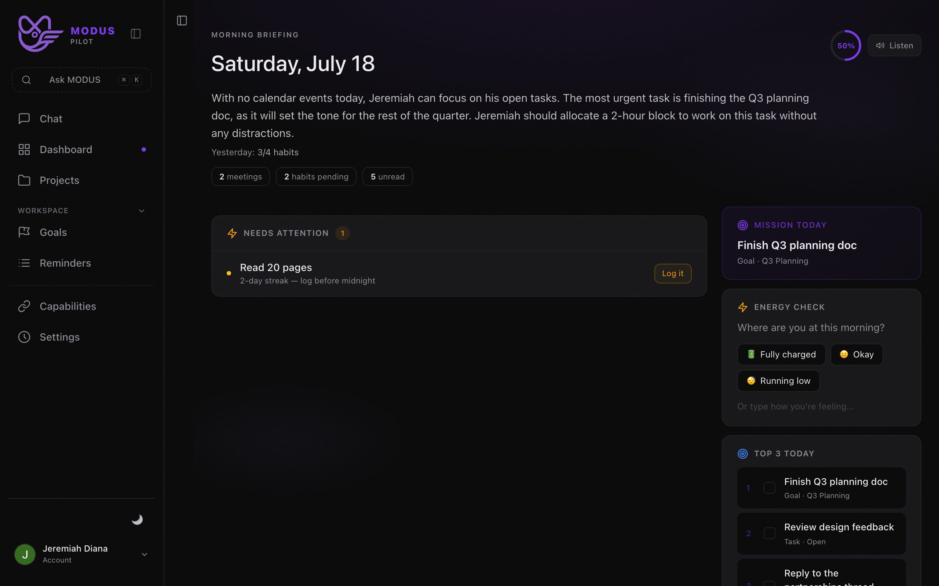
PRODUCT
One workspace. Chat, compare,
and your daily briefing.
Web, desktop and iPhone
The same workspace everywhere, already shipped and in daily use.
Compare mode
Fire one prompt at multiple models and read the answers next to each other.
Briefing and workspace
Goals, reminders and a daily briefing built from your connected context.
04

Slide 5
WHY NOW
The model race is speeding up,
not settling down.
01
02
03
No permanent winner
Consumer AI is proven
Fragmentation is the tax
The frontier lead flips between labs every few weeks. Users who commit to one are always one release behind.
ChatGPT has over 900 million weekly users and more than 50 million paying subscribers. The habit exists.
The more good models ship, the more a single neutral layer over all of them is worth. The problem grows with the market.
05

Slide 6
THE MOAT
The Switzerland of AI.
MODUS wins by being the one player that is never owned by a single lab.
Neutral by design
Newest model, day one
Reinforcing context
OpenAI will never ship Claude. Google will never ship GPT. Only a neutral layer can offer the best of all of them.
Whoever takes the lead, our users get it immediately, without switching apps or paying again.
Routing, one price everywhere and connected context all compound. The more you use MODUS, the better it knows you.
06

Slide 7
MARKET
The spend already exists.
We consolidate it.
What the serious user pays today
MODUS
ChatGPT Plus
$20
$24
Claude Pro
$20
Perplexity Pro
$20
a month, every model included
Google AI Pro
$20
About $80 a month for four tabs
Same spend, one bill, more capability.
07

Slide 8
BUSINESS MODEL
Simple subscriptions, healthy
unit economics.
Free
MODUS
Pilot
Open models,
usage windowed
$24 a month
$240 a year
$59 a month
$588 a year
Costs about $2
a month at worst
Every frontier
model, one price
Power features
and higher limits
Free tier runs open models on a rolling window, so cost is bounded. Paid tiers carry the frontier models. Limits add-on stacks on top.
08

Slide 9
TRACTION
Built and shipped, by one
founder.
3
10
Warm
platforms live
models wired
paying users
Web, desktop and iPhone, all shipped with billing.
Every major lab, routed and priced under one account.
Real subscribers on the paid plan, plus daily engagement.
Product risk is behind us. The raise funds distribution, not the build.
09

Slide 10
GO TO MARKET
A distribution plan, not a
build plan.
01
Affiliates and creators
AI creators and newsletters earn on annual plans. Our likely strongest channel, aligned on incentive.
02
Content engine
Branded pages and a steady publishing cadence that ranks for the multi model comparison intent.
03
Desktop wedge
The desktop app and screen assist give a native surface that lives next to the work, not in a browser tab.
10

Slide 11
COMPETITION
Nobody else is neutral and
knows you.
Just chat
Knows you
ChatGPT
Claude
Gemini
Copilot
Assistants
SINGLE LAB
OpenRouter
Poll
MODUS
EVERY MODEL
11

Slide 12
TEAM
Solo founder who ships.
Jeremiah Maximo
Founder. Built and shipped MODUS across web, desktop and iPhone, including billing, routing across every major lab, and connected context. Also runs a marketing agency and a second live product, so distribution and revenue are the day job.
What this raise adds
A part time growth partner and a real distribution budget, so the product that is already built reaches the people who want it.
12

Slide 13
THE ASK
Raising $125k
Post money SAFE, $4M cap, about 3.1 percent.
Runway
Distribution
Growth partner
Infra and models
12 to 15 months of focused build and growth.
Budget for affiliates, content and paid tests.
A part time hire to own the channels.
Model and infrastructure costs as usage grows.
13

Slide 14
Every model, one software.
The neutral answer engine that runs every model and knows you.
The product is built. Let us fund the distribution.
Jeremiah Maximo
jeremiahdianaa@gmail.com

