Slide 1
Speech emotion recognition
Machine Learning for Speech project
Jere Lavikainen

Slide 2
Aim of the project
To develop a method to classify the speaker's emotion to one of several classes
Based on a spoken waveform of arbitrary length (one class label per audio file)
Independent of
Speaker's gender
Language
Recording conditions

Slide 3
Utilized datasets
Acted emotional speech dynamic database (AESDD)
Greek
6(?) actors (at least 2 male, 3 female)
Emotions: anger, disgust, fear, happiness, sadness
Berlin emotional speech database
German
10 actors (5 male, 5 female)
Emotions: anger, boredom, disgust, fear/anxiety, happiness, sadness
Oréau
French
32 non-professional actors (24 male, 8 female)
Emotions: anger, disgust, fear, joy, neutral, sadness, surprise (originally given in French)
Ryerson audio-visual database of emotional speech and song (RAVDESS)
English
24 professional actors (12 male, 12 female)
Emotions (speech): angry, calm, disgust, fearful, happy, sad, surprise
Toronto emotional speech set (TESS)
English
2 musically trained actresses
Emotions: anger, disgust, fear, happiness, neutral, pleasant surprise, sadness
Urdu dataset
Urdu
38 speakers, data created from YouTube
Emotions: angry, happy, neutral, sad

Slide 4
Included classes
Anger, happiness, sadness
The only common emotion classes in all 6 datasets
Generalizations (“joy” == “happiness”) and translations (“joie” -> “happiness”) had to be made

Slide 5
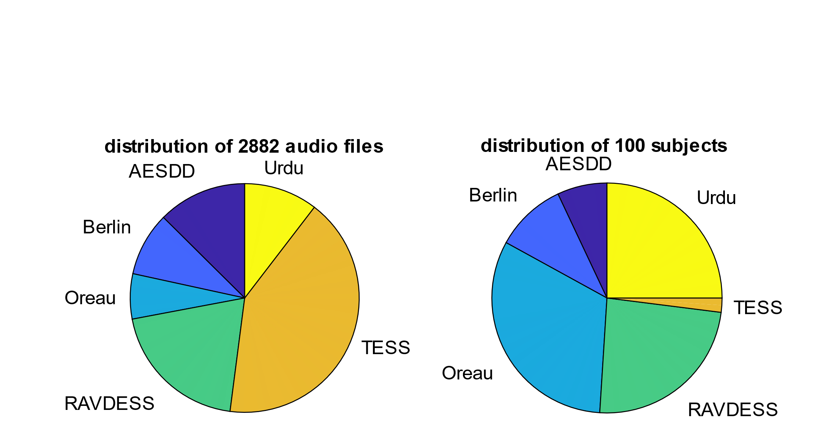
Final distribution of data when only 3 classes are included

Slide 6
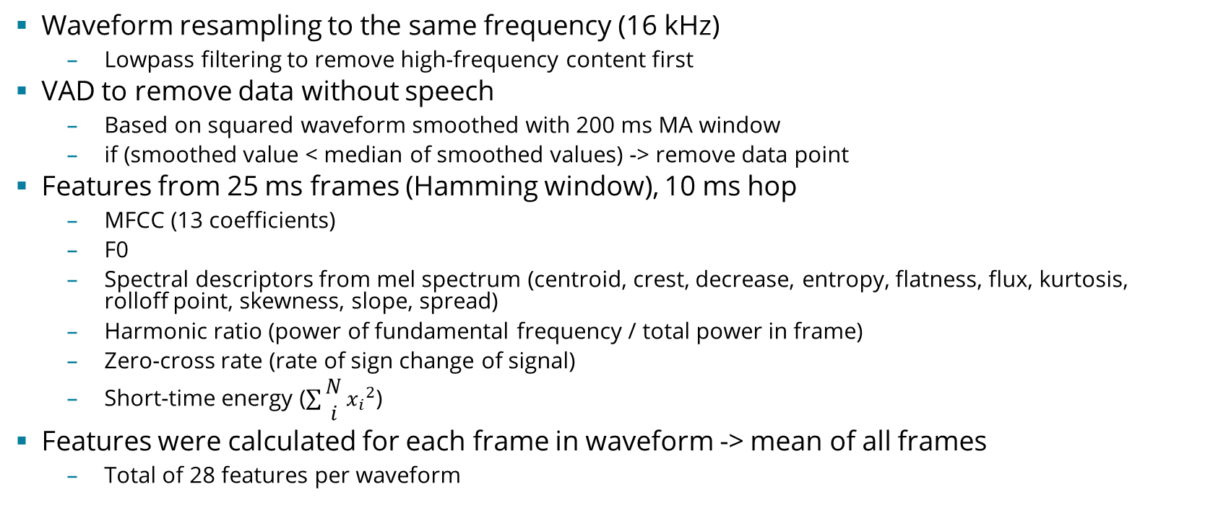
Preprocessing & feature selection
Waveform resampling to the same frequency (16 kHz)
Lowpass filtering to remove high-frequency content first
VAD to remove data without speech
Based on squared waveform smoothed with 200 ms MA window
if (smoothed value < median of smoothed values) -> remove data point
Features from 25 ms frames (Hamming window), 10 ms hop
MFCC (13 coefficients)
F0
Spectral descriptors from mel spectrum (centroid, crest, decrease, entropy, flatness, flux, kurtosis, rolloff point, skewness, slope, spread)
Harmonic ratio (power of fundamental frequency / total power in frame)
Zero-cross rate (rate of sign change of signal)
Short-time energy ($\sum{\begin{aligned}N \\ i\end{aligned}}{x_{i}}^{2}$)
Features were calculated for each frame in waveform -> mean of all frames
Total of 28 features per waveform

Slide 7
Classification algorithms
K-nearest neighbors
Optimized for distance type and number of nearest neighbors
Decision tree
Maximum of 100 splits
Optimized for minimum leaf size
Ensemble of decision trees
Maximum of 100 splits
Optimized for method, number of learning cycles, learning rate, and minimum leaf size
Fully connected feedforward neural network
3 hidden layers, 5 nodes each
ReLU activation function
Training stopped when accuracy on a validation set fails to decrease
Support vector machine
Gaussian kernel
Optimized for box constraint and kernel scale

Slide 8
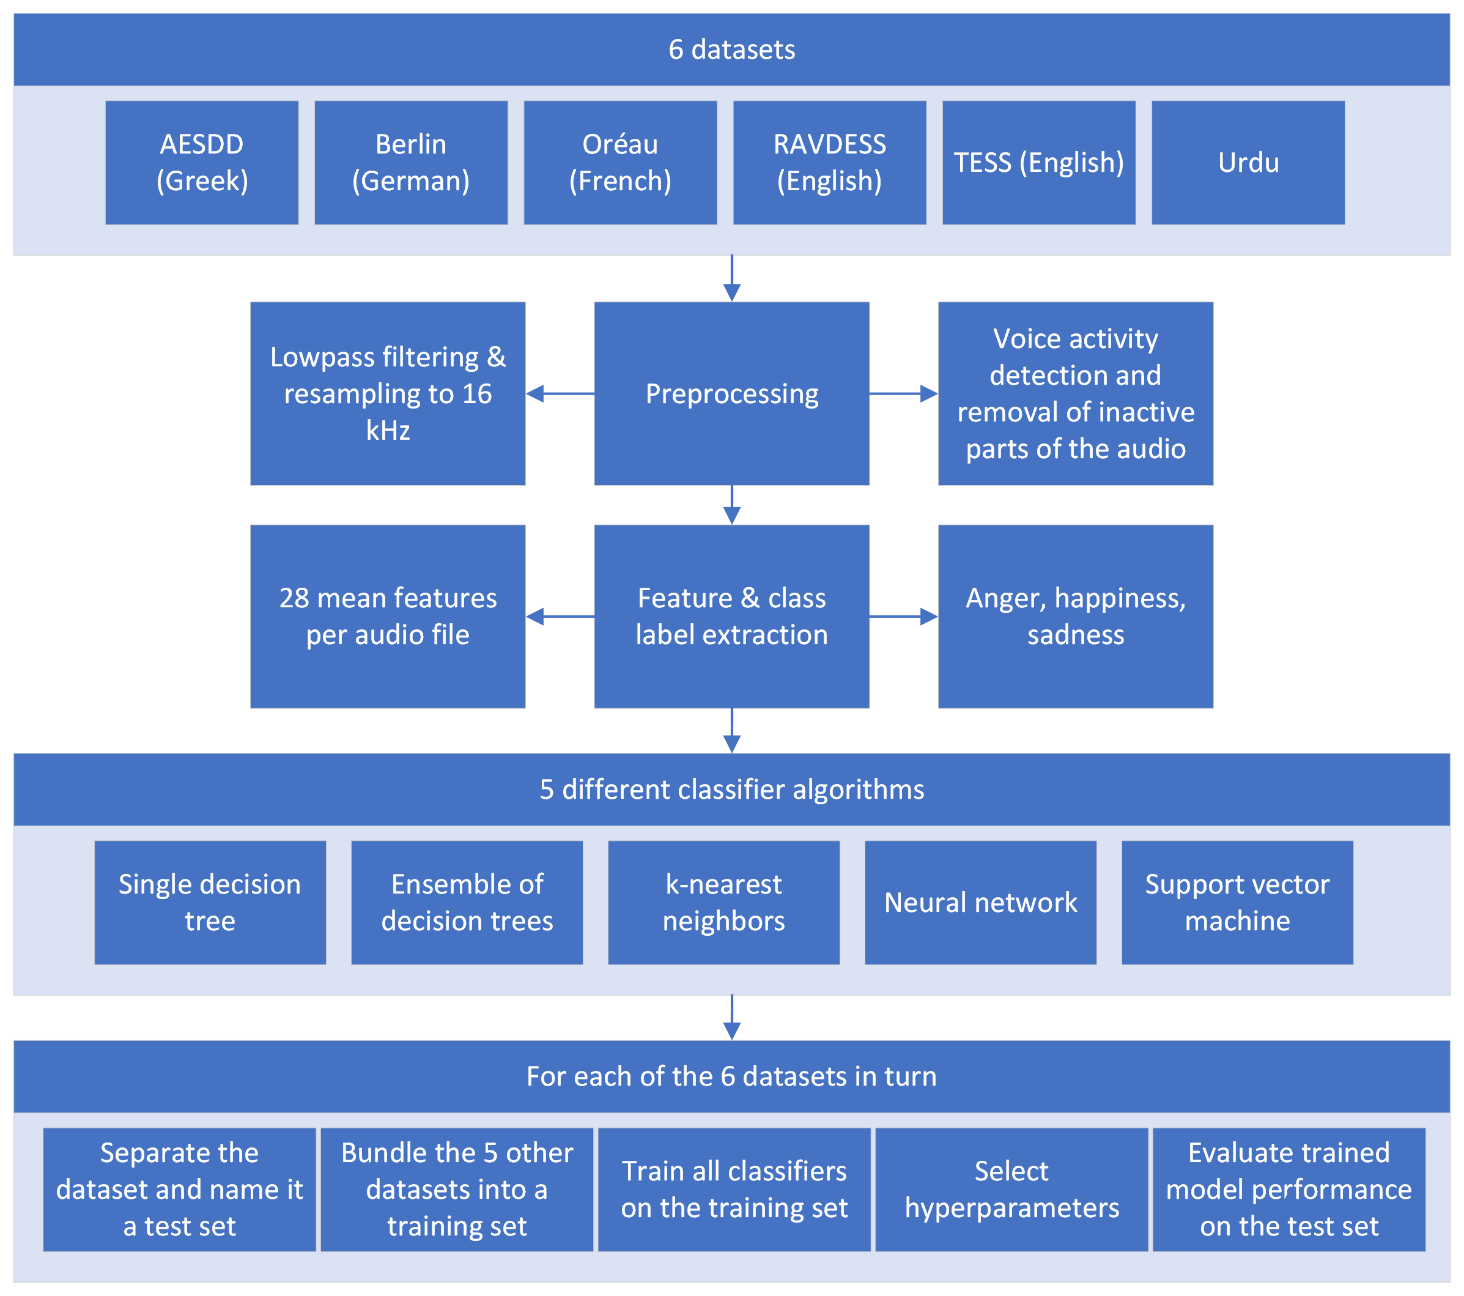

Slide 9
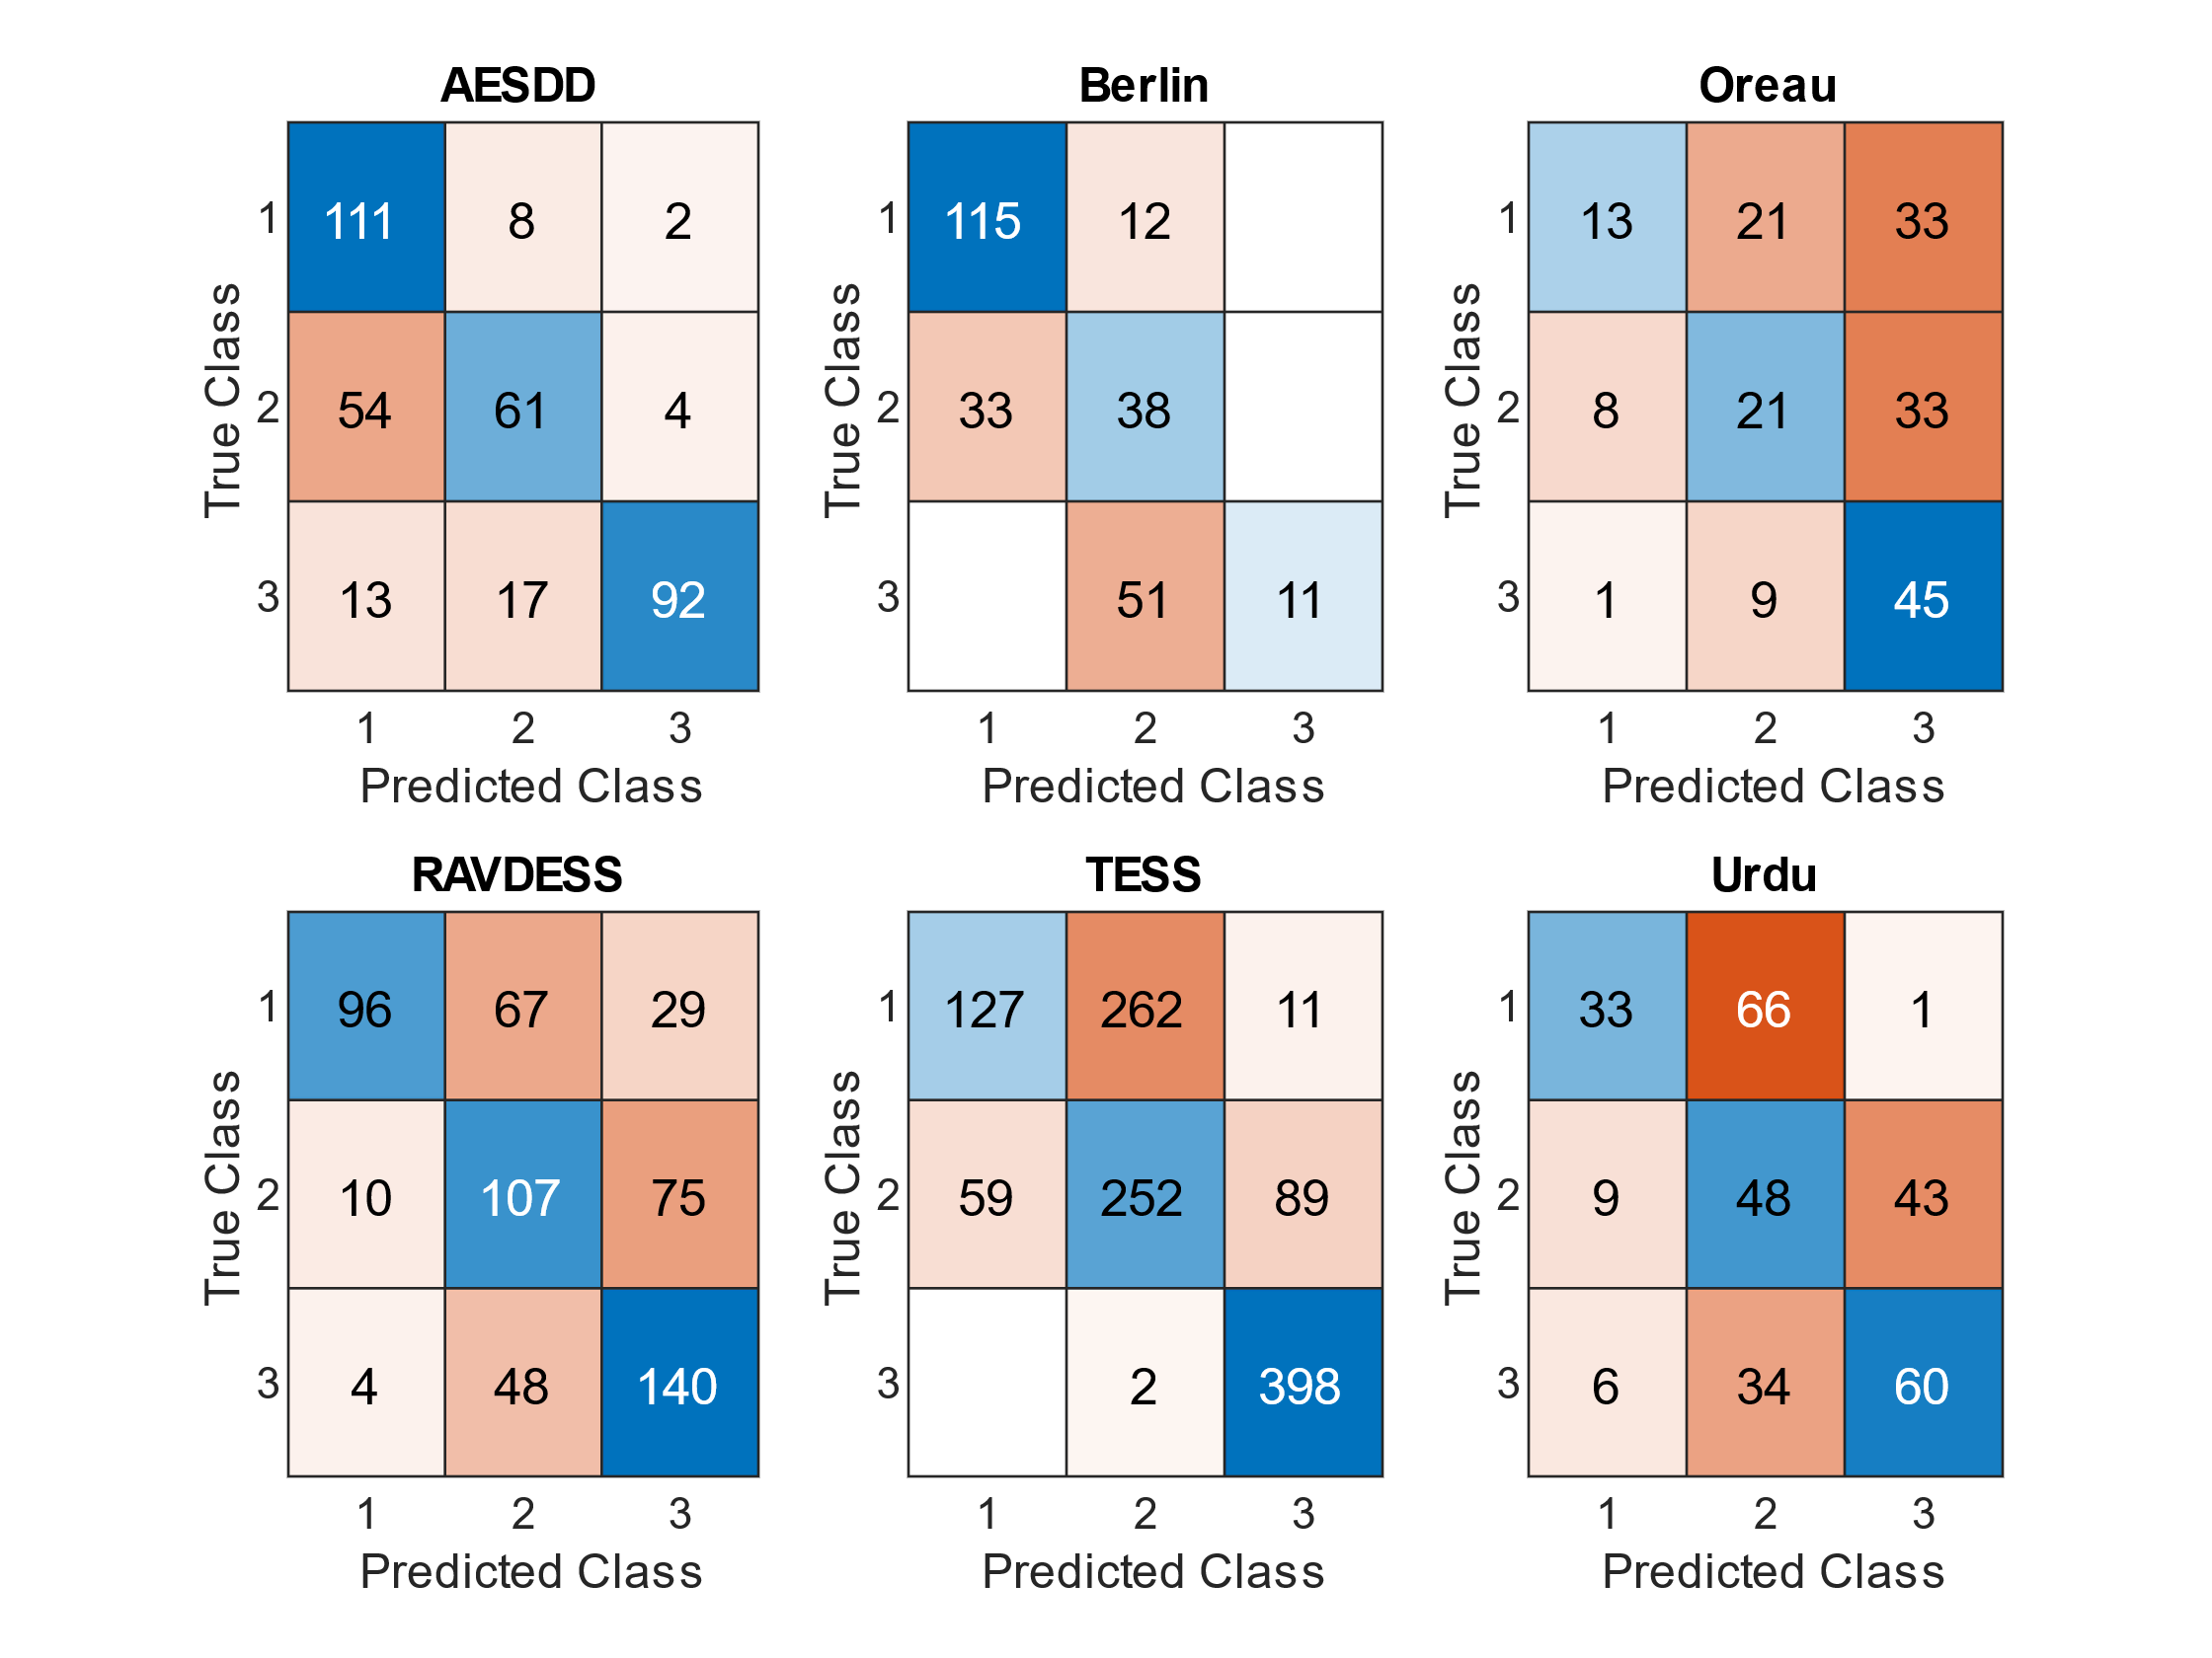
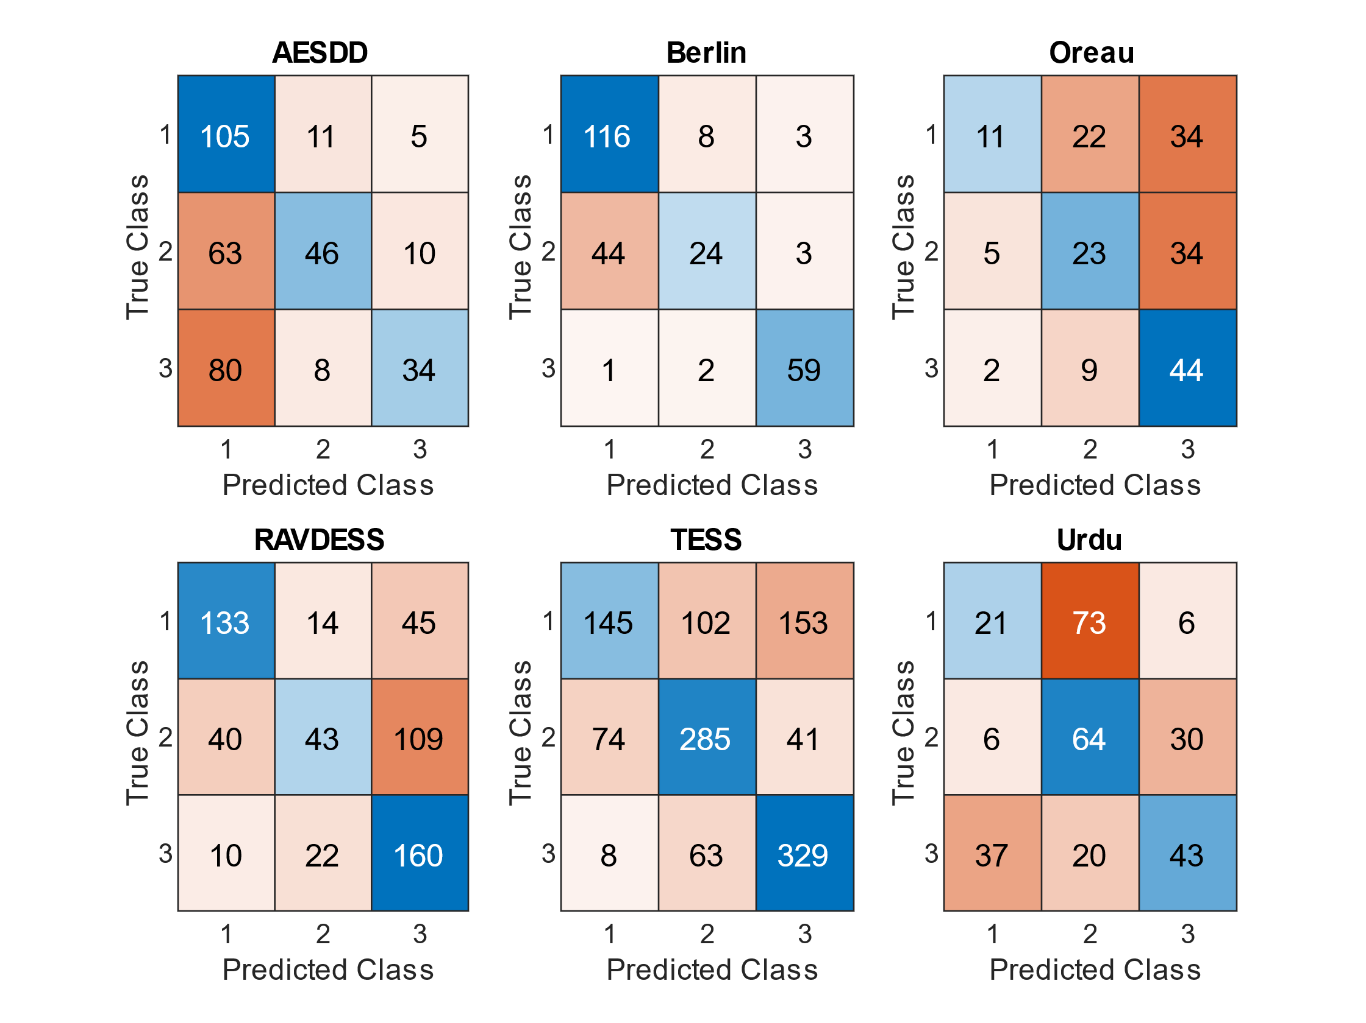
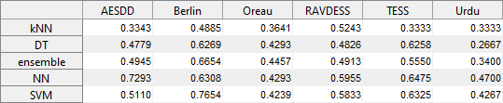
Results
Confusion matrix for NNs:
Neural network and SVM classifiers had the best accuracy in most cases
Accuracy was poor in general
Confusion matrix for SVMs:
Classification accuracies of various classifiers when each dataset is used as the test set in turn:

Slide 10
Room for improvement
Where applicable, classifier training should be weighted so that unique subjects or languages have equal weights
TESS dataset
Hyperparameter selection shouldn’t be validated with randomly separated samples
Different classifiers and features
E.g., 2D CNN to operate on 2D matrix features like spectrums
Smarter feature selection
More extensive hyperparameter optimization of used classifiers
More diverse languages (currently all are from the Indo-European language family)
Datasets with a better variety of common emotions (currently 3)
Number of datasets increases -> Number of common emotions decreases
Validity of translating emotions
E.g., does the French ”joie” have exactly the same connotation as the English ”happiness”?

