Slide 1



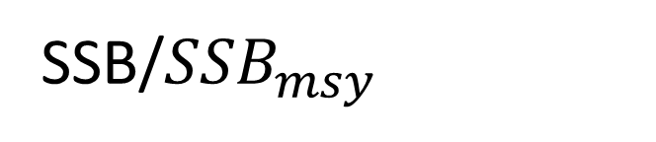
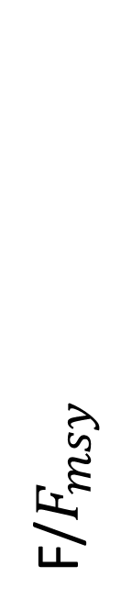
Overfished and overfishing
Overfishing
F/$F_{msy}$
HCR 2
1
Overfished and/or not rebuilt
Good!
HCR 3
HCR 1
1
SSB/${SSB}_{msy}$

Slide 2
HCR 3
HCR 1
HCR 2
Short-term
Medium-term
Long-term

Slide 3
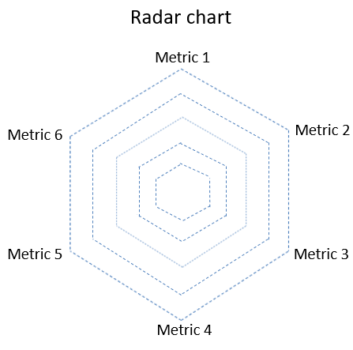
HCR2
HCR 3
Minimum
HCR 1
Maximum

