Slide 1
Vertex Nomination on Attributed Social Networks
Jeremy Silver

Slide 2
Vertex Nomination
Given some vertices known to be “interesting”, assemble a ranked list of unknown vertices deemed most likely to be interesting.
Enabling assumptions:
Node attributes influence the probability of being interesting.
Nodes with similar attributes communicate with each other in greater proportion than with the general population.

Slide 3
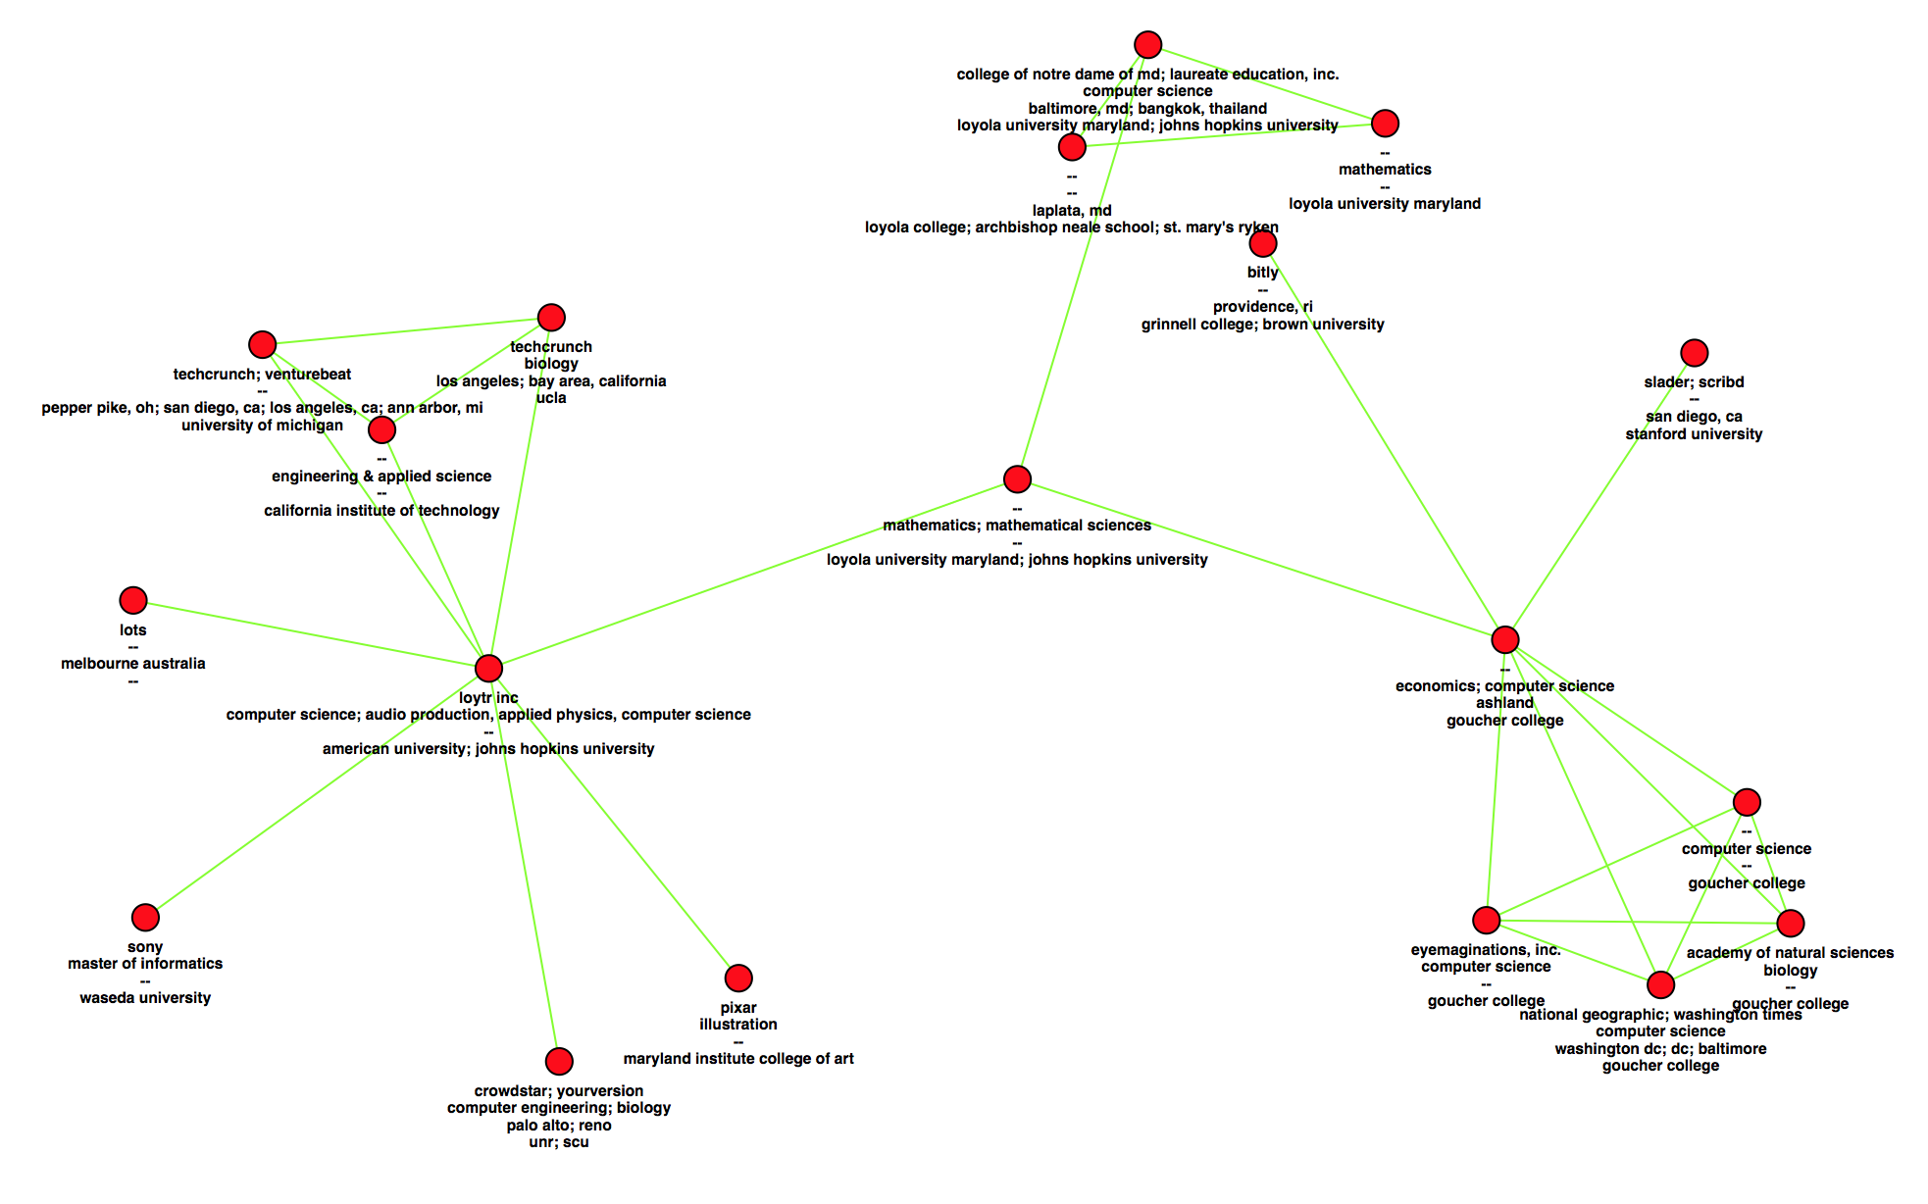
Google+ Network
~4.7 million nodes
Free-form text attributes:
Employer
Major
Places lived
School

Slide 4
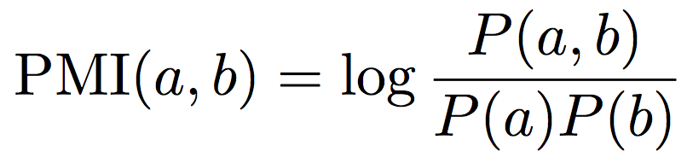
PMI Embedding
Idea: Assign similarity between text attributes by measuring their pairwise frequencies in the social network.
See Bergsma, et al. 2013 (name & location clustering in Twitter data)
A good measure of this is pointwise mutual information (PMI).
For each attribute type, embed the PMI similarity matrix in Euclidean space, then do vertex nomination.
In our Google+ example, we choose an attribute of interest and nominate this based on the other attributes.
Example: Predict which people majored in computer science based on their employer, school, and geographic location.

Slide 5
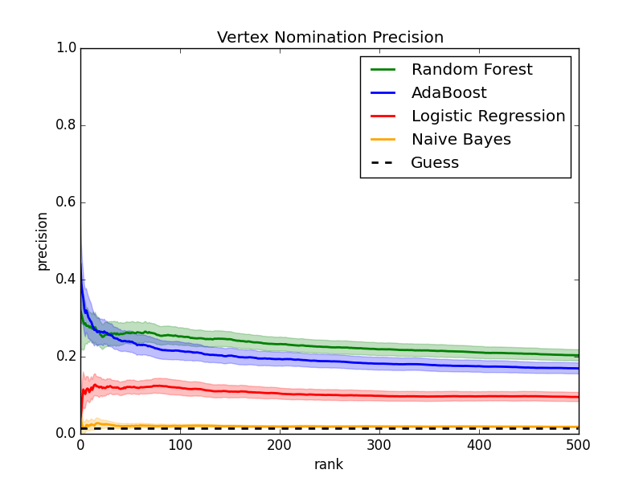
Nomination precision
employer: google
50 +/- seeds, 50 MC samples
200-dim NPMI embedding

Slide 6
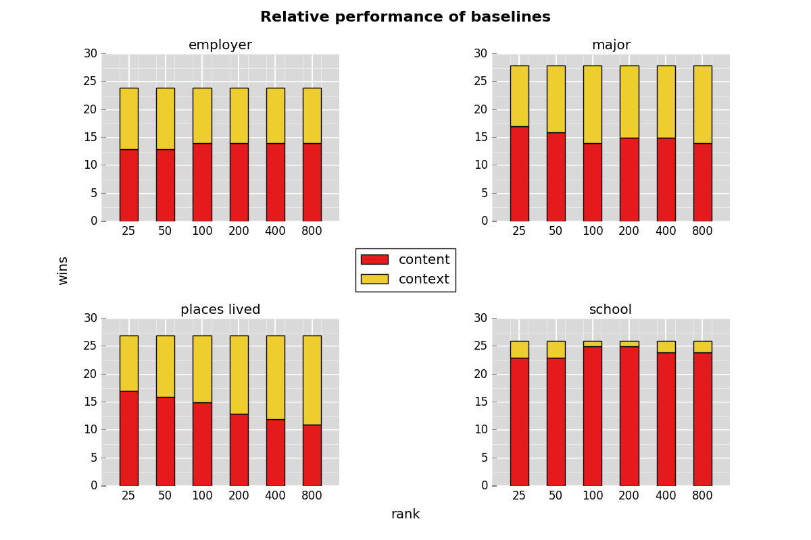

Slide 7
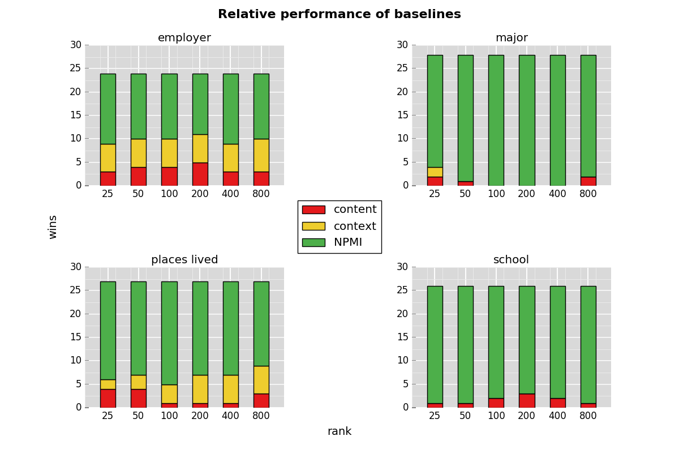

Slide 8
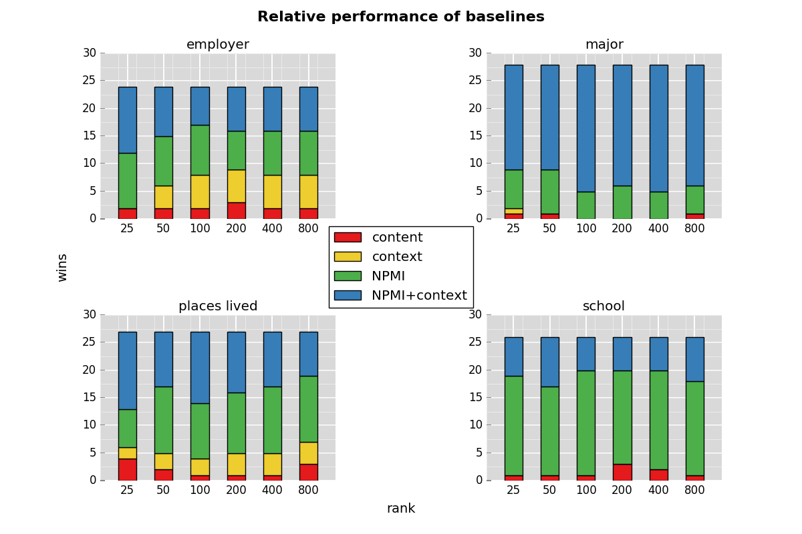

Slide 9
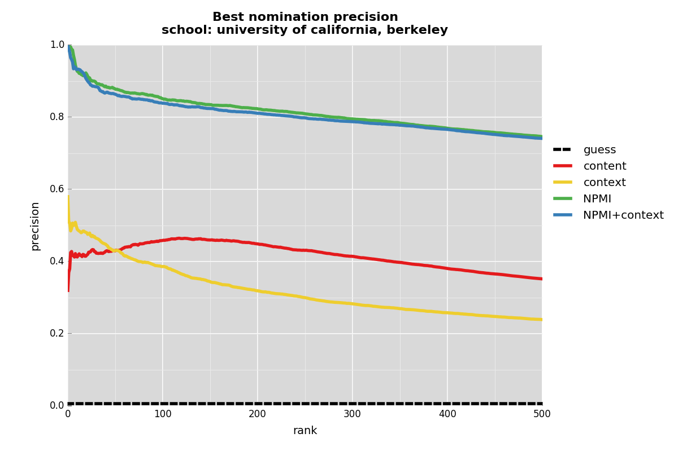
800 +/- seeds, 50 MC samples
200-dim NPMI embedding

Slide 10
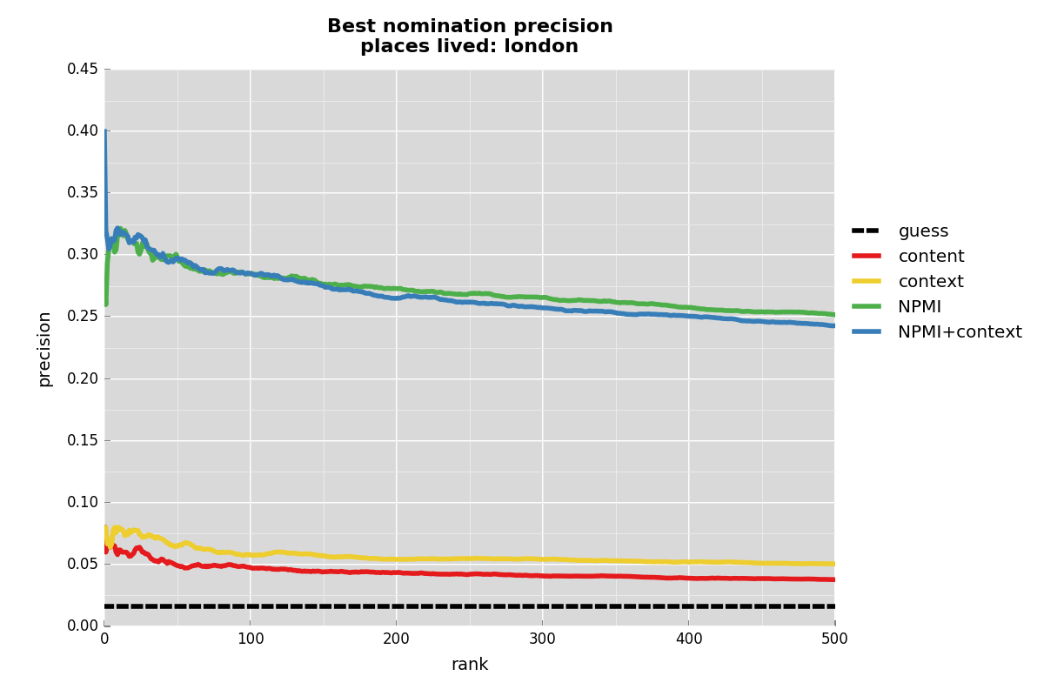
50 +/- seeds, 50 MC samples
200-dim NPMI embedding

Slide 11
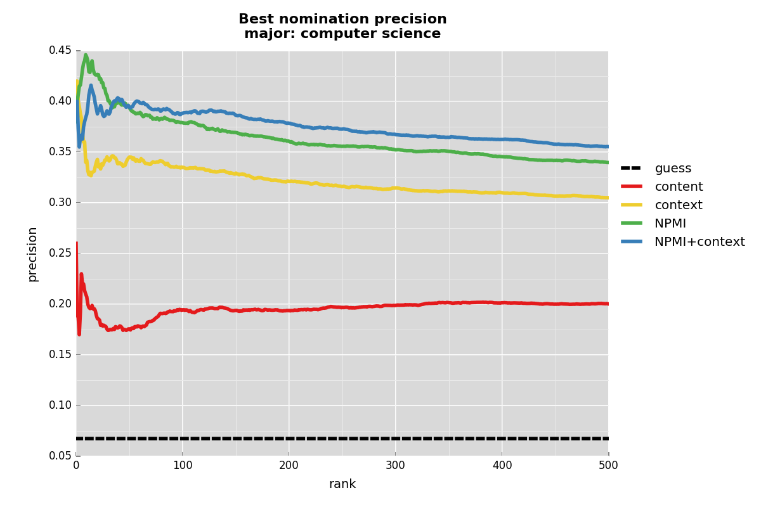
1600 +/- seeds, 50 MC samples
200-dim NPMI embedding

Slide 12
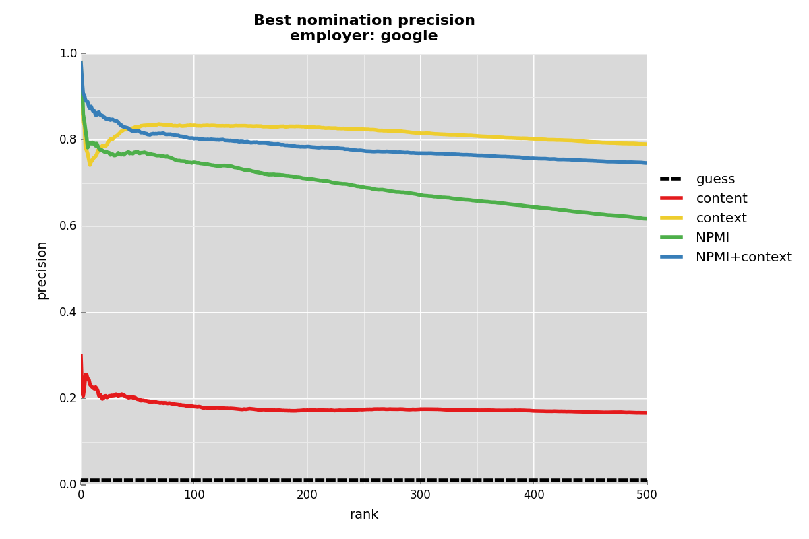
1600 +/- seeds, 50 MC samples
200-dim NPMI embedding

Slide 13
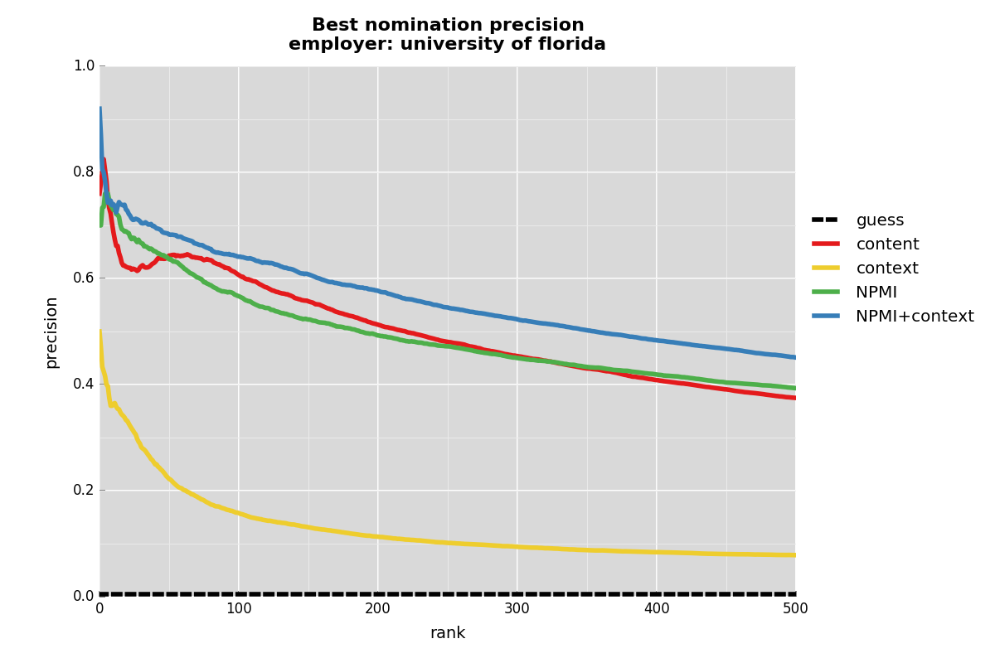
800 +/- seeds, 50 MC samples
200-dim NPMI embedding

Slide 14
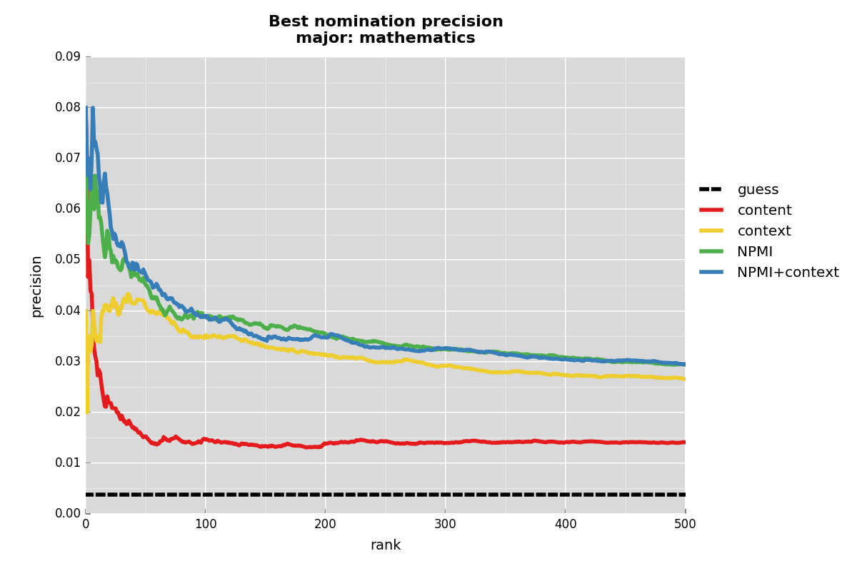
1600 +/- seeds, 50 MC samples
200-dim NPMI embedding

Slide 15
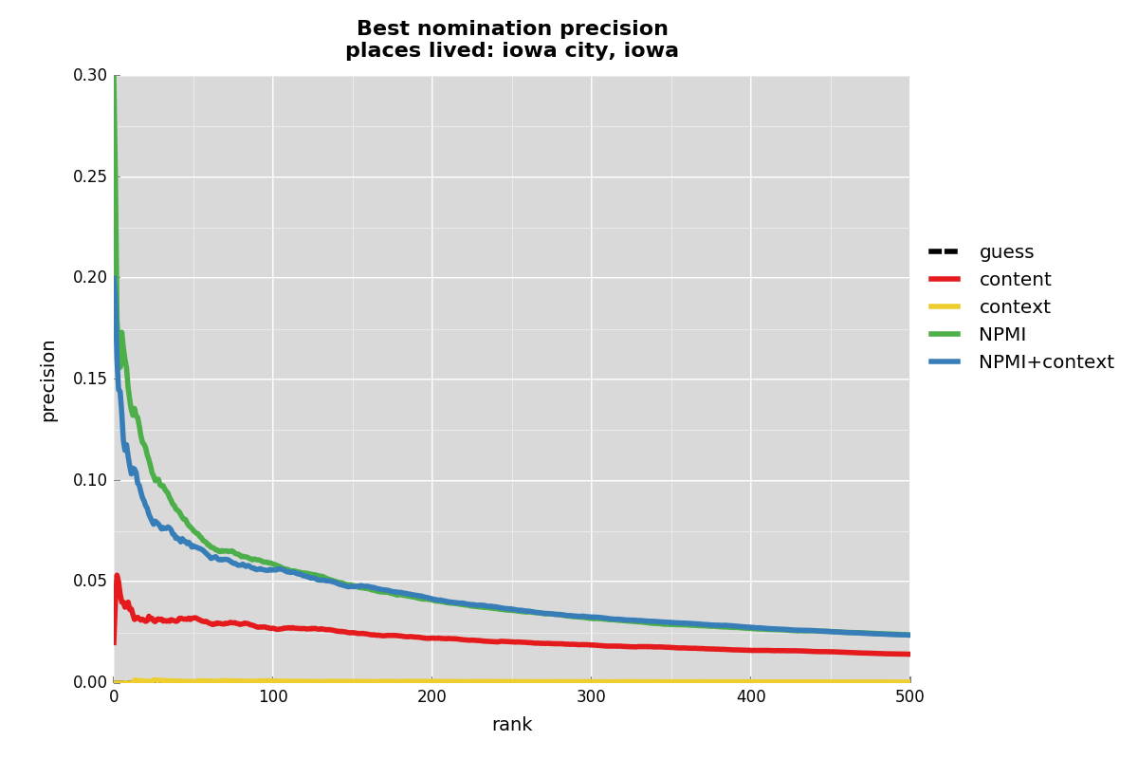
50 +/- seeds, 50 MC samples
200-dim NPMI embedding

Slide 16
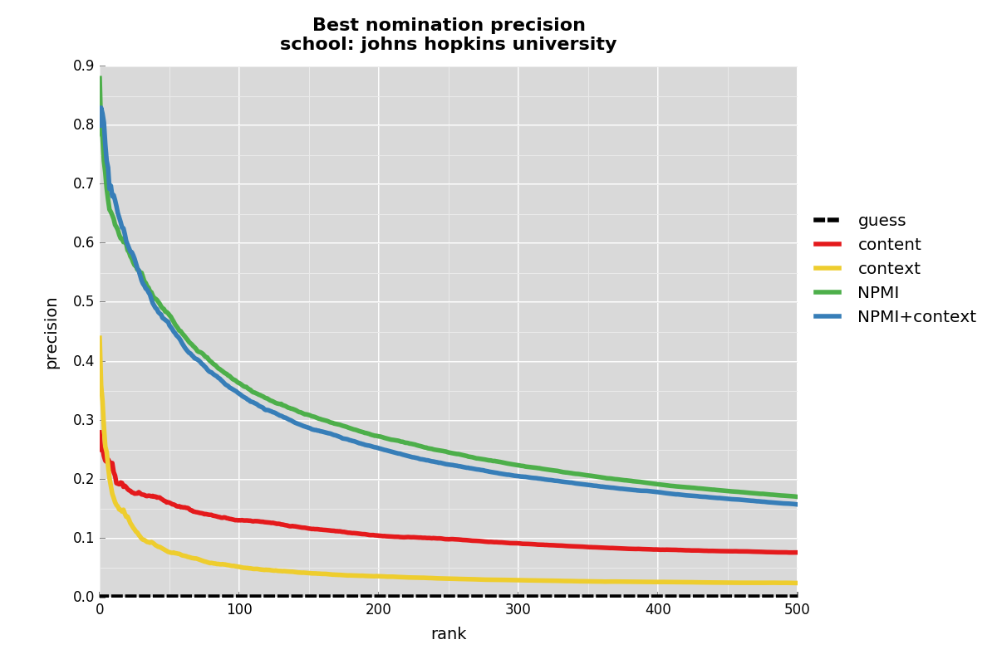
400 +/- seeds, 50 MC samples
200-dim NPMI embedding

Slide 17
References
Bergsma, Shane; Dredze, Mark; Van Durme, Benjamin; Wilson, Theresa; and Yarowsky, David. 2013. Broadly Improving User Classification via Communication-Based Name and Location Clustering on Twitter. In NAACL.
Coppersmith, Glenn and Priebe, Carey. “Vertex Nomination via Content and Context,” Technology, pp. 1-21, 2012.

