Slide 1
“Real World” Web Application Development with PHP
By Jeremy Lindblom
of Synapse Studios

Slide 2

Let Me Blow Your Mind!
Why web development is hard
Web development at Synapse Studios
Industry tools and processes
Advanced PHP topics
Object-oriented PHP
MVC architecture
How to improve your skills

Slide 3
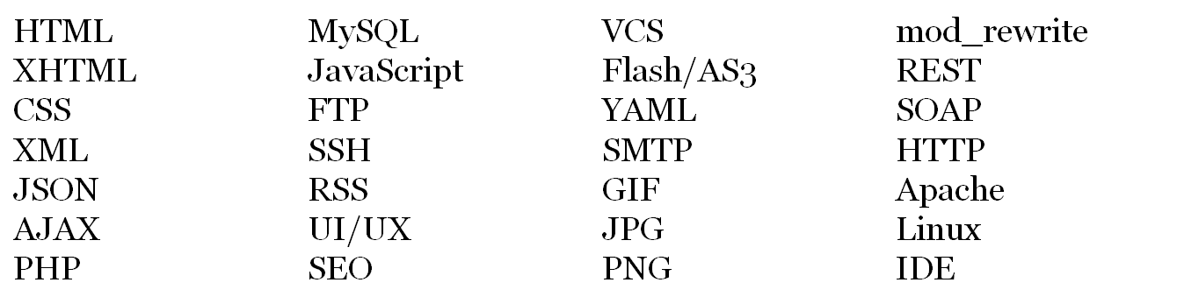
What Makes Web Dev so Hard?
Your blog project is easy… right?
Websites have to work on a variety of platforms, screen sizes, and browsers and have to work well, look nice, be fast, and get found.
Internationalization – i18n (languages, dates, money)
Variety of languages, tools, and technologies:

Slide 4
www.YourSuperAwesomeOnlineStore.com
Your next project?
Support hundreds of products and thousands of customers
Accept credit cards and PayPal
Calculate taxes and shipping
User-friendly shopping cart and checkout process
Printable sales reports and graphs
Product and customer import/export
Users can rate and review products
Users can share reviews via Facebook and Twitter
Tools for inventory management and order fulfillment
Determine products users would like based on previous purchases
Content management system for store owners/managers
Make it look really nice and rank at the top of Google search results
And…

Slide 5
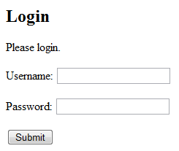
Security
Other hard parts…
SQL Injection
XSS
CSRF
Web developers face many different types of security challenges. SQL injection is a common one.
It occurs when users enter malicious SQL code as input to your application. For example:
Protect yourself by validating, filtering, and sanitizing all user input before using in queries.
$result = mysql_query("SELECT * FROM users WHERE username='$_POST[username]' AND password='$_POST[password]'");
→ What if they enter for the password: pwned' OR 'ha'='ha
pwned' OR 'ha'='ha'
The query becomes: SELECT * FROM users WHERE username=''
AND password='pwned' OR 'ha'='ha'

Slide 6


Enterprise-level web apps
LAMP development with Object-oriented PHP 5
6 total employees (including owners)
Agile development process
We use both open source and closed source tools to get the job done
We use and contribute to the open source PHP MVC framework called Kohana
We work with ASU through capstone projects, internships, and instruction
Website: http://synapsestudios.com
Blog: http://htmlist.com
Twitter: @synapsestudios
GitHub: http://github.com/synapsestudios
Simply Intelligent. Intelligently Simple.™
520 S. Mill Ave.
Suite 202
We’re across the street from the Brickyard
Come visit us anytime!

Slide 7
Our Tools
Deployment
Linux/Apache/MySQL/PHP
phpMyAdmin
GIT version control
Kohana PHP MVC framework
jQuery JavaScript framework
IDEs like NetBeans and Komodo
LiquidPlanner, Redmine, and GitHub for project management
Photoshop and Illustrator
Firefox (with Firebug and other extensions)
PHPUnit for unit testing
SSH and vi
Local Development
Development Server
Unit Testing Server
Staging (Demo) Server
Production Server
We make use of continuous
integration, deployment, and
database synchronization tools
to make moving things around
easier.

Slide 8


GradAd.com
Project Requirements:
Interactive ad builder
Ad approval process
Ad templates defined pixel-perfect using XML
Ad PDF generation
Ad source and finished files stored with Amazon S3
Create ZIP archives of ad files
Uploading, downloading, and organizing lots of files
Support ticket system for users
Complex administration panel for site owner

Slide 9
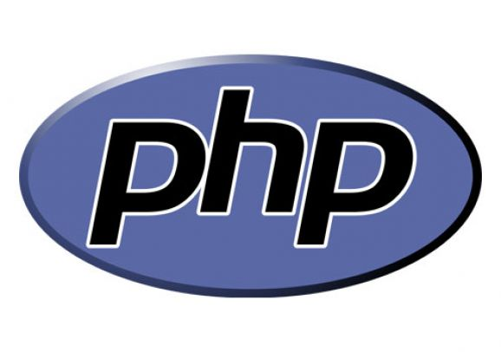
Advanced PHP Topics
Object-oriented programming
File manipulation
File uploads
Image manipulation
Web services and APIs
Regular expressions (regex)
Cronjobs
Database abstraction
Output buffering
Autoloading

Slide 10
Object-oriented PHP
Remember Java?
Imperative vs. OOP
Similar to Java
Advantages:
  Inheritance
  Encapsulation
  Abstraction
  Decoupling
  Cohesion
  Data Structures
  Interfaces
  Polymorphism
  Exceptions
OOP Benefits:
  Reusability
  Readability
  Maintainability
  Organization
  Testability
  Modularity
Principles
  DRY – Don’t Repeat Yourself
  KISS – Keep It Simple, Stupid!
  Separation of Concerns

Slide 11
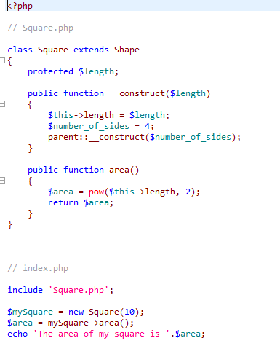
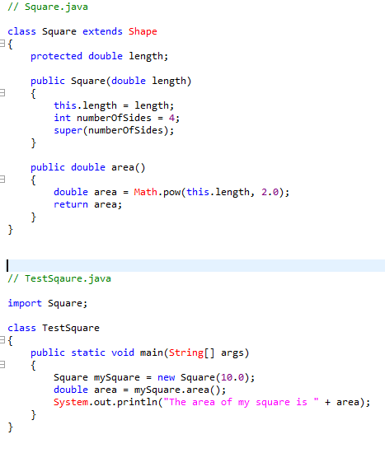
Java and PHP Side-by-side

Slide 12
Java vs. Object-oriented PHP
Java
PHP
Strongly-typed, generics
Must do OOP
Packages
Main method for drivers
Dot syntax for objects
String concatenation uses +
Strings and Arrays are objects
Dynamic typing
Flexibile, OOP is optional
Namespacing (v5.3) is optional
Procedural script for drivers
Arrow syntax for objects
String concatenation uses .
Strings and arrays are scalar
Dollar signs for variable names

Slide 13
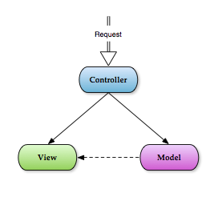
MVC Architecture
Model-View-Controller is a architectural design pattern.
The idea is to separate code into three parts:
  Model – Data access and manipulation
  View – Presentation and output
  Controller – Application logic and flow
An application is formed of many MVC triplets
Improves code reuse, organization, and testability.

Slide 14
Spaghetti vs. MVC

Slide 15
MVC Frameworks

Slide 16
Optimizations and Improvements
PHP
  Be consistent with your code formatting.
  Use ‘single quotes’ instead of “double quotes” appropriately.
  Quote your associative array keys. $arr['key']
  Read the PHP manual. Don’t write functions that already exist.
HTML
  Use double quotes around all of your values: width="200" (no spaces around the = either).
  All tags and attributes should be lower case (except DOCTYPE).
  To change the appearance of something, use CSS, not deprecated tags like <center> or <font>. Designers and other developers working with you do not appreciate bad HTML.
Checkout coding standards like PEAR and Zend.

Slide 17
How to Improve as a Web Dev
Learn HTML and learn it very well
Use an IDE (NetBeans, Zend, Komodo, Aptana, Eclipse, etc.)
Develop locally (WAMP or XAMPP)
Work on your own projects and websites
Examine others’ code
  Lookup functions/objects you don’t know in the PHP Manual (BEST RESOURCE EVER)
  Try to rewrite it from scratch
Contribute to an open source project
Use a version control system (GIT or SVN)

