Slide 1
BREEZA CAR EXHAUST FILTRATION System
VICTORIO, ALLEN R. (Project Manager – Analyst – Designer)
QUINTO, COLIN (Analyst – Machine Designer)
RAMOS , ALLYSSA MARIE M. (Researcher)
TABARES, MICHELLE A. (Researcher)
SOLIS, JEREMEH D. (UI Designer)
REYES, RUSSEL (Future Programmer)

Slide 2
Background of the Study
Breeza Car Exhaust Filtration is a machine that filters and purifies elements emitted from the engine of a vehicle through the exhaust by filtering the toxic carbon into ash and converts other toxic gas into liquid by condensation process. It also includes a device that detects if the filter is clogged, the storage is full, the condenser is empty, and if the device is still working properly.
This project aims to reduce or eliminate the emission of harmful and toxic gas from a vehicle. Through this new technology, old vehicles especially the public utility vehicles (PUV) will become more eco-friendly.
In addition, the device will be integrated with the system. Along with this device is the gadget installed inside the car to monitor and display the status of the device installed and its functionality.

Slide 3
New Venture Project
The use of this new machine/system will be a way better as an alternative technology to help jeep owners and most of PUV operators a cost-effective device rather than facing out the traditional or old four-wheeled vehicles and buy the newly recommended eJeep.
In this way, this environmentally friendly device will be cheaper than buying new electronically operated vehicle. The issues for environment and global warming will be lessen because the toxic and hazardous gases will be trapped and filtered and the condensation process will separate other toxic gases into liquid.
First, installation of the machine and the system will be dealt according to the type of jeep, design and machinery. Furthermore, the 2nd plan is to install the machine/system to cars like taxis but will be dealt with if the first plan becomes successful.
The project will be limited to 4-wheeled vehicles and is delimited to big vehicles like buses, trucks, etc..

Slide 4
Importance of the Project
This system is very timely relevant to the needs of or growing economy in the Philippines as well as to support the fight to global warming initiating the technology to eliminate carbon in the air and other toxic gases. In this concern, it will help the public and the majority to have a better alternative to whether choose e-Jeep or install this new technology.

Slide 5
Business Form
This project will be a joint project of the inventors with the support of government to invest in this new technology because of its ability to gain credibility, flexibility, and attract investors. Organizing this project in corporate form increases the credibility of the project.
In addition, PUV operators will create a better partnership for a better transport services and a environmentally friendly machine.
The project team will come up with an outlet/shop for installation, repair, maintenance, monitoring and troubleshooting of the system with the machine and device. Priority location will be the urban areas like cities or nearby rural areas.

Slide 6
Business Form…
Breeza Car Exhaust Filtration is a product-based model that generates revenue through the sale of the filtration system to vehicle owners or operators. The project will employ various marketing strategies to reach potential customers and offer after-sales services such as installation, maintenance, and repair to ensure optimal performance.
The revenue streams will come from the sales of the device and after-sales services provided. The cost structure will include expenses related to development, manufacturing, and distribution of the device, as well as costs of marketing and selling the product.
The project will need to understand its target market, demand for the product, and pricing strategies to ensure profitability and sustainability. The project may also explore other potential revenue streams such as licensing its technology or providing consulting services.

Slide 7
Business Model
Product Sales Model: The primary business model could involve manufacturing and selling the Breeza Car Exhaust Filtration devices to vehicle owners and operators. The company would generate revenue through the sale of the filtration devices, which can be installed in various types of vehicles, including public utility vehicles (PUVs) and other four-wheeled cars. Different models of the device can be developed to suit different vehicle types, designs, and machinery. The revenue would be generated through direct sales to individual vehicle owners, PUV operators, or even through partnerships with vehicle manufacturers for factory installations.
Subscription or Service Model: Vehicle owners or operators can subscribe to a maintenance and monitoring service that includes regular filter replacements, system maintenance, and monitoring of the device's functionality. This model would provide recurring revenue streams for the company while ensuring the proper functioning of the filtration system.

Slide 8
Operational Feasibility
It is important to ensure that the device/system is easy to use, maintained, and can be repaired together with the machine. The system should also consider its application and the operational processes to control and manage the device to work properly. The device should also be safe, effective and reliable as well as durable to ensure its continued use and effectiveness.
The use of the device and the system will be feasible once developed, tested and used.

Slide 9
Operational Feasibility
Installing and maintaining the filters will be a key aspect of the business. It is important to have a team of trained technicians who can install the filters in vehicles and provide ongoing maintenance and support. This will require investing in training and support resources to ensure that the team is equipped to handle the installation and maintenance of the filters.

Slide 10
Business Plan
The Breeza company is a startup that aims to provide car exhaust filtration solutions to jeep owners and businesses that care about the environment. Our product is designed to reduce harmful emissions released by vehicles, helping to make the air cleaner and safer to breathe. The company is based in Pangasinan and will operate in the Philippines as soon as the plan materialized and implemented. The company is well positioned to capitalize on the growing demand for eco-friendly automotive solutions.
The company will have a strong product, a talented team, and a solid business plan. It is committed to helping reduce vehicle emissions and create a cleaner, healthier environment for everyone.

Slide 11
Technical Feasibility
The project appears to be highly and advance technology as it will not operate with the device itself but will be controlled and operated by a system in a touchscreen device like a tablet to filter and purify elements emitted from the engine through the exhaust installed with the machine.
The design, development and manufacturing elements of the device and the system will be dealt with contractual agreement from the government to support the project and the help or assistance of car companies to deal with some compatibilities of where to put and installed the device.
However, there may be some challenges in integrating the device with the existing car model and mechanical compatibilities of the vehicle.

Slide 12
Financial Feasibility
The Breeza Car Exhaust Filtration Device aims to reduce or eliminate the emission of harmful and toxic gases from a vehicle. Through this new technology, old vehicles, especially public utility vehicles (PUV), will become more eco-friendly. In addition, the device will be integrated with the system. Along with this device is the gadget installed inside the car to monitor and display the status of the device and its functionality.
Costing will have the following:
System design and development
The device/gadget to be used for system installation
Prototype design of the machine
Final design of the machine
Test and troubleshooting
Manufacturing and production of the machine

Slide 13
Financial Plan
Costing will have the following:
System design and development
The estimated cost will be Php 220,000 as contractual agreement from the team.
Analyst : Php 32,000
Programmer : Php 36,000
UI Designer : Php 25,000
Project Leader : Php 52,000
Machine Designer : Php 35,000
Prototype design of the machine will be Php 10,000
Final design of the device will be Php 30,000

Slide 14
Financial Plan
Costing will have the following:
Manufacturing and production of machine for testing
1st batch of Breeza Package for 5 units (Php 50,000.00 per unit)
2nd batch will be dealt after the installation and testing will be successful
Production of machine using machineries as an initial investment will cost Php 2-3 million from the government as initial assistance
Installation
The device/gadget to be used for system with installation/system cost will be Php 10,000.00
Machine will cost (Php 30,000.00 per unit)

Slide 15
Scheduling Feasibility
The project will depend on several factors including manufacturing lead time, installation time, testing and validation, availability of resources, and market demand. It will be finished in approximately in 22 months.
Planning (4 months)
System design and development (5 months)
Prototype design of the machine (5 months)
Final design of the machine (3 months)
Production of the machine (2 months)
Test and troubleshooting (1 month)
Manufacturing (2 months)
The project planning will began March 2023 and is expected to be completed in January 2025 upon approval with budget, prototype testing and use for implementation.

Slide 16
Patent Application
Breeza car exhaust filtration system, which removes harmful substances from the exhaust of a vehicle. Through a condensation process, the filtration system transforms poisonous carbon into ash and other toxic gases into liquid. The monitoring system for the filtration system can identify the device's functionality and status, such as a clogged filter, a full storage capacity, or an empty condenser. Public utility vehicles (PUVs) and other 4-wheeled vehicles are intended for the filtration system. The filtration system makes a vehicle more environmentally friendly instead of totally eliminating it. Comparing the filtering system to other eco-friendly options like the e-Jeep, it is more effective, accessible, and affordable. A patent is a set of exclusive rights granted by a government or intergovernmental organization to an inventor (or assignee) for a limited period of time (in the case of the Philippines it is 20 years) in exchange for detailed public disclosure of an invention. An invention is a solution to a specific technological problem and is a product or a process. The Philippines is a signer of the World Trade Organization’s (WTO) TRIPS Agreement, and thus patents should be available in WTO member states for any invention, in all fields of technology, provided they are new, involve an inventive step, and are capable of industrial application.
Source: https://www.patent.net.ph/invention-patent/?utm_source=google&utm_medium=cpc&utm_campaign=PHPcampaign&gclid=CjwKCAjw6vyiBhB_EiwAQJRopuZ9nL8R3V04sGOir663VGLoHC5TEfBRt0E4GpJ-MSpPlddQcPuzghoCegEQAvD_BwE

Slide 17
Copyright
This copyright claim applies to the Breeza Car Exhaust Filtration Device and System, including its design, functionality, and associated software and hardware components. This project is protected by copyright laws and international treaties. Unauthorized reproduction or distribution of any part of this project, including but not limited to the device, system, design, software, and hardware, is prohibited.
Breeza Car Exhaust Filtration is a proprietary technology developed by QWERTY coders to reduce or eliminate the emission of harmful and toxic gases from vehicles, particularly public utility vehicles (PUV) in the Philippines. The device filters and purifies the elements emitted from the engine of a vehicle through the exhaust, converting toxic carbon into ash and other toxic gases into liquid by the condensation process. It also includes a detection system to monitor the filter, storage, and condenser, as well as the device's functionality.

Slide 18
SWOT Analysis
The Breeza Car Exhaust Filtration System is a unique and innovative product that can improve air quality and reduce harmful emissions from cars, making them more eco-friendly.
The system can be a cost-effective and accessible alternative for older vehicles, including public utility vehicles, that cannot afford to transition to e-vehicles.
The device's monitoring system ensures optimal functionality, making it more reliable and efficient.
The project aligns with the growing need for more environmentally sustainable solutions and supports the fight against global warming.
STRENGTHS
The effectiveness of the Breeza system may depend on the design and machinery of different types of vehicles, which can be challenging to address.
The initial installation cost may be a barrier to entry for some vehicle owners, and ongoing maintenance costs may also be a concern.
WEAKNESSES
SWOT
The market for the car exhaust filtration systems is competitive and evolving.
The advancement of technology might make the product unnecessary.
The automotive industry’s resistance to adopting new systems can be challenge.
Changes in regulatory standards or incentives can reduce demand or create uncertainty.
The growing concern about air quality and the environment may increase demand for the Breeza system.
As the regulatory standards on emissions become stricter, the demand for cost-effective alternatives such as Breeza may increase.
The project could be scaled up and expanded to include other countries facing similar air quality challenges.
THREATS
OPPORTUNITIES

Slide 19
Marketing Strategies
The marketing plan will be very effective in terms of:
Social media
TV ads or news
Partnership with the government and their unique way to advertise the new technology integrating it to their websites, TV ads, FB group pages or even flyers if necessary.

Slide 20
Software and Hardware
JavaScript
Photoshop
Android Studio
Blender
AutoCAD

Slide 21
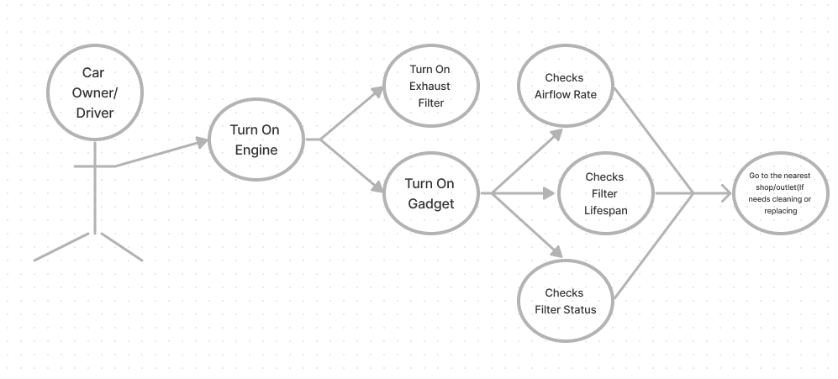
Use CASE Diagram
“Car Owner”

Slide 22
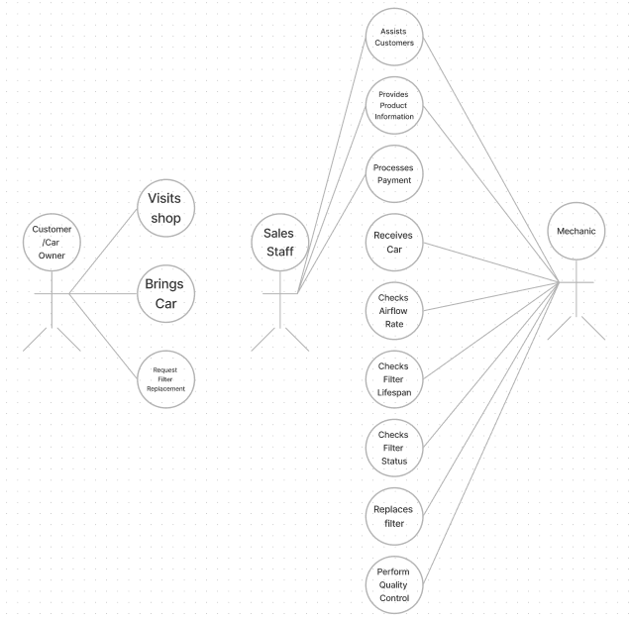
Use CASE Diagram
“Outlet/Shop”

Slide 23
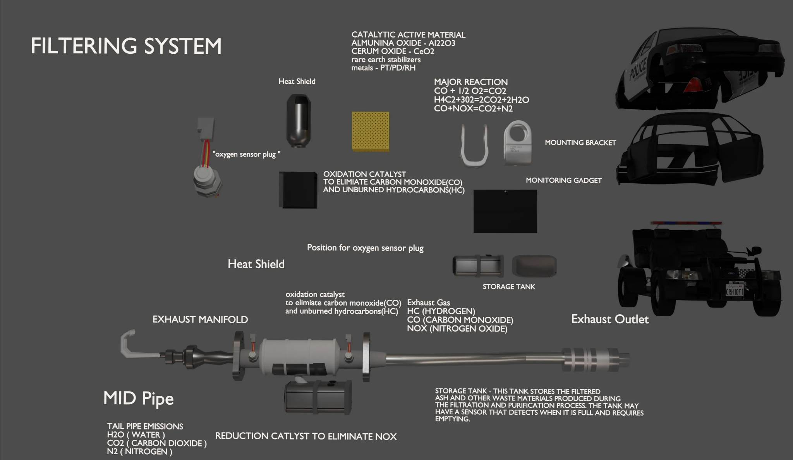
Project Structure

Slide 24
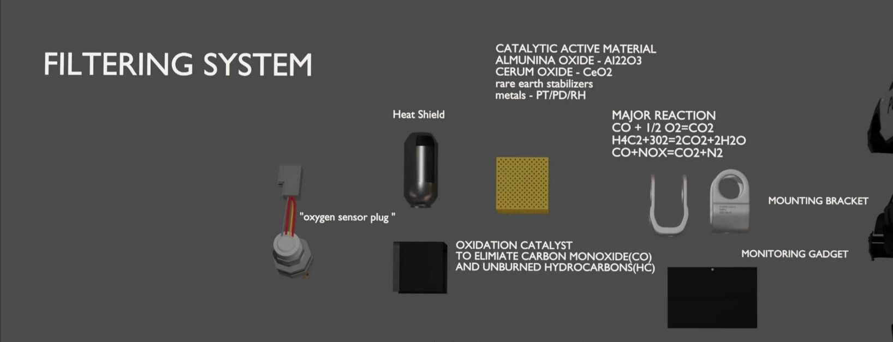
Project Structure

Slide 25
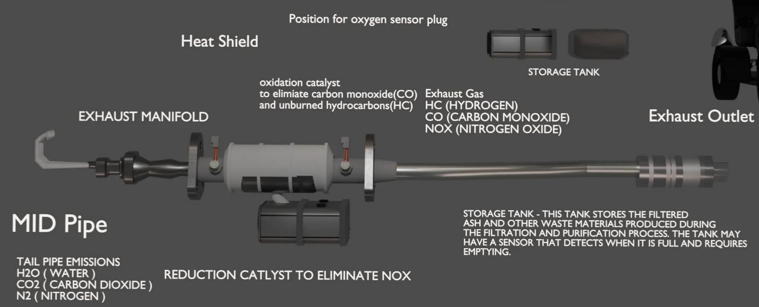
Project Structure

Slide 26
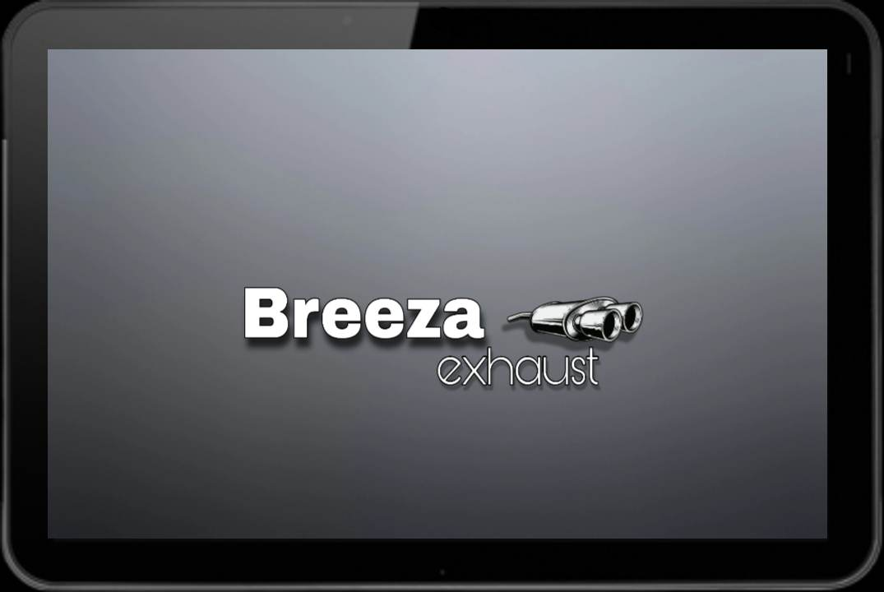
Project Structure

Slide 27
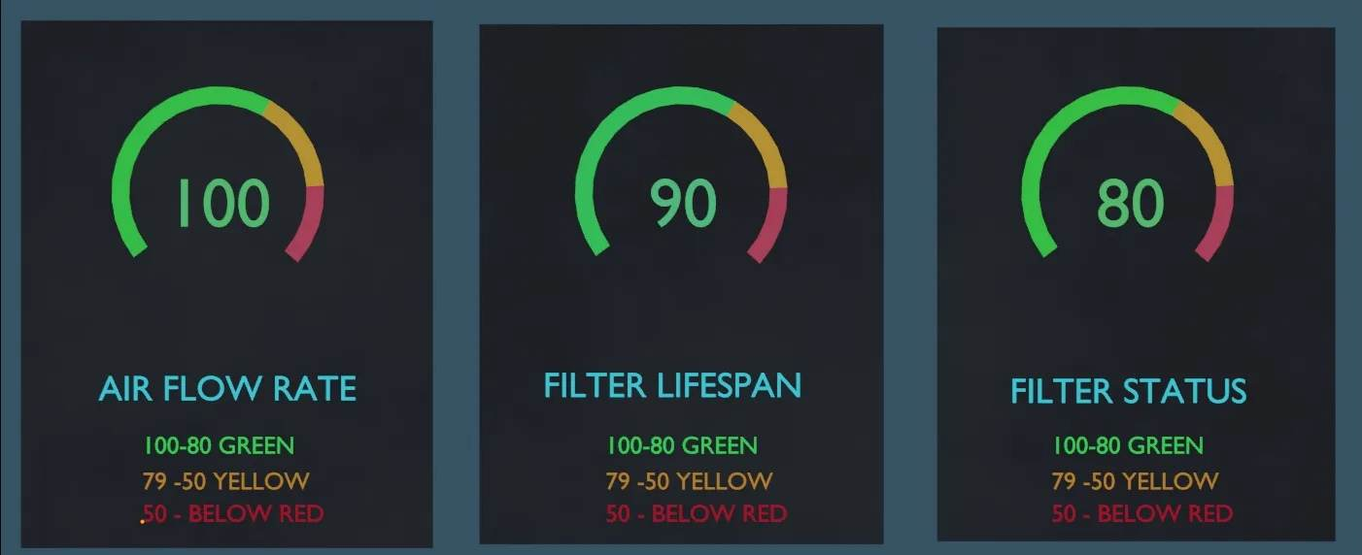
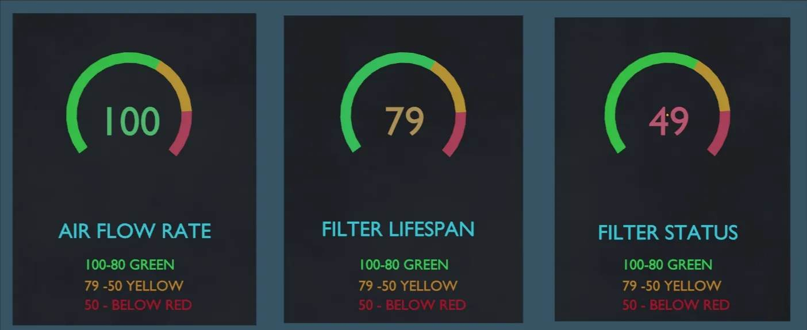
Project Structure

Slide 28
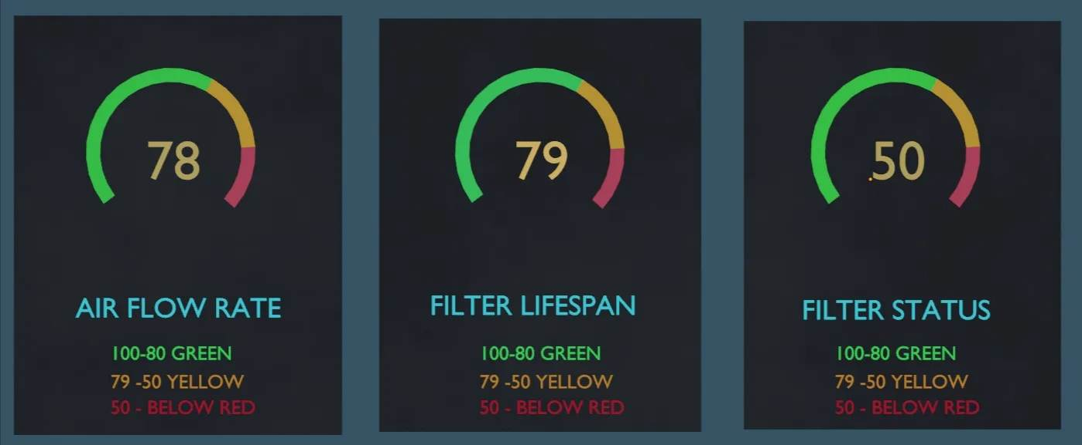
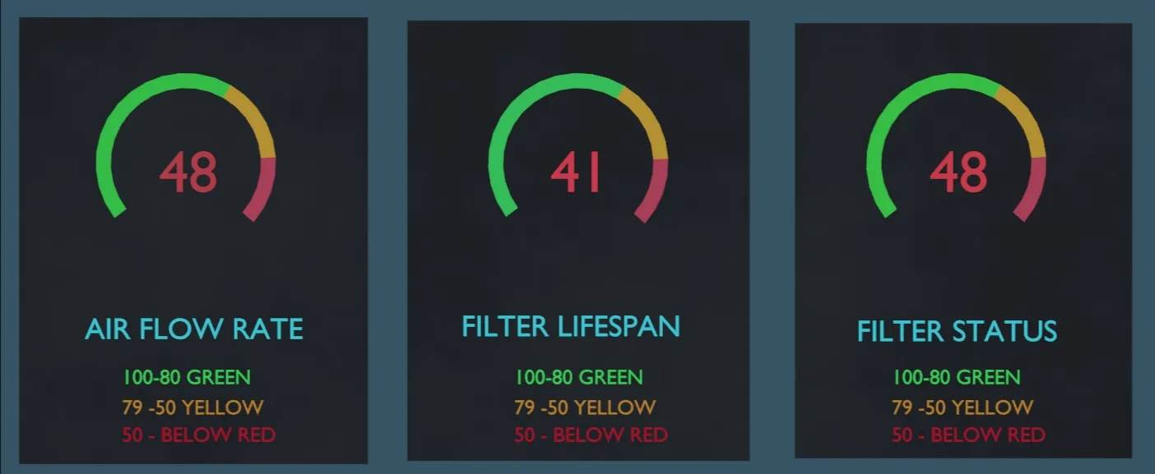

Slide 29
Project Features
Exhaust Filtering machine - An exhaust filtering device is a device that is used to filter or clean the exhaust gases that are released from an engine or any other internal combustion system. The main purpose of this device is to remove harmful pollutants such as carbon monoxide, nitrogen oxides, sulfur dioxide, and other particulate matter from the exhaust gas before it is released into the atmosphere.
Device/Gadget - An gadget checks if the equipment or device is still functional or not.
System - The system display the current status of the device such as airflow rate, filter lifespan, and whether the filter is clean or dirty. The system should include an indicator for the filter status and when it needs cleaning or replacing

Slide 30
Market Analysis
A market analysis can help identify how to better position your business to be competitive and serve your customers. A market analysis is a thorough assessment of a market within a specific industry, company, or business. A market analysis has many benefits, such as reducing risk for businesses and better informing business decisions.

Slide 31
Market Analysis
A thorough marketing analysis should answer this following question.
Who are the potential client?
Clients will be the jeepney drivers and operators, automotive outlet/shop service centers, governments, or environmental organizations.
Who are the main competitors?
Breeza's main competitors are the other automotive companies that offer car exhaust filters.

Slide 32
Market Analysis
What are the competitor’s strengths and weaknesses?
The other competitors have their own size and shape of the exhausted filtration brand from other countries, but having your own design and usable exhausted filtration has a big impact because this product makes for productive and energetic vehicles. Competitors have exhaust filters, but not all competitors have gadgets or systems with exhaust filters.

Slide 33
Market Analysis
Basis and reasons of Market Analysis.
Risk reduction : Weekly maintenance for surely and comparable vehicles.
Targeted products or services : Maintenance of the exhausted filtration product if it's a sale of products.
Emerging trends : The system and device of breeza car.
Revenue and Projections : The estimated revenue of Breeza Car Exhaust Filtration is around 50,000 php per month.

Slide 34
Market Analysis
Any source in google that concerns about the facing out of old jeepney to eJeep.
The Public Utility Vehicle Modernization Program (PUVMP), which was initially introduced in 2017, is the "jeepney phase-out." Traditional jeepneys are considered dangerous and harmful to the environment by the Land Transportation Franchising and Regulatory Board (LTFRB). It seeks to replace jeepneys that are 15 years old or older with new vehicles that meet Philippine National Standards and are propelled by an electric drivetrain or a diesel engine that complies with Euro 4 regulations. By the end of 2023, this phase-out requires jeepney drivers to join cooperatives or businesses. Their ability to obtain loans and payment plans for "modern jeepneys" should be aided by this. For seven years of payments, the program plans to provide a 5.6% subsidy with a 6% interest rate. In addition to offering passengers a more roomy and comfortable ride, these updated jeepneys also lessen the discomfort and tension brought on by crowding.

Slide 35
Market Analysis
Any source that concerns about the filtration device on air
Just as humans need oxygen to breathe, a car needs oxygen for the combustion process. The air filter prevents any insects, dust, particles, sand or debris reaching the engine and ensures a good mixture of air and fuel to support performance. Car air filters come in different shapes: panels, circular or cylindrical. They are made of a pleated material which filters the air and may be made of cotton, synthetic paper or foam.
Reasons to change your air filter:
For a better car performance To save on fuel
To avoid black smoke

Slide 36
Market Analysis
Any source of how condensing machine works prior toxic gas to water.
Condensation is a process used heavily throughout industry to convert a gas or vapor to liquid. Any gas can be reduced to a liquid by sufficiently lowering the temperature (or increasing the pressure). Common examples can include distillation of various hydrocarbons in refining operations and drying of air. Condensation can be used to remove a pollutant from a gas stream if the dew point of the pollutant is higher than the carrier gas (or non-pollutant gas). If this is true, the total gas stream can be reduced in temperature to below the pollutant’s dew point, which will then separate the pollutant from the remaining gas stream as a liquid.

