Slide 1

Customer Reviews Analysis

Slide 2
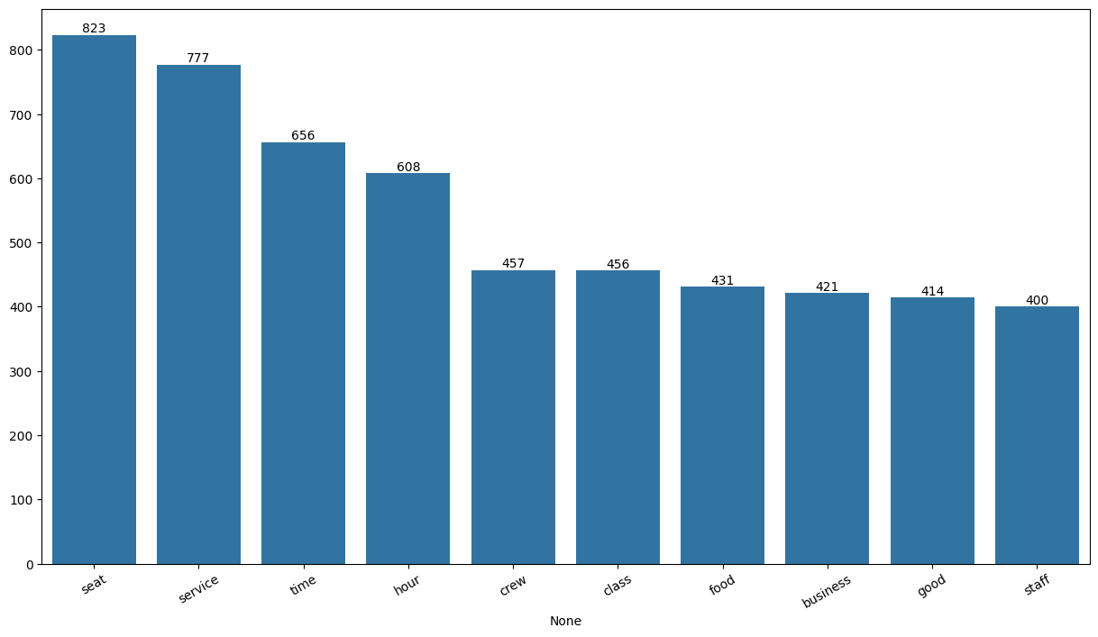
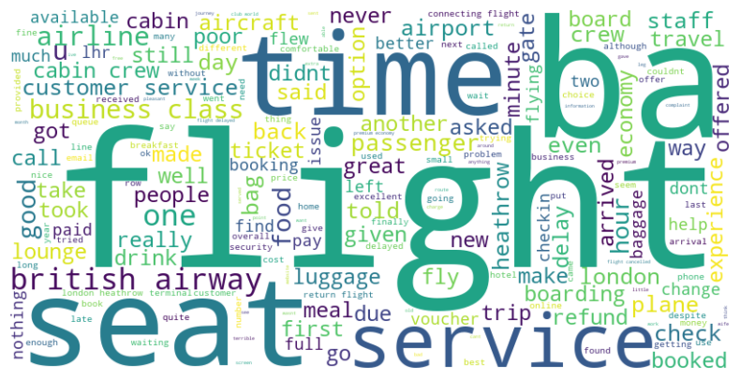
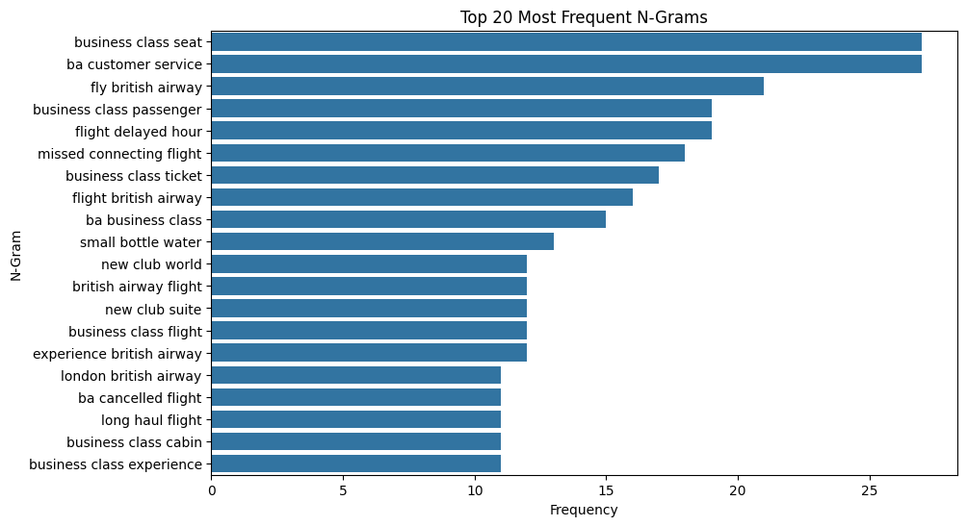
Key Metrics
Business-class services and experiences are heavily scrutinized (repeated mentions in N-grams)
Flight delays, missed connections, and issues with customer service seem to be recurring complaints.
Service aspects such as punctuality, staff performance, and food quality are vital determinants of passenger satisfaction.

