Slide 1
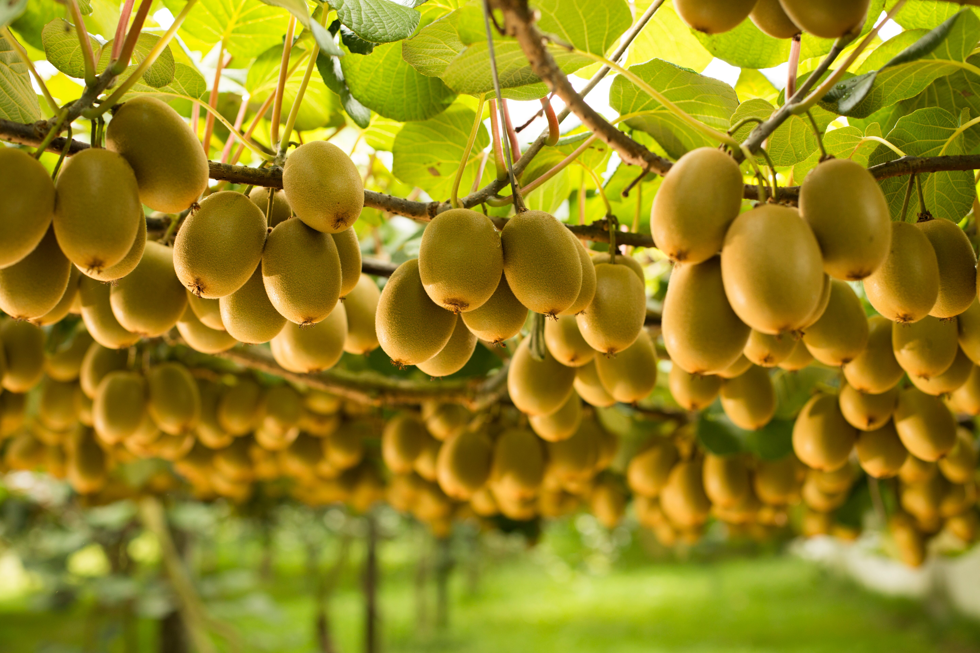
Optimising Sampling Strategy for Accurate Kiwifruit Yield Estimation
Presented by: Jeremy Chen

Slide 2
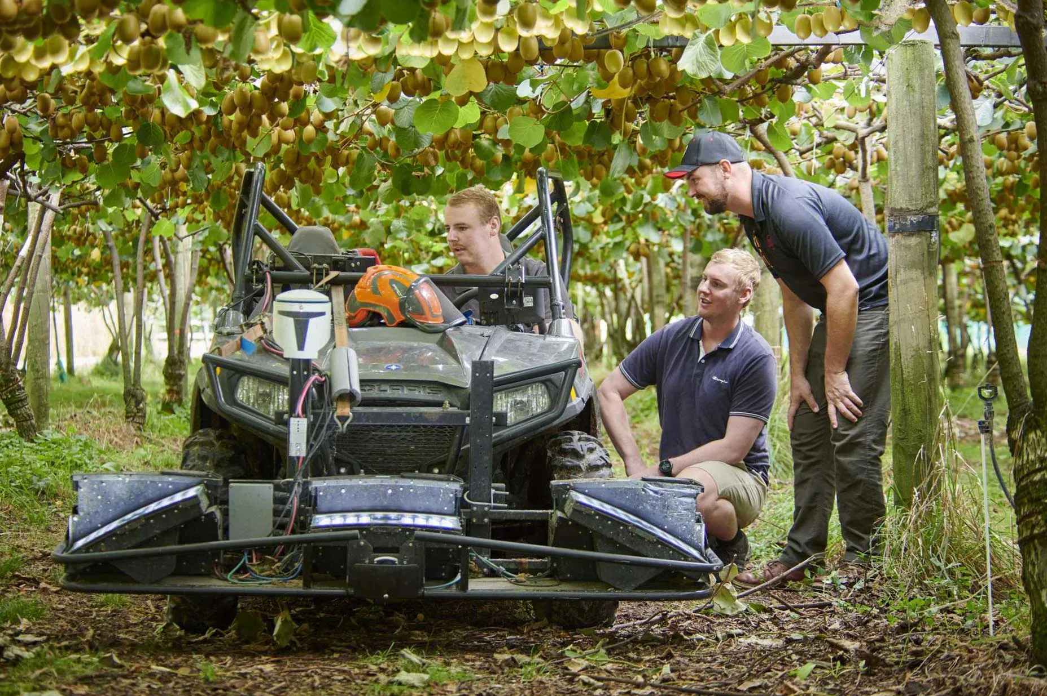
Current Sampling Strategy
Digital Orchard Scanning technology
Full-width scanning
High operational cost
Limited scalability
Research objective
Investigation of cost-effective alternatives
Notes:
Currently, Zespri relies on Digital Orchard Scanning technology, which uses high-resolution cameras mounted on all-purposed vehicles to collect sample data. When the vehicle goes underneath canopies, the cameras capture images like this. Fruit will be detected and counted. Yield will be measured using fruit density, which is the number of fruits per square metre. The current sampling strategy scans the full-width of each sampled row, and need to cover approximately 10% of the total orchard area within a three-week window. This brings up the challenge as this technology is resource-intensive, time-consuming and costly, and it is running at full capacity.

Slide 3
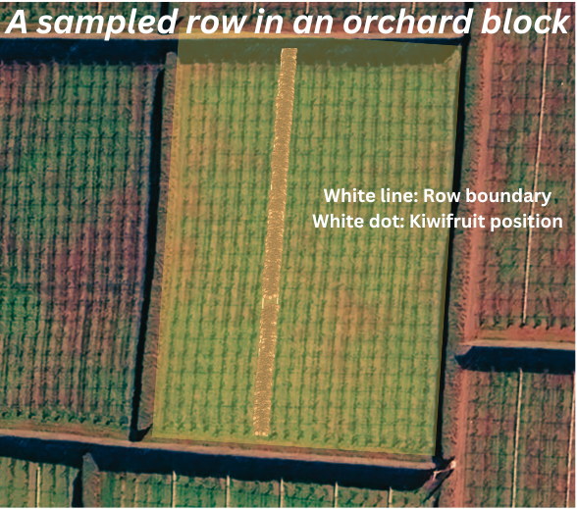
Raw Data
Geospatial location data (log, lat & ele) for each sampled row
Stored in separated XML files
Extremely large number of points distributed across orchards
Notes:
The raw data provided by Zespri contains geospatial locations stored in XML files. Each file represents a single sampled row and includes two geometric components: one is polygon, which defines the row boundary, and the other is points, which mark the geospatial locations of individual kiwifruit.

Slide 4
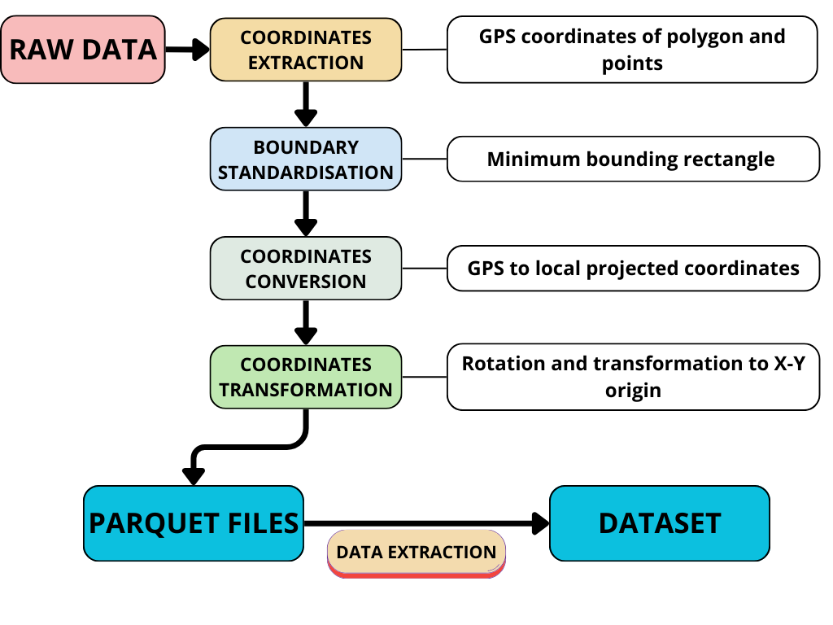
Data Processing
Data preprocessing pipeline
Notes:
First, we need to extract the coordinates of the polygon boundaries and kiwifruit points from each XML file.
Next, we use the minimum bounding rectangle function from shapely to simplify complex shape of polygons. The corner coordinates can be used to define row length and width.
Then, we convert the GPS coordinates to projected coordinates for measurements of area and distance.
Last, we rotate and transform coordinates to X-Y origin system, for easy calculation
Once completed, we save the all results into parquet files for downstream tasks.

Slide 5
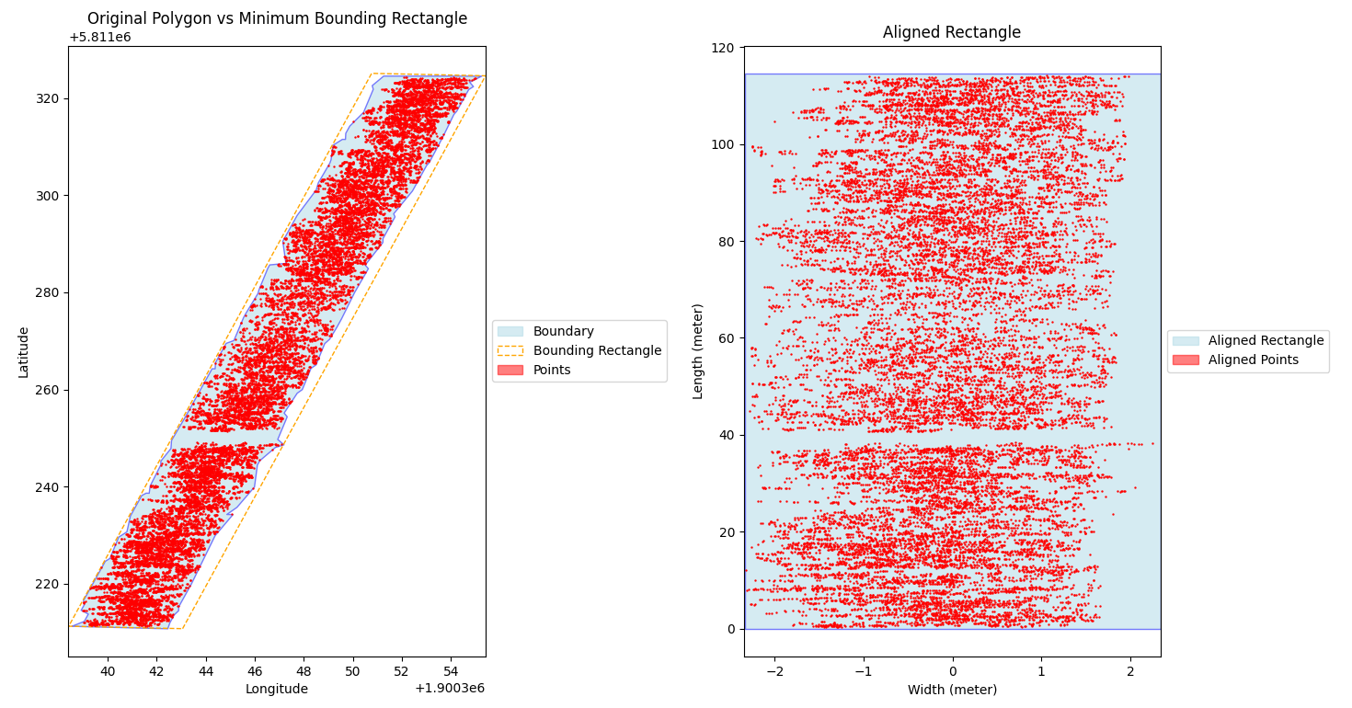
Visual example of data preprocessing

Slide 6
EDA & FEATURE EXTRACTION
Geometric features: row length, width, area
Point based features: # of points, row density
Notes:
First, we need to extract the coordinates of the polygon boundaries and kiwifruit points from each XML file.
Next, we use the minimum bounding rectangle function from shapely to simplify complex shape of polygons. The corner coordinates can be used to define row length and width.
Then, we convert the GPS coordinates to projected coordinates for measurements of area and distance.
Last, we rotate and transform coordinates to X-Y origin system, for easy calculation
Once completed, we save the all results into parquet files for downstream tasks.

Slide 7
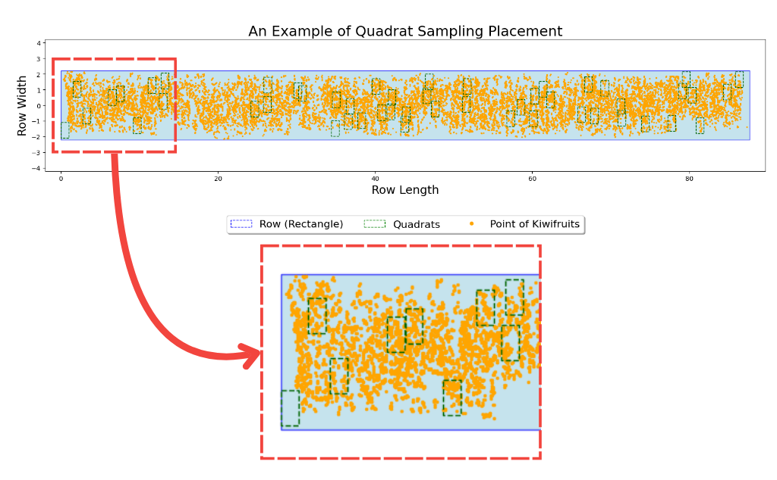
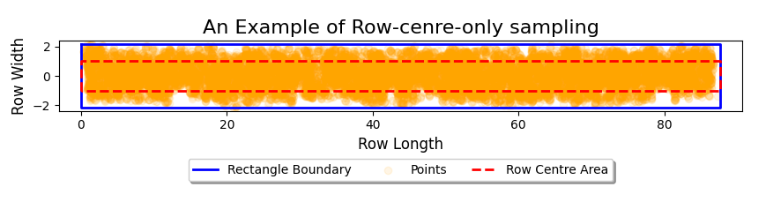
Methods
Quadrat Sampling
Row-Centre-Only Sampling
Machine Learning Integration
Feature engineering
Model selection

Slide 8
DATA ENGINEERING
Quadrat sampling features:
avg quadrat density
avg distance of quadrat centroid to row central line
mean X coords of quadrat centroid
std X coords of quadrat centroid
quadrat size to row width ratio
Row centre sampling feature:
row centre area to entire row area ratio
row centre density
Target: Actual density
Notes:
First, we need to extract the coordinates of the polygon boundaries and kiwifruit points from each XML file.
Next, we use the minimum bounding rectangle function from shapely to simplify complex shape of polygons. The corner coordinates can be used to define row length and width.
Then, we convert the GPS coordinates to projected coordinates for measurements of area and distance.
Last, we rotate and transform coordinates to X-Y origin system, for easy calculation
Once completed, we save the all results into parquet files for downstream tasks.

Slide 9
MODEL & PERFORMANCE METRICS
Linear Regression
simple and interpretability
Random Forest
handling complex, non-linear relationship
Metrics
Root Mean Squared Error (RMSE)
Coefficient of Determination (R²)
Notes:
First, we need to extract the coordinates of the polygon boundaries and kiwifruit points from each XML file.
Next, we use the minimum bounding rectangle function from shapely to simplify complex shape of polygons. The corner coordinates can be used to define row length and width.
Then, we convert the GPS coordinates to projected coordinates for measurements of area and distance.
Last, we rotate and transform coordinates to X-Y origin system, for easy calculation
Once completed, we save the all results into parquet files for downstream tasks.

Slide 10
Thank you
Any Questions?

