Slide 1



Optimising Sampling Strategy for Accurate Kiwifruit Yield Estimation
Presented by: Jeremy (Yucheng) Chen
Supervisors: Dr. Sinead Moylett (UC), Goldie Leung (UC) Industry Partner: Dr. Andrew Gilman (Zespri)

Slide 2

Current Sampling Strategy
Digital Orchard Scanning technology
Full-width scanning
High operational cost
Limited scalability
Research objective
Investigation of cost-effective alternatives

Slide 3
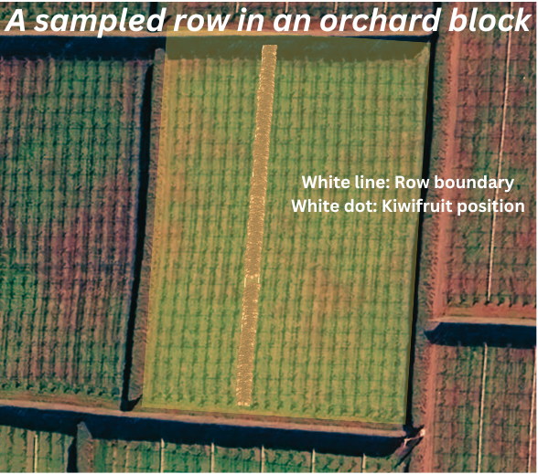
Raw Data
Geospatial location data for each sampled row
4,816 valid XML files
Over 100 million kiwifruit points
Notes:
Reduce words

Slide 4
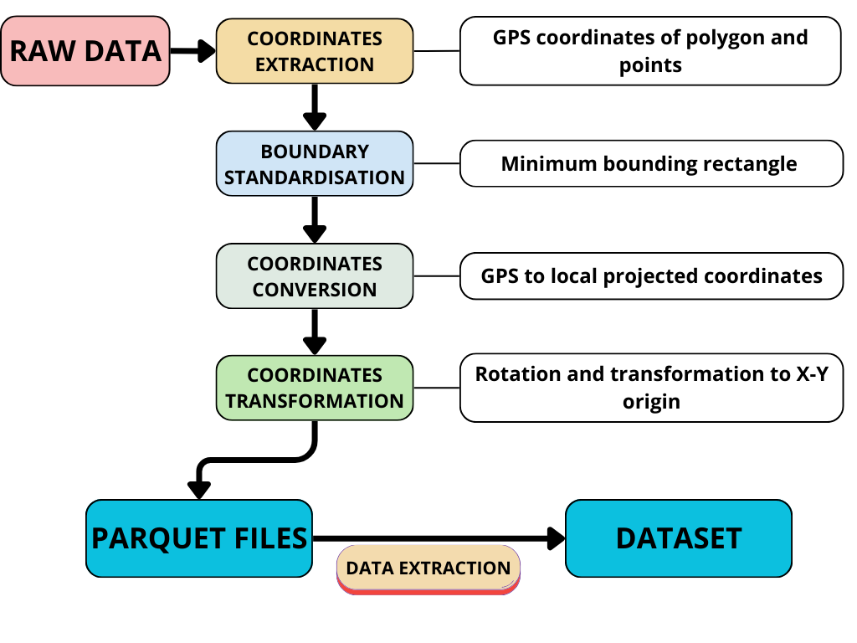
Data Processing
Data preprocessing workflow
Notes:
Change diagram

Slide 5
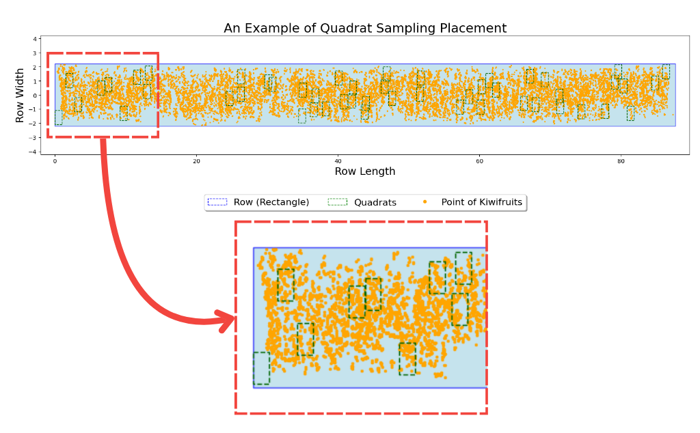
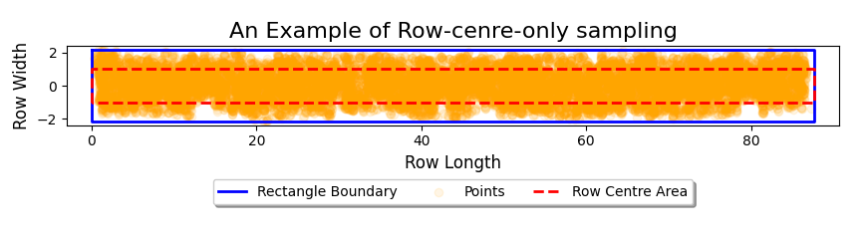
Methods
Quadrat Sampling
Row-Centre-Only Sampling
Machine Learning Integration
Feature engineering
Model selection
Notes:
Reduce words

Slide 6
Results – Quadrat Sampling
Quadrat sampling result summary
Larger quadrats tend to have lower variance.
Optimal quadrat configuration

Slide 7
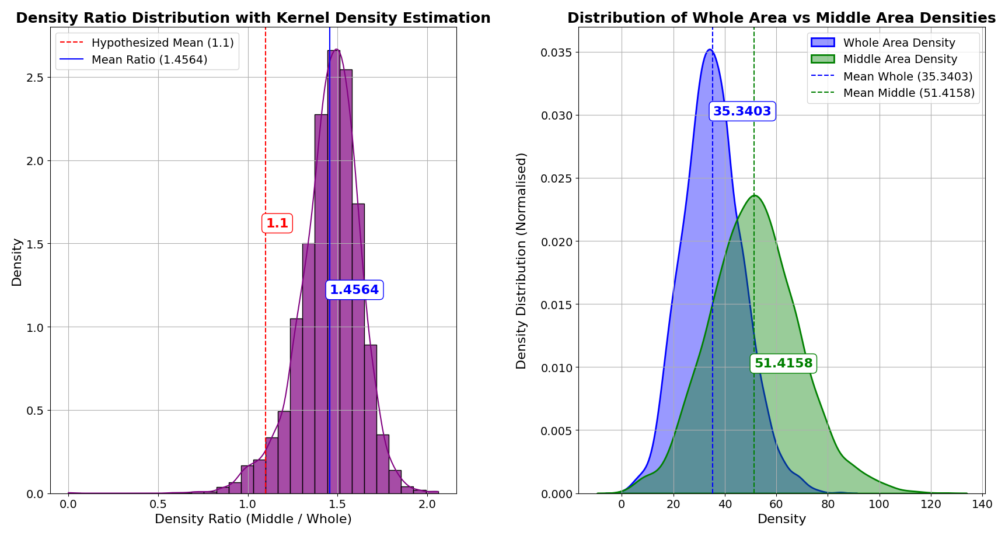
Results – Row-Centre-Only Sampling
Overestimates density by 45.64% (significant bias)
High variability against full-width sampling
Notes:
Reduce words

Slide 8
Results – Machine Learning Integration
Model performance comparison
High estimation accuracy (94.18%)
Linear Regression overperforms Random Forest Regression

Slide 9
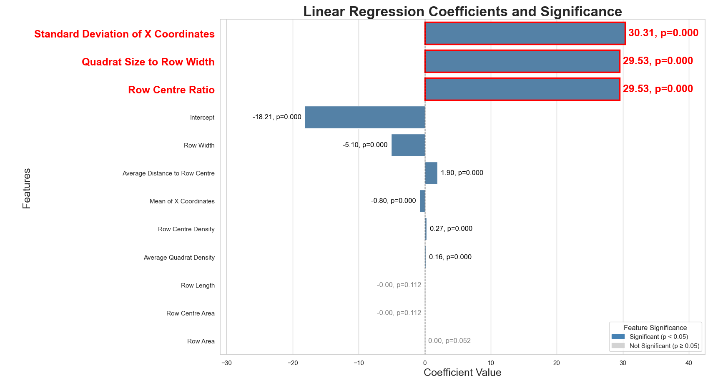
Results – Machine Learning Integration
Feature importance (Linear Regression)

Slide 10
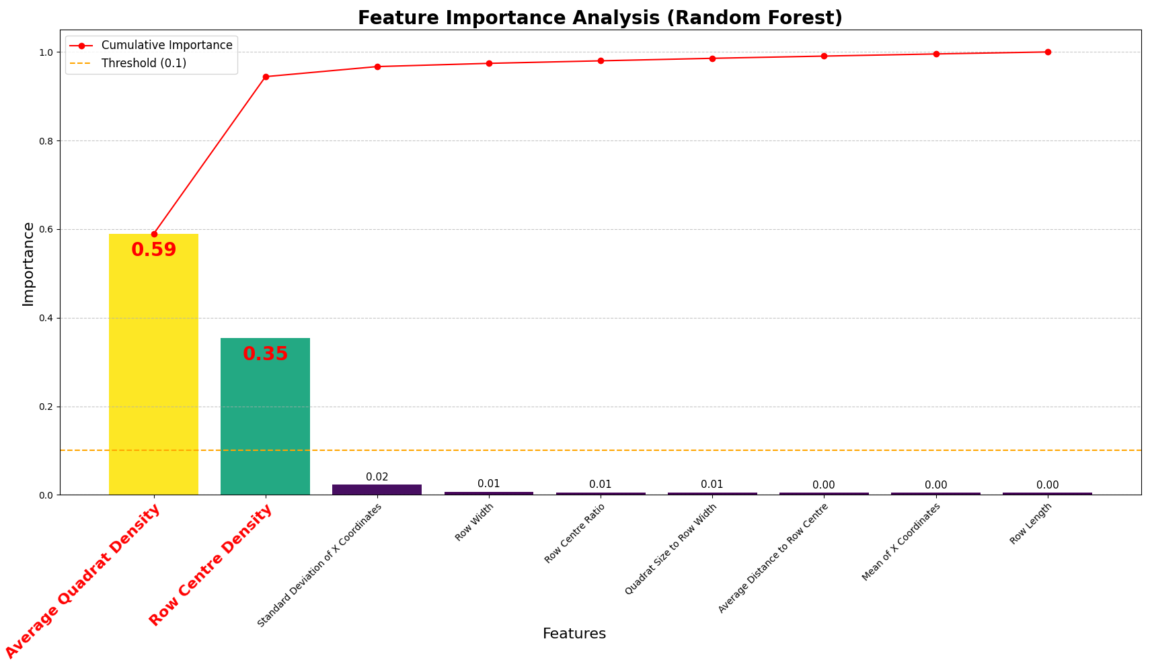
Results – Machine Learning Integration
Feature importance (Random Forest)

Slide 11

Conclusion
Incorporative sensitive analysis
Comparison between random, stratified and systematic quadrat sampling
Geospatial analysis of sampling bias
A hybrid sampling strategy
Integrate sampling results with machine learning
Future Work
Cost-benefit analysis
Notes:
Reduce words

Slide 12
Thank you
Any Questions?

Slide 13
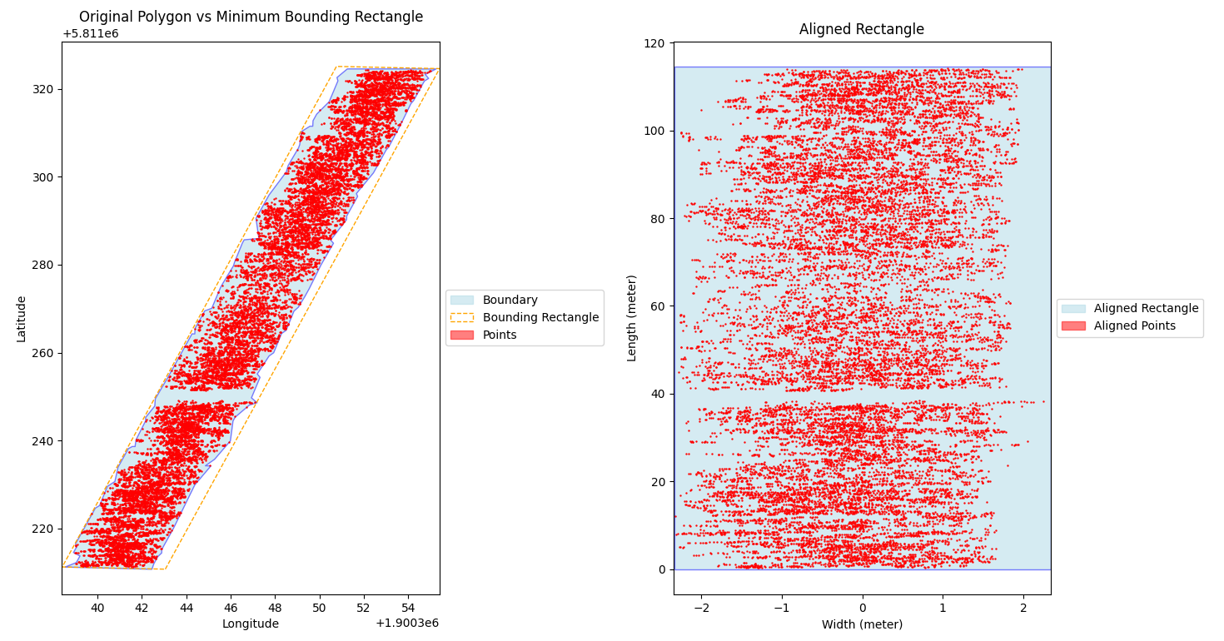
Visual example of data preprocessing

Slide 14
Dataset – after preprocessing
Data summary

Slide 15
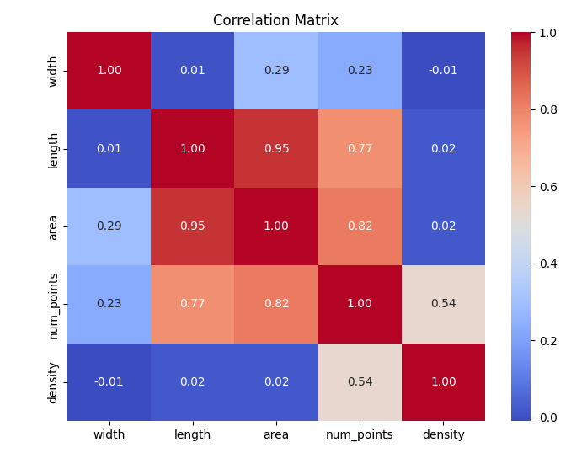
Correlations of variables

Slide 16
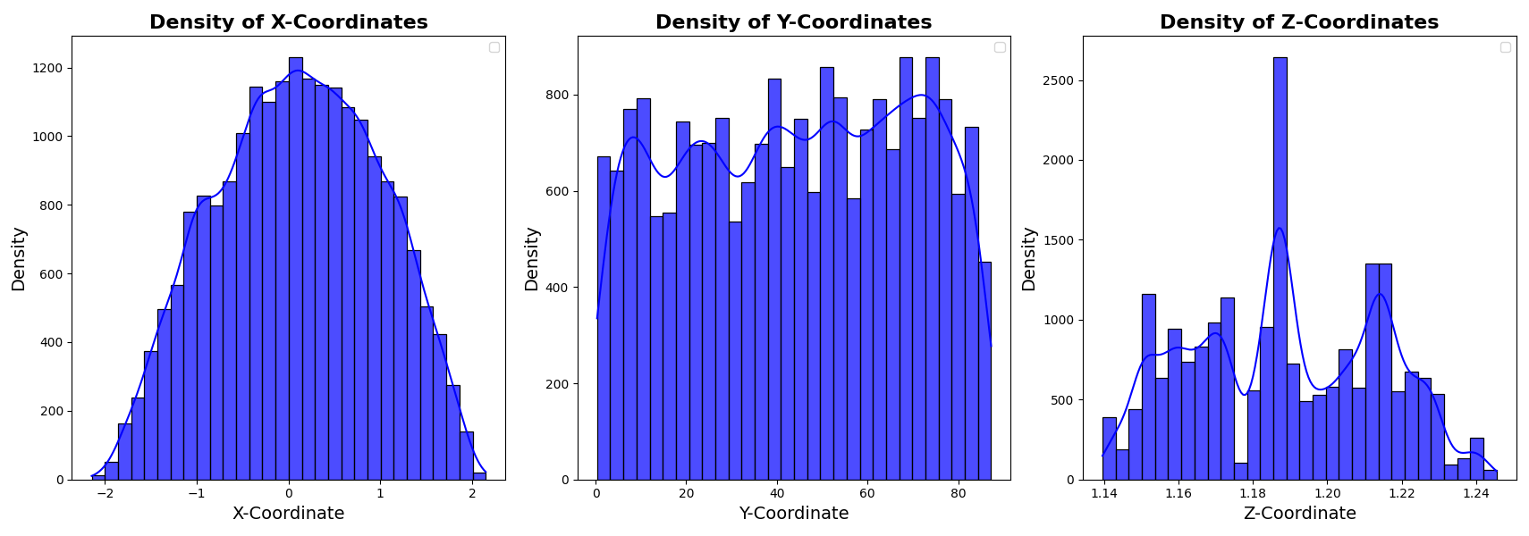
Spatial distribution of points
X-coordinates: denser near the centre, sparser towards the edges
Y-coordinates: fluctuated spatial variable along the row
Z-coordinates: minimal vertical variance

Slide 17
Quadrat configurations (to be tested)
Metric for evaluation: Mean Square Error (MSE)
Mean Square Error = Bias² + Variance

Slide 18
Quadrat configurations test results

Slide 19
Additional ML experiments
Outliner removal (IQR method)
Grid search for RF
5-fold cross-validation
Results of all experiments confirmed robustness of both models.

